Slide 1
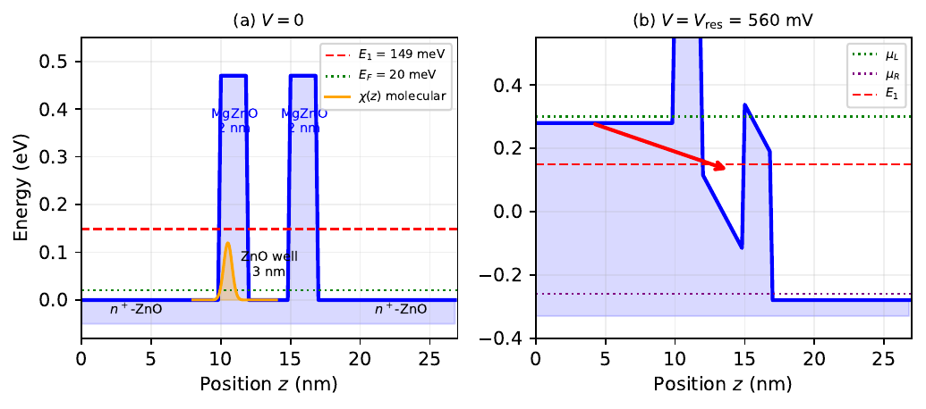
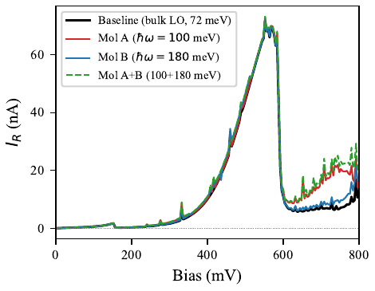
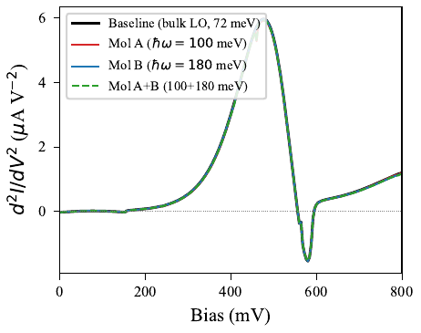
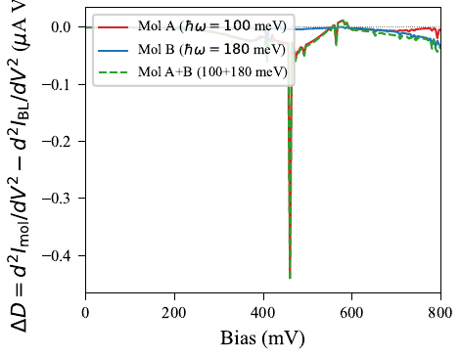
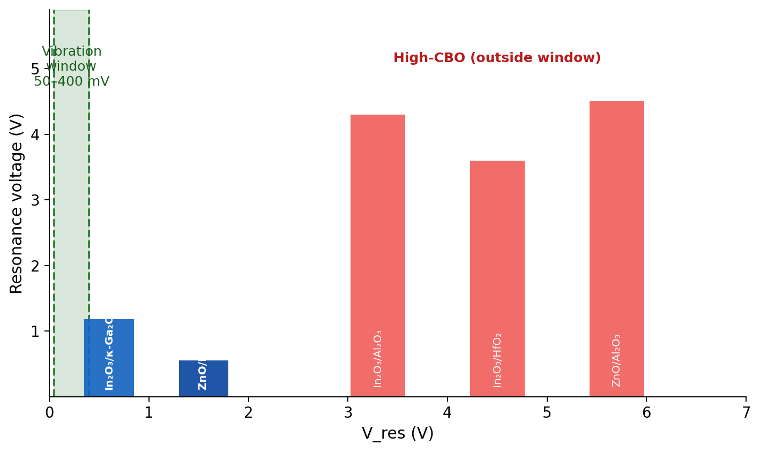
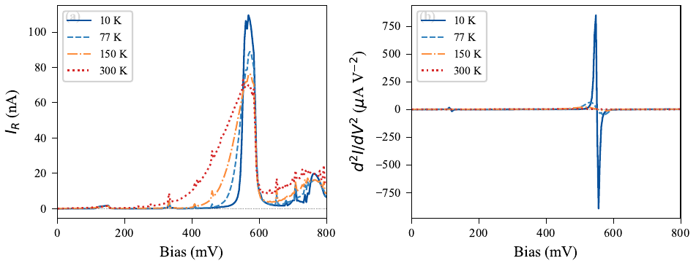
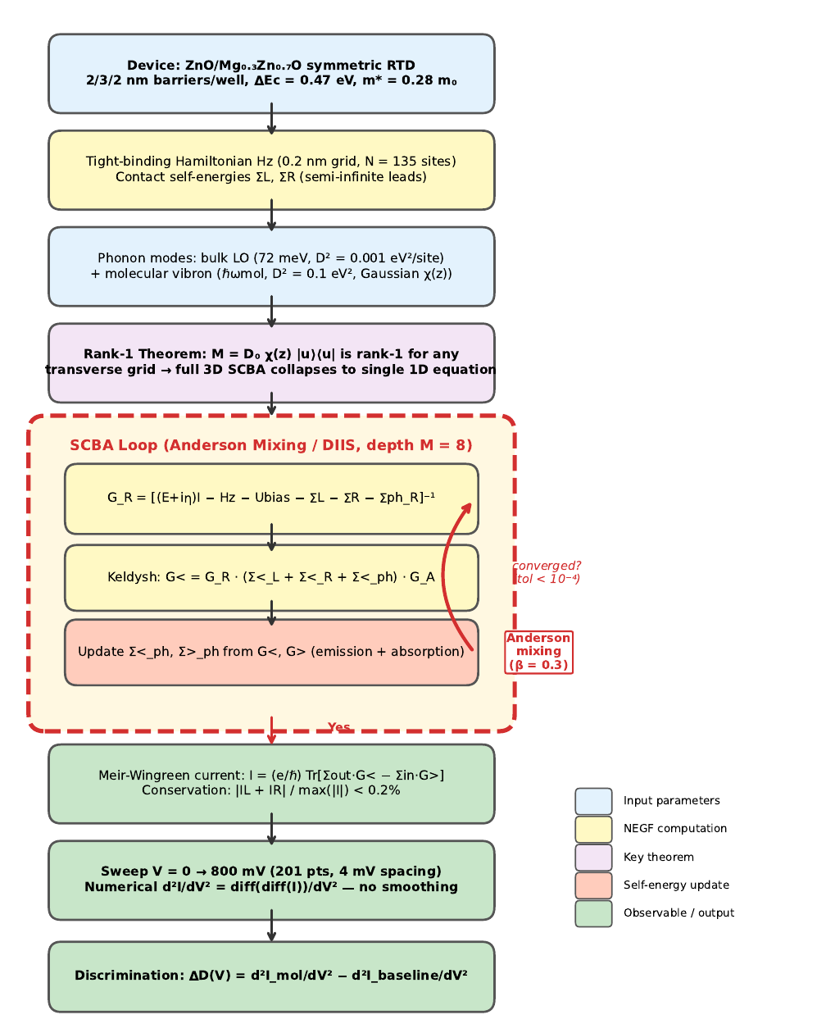
Material Stack Discovery for BEOL-Compatible Quantum Electronic Nose
Abhineet Agarwal · Swaroop Ganguly
Department of Electrical Engineering, Indian Institute of Technology Bombay, Mumbai, India | swaroop.ganguly@iitb.ac.in | EMRS Spring Meeting 2026
Motivation: Room-Temperature IETS
Material Survey: Simulation Results (300 K, Symmetric RTD)
Selected Stack: ZnO/Mg₀.₃Zn₀.₇O RTD
IETS identifies molecules via vibrational fingerprints — peaks in d²I/dV² at bias V = ℏω/e for each vibrational mode.
Fundamental problem. Conventional MIM junctions require T < 10 K: thermal broadening (~k_BT) washes out vibrational peaks [1].
All devices: 10 nm n⁺ contacts / barrier / 3 nm well / barrier / 10 nm n⁺ contacts. High-barrier stacks show artifact PVCR only.
Symmetric 2 nm MgZnO / 3 nm ZnO / 2 nm MgZnO, 10 nm n⁺-ZnO contacts (N_D = 10²⁵ m⁻³). ΔEc = 0.47 eV, m* = 0.28 m₀, ℏω_LO = 72 meV. Single bound state E₁ = 149 meV; NDR at V_res ≈ 552 mV, peak ~72 nA, PVR ~6 (SCBA, 300 K).
Stack | CBO (eV) | E_res (meV) | V_peak (V) | PVCR
In₂O₃/Al₂O₃ | 2.8 | >2000 | 4–5 | ~1†
In₂O₃/HfO₂ | 2.0 | >2000 | 3–4 | ~1†
In₂O₃/β-Ga₂O₃ (2 nm) | 0.07 | 30 | 1.43 | 1.33
In₂O₃/β-Ga₂O₃ (1 nm) | 0.07 | 53 | 1.48 | 1.05
In₂O₃/κ-Ga₂O₃ (2 nm) | 0.45 | 278 | 1.18 | 3.55
In₂O₃/κ-Ga₂O₃ (1 nm) | 0.45 | 177 | 1.10 | 3.50
In₂O₃/κ-Ga₂O₃ (asym) | 0.45 | 402 | 1.33 | 2.80
ZnO/Mg₀.₃Zn₀.₇O (2 nm) | 0.47 | 290 | 1.10 | 6.32
RTD solution [2]: the quantum-well resonance acts as an energy filter narrower than k_BT, restoring d²I/dV² peaks at 300 K.
Remaining gap. Patil's proof-of-concept [2] used GaAs/AlAs grown by MBE at >700 °C — incompatible with CMOS back-end-of-line (BEOL).
This work:
Systematic computational screening of 12 oxide heterostructures (all ALD/sputtering, <400 °C) to identify BEOL-compatible stacks for room-temperature RTD-IETS molecular sensing.
Fig. 2. Band diagram: (i) V = 0; (ii) resonance at 552 mV. Orange Gaussian χ(z): molecular coupling region.
† Artifact — resonance outside molecular vibration window; not physical NDR.
Outside window
CBO too low
Good candidate
Selected
Key Result: Molecular Discrimination at 300 K
Material Selection Criteria
ZnO/Mg₀.₃Zn₀.₇O has the highest PVCR (6.3, comparable to III-V RTDs), demonstrated experimental NDR [3,4], and lowest process temperature (<350 °C).
1. BEOL compatibility: process temperature < 400 °C
2. Band offset: CBO ≈ 0.5 eV — aligns V_res with molecular vibrations (50–400 meV)
3. Effective mass: enables quantum confinement in practical barrier/well widths (1–3 nm)
(a) I–V. NDR at ≈ 552 mV, PVR ~6. Molecule-specific ΔI in pre-NDR region.
(b) d²I/dV². Peaks at 100 mV (Mol A) and 180 mV (Mol B) at V = ℏω/e.
4. Mature deposition: ALD or sputtering with demonstrated thickness uniformity
5. Integration readiness: prior use in semiconductor industry processes
Candidate Stacks: IETS Viability Criteria
Well materials screened:
In₂O₃ (m*=0.30, LO 70 meV), IGZO (m*=0.34, LO 60 meV), ZnO (m*=0.28, LO 72 meV), SnO₂ (m*=0.25, LO 75 meV)
Stack | CBO (eV) | m*/m₀ | NDR | BEOL | Ref.
AlGaAs/GaAs | 0.23 | 0.067 | ✓ | ✗ | [8]
GaN/AlN | 1.8 | 0.20 | ✓ | ✗ | [9]
In₂O₃/κ-Ga₂O₃ | 0.45 | 0.30 | ✗ | ✓ | [10]
ZnO/Mg₀.₃Zn₀.₇O | 0.47 | 0.28 | ✓ | ✓ | [3,4]
Barrier materials screened:
Al₂O₃ (CBO 2.8–3.0 eV), HfO₂ (CBO 2.0–2.3 eV), Ga₂O₃ polymorphs (CBO 0.07–0.61 eV), MgZnO (CBO = 1.57·x_Mg, tunable)
Key Insight: The CBO ≈ 0.5 eV Design Rule
‡ Ref. [3] uses x = 0.2; this work uses x = 0.3 (ΔEc = 1.57·x_Mg [12]).
Only ZnO/Mg₀.₃Zn₀.₇O satisfies all three IETS criteria simultaneously: CBO in window, experimental NDR, and BEOL-compatible deposition.
Fig. 3. ΔD = d²I_mol/dV² − d²I_BL/dV². Each molecule gives a distinct peak pattern. Mol AB ≈ superposition of A + B (rank-1 linearity).
Three synthetic odorants discriminated at 300 K — no cryogenic cooling.
Temperature Dependence — Mol A (ℏω = 100 meV)
Simulation Methodology
1. NEGF + Rank-1 SCBA
Quasi-3D Non-Equilibrium Green's Function with self-consistent Born approximation. For a Gaussian molecular form factor (σ_mol = 3 Å ≪ L⊥), the coupling matrix is rank-1: M = D₀·χ(z)|u⟩⟨u| (O(10⁻⁶) correction). Full 3D SCBA collapses to a single 1D projected Dyson equation, exact for any transverse grid size.
High-CBO oxides resonate at 3–5 V, far outside the molecular vibration window (50–400 mV). Only low-CBO stacks (CBO ≈ 0.5 eV) bring V_res into the sensing range.
Fig. 4. 10–300 K. (a) Peak current: 73 nA (300 K) → 110 nA (10 K). (b) IETS peak sharpens at low T but remains resolvable at 300 K — RTD energy filtering preserves features beyond the 3k_BT broadening limit [2].
2. Anderson Mixing (DIIS) [6]
Fixed-point iteration diverges near NDR. History depth M = 8; solve min‖Σαᵢrᵢ‖², Σαᵢ = 1 at each step. 10–60 iterations at all 201 bias points; current conservation |I_L+I_R|/max|I| < 0.2 %.
Fabrication: ALD Deposition Routes
Layer | Temp. | Precursors | Rate
ZnO (well) | RT–350 °C | DEZ + H₂O | 1.5–2.0 Å/cyc
MgₓZn₁₋ₓO (barrier) | RT–350 °C | Mg(Cp)₂ + DEZ + H₂O | 1.0–1.5 Å/cyc
In₂O₃ | 150–275 °C | In(DMAMP)₂(OiPr) + H₂O | 0.3–0.5 Å/cyc
κ-Ga₂O₃ | 200–350 °C | TMGa + O₂ plasma | ~0.5 Å/cyc
3. Numerical d²I/dV²
d²I/dV² computed by diff(diff(I))/dV² on the converged SCBA I(V) — exactly the procedure of Patil [2]. Self-consistent SCBA produces inherently smooth I(V); no smoothing applied.
All layers depositable in a single ALD tool run below 350 °C — within the BEOL thermal budget. MgZnO composition is controlled by the Mg(Cp)₂:DEZ pulse ratio (ΔEc = 1.57·x_Mg). Wurtzite phase-stable at x_Mg ≤ 0.33, avoiding phase segregation. Proposed device: ALD stack on CMOS backend test structure.
Conclusions
▶ High-CBO oxides (CBO > 2 eV) resonate at 3–5 V — outside molecular vibration range.
▶ Design rule: CBO ≈ 0.5 eV aligns V_res with the 50–400 meV fingerprint band.
▶ ZnO/Mg₀.₃Zn₀.₇O: only oxide stack with experimental NDR + BEOL ALD + highest PVCR (6.3).
▶ NEGF–SCBA with Anderson mixing discriminates three odorants at 300 K.
References
▶ Full ALD fabrication route identified; next step: RTD on CMOS test structure.
[1] R.C. Jaklevic & J. Lambe, PRL 17, 1139 (1966).
[7] N. Pandey et al., Sci. Rep. 11, 11389 (2021).
[2] A. Patil et al., Sci. Rep. 8, 128 (2018).
[8] T.C.L.G. Sollner et al., APL 43, 588 (1983).
[3] S. Krishnamoorthy et al., SSE 46, 1633 (2002).
[9] C. Bayram et al., APL 96, 042103 (2010).
[4] I.-C. Cheng et al., IEEE EDL 36, 1330 (2015).
[10] Y. Kuang et al., ACS AEM 3, 795 (2021).
[5] S. Datta, Quantum Transport, Cambridge (2005).
[11] J. Zhu et al., Nanotechnology 35 (2024).
[6] D.G. Anderson, J. ACM 12, 547 (1965).
[12] H. Yin et al., Sci. Rep. 7, 41567 (2017).
Fig. 1. Rank-1 projected NEGF–SCBA convergence loop.

