Slide 1



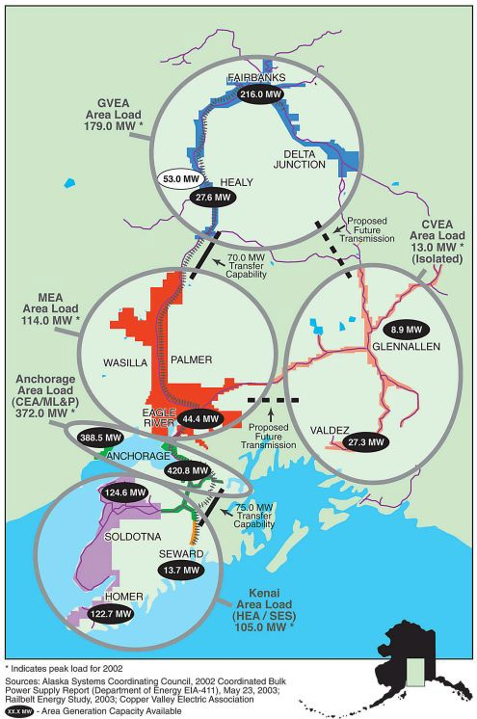
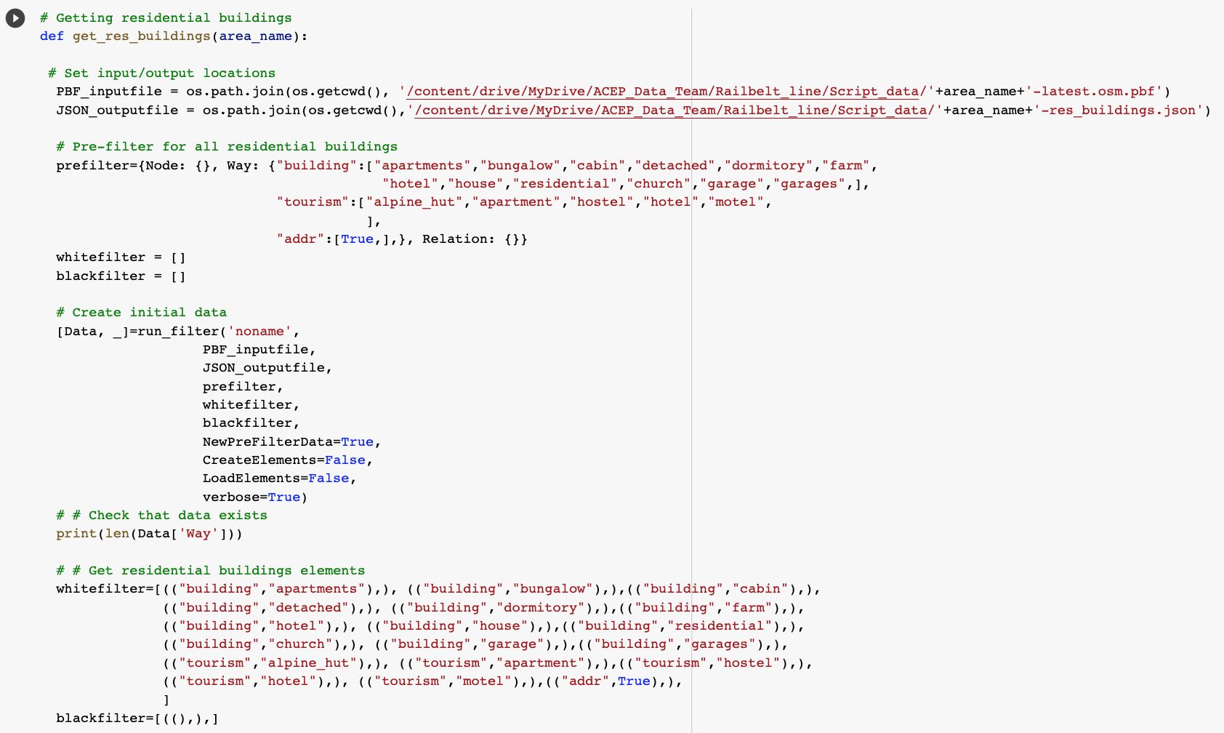
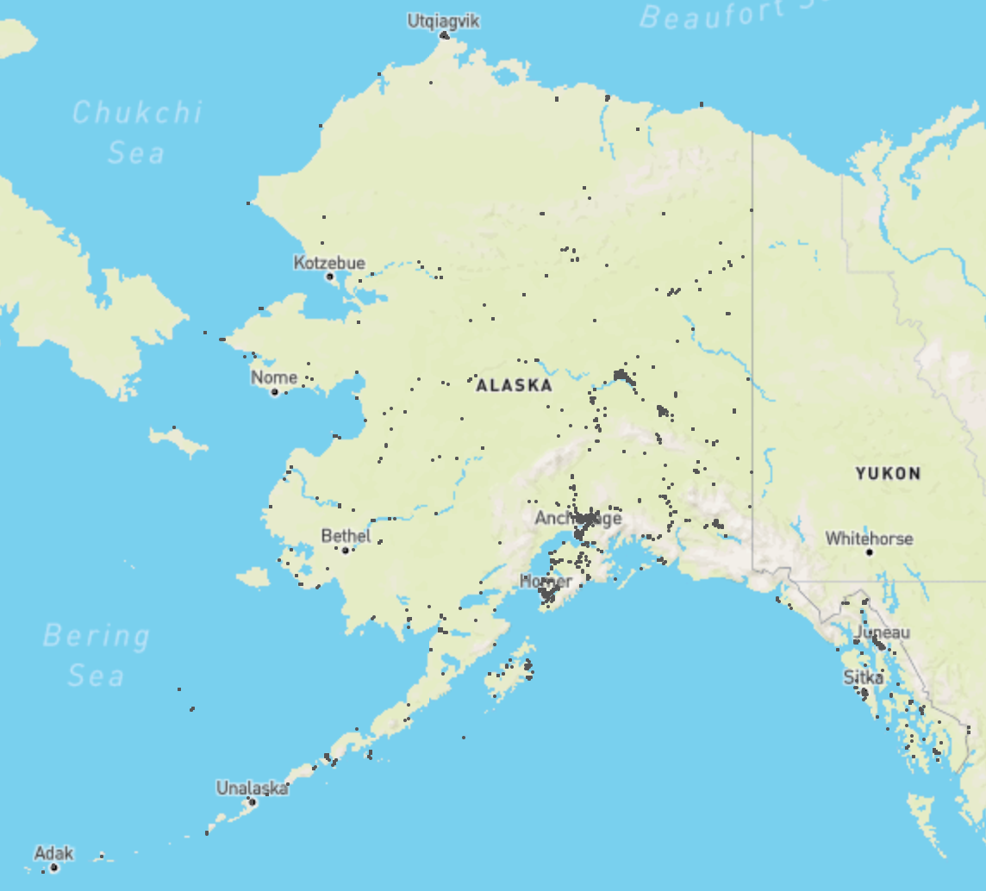
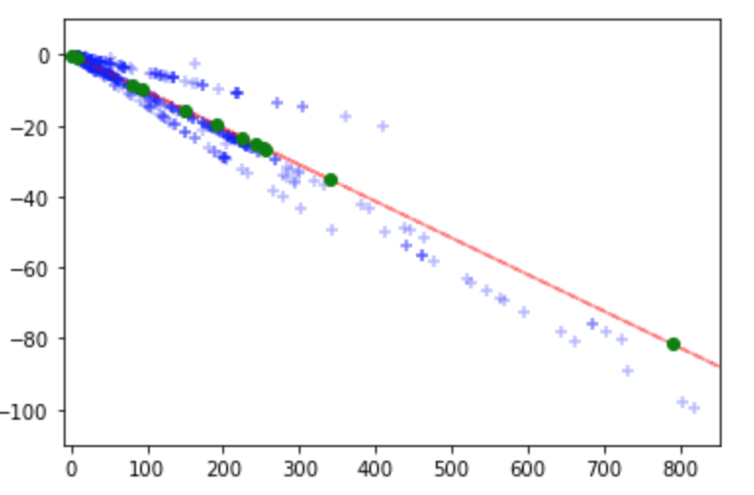
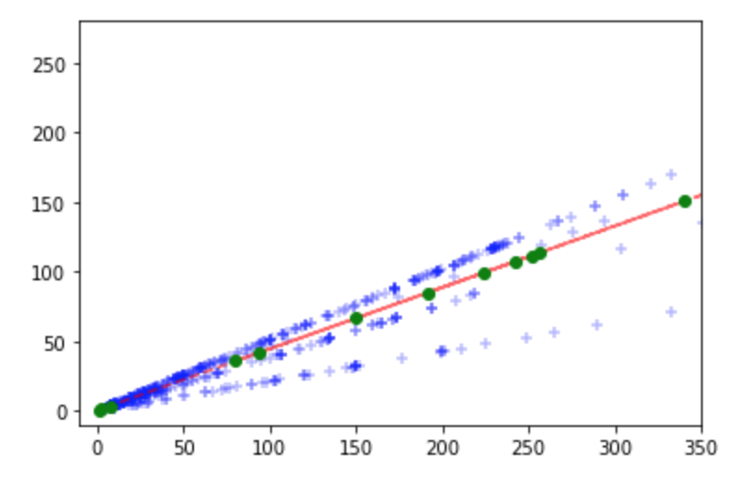
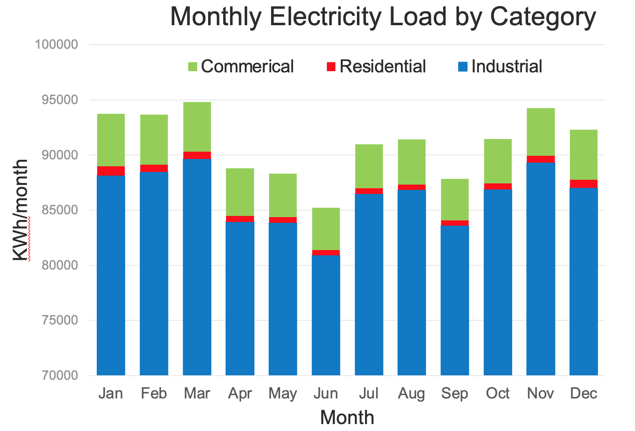

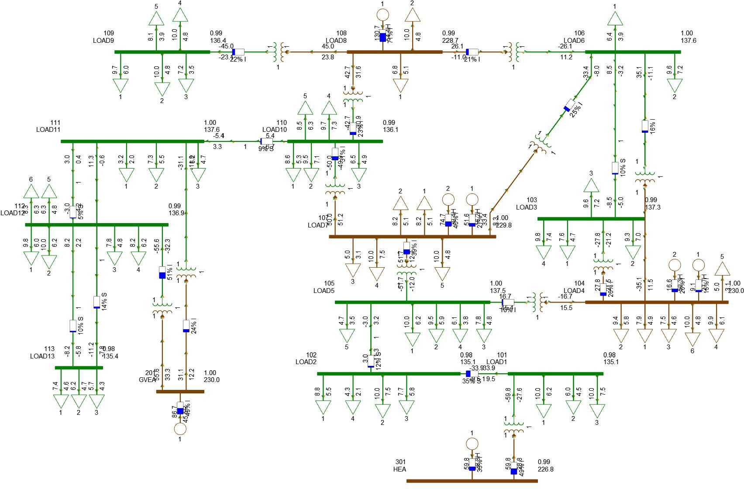
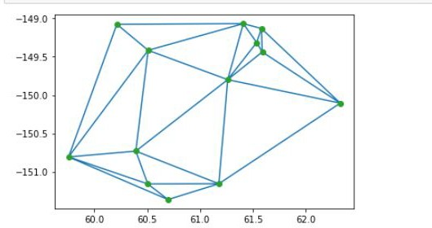
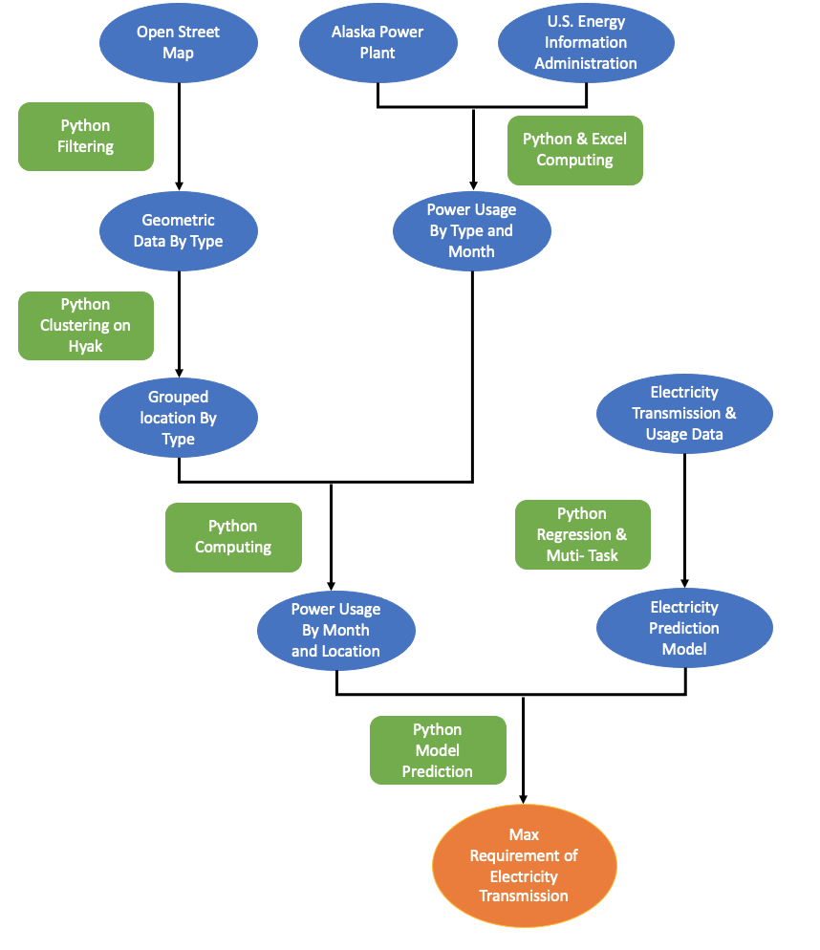
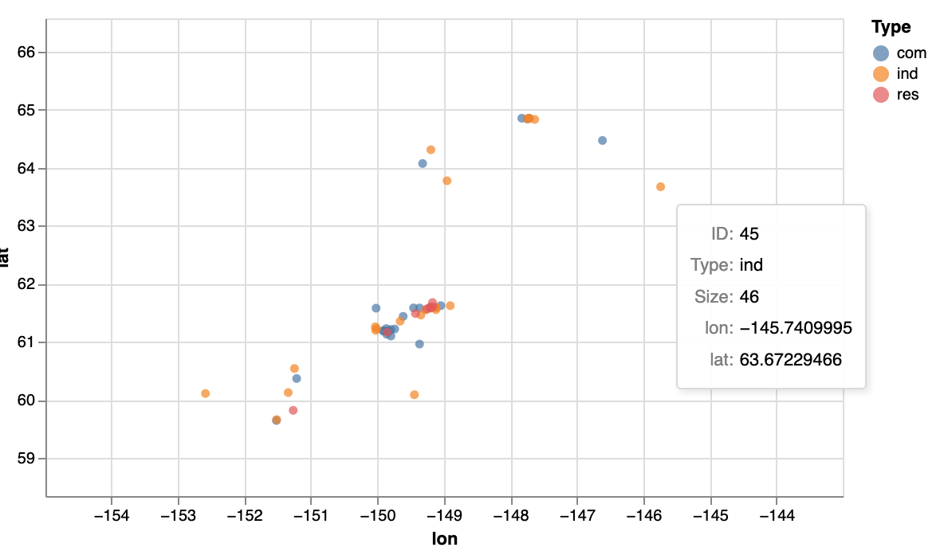

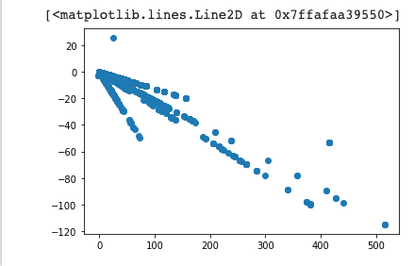


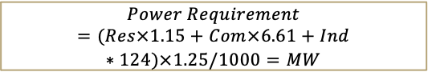
Alaska Center Energy and Power Capstone Synthetic Electrical Grid and Data Model STUDENTS: Yao-Yang Hsieh, Abhineet Nigam, and Hu-Kung Chen
01
##
Motivation & Objective
Data
Results
Motivation:
Alaska has a unique power grid requirements due to its geographical layout which can cause power outages. A synthetic electrical grid model that can predict and simulate seasonal and regional power usage patterns is needed for transmission planning and analysis.
Objective:
Build algorithms to extract geographical patterns and building clusters in the Alaska Railbelt region for estimating load data for electricity generation.
Develop algorithms and Machine Learning models for:
Hierarchical Clustering – Clustering different building types and plan transmission infrastructure locations.
Linear Regression and Muti-ouputs – Predicting electricity usage data.
Location data (OpenStreetMap)
Prefilter is the primary filter for OpenStreetMap to limit the item that need to be kept
Whitefilter and blackfilter are secondary filter that eliminate what needs to be kept and what is not.
All geographical data was captured using Python’s GeoPandas and outputted as a CSV file.
Electricity data (APP & EIA)
Cross referencing APP’s population, monthly utility bills and utility price data with EIA’s residential, commercial and industrial monthly utility spending
Min Reactive Power Linear Regression Prediction
Max Reactive Power Linear Regression Prediction
Blue: Given Data
Red: Prediction Line
Green: Predictions
Blue: Given Data
Red: Prediction Line
Green: Predictions
Min Reactive Power
Max Reactive Power
Power Requirement
Power Requirement
Linear Regression Error and Prediction
Synthetic System Transmission model
Requirements
$$Usage=\frac{\$ / month}{\$ / kWh}=kWh/month$$
 | Max Reactive Power | Min Reactive Power
RMSE | 0.319 | 0.215
R² | 0.953 | 0.898
All Groups’ Predictions [MW] | 107.036 | -24.640
 | 111.335 | -25.621
 | 84.679 | -19.540
 | 442.312 | -101.129
 | 347.554 | -79.51
 | 66.547 | -15.403
 | 41.832 | -9.765
 | 35.834 | -8.397
 | 113.039 | -26.010
 | 99.001 | -22.807
 | 1.192 | -0.493
 | 3.792 | -1.087
 | 1.552 | -0.576
Access, filter, and collect geographical and power data
Create a hierarchical clustering model with cluster size as the clustering threshold.
Create machine learning models for predicting energy generation and usage patterns.
Train, test, and improve machine learning model accuracy and efficiency
Machine Learning (Clustering and Regression)
Hierarchical Clustering
Hierarchical clustering groups points based on their geographical proximity with a bottom up approach.
Hierarchical clustering was preformed twice on the location data
1.) Each type of buildings were grouped together for feeders with maximum threshold for buildings per group (Res: 8700, Com: 1513, Ind: 80 [building/group] )
2.) Combined all feeders into buses from the first step (3-6 feeders per bus)
Hierarchical clustering code is done using Python and computed using Hyak due to a requirement of over 220 GB of memory.
Linear and Multi-output Regression
Given input as power requirement and outputs as maximum and minimum Reactive Power, regression models were developed.
Both the outputs are correlated so the model was divided into two of one input and output each.
Linear regression model showed a 2% better accuracy than the multi-output regression model.
Models developed using the data received from the sponsors.
Predictions
Input the power requirement from transmission clusters to the trained linear regression model
Apply outputs to PSS/e, a power system simulation and model software to generate synthetic electrical model
Industrial Data Cluster
Overview Methodology
Data Collection and Computation
Obtain geographic location coordinate data from Open Street Map, a world geographic database, by filtering out unrelated data
Compute seasonal electricity usage data from monthly utility bill and power price from Alaska Power Plant (APP) and Energy Information Administration (EIA)
Separate energy use by different building types (Residential, Commercial and Industrial)
Hierarchical Clustering
Group specific number of buildings into clusters for feeder allocation based on closest distance using supercomputer, Hyak.
Cluster the feeders again into buses for electricity transmission.
Compute each buses' power usage
Linear and Multi-output regression
Generate a machine learning model using linear regression and Multi-output regression
Improve model accuracy using test and validation sets.
Compare and select the most accurate model
Model Prediction
Apply the calculated power usage (P) from building clusters to the ML models to predict generator reactive power requirements (Q).
Collaborate with Electrical Engineering team to create synthetical electrical model based on the predictions.
Longitude
Latitude
Final Cluster for Electricity Calculation
$$Power Requirement=(Res×1.15+Com×6.61+Ind∗124)×1.25/1000=MW$$
Latitude
Conclusion & Future Work
Longitude
Conclusion:
Regression models predict electricity requirement with an at least 89% of accuracy on the test data set for 13 clustered location groups that contain residential, commercial and industrial type of buildings.
A validated Transmission Synthetic System’s case and diagram are created in PSS\e
Future Work:
Enhance machine learning models using more data and other complex models and methods.
Improve hierarchical clustering efficiency to decrease computational resources and time.
Max and Min Reactive Power Correlation
Min
References
Max
Erin Trochim. OpenStreetMap Alaska Python Code.
ACEP. All Transmission Electricity Data.
a.
4.
ADVISORS:
PHYLICIA CICILIO, CHRISTOPHER PIKE, Erin Trochim, MOHAMMAD HEIRDARI KAPOURCHALI AND MICHELLE WILBER
FACULTY ADVISOR:
Prof. DAVID A.C. BECK
SPONSOR: ALASKA CENTER FOR ENERGY AND POWER

