Slide 1
MILWAUKEE COUNTY
DRUG TREATMENT COURT
EVERY DAY IS A SECOND CHANCE
January 16, 2020

Slide 2
Our Mission
The mission of the Milwaukee County Drug Treatment Court (DTC) is to enhance public safety through the reduction of recidivism by coordinating effective and accountable substance abuse treatment and supportive services for offenders with substance use disorders.

Slide 3
Our Goal
1) reduce recidivism among offenders with substance use disorders
2) provide an effective and accountable community based alternative to incarceration
3) improve public safety
4) effectively manage limited criminal justice system resources

Slide 4
DTC Eligibility
Milwaukee County resident
18 years old or older
Moderate to severe substance use disorder per DSM-5
Interested in receiving AODA Treatment (voluntary program)
Facing a sentence recommendation of at least 120 days straight time

Slide 5
Type of Abuse Experience by MCADTC Participants in Lifetime
Percent

Slide 6
Types of Abuse by Gender
Percent

Slide 7
ADTC Participant Characteristics

Slide 8
ADTC Participant Characteristics

Slide 9
Phase 1
Orientation/Stabilization
Participants learn to manage a life without drugs or alcohol
Cope with physical symptoms of withdrawal
Participant familiarize themselves with the program
Weekly meetings with Recovery support coordinator, case manager, and treatment providers
Weekly court hearings
Formal AODA treatment

Slide 10
Phase 2
Treatment Plan/ Early Recovery
Participants begin to fully engage in treatment and understand their addiction.
Lifestyle and personality changes to avoid relapse
Behavior and thought patterns change as it relates to their criminal offending

Slide 11
Phase 3
Community Transition/ Relapse Prevention
Participants will effectively utilize recovery skills to maintain sobriety
People, Places, and Things
Participants now expected to transition to community living and self-sufficiency.
Personal Goals
Employment, community services, self help groups, family reconnection

Slide 12
Phase 4
Maintenance/ Aftercare
Participants continue to maintain changes and regimens that are consistent with a sober, crime free lifestyle.
Develop pro-social life skills and community building
Develop a plan for when DTC is no longer in their life when challenges arise
“Phase 5”

Slide 13
Wisconsin Recidivism Rates
In 2011those released with a 3 year follow up
An overall 31.3% recidivism rate
Males recidivate higher than females
35.3% vs. 26.1%
Largest recidivate age range is 20-29 years old
African Americans recidivated 1% more than White counterparts
*Drug Treatment Court 2016-2018 Recidivism Rates
11.1% after 12 months

Slide 14
Status of Clients from February 2009- December 2017 N=622

Slide 15
Graduation Rates by Year (2015-Oct 2018)

Slide 16

Family Drug Treatment Court Movement
High prevalence AOD + lack treatment completion + poor outcomes = FDTC emergence
First FDTC started in Reno, Nevada in 1995
Similar to Adult Drug Treatment Courts but uniquely family-oriented and less punitive (2014-25th Anniversary of the first Drug Treatment Courts)
Approximately 360 FDTC in the U.S.
Milwaukee County FDTC is the first in WI
Pilot began in April 2011
Six more counties developing FDTCs

Slide 17
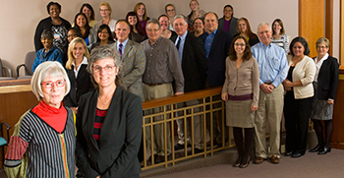
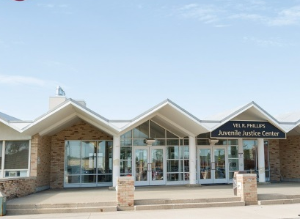
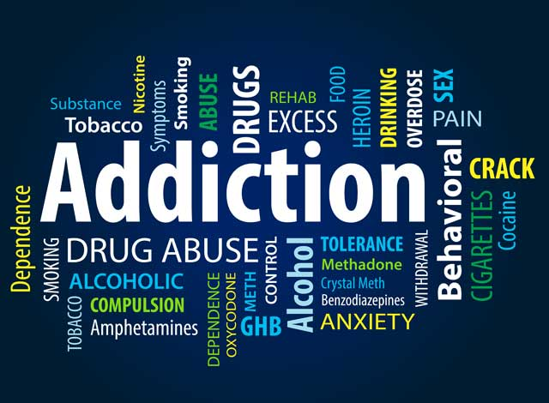

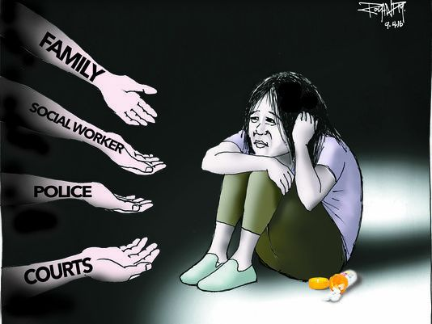
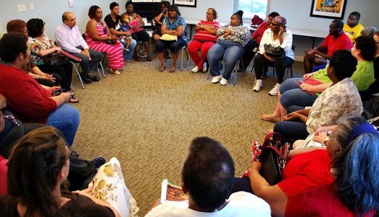
Problem-Solving Courts in Child Welfare
Judiciary & Child Welfare
Family Drug Treatment Court
Team
AODA & Mental Health Expertise
Collaborative, Trauma-Informed Approach

Slide 18
The FDTC Mission
Through collaboration, and with accountability and enhanced access to treatment services, the Family Drug Treatment Court improves the safety, well-being and permanence of children, supports the recovery of their parents from alcohol and drug dependence, and enhances the functioning of the family.

Slide 19

How does FDTC work?
Voluntary Program that successfully addresses parental substance use disorders
Participants commit to 4 Phase Program
Family-centered clinical and recovery support coordinator services
Team approach
FDTC Team, including Judge, conducts weekly reviews of each participant
Frequent, random, observed drug tests

Slide 20

Opiate use, primarily heroin, is the leading type of addiction.
Addictive substance | Primary drug of choice | Any use of drug
Any opiates | 54.9% | 67.4%
Cocaine/crack | 19.6% | 44.6%
Alcohol | 18.5% | 34.8%
Marijuana | 6.5% | 29.3%

Slide 21

Quick Connection to Substance Abuse Treatment and Services
“You may be free of me now, but I could always put you in restriction. All it takes is “one more time” and I’ll have you on that mission! I’ll pretend to be your friend even though I’m faker than fiction! You need to always be aware of this because I am YOUR ADDICTION!!!
--- Rebekkah Webb, FDTC Participant
Most participants are served through Milwaukee County’s WIser Choice program. Others have private insurance.
Treatment services
Recovery support services align with comprehensive, trauma-informed services:
Peer support
Mental health services
Education/employment
Housing assistance
The FDTC Team coordinates treatment, recovery and child welfare services to achieve agreed-upon goals.

Slide 22
4 Phases of FDTC
Phase 1: Support the choice to become a drug-free parent and start living drug-free. | Phase 2: Challenge the parent to confront the reasons for addiction.
Phase 3: Support the transition of parent’s behavior into self-sufficiency for the family. | Phase 4: Improve the capacity to safely parent children with or without ongoing supervision by BMCW.

Slide 23
Why FDTC Works
FDTC Best Practices | Milwaukee County FDTC
Focus on services to child and parents | √
Decrease time to treatment entry | √
Frequent counseling sessions | √
Longer time in treatment | √
Relationship with judge | √
Frequent random and observed urine drug testing | √
Treatment representative attends staffings | √
Judge attend staffings | √
Results of program evaluation lead to drug court modifications | √
Program caseload is less than 125 | √
S.M. Carey, J. Mackin, Judge D. Burleson, K. Walker, “Family Drug Treatment Court Costs and Best Practices: What do we know so far?” NPC Research, NADCP Annual Conference 2013

Slide 24
National Outcomes
FDTC approach is a winning one:
Improving treatment engagement and completion
Reducing length of time children spend in foster care
Increasing the rate and speed of reunification
Reducing arrests
Saving system resources

Slide 25
Is permanency being achieved?
*Parents who were eligible for participation in FDTC but chose not to enter
Statistics as of 2016

Slide 26
FDTC OUTCOMES
291 participants served and 524 children served
52 current active participants
58 successful completions – graduates and/or reunifications
27 babies born healthy and free from illegal substances to active participants and graduates
12 graduates trained as certified peer mentors
50% less likely to remain in out of home care - children of FDTC participants were 50% less likely to remain in OOHC without a permanent placement after 12 months than children of the comparison group
55% of the children were reunified with their FDTC participant parents who had completed at least phase 2, or approximately 5 months in the program, while only 12% of children of the comparison group were reunified (2016).
3 of the 58 re-entered the child welfare system, 2 of 3 re-enrolled in FDTC

