Slide 1
Predicting ICU Requirement for Covid-19 Positive Cases.
GROUP 21
Abhinesh Prajapati (2018005),
Anup Kumar Jaiswal (2018131),
Gauri Shankar (2018035)

Slide 2

Introduction
Covid 19 is the biggest challenge that the world is facing currently.
Shortages of medical resources are already burdening the overburdened medical infrastructure.
In this context of overwhelming demand for medical assessment and triage in emergency departments (EDs), early warning scores (EWS) may be useful.

Slide 3
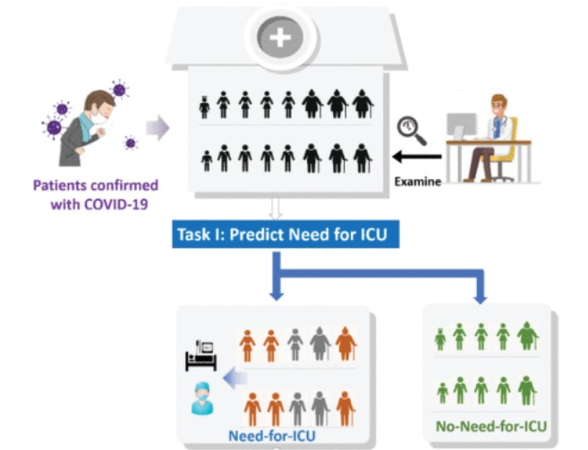
Approaches
We have used Naive Bayes, Random Forest, Neural Networks, SVM and Gradient boosting approaches.
We performed hyperparameter tuning on every models and find out the best parameters.
We used Random and Grid Search for Hyperparameter tuning.
We used Bagging classifier and XGBoost for better performance
We checked Overfitting and underfitting of our models by making plots of accuracy vs parameters.

Slide 4
DataSet Description
The dataset used in the project is available on Mexican Government Website.
The dataset contains 60L data samples with 40 features.
Prominent features among dataset are comorbidities like obesity, COPD, hypertension, diabetes, neumonia, asthma, obesity, etc.
Evaluation metric used :- Precision, Recall, F1-Score, ROC-AUC Score
Data Link :- Datos Abiertos Dirección General de Epidemiología | Secretaría de Salud | Gobierno | gob.mx (www.gob.mx)

Slide 5
Data Analysis (1/4)
Our Dataset and its description was in spanish. So, we converted our columns names into English.
We removed all those Data points with false or pending RT-PCR. We took only positive RT-PCR rows in our final dataset. This left us with dataset with 6L rows.
We dropped columns that have significant number of null values. We also dropped few features which are of no use for our model like date of admission of patient, Nationality Of patient etc.
Our prominent features contains SEX , INTUBATED, PNEUMONIA, AGE, DIABETES, COPD, ASTHMA , INMUSUPR , HYPERTENSION ,OTHER_COMORBIDITIES , CARDIOVASCULAR, OBESITY , KIDNEY_CHRONICLE , SMOKING , ICU

Slide 6
Data Analysis (2/4)
We have Plotted pair-plot using seaborn for checking data feature correlation. None of our attributes are highly correlated.
We have change NULL values in our dataset with most frequent occurrence of status in that column.
We also have normalised Age column so that this features does not overshadow other features due to its large range.
The data-set is highly imbalanced, therefore, up-sampling of the minority class has been done using SMOTE
We also have analysed the relationship between Target variable(ICU status) with other variables.

Slide 7
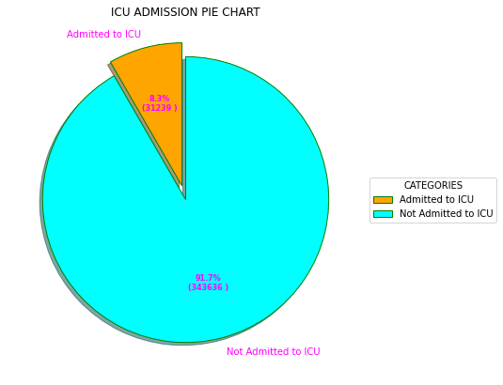
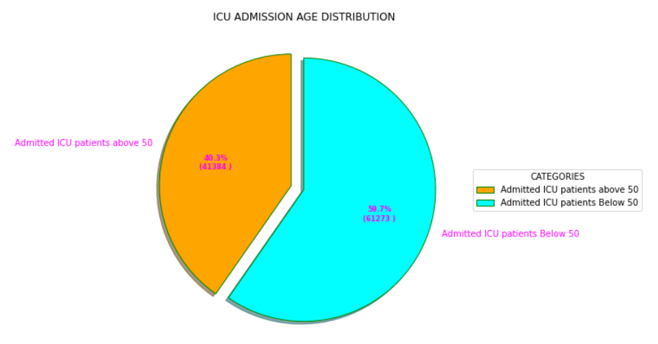
Data Analysis (3/4)
Only a minority( 8.2 %) of the Covid positive patients will ever need an ICU.
Males are more likely to be admitted in an ICU than females.

Slide 8
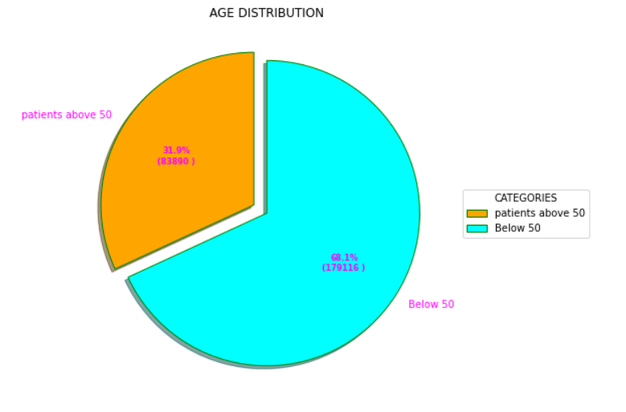
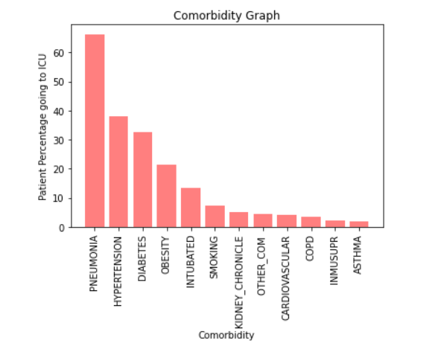
Data Analysis (4/4)
Of those who need to be admitted to an ICU, an overwhelming majority of them have age more than 50+.
Having Comorbidities like Pneumonia, Obesity, Diabetes increase the chance of being admitted in an ICU.

Slide 9
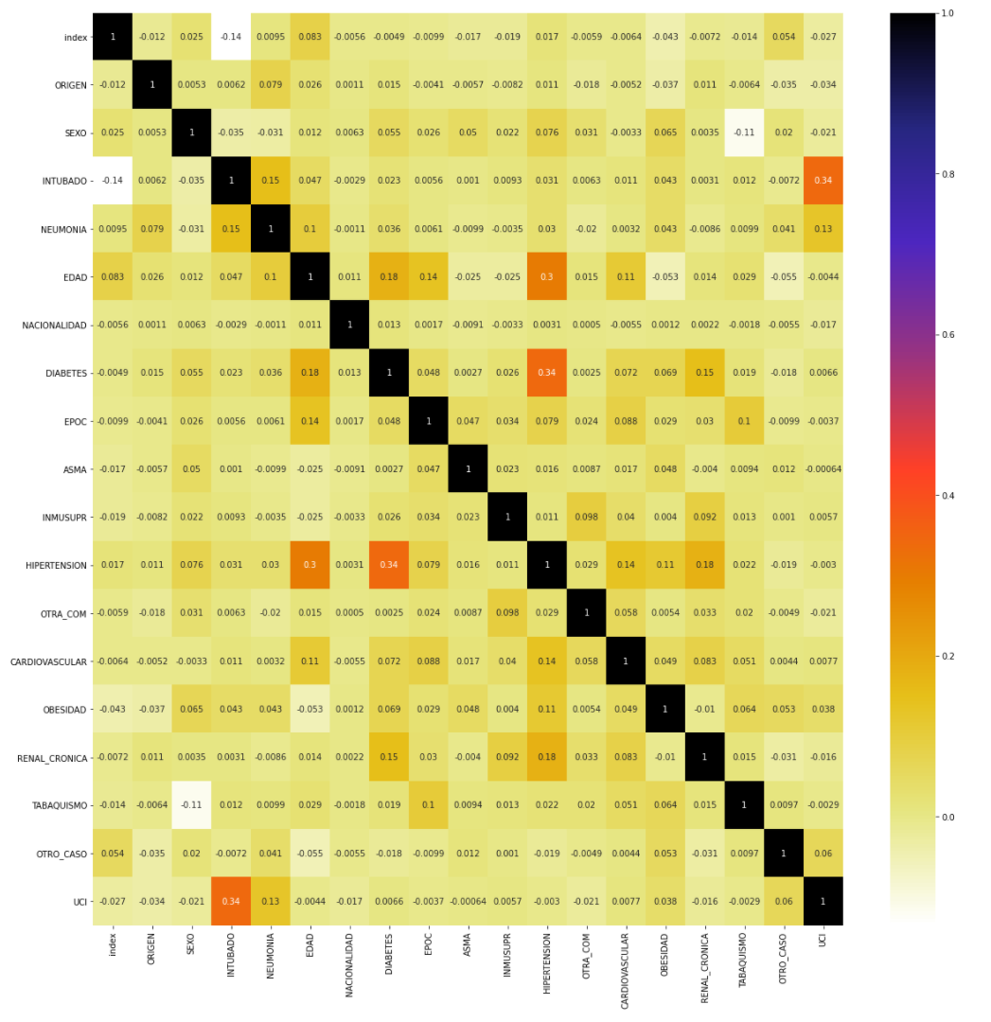
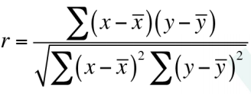
CORRELATION BETWEEN DIFFERENT ATTRIBUTES
Positive Correlation is observed between similar Comorbidities like Hypertension and Diabetes.
There is also some correlation between Age and Hypertension.
Correlation Formula:-

Slide 10
Evaluation Scores for Different Models
Models/Metric | Precision | Recall | F1-Score | ROC-AUC-Score
Logistic Regression | 0.790 | 0.773 | 0.781 | 0.773
Naive Bayes | 0.865 | 0.645 | 0.739 | 0.772
SVM(poly Kernel) | 0.656 | 0.853 | 0.742 | 0.786
Random Forest | 0.872 | 0.878 | 0.875 | 0.874
Deep Neural Network | 0.813 | 0.816 | 0.814 | 0.813
Bagging Classifier | 0.880 | 0.895 | 0.888 | 0.887
XGBoost | 0.894 | 0.803 | 0.846 | 0.854

Slide 11
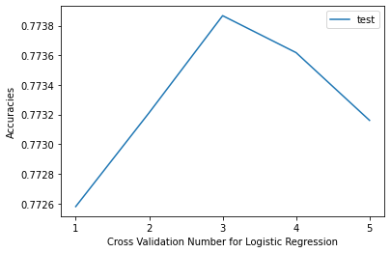
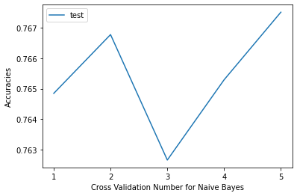
BASE MODELS USED
We have Used Logistic regression and Naive Bayes Models
We have performed 5 fold cross validation for analysing overfitting. Scores of Validation are within a range of 1% which shows absence of overfitting in our model.
Models/Metric | Precision | Recall | F1-Score | ROC-AUC-Score
Logistic Regression | 0.7902 | 0.7732 | 0.7816 | 0.7734
Naive Bayes | 0.8657 | 0.6457 | 0.7397 | 0.7725

Slide 12
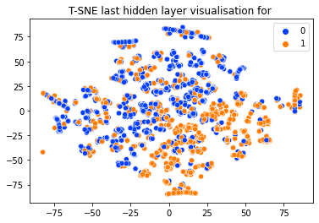
t-SNE Visualization
t-SNE plot did not yield any key information nor indicated towards presence of any clear decision boundary
Since the plot does not have a decisive boundary, this reinforces the reasons why linear models like Linear Regression weren't able to perform well.

Slide 13
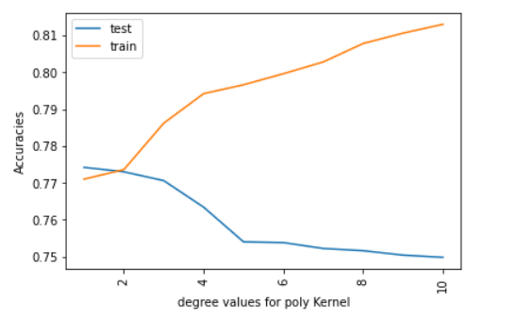
SVM(Polynomial Kernel)
Optimal Hyperparameter for polynomial kernel is 2
After degree 2, model starts overfitting with increasing train accuracy and decreasing test accuracy.
RBF with tuned hyperparameter is giving AUC-ROC score of 76
Evaluation Metric | Precision | Recall | F1-Score | AUC-ROC Curve
Score | 0.6597 | 0.8539 | 0.7426 | 0.7867

Slide 14
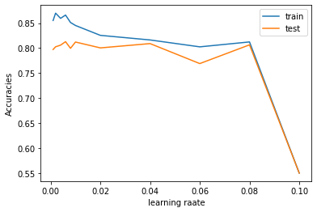
Deep neural network
In this graph accuracy is decreasing with increase in learning rate.
High difference at the starting shows underfitting.
Low test accuracy at high learning rate shows overfitting.
So we took 0.04 as best fit learning rate.
Evaluation Metric | Precision | Recall | F1-Score | AUC-ROC Curve
Score | 0.8130 | 0.8164 | 0.8147 | 0.8138
Optimal Parameters :-
Activation : relu
Learning Rate : 0.04
Total hidden layers : 3

Slide 15
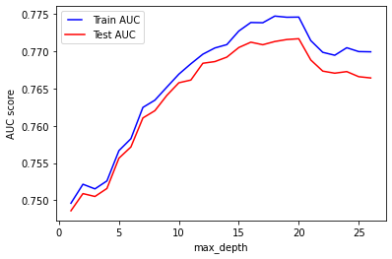
Random Forest
It uses multiple decision trees to build the model.
It is used to overcome possible overfitting/high variance caused by Decision Trees.
Hence, it performed better than previous models.
Hyperparameter tuning has been done to ensure optimal performance of the model.
Optimal Parameters :-
N_estimators :- 100
max_depth :- 18
Metric | Precision | Recall | F1-Score | AUC-ROC Curve
Score | 0.872 | 0.878 | 0.875 | 0.874

Slide 16
Bagging
It an ensemble technique, which works by applying similar classifiers on small partitions of the dataset and then taking the average of all the predictions.
Due to the averaging,there is reduction in variance.
Here Decision Trees is used a base classifier to perform Bagging.
Hyperparameter tuning has been done on n_estimators to ensure optimal performance.

Slide 17
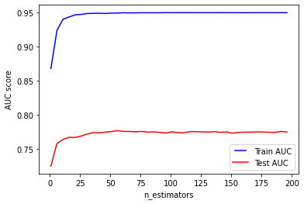
Bagging
Optimal Parameters:-
n_estimator :- 100
max_depth :- 20
Evaluation Scores Obtained:-
Recall: 0.895
Precision: 0.8807
F1 Score: 0.8881
ROC-AUC-Score 0.8872

Slide 18
Boosting
Boosting is an ensembling technique which uses sequential learning of classifiers.
A model is first trained on the complete dataset. Now the model will get some instances right while some wrong.
In the next iteration, the learner will focus more on the wrongly predicted instances or give more weight to it.
This iterative process continues, and new classifiers are added to the model until the limit is reached on the accuracy.
Hyperparameter tuning is done on n_estimators using GridSearchCV for optimal performance.
Optimal Parameters :-
n_estimators :- 3000
max_depth :- 20

Slide 19
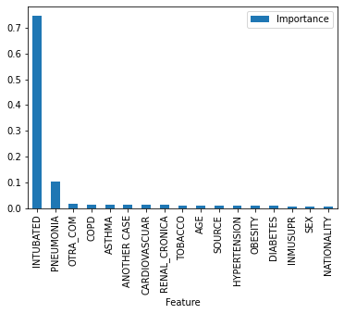
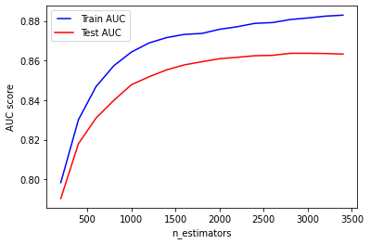
XGBoost Classifier
Evaluation Scores Obtained :-
Recall: 0.803
Precision: 0.894
F1 Score: 0.846
ROC-AUC-Score 0.854

Slide 20
Conclusion
Naive Bayes turned out to be most in-effective model.
Models like Random Forest performed better than SVM, Neural Network.
Ensembling Techniques performed best among all model.
Future improvements on the approach can be made by gathering more features like Genetics of the Person, the strain of the virus, Severity of Infection, Hygiene Habits etc to improve the performance.

Slide 21
Summary of Learnings
We learnt about processing datasets to handle missing values, data imbalance and normalization.
We learnt how to visualize our dataset using t-SNE and other plotting methods.
We learnt how to analyze our result on accuracy, time and prepared a research paper
We applied various machine learning algorithms like NN, SVM, random forests, Neural Network, and ensemble technique like Bagging and Boosting.

Slide 22
Thank you

