Slide 1


Mathematical Analysis of
PAM signals.
ABHIJITH P A
Roll No.1
S6 ECE

Slide 2


Introduction…
In this powerpoint presentation I am going to explain about Power amplitude modulation(PAM) and the mathematical analysis of power amplitude modulation.
I hope it will be helpful for you.

Slide 3
PULSE AMPLITUDE MODULATION (PAM)
In Pulse Amplitude Modulation (PAM), the amplitudes of regularly spaced pulses are varied in proportion to the corresponding sample values of a continuous message signal; the pulses can be of a rectangular form or some other appropriate shape. Pulse amplitude modulation as defined here is somewhat similar to natural sampling, where the message signal is multiplied by a periodic train of rectangular pulse. However, in natural sampling the top of each modulated rectangular pulse varies with the message signal, whereas in PAM it is maintained flat.

Slide 4
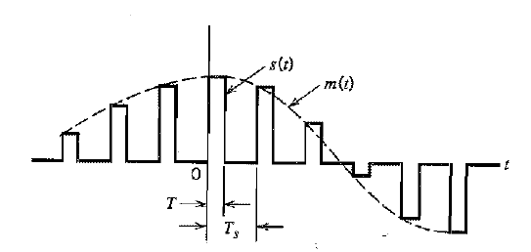
Fig. Flat-top samples, representing an analog signal

Slide 5
In the figure, the dashed curve in this figure depicts the waveform of a message signal m(t), and the sequence of amplitude modulated rectangular pulse shown as solid lines represents the corresponding PAM signa s(t).
There are two operations involved in the generation of PAM signal:
Instantaneous sampling of the message signal m(t) every T , seconds where the sampling rate fs = 1/Ts is chosen in accordance with the sampling theorem.
Lengthening the duration of each sample so obtained to some constant value T.

Slide 6
In digital circuit technology, these two operations are jointly referred to as “sample and hold”. One important reason for intentionally lengthening the duration of each sample is to avoid the use of an excessive channel bandwidth, since bandwidth is inversely proportional to the pulse duration. However, care has to be exercised in how long we make the sample duration T, as the following analysis reveals.

Slide 7
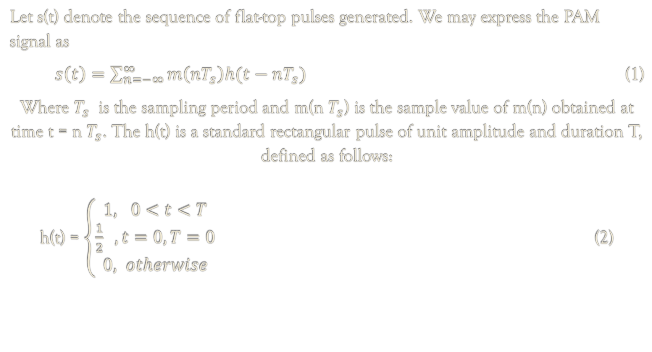
Let s(t) denote the sequence of flat-top pulses generated. We may express the PAM signal as
$s\left(t\right)=\sum_{n=−∞}^{∞}{m\left(nT_{s}\right)h(t−nT_{s})}$ (1)
Where $T_{s}$ is the sampling period and m(n $T_{s}$) is the sample value of m(n) obtained at time t = n $T_{s}$. The h(t) is a standard rectangular pulse of unit amplitude and duration T, defined as follows:
h(t) = $\left\{\begin{aligned}1, 0<t<T \\ \frac{1}{2} , t=0,T=0 \\ 0, otherwise\end{aligned}\right.$ (2)

Slide 8
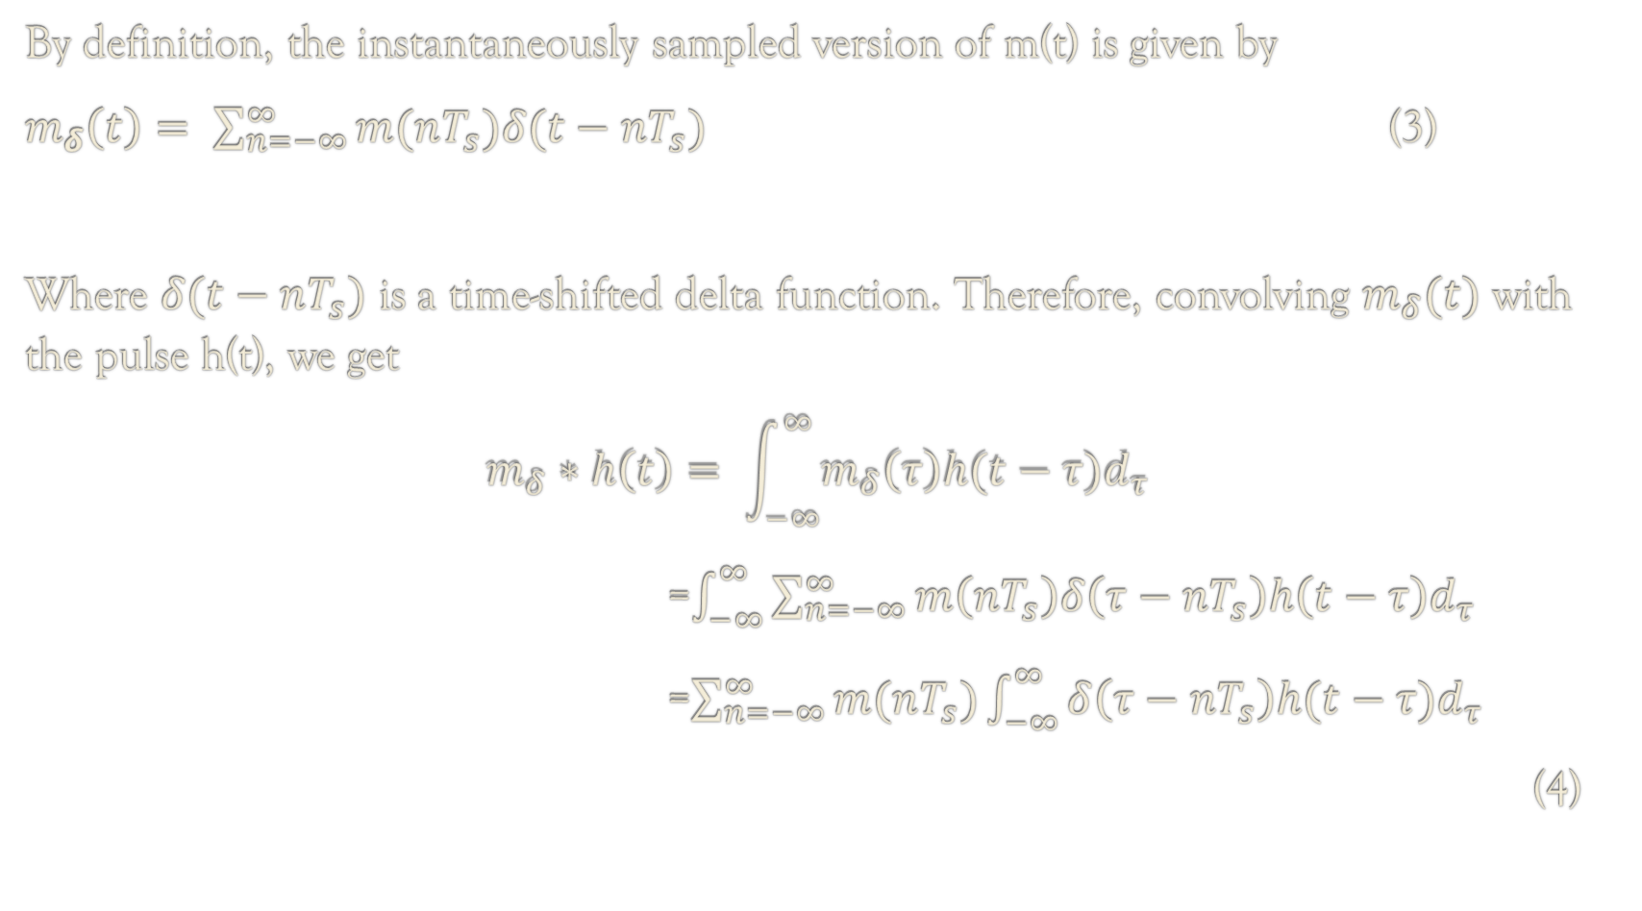
By definition, the instantaneously sampled version of m(t) is given by
$m_{δ}\left(t\right)= \sum_{n=−∞}^{∞}{m(nT_{s})δ(t−nT_{s})}$ (3)
Where $δ(t−nT_{s})$ is a time-shifted delta function. Therefore, convolving $m_{δ}(t)$ with the pulse h(t), we get
$$m_{δ}∗h\left(t\right)= \int_{−∞}^{∞}{m_{δ}\left(τ\right)h(t−τ)d_{τ}}$$
=$\int_{−∞}^{∞}{\sum_{n=−∞}^{∞}{m\left(nT_{s}\right)δ\left(τ−nT_{s}\right)h\left(t−τ\right)d_{τ}}}$
=$\sum_{n=−∞}^{∞}{m(nT_{s})}\int_{−∞}^{∞}{δ\left(τ−nT_{s}\right)h(t−τ)d_{τ}}$
(4)

Slide 9
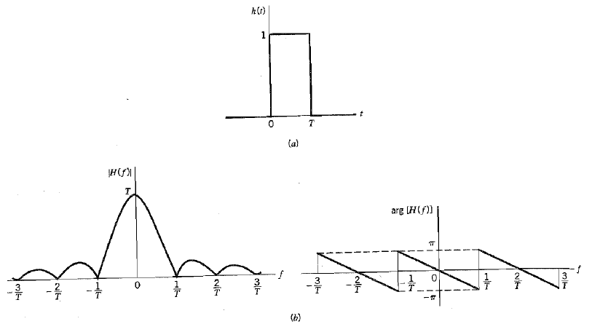
Figure (a) Rectangular pulse h(t) . (b) Spectrum H(f), made up of the magnitude |H(f)|, and phase arg{H(f)}

Slide 10
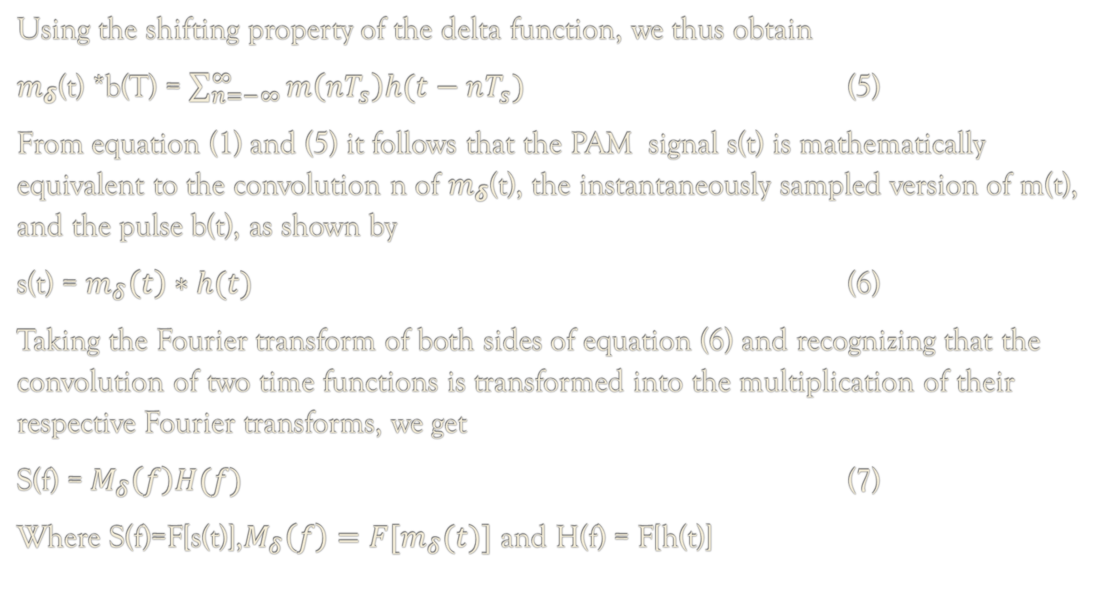
Using the shifting property of the delta function, we thus obtain
$m_{δ}$(t) *b(T) = $\sum_{n=−∞}^{∞}{m\left(nT_{s}\right)h(t−nT_{s}})$ (5)
From equation (1) and (5) it follows that the PAM signal s(t) is mathematically equivalent to the convolution n of $m_{δ}$(t), the instantaneously sampled version of m(t), and the pulse b(t), as shown by
s(t) = $m_{δ}\left(t\right)∗h(t)$ (6)
Taking the Fourier transform of both sides of equation (6) and recognizing that the convolution of two time functions is transformed into the multiplication of their respective Fourier transforms, we get
S(f) = $M_{δ}\left(f\right)H(f)$ (7)
Where S(f)=F[s(t)],$M_{δ}\left(f\right)=F[m_{δ}(t)]$ and H(f) = F[h(t)]

Slide 11
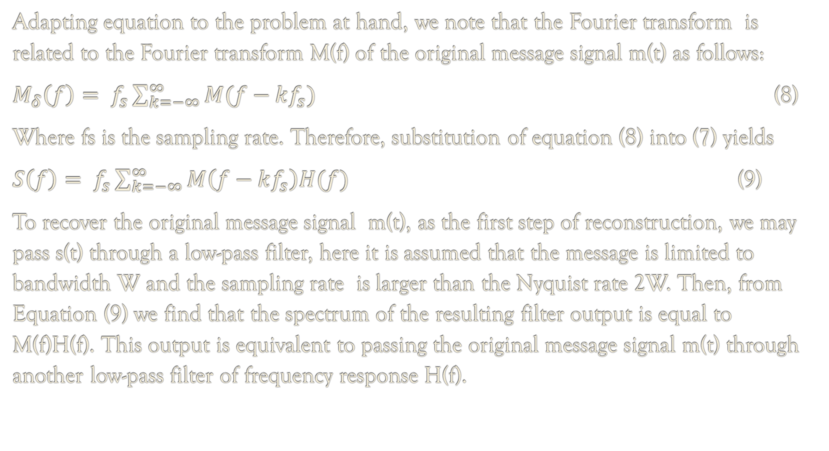
Adapting equation to the problem at hand, we note that the Fourier transform is related to the Fourier transform M(f) of the original message signal m(t) as follows:
$M_{δ}\left(f\right)= f_{s}\sum_{k=−∞}^{∞}{M(f−kf_{s})}$ (8)
Where fs is the sampling rate. Therefore, substitution of equation (8) into (7) yields
$S\left(f\right)= f_{s}\sum_{k=−∞}^{∞}{M\left(f−kf_{s}\right)H(f)}$ (9)
To recover the original message signal m(t), as the first step of reconstruction, we may pass s(t) through a low-pass filter, here it is assumed that the message is limited to bandwidth W and the sampling rate is larger than the Nyquist rate 2W. Then, from Equation (9) we find that the spectrum of the resulting filter output is equal to M(f)H(f). This output is equivalent to passing the original message signal m(t) through another low-pass filter of frequency response H(f).

Slide 12
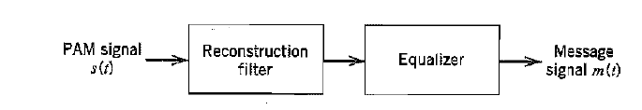
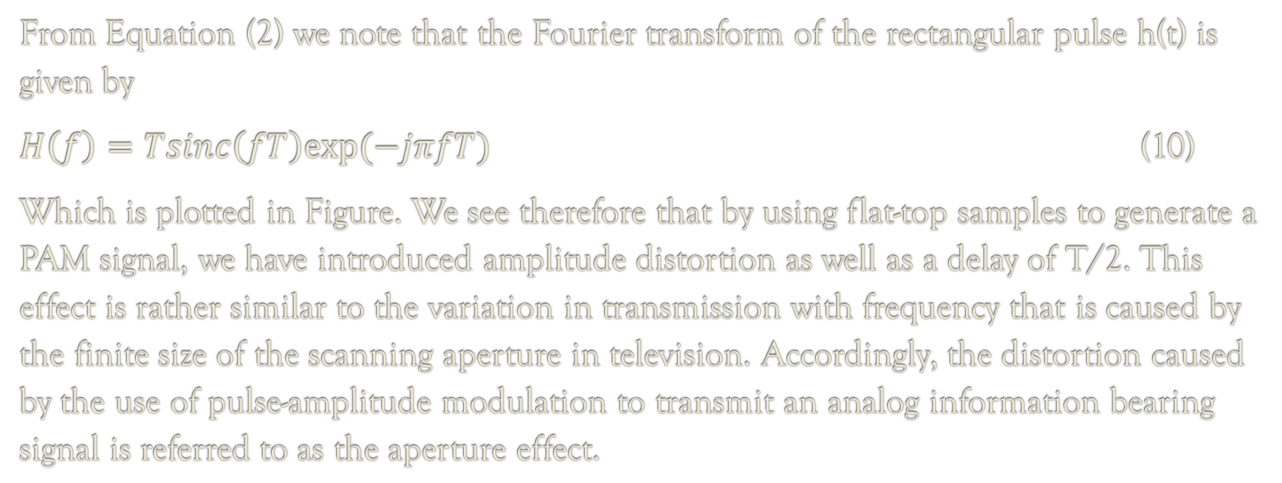
Figure. System for recovering message signal m(t) from PAM signal s(t)
From Equation (2) we note that the Fourier transform of the rectangular pulse h(t) is given by
$H\left(f\right)=Tsinc\left(fT\right)exp⁡(−jπfT)$ (10)
Which is plotted in Figure. We see therefore that by using flat-top samples to generate a PAM signal, we have introduced amplitude distortion as well as a delay of T/2. This effect is rather similar to the variation in transmission with frequency that is caused by the finite size of the scanning aperture in television. Accordingly, the distortion caused by the use of pulse-amplitude modulation to transmit an analog information bearing signal is referred to as the aperture effect.

Slide 13
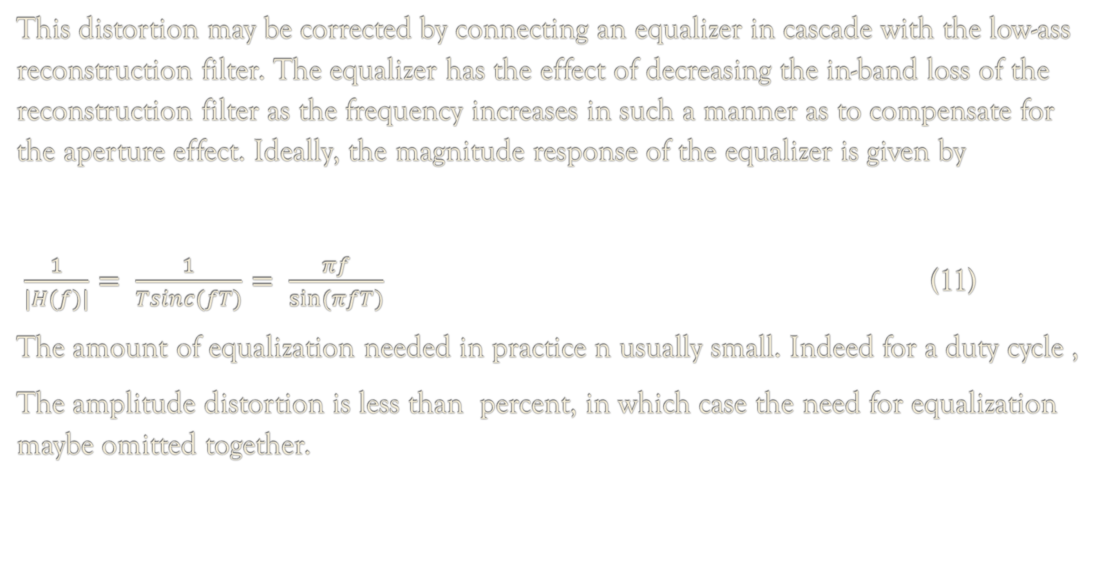
This distortion may be corrected by connecting an equalizer in cascade with the low-ass reconstruction filter. The equalizer has the effect of decreasing the in-band loss of the reconstruction filter as the frequency increases in such a manner as to compensate for the aperture effect. Ideally, the magnitude response of the equalizer is given by
$\frac{1}{|H(f)|}= \frac{1}{Tsinc(fT)}= \frac{πf}{sin⁡(πfT)}$ (11)
The amount of equalization needed in practice n usually small. Indeed for a duty cycle ,
The amplitude distortion is less than percent, in which case the need for equalization maybe omitted together.

Slide 14
The transmission of PAM signal imposes rather stringent requirements on the magnitude and phase responses of the channel, because of the relatively short duration of the transmitted pulses. Furthermore, the noise performance of a PAM system can never be better than baseband-signal transmission. Accordingly, we find that the transmission over long distances, PAM would be used only as a means of message processing for time-division multiplexing, from which conversion to some other form of pulse modulation is subsequently made.

Slide 15
Sources:
Simon Haykin, Communication Systems, Wiley, 2001
Google
Wikipedia
Youtube

Slide 16
Thank you…

