Slide 1

CPU
ARCHITECTURE OF ARM9 PROCESSOR
ABHIJITH P A ROLL NO. 1
S6 ECE

Slide 2
ARM ARCHITECTURE (ARM9)
The ARM9TDMI is a member of ARM family of general purpose microprocessors.
The ARM9TDMI is targeted at embedded control applications where high performance, low die size and low power are all important.
The ARM9TDMI supports both the 32-bit ARM and 16-bit Thumb instruction sets, allowing the user to trade off between high performance and high code density.
The ARM9TDMI supports the ARM debug architecture and includes logic to assist in both hardware and software debug.
The ARM9TDMI supports both bidirectional and unidirectional connection to external memory systems.

Slide 3
The ARM9TDMI also includes support for coprocessors.
The ARM9TDMI processor core is implemented using a five-stage pipeline consisting of fetch, decode, execute, memory and write stages.
The device has a Harvard architecture, and the simple bus interface eases connection to either a cached or SRAM-based memory system.

Slide 4
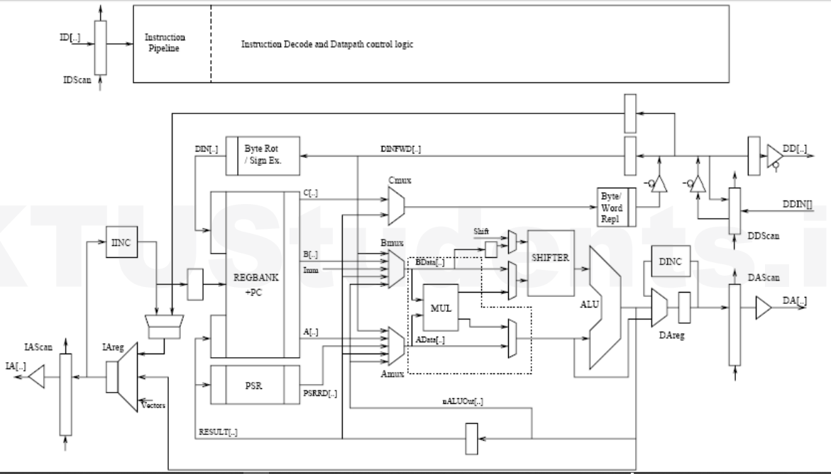

Slide 5
MAIN PARTS OF ARM PROCESSOR
Register file: The processor has a total of 37 registers made up of 31 general 32 bit registers and 6 status registers.
Booth Multiplier.
Barrel Shifter
Arithmetic Logic Unit.
Control Unit

Slide 6
1. REGSTERS
The processor has a total of 37 registers made up of 31 general 32 bit registers and 6 status registers.
At any one time 6 general registers (R0 to R15) and one or two status registers are visible to the programmer.
The visible registers depend on the processor mode.
In all modes 16 registers,R0 to R15, are directly accessible. All registers except R15 are general purpose and may be used to hold data or address values. Register R15 holds the Program Counter(PC).

Slide 7
A seventeenth register (the CPSR- Current Program Status Register) is also accessible. It contains condition code flags and the current mode bita and may be thought of as an extension to the PC.
R14 is used as the subroutine link register and receives a copy of R15 when a Branch and link instruction is executed.
Program status register contains the processor flags (Z, S, V and C).
The mode bits also exist in the program status register in addition to the interrupt and fast interrupt disable bits.
Some special registers: Some registers are used like the instruction register, memory data read and write register and memory address register.

Slide 8
2. Barrel shifter
The barrel shifter has a 32 bit input to be shifted.
This input is coming from the register file or it could be immediate data.
The shifter has other control inputs coming from instruction register.
Shift field in the instruction controls the operation of the barrel shifter.
This field indicates the type of shift to e performed (logical left or right, arithmetic right or rotate right)
The amount by which the register should be shifted is contained in an immediate field in the instruction or it could be the lower 6 bits of a register in the register file.

Slide 9
3. BOOTH MULTIPLIER
The multiplier has three 32-bit inputs.
All the inputs come from the register file.
The multiplier output is only the 32least significant bits of the product.

Slide 10
4.ARITHMETIC LOGIC UNIT(ALU)
The ALU has two 32-bit inputs.
The first comes from the register file while the other comes from the shifter
ALU outputs modify the status register flags.

Slide 11
5.Control unit
For any microprocessor, control unit is the heart of the system.
It is responsible for the system operation and so the control unit design is the most important part in the whole design.
Control unit is usually a pure combinational circuit.
The processor timing is also included in the control unit.

Slide 12
PIPELINE IMPLEMENTATION
The ARM9TDMI implementation uses a five-stage pipeline design. These five stages are:
Instruction fetch(F)
Instruction decode(D)
Execute(E)
Data memory access(M)
Register write(W)

Slide 13
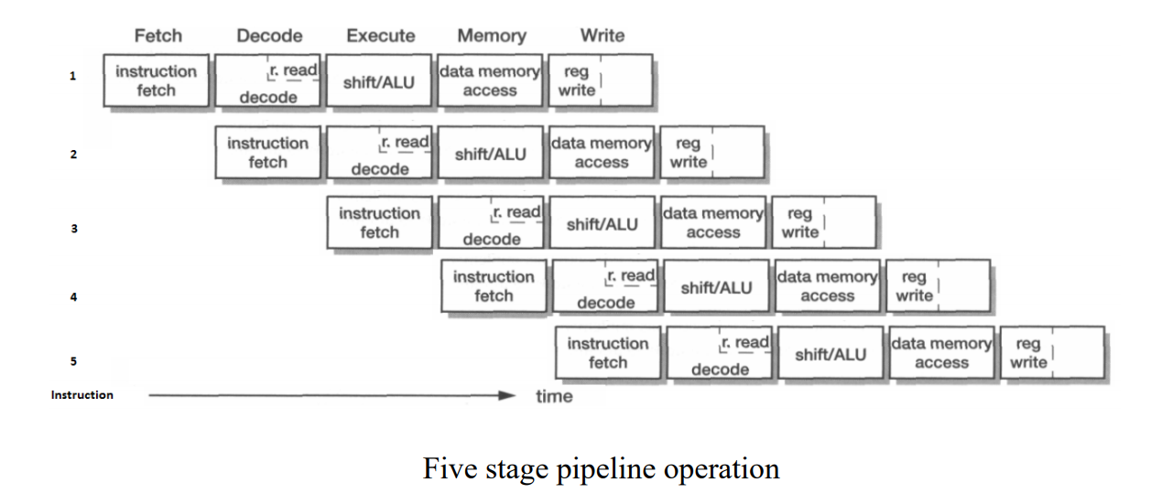

Slide 14
THANK YOU

