Slide 1


A Final Year Project Final Defense
On
Electric Vehicle Charging Station Recommendation System
Presented By:
Rajat Budhathoki (20820/075)
Bipin Chaudhary (20800/075)
Abhinna Ojha (20788/075)
April 29, 2023

Slide 2
Presentation Outline
Introduction
System Analysis
System Design
Implementation
Conclusion

Slide 3
Introduction
Project Introduction
EVCS is a system to recommend the charging station to the users
It uses Cosine Similarity to calculate similarity scores and uses the user ratings to recommend
Problem Statement
EV charging is not as easy as filling up fuel as in an internal combustion engine-based vehicle as it takes quite a significant time for the EV to be fully charged
There are limited EV charging stations and it can be very difficult for people to find the suitable charging station

Slide 4
Introduction
Objectives
To build a web-based system to recommend EV charging station in a specified location
To implement Cosine Similarity algorithm to implement collaborative filtering
Scope and Limitation
Provide ratings to various charging stations and receive recommendation of charging station in a user specified location.
The system will not detect the user location of provide routes to the said charging stations.

Slide 5
System Analysis
Use-case diagram
Class Diagram
Activity Diagram
Sequence Diagram

Slide 6
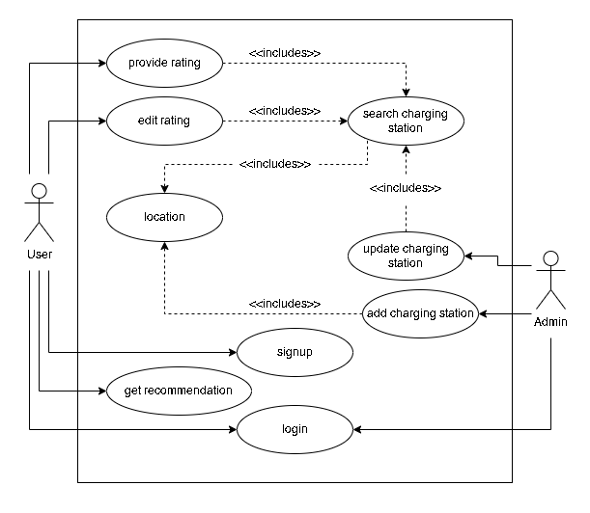

Slide 7
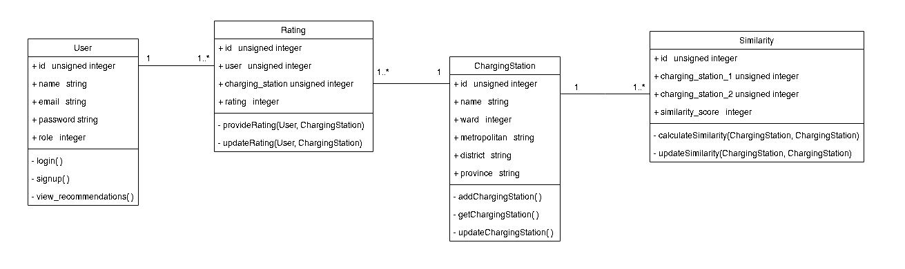

Slide 8
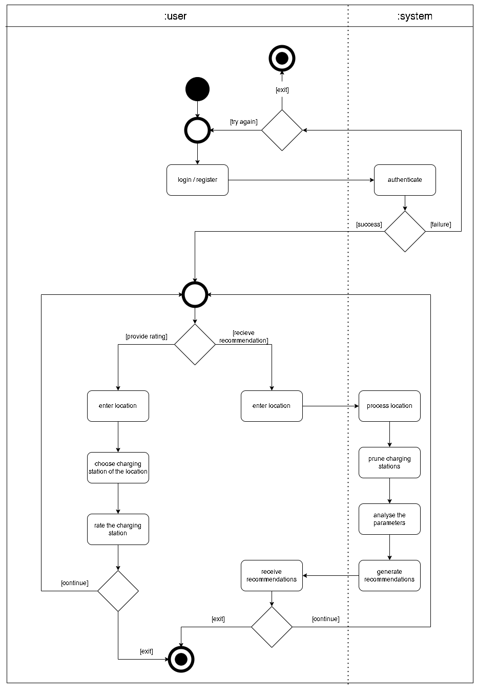

Slide 9
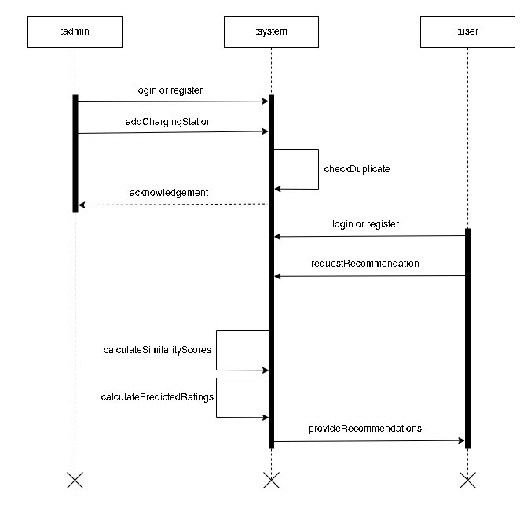

Slide 10
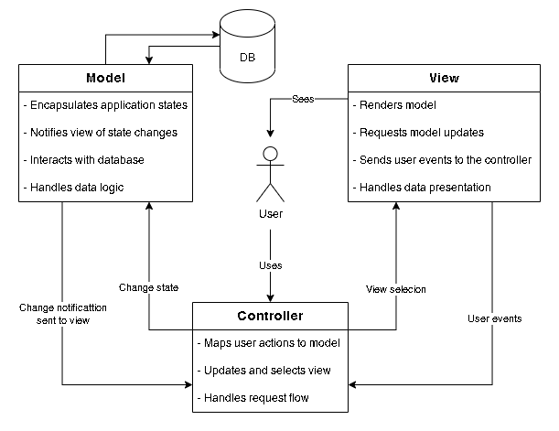
System Design: System Architecture

Slide 11

System Design: Cosine Similarity
$$S_{c}\left(A, B\right)=\cos{(θ)}= \frac{A. B}{\left|\left|A\right|\right| . \left|\left|B\right|\right|}= \frac{\sum_{i=1}^{n}{A_{i}.B_{i}}}{\sqrt{\sum_{i=1}^{n}{A_{i}^{2}}}. \sqrt{\sum_{i=1}^{n}{B_{i}^{2}}}}$$

Slide 12

System Design: Weighted average
$$W= \frac{\sum_{i=1}^{n}{w_{i}X_{i}}}{\sum_{i=1}^{n}{w_{i}}}$$

Slide 13
System Implementation
Tools used
Database implementation
Algorithm implementation

Slide 14
System Implementation: Tools used
Development Tools
HTML and CSS
JS along with jQuery
PHP with Laravel
PHP Storm IDE
MySQL
GitHub with Git
XAMPP server
Design and Documentation
diagrams.net
Microsoft Project
Microsoft Word
Microsoft PowerPoint

Slide 15
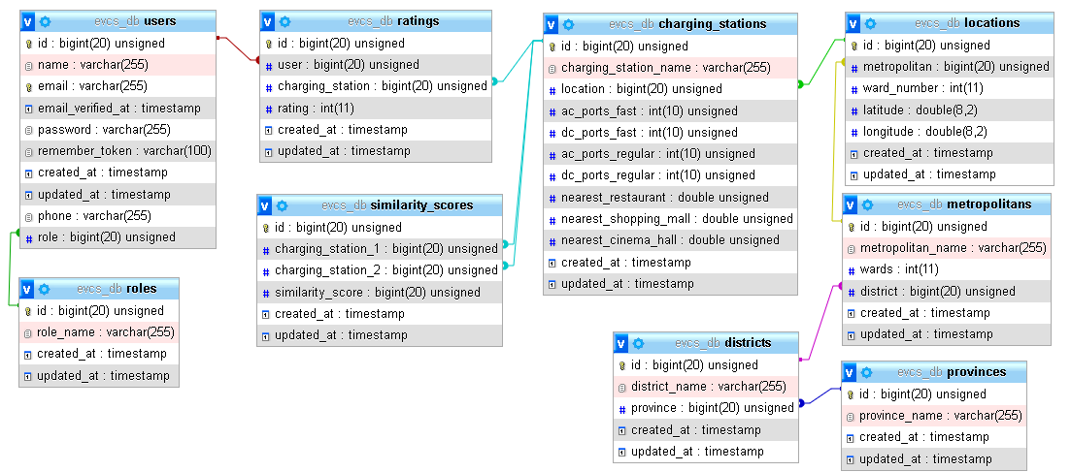
System Implementation: Database

Slide 16
System Implementation : Algorithm
Number of Type 1 AC charging ports, AC regular charging ports
Number of Type 2 AC charging ports, AC fast charging ports
Number of CHAdeMO charging ports, DC regular charging ports
Number of Combined Charging System (CCS) charging ports, DC fast charging ports
Distance from the nearest restaurant
Distance from the nearest shopping mall
Distance from the nearest cinema hall

Slide 17
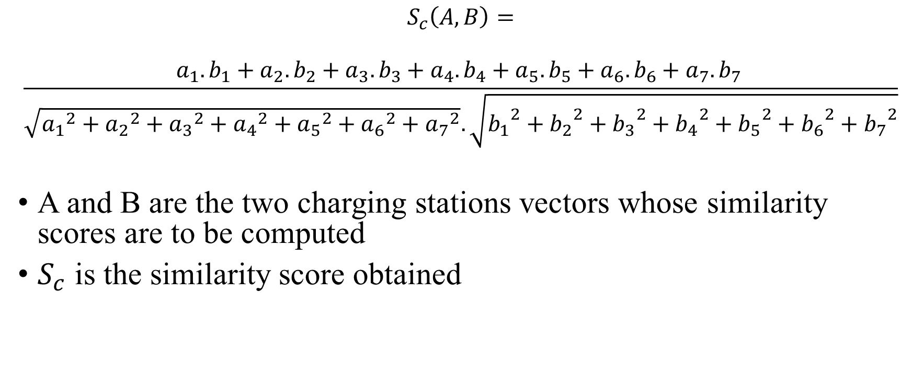
System Implementation : Algorithm
$$S_{c}\left(A, B\right)=$$
$$\frac{a_{1}. b_{1}+a_{2}. b_{2}+a_{3}. b_{3}+a_{4}. b_{4}+a_{5}. b_{5}+a_{6}. b_{6}+a_{7}. b_{7 }}{\sqrt{{a_{1}}^{2}+{a_{2}}^{2}+{a_{3}}^{2}+{a_{4}}^{2}+{a_{5}}^{2}+{a_{6}}^{2}+{a_{7}}^{2}}. \sqrt{{b_{1}}^{2}+{b_{2}}^{2}+{b_{3}}^{2}+{b_{4}}^{2}+{b_{5}}^{2}+{b_{6}}^{2}+{b_{7}}^{2}}}$$
A and B are the two charging stations vectors whose similarity scores are to be computed
$S_{c}$ is the similarity score obtained

Slide 18
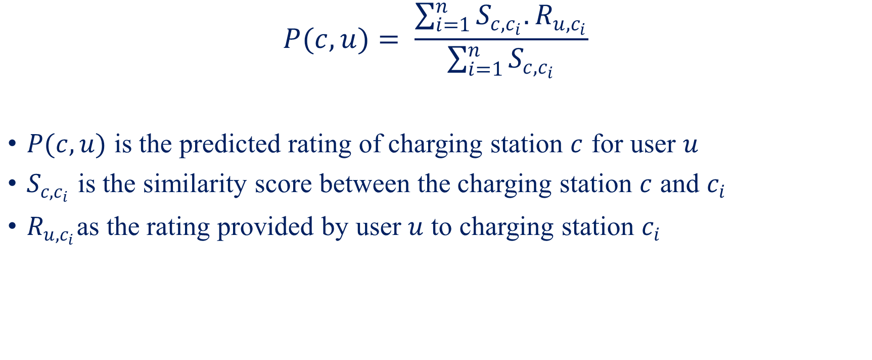
System Implementation : Algorithm
$$P(c,u)= \frac{\sum_{i=1}^{n}{S_{c,c_{i}}.R_{u, c_{i}}}}{\sum_{i=1}^{n}{S_{c,c_{i}}}}$$
$P(c, u)$ is the predicted rating of charging station $c$ for user $u$
$S_{c,c_{i}}$ is the similarity score between the charging station $c$ and $c_{i}$
$R_{u, c_{i}}$as the rating provided by user $u$ to charging station $c_{i}$

Slide 19
System Implementation : Testing
Test Case ID | TC-3
Test Scenario | Addition of rating using valid data.
Actions | Open rate page. Input the location, the charging station, and rating. Press “Add Rating” button.
Input | Province: Bagmati District: Kathmandu Metropolitan: Kathmandu Ward: 22 Charging Station: Jagat Charging Station Rating: 4

Slide 20
System Implementation : Testing
Expected Results | Success message is displayed. “ratings” table is updated.
Observed Results | As expected
Assertation | Pass

Slide 21
System Implementation : Testing
Test Case ID | TC-6
Test Scenario | Get recommendation of charging station without inputting ward.
Actions | Open Recommendations page. Input the location and check the Exclude Ward checkbox. Press “Get recommendation” button.
Input | Province: Bagmati District: Kathmandu Metropolitan: Kathmandu
Expected Results | Top 3 charging stations displayed.
Observed Results | As expected
Assertation | Pass

Slide 22
Conclusion and Further Recommendation
Conclusion
A web-based system to recommend EV charging station in a specified location
Cosine Similarity algorithm is used to implement collaborative filtering to recommend the EV charging stations.
Further Recommendation
Dynamic distance computation
Charging point booking and scheduling
Use of hybrid approach for better sparce data computation

Slide 23
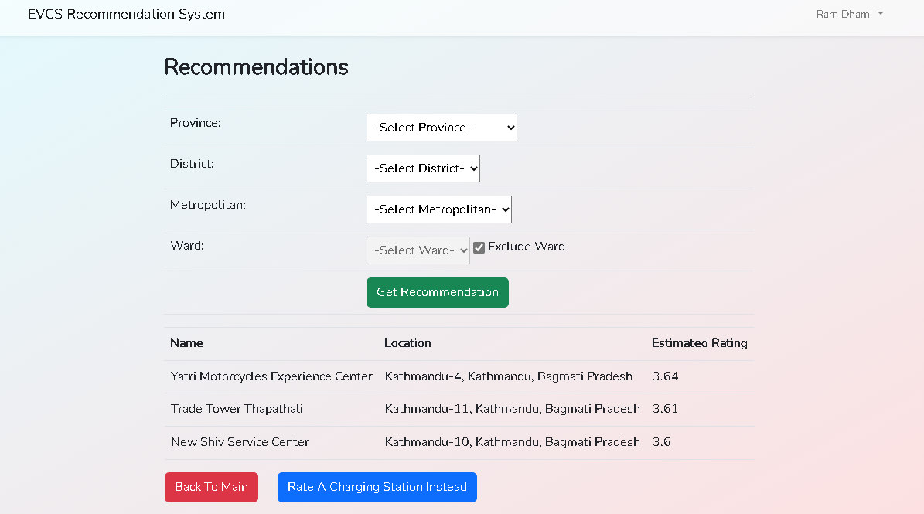
Appendix

Slide 24
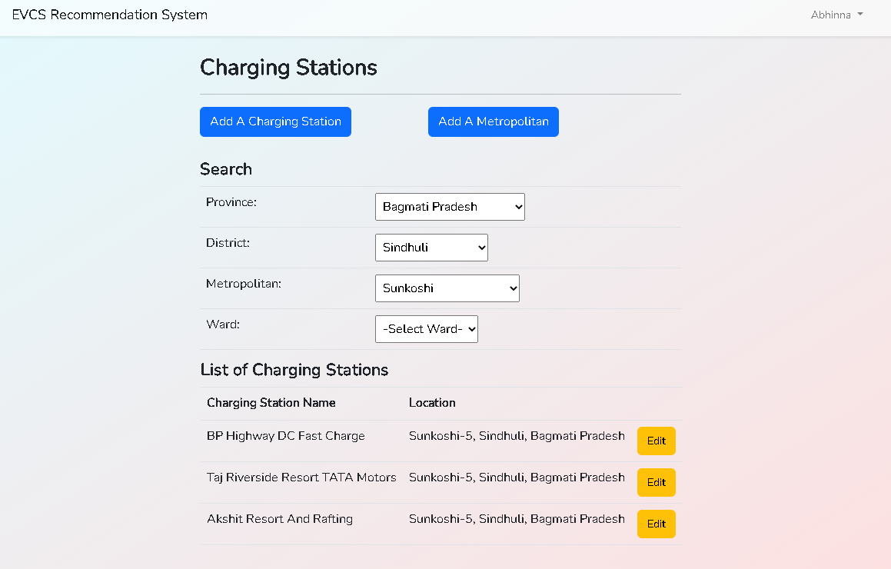
Appendix

Slide 25
Thank You

