Slide 1
Optical Character Recognition
Group 11

Slide 2
Introduction to Optical Character Recognition (OCR)
It is the mechanical or electronic conversion of images of typewritten or printed text into machine-encoded text.
It is a common method of digitizing texts.
Advantages being easy storage, editability, searching, etc.
OCR is a field of research in pattern recognition, artificial intelligence and computer vision.

Slide 3
HIGHLIGHTS
IN THIS PROJECT WE APPLIED THE CONCEPT OF -
Grayscaling - Converting image (rgb) into grayscale.
Median Filter - To reduce salt and pepper noise
Thresholding - Converting image (rgb) into threshold (black and white) form.
Opening - The morphological process where we remove objects less than 30px from image.
Correlation - For character identification.

Slide 4
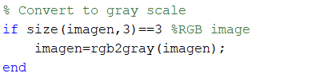

Functions used:
CONVERTING TO GRAYSCALE
THRESHOLD

Slide 5


3. OPENING
4. CORRELATION
5. MEDIAN FILTER

Slide 6
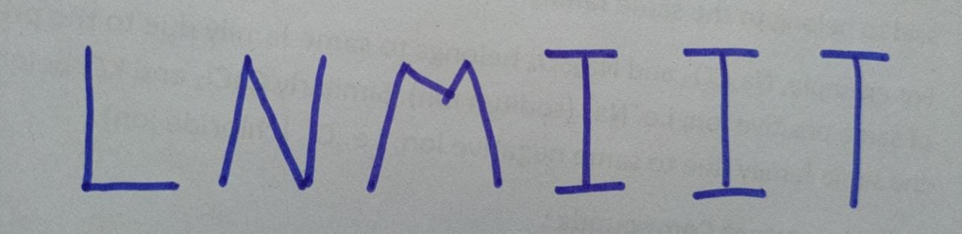
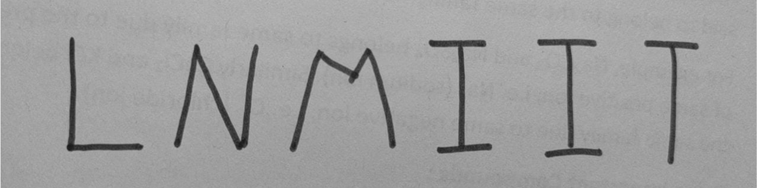
Sample Input And Output
Input Image
Image after gray scaling

Slide 7
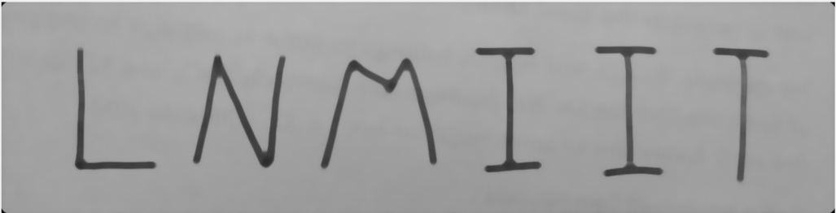
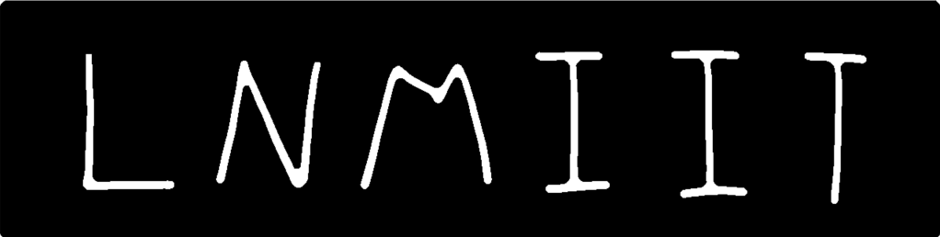
Image after applying median filter to reduce salt and pepper noise
Image after applying thresholding

Slide 8

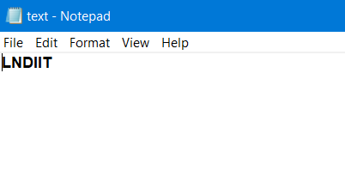
Image after applying opening
Output in text file

Slide 9
CONCLUSION
So we come to a conclusion that when we used scanned black and white images with some noise our optical character works perfectly fine.
But when we use ‘ handwritten text ’ image and using a median filter for it then our result is not 100% correct but it has around 80% accuracy in reading the characters correctly.

Slide 10
Thank You
19UCS185 - Harsh Kumar
19UCS214 - Subham Khetan
19UCS215 - Siddharth Akar
19UCS237 - Raghav Agarwal
19UCS245 - Abhinav Agarwal

