Slide 1


MediCare
- A Hospital Management System
Abhinav Sharma
BCA 3rd Year
A-Batch
FINAL YEAR PROJECT

Slide 2










Table Of Contents

Slide 3
Project
Description
What is medicare?
Technology Stack
MediCare is a full-stack web application that digitizes hospital operations. It provides a single platform for all hospital roles to perform daily tasks efficiently.
Built with Python (Flask), SQLite3, HTML/CSS/JS, and Jinja2 templating.
Backend
Python 3 + Flask Framework
Database
SQlite3
Frontend
HTML5 , CSS3 , JavaScript
User Roles
Templating
Jinja2
👨‍💼 Admin
Full System Control
Security
Werkzeug password hashing
🩺 Doctor
Appointments And Records
Sessions
Flask session management
🏥 Staff
Attendance And Salary
IDE
Visual Studio Code
🙋 Patient
Book Appointments And Pay Bills

Slide 4
Project
Description
What is medicare?
Technology Stack
MediCare is a full-stack web application that digitizes hospital operations. It provides a single platform for all hospital roles to perform daily tasks efficiently.
Built with Python (Flask), SQLite3, HTML/CSS/JS, and Jinja2 templating.
Backend
Python 3 + Flask Framework
Database
SQlite3
Frontend
HTML5 , CSS3 , JavaScript
User Roles
Templating
Jinja2
👨‍💼 Admin
Full System Control
Security
Werkzeug password hashing
🩺 Doctor
Appointments And Records
Sessions
Flask session management
🏥 Staff
Attendance And Salary
IDE
Visual Studio Code
🙋 Patient
Book Appointments And Pay Bills

Slide 5
Why
This Project?
Problem
Real World Need
Hospitals still rely on paper registers and manual processes for patient records, appointments, and billing — leading to errors and delays.
Tracking doctor availability, patient appointments, staff attendance, and billing manually is slow and error-prone in any real hospital.
Learning Opportunity
Practical Impact
A hospital system covers almost every concept of software engineering: authentication, database design, role management, CRUD, and UI.
By building this, we create a system that could realistically be deployed in a small clinic or hospital to improve daily operations.

Slide 6
Why
This Project?
Problem
Real World Need
Hospitals still rely on paper registers and manual processes for patient records, appointments, and billing — leading to errors and delays.
Tracking doctor availability, patient appointments, staff attendance, and billing manually is slow and error-prone in any real hospital.
Learning Opportunity
Practical Impact
A hospital system covers almost every concept of software engineering: authentication, database design, role management, CRUD, and UI.
By building this, we create a system that could realistically be deployed in a small clinic or hospital to improve daily operations.

Slide 7
Objectives
1
Provide a secure, role-based login system for Admin, Doctor, Staff & Patient
2
Handle billing for consultations with paid/unpaid status
3
Enable patients to book and manage appointments online
4
Calculate and manage monthly salary slips for doctors and staff
5
Allow doctors to manage medical records and view patient history
6
Allow leave application and approval through the admin panel
7
Automate attendance tracking — marked automatically on login
8
Give admin a central dashboard to oversee all users and departments

Slide 8
Objectives
1
Provide a secure, role-based login system for Admin, Doctor, Staff & Patient
2
Handle billing for consultations with paid/unpaid status
3
Enable patients to book and manage appointments online
4
Calculate and manage monthly salary slips for doctors and staff
5
Allow doctors to manage medical records and view patient history
6
Allow leave application and approval through the admin panel
7
Automate attendance tracking — marked automatically on login
8
Give admin a central dashboard to oversee all users and departments

Slide 9
Technologies
Used
Backend Language
Python 3
Web Framework
Flask
Database
SQLite3
DB Access
sqlite3 module (raw SQL)
Frontend
HTML5, CSS3, JavaScript
Templating Engine
Jinja2
Password Security
Werkzeug (hash + verify)
Session Management
Flask Sessions
IDE / Editor
Visual Studio Code

Slide 10
Technologies
Used
Backend Language
Python 3
Web Framework
Flask
Database
SQLite3
DB Access
sqlite3 module (raw SQL)
Frontend
HTML5, CSS3, JavaScript
Templating Engine
Jinja2
Password Security
Werkzeug (hash + verify)
Session Management
Flask Sessions
IDE / Editor
Visual Studio Code

Slide 11
Team
Contribution
Abhinav’s Work
Abhay’s Work
Designed the full schema for tables
Database creation using foreign keys
Developed Admin Panel
Built Login, Sign Up logic
Basic CRUD command application while integrating this with the UI
Designed the frontend using HTML CSS
Made the Patients, Doctors , Staff dashboards while using Jinja2 to identify the type of user
Medical Records and billing Pages created

Slide 12
Team
Contribution
Abhinav’s Work
Abhay’s Work
Designed the full schema for tables
Database creation using foreign keys
Developed Admin Panel
Built Login, Sign Up logic
Basic CRUD command application while integrating this with the UI
Designed the frontend using HTML CSS
Made the Patients, Doctors , Staff dashboards while using Jinja2 to identify the type of user
Medical Records and billing Pages created

Slide 13
Database
Design
Database Type : SQLite
Separate for roles like doctor , patient , staff , admin.
Different tables for different purposes,
, eg : departments.
The system uses a relational database to manage hospital data efficiently.
Each table is uniquely identified using Primary Keys (PK).
Foreign Keys (FK) establish relationships and ensure data consistency.
USERS
DOCTOR
DEPARTMENTS

Slide 14
Database
Design
Database Type : SQLite
Separate for roles like doctor , patient , staff , admin.
Different tables for different purposes,
, eg : departments.
The system uses a relational database to manage hospital data efficiently.
Each table is uniquely identified using Primary Keys (PK).
Foreign Keys (FK) establish relationships and ensure data consistency.
USERS
DOCTOR
DEPARTMENTS

Slide 15
System
Design
ARCHITECTURE
Frontend
(User Interface)
The frontend handles user interaction and input. The backend processes requests and manages application logic.
The database stores and retrieves data efficiently.
Backend
(Server side Processing)
Database
(Data Storage)

Slide 16
System
Design
ARCHITECTURE
Frontend
(User Interface)
The frontend handles user interaction and input. The backend processes requests and manages application logic.
The database stores and retrieves data efficiently.
Backend
(Server side Processing)
Database
(Data Storage)

Slide 17
Data Flow
Diagram
Data Store
PATIENTS
Register / Login
User
Management
Save \ Update
User Data
Users
User Details
Appointment
Management
Save Appointment
Book Appointments
Appointment Data
Appointments
Appointment Confirmation
DOCTOR
Medical Record
Management
Save Medical Records
Diagnosis, Treatment
Record Data
Medical Records
Patient History
Billing
Management
Bills Details
Save Bill
ADMIN
Bill Data
Bills
Bills receipts
Attendance , Leaves
HR
Management
Attendance
Leaves
Salary Slips
Save
Salary
Data And Reports

Slide 18
Data Flow
Diagram
Data Store
PATIENTS
Register / Login
User
Management
Save \ Update
User Data
Users
User Details
Appointment
Management
Save Appointment
Book Appointments
Appointment Data
Appointments
Appointment Confirmation
DOCTOR
Medical Record
Management
Save Medical Records
Diagnosis, Treatment
Record Data
Medical Records
Patient History
Billing
Management
Bills Details
Save Bill
ADMIN
Bill Data
Bills
Bills receipts
Attendance , Leaves
HR
Management
Attendance
Leaves
Salary Slips
Save
Salary
Data And Reports

Slide 19
Database
Structure
Central Table:
USERS
Main Tables:
• Users
• Patients
• Doctors
• Staff
• Departments
Core Tables:
• Appointments
• Medical Records
• Bills
HR Tables:
• Attendance
• Salary Slips
• Leaves
Field Name | Type | Key Or Constraint | Description
id | INTEGER | PK | Unique user ID
username | TEXT | NOT NULL, UNIQUE | User login name
email | TEXT | NOT NULL, UNIQUE | User email address
password_hash | TEXT | NOT NULL | Encrypted password
role | TEXT | NOT NULL | User role (patient/doctor/staff/admin)
phone | TEXT |  | Contact number
address | TEXT |  | User address
created_at | TIMESTAMP |  | Account creation time

Slide 20
Database
Structure
Central Table:
USERS
Main Tables:
• Users
• Patients
• Doctors
• Staff
• Departments
Core Tables:
• Appointments
• Medical Records
• Bills
HR Tables:
• Attendance
• Salary Slips
• Leaves
Field Name | Type | Key Or Constraint | Description
id | INTEGER | PK | Unique user ID
username | TEXT | NOT NULL, UNIQUE | User login name
email | TEXT | NOT NULL, UNIQUE | User email address
password_hash | TEXT | NOT NULL | Encrypted password
role | TEXT | NOT NULL | User role (patient/doctor/staff/admin)
phone | TEXT |  | Contact number
address | TEXT |  | User address
created_at | TIMESTAMP |  | Account creation time

Slide 21



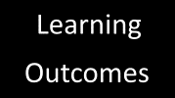




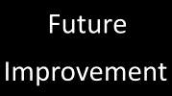
Table Of Contents

Slide 22








Table Of Contents

Slide 23
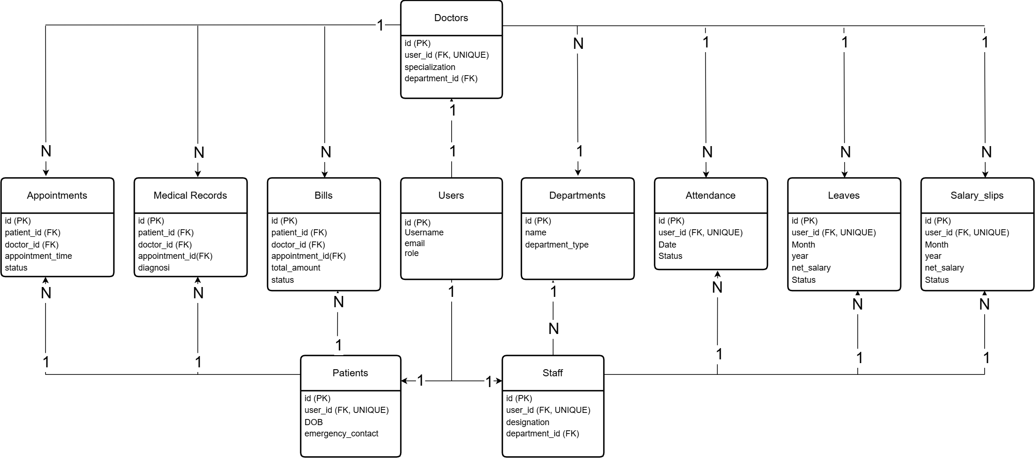
ER
Diagram

Slide 24
ER
Diagram

Slide 25
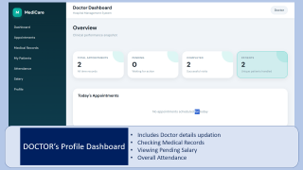
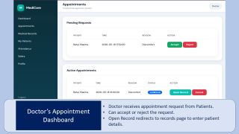
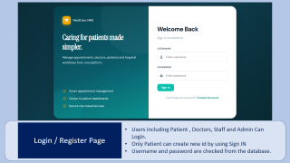
UI
Design
• The system UI is designed to be simple, clean, and user-friendly.
• It provides an intuitive layout for easy navigation.
• The interface is role-based, providing different views for Admin, Doctor, Staff, and
Patient.
• Key Screens:
- Login Page for secure access
- Dashboard for system overview
- Appointment Management for booking and tracking

Slide 26
UI
Design
• The system UI is designed to be simple, clean, and user-friendly.
• It provides an intuitive layout for easy navigation.
• The interface is role-based, providing different views for Admin, Doctor, Staff, and
Patient.
• Key Screens:
- Login Page for secure access
- Dashboard for system overview
- Appointment Management for booking and tracking

Slide 27
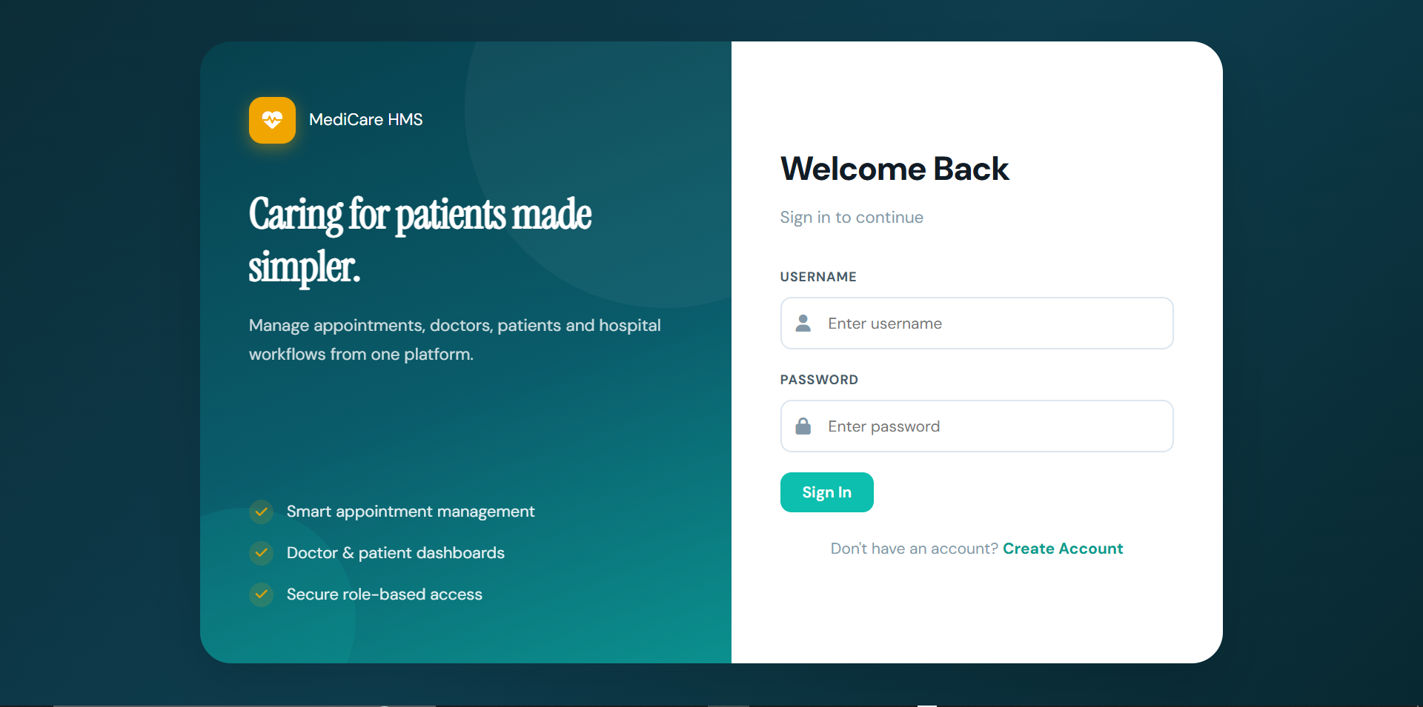
Login / Register Page
Users including Patient , Doctors, Staff and Admin Can Login.
Only Patient can create new id by using Sign IN
Username and password are checked from the database.

Slide 28
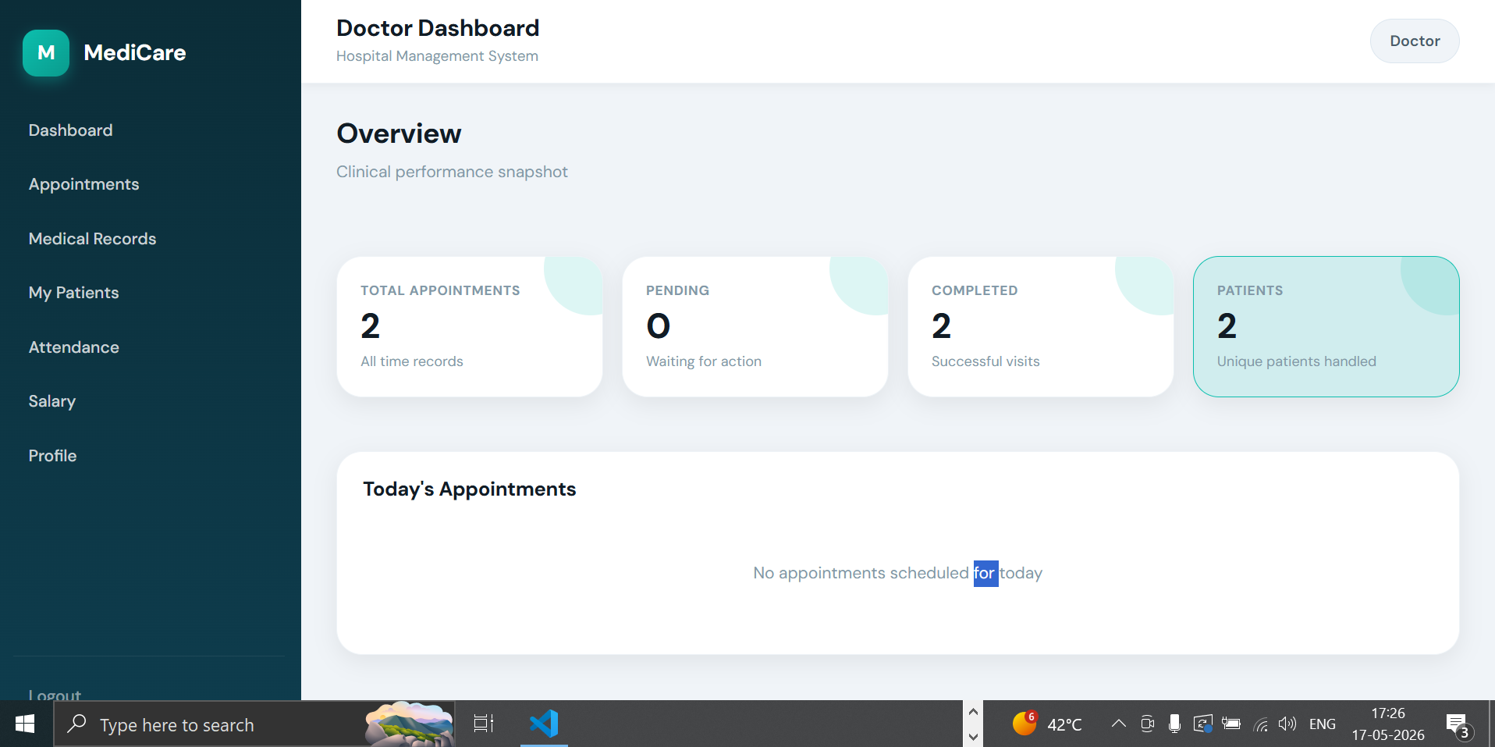
DOCTOR’s Profile Dashboard
Includes Doctor details updation
Checking Medical Records
Viewing Pending Salary
Overall Attendance

Slide 29
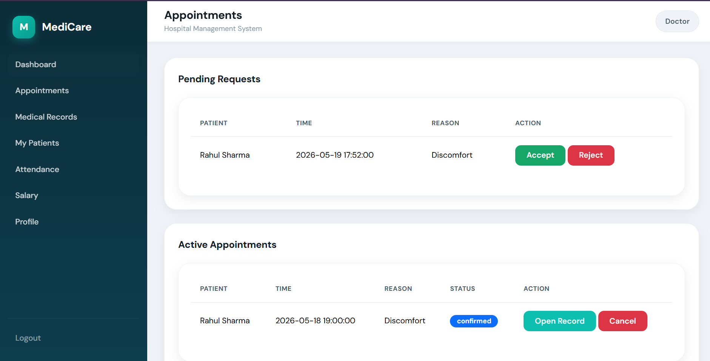
Doctor’s Appointment
Dashboard
Doctor receives appointment request from Patients.
Can accept or reject the request.
Open Record redirects to records page to enter patient details.

Slide 30
Modules
&
Features
Authentication
Admin Module
Login with hashed password
Patient self-registration (regex validation)
Admin-created doctor/staff accounts
Session-based login + role redirect
Approve/reject leaves
Generate & pay salary slips
Create & manage all users
Live stats dashboard
Doctor Module
Submit medical records per appointment
Appointment confirmation & updates
View patient history
Own salary & profile management
Patient Module
View appointment history & status
Book appointments by doctor & time
View & pay bills online
Personal medical records access

Slide 31
Modules
&
Features
Authentication
Admin Module
Login with hashed password
Patient self-registration (regex validation)
Admin-created doctor/staff accounts
Session-based login + role redirect
Approve/reject leaves
Generate & pay salary slips
Create & manage all users
Live stats dashboard
Doctor Module
Submit medical records per appointment
Appointment confirmation & updates
View patient history
Own salary & profile management
Patient Module
View appointment history & status
Book appointments by doctor & time
View & pay bills online
Personal medical records access

Slide 32
Challenges
Faced
• Designing an efficient and normalized database structure
• Managing relationships using primary and foreign keys
• Implementing role-based access for different users
• Handling appointment scheduling and status updates
• Designing a simple and user-friendly interface
• Handling Multiple Files and integrating them.

Slide 33
Challenges
Faced
• Designing an efficient and normalized database structure
• Managing relationships using primary and foreign keys
• Implementing role-based access for different users
• Handling appointment scheduling and status updates
• Designing a simple and user-friendly interface
• Handling Multiple Files and integrating them.

Slide 34
Future
Improvement
• Add online payment integration for billing
• Implement real-time notifications for appointments
• Improve UI/UX for better user experience
• Add advanced reporting and analytics features
• Enhance security with authentication and encryption
• Deploy the system on cloud for wider accessibility
• Develop mobile application support

Slide 35
Future
Improvement
• Add online payment integration for billing
• Implement real-time notifications for appointments
• Improve UI/UX for better user experience
• Add advanced reporting and analytics features
• Enhance security with authentication and encryption
• Deploy the system on cloud for wider accessibility
• Develop mobile application support

Slide 36
Learning
Outcomes
• C / C++: Developed problem-solving and programming fundamentals
• Java / Python: Helped in understanding object-oriented programming and logic building
• Web Development: Used to design the user interface and frontend structure
• DBMS: Applied to design database, ER diagram, and relationships
• .NET: Helped in understanding application development and backend concepts
• Android Programming: Gained knowledge of user interface design and mobile-based systems
• Overall Learning: Improved logical thinking, debugging, and system design skills

Slide 37
Learning
Outcomes
• C / C++: Developed problem-solving and programming fundamentals
• Java / Python: Helped in understanding object-oriented programming and logic building
• Web Development: Used to design the user interface and frontend structure
• DBMS: Applied to design database, ER diagram, and relationships
• .NET: Helped in understanding application development and backend concepts
• Android Programming: Gained knowledge of user interface design and mobile-based systems
• Overall Learning: Improved logical thinking, debugging, and system design skills

Slide 38
Thank You

