Slide 2



DAY 2 · MODULE 6 · OPENID4VCI
Openid4VCI is a multi-step protocol
01 / INITIATE
Offer or select
Credential
02 / DISCOVER
Issuer + AS
Metadata
03 / AUTHORIZE
Grant path
Pre-auth or code
04 / ACCESS
Token + nonce
Key proof
05 / ACCEPT
Request + validate
Store + render
Mental model: initiate → discover → authorize → access → accept.
Notes:
Talk about the steps like offer, issuer, grant, Token, Validation.

Slide 3
DAY 2 · MODULE 6 · OPENID4VCI
Pre-authorized flow
01 / OFFER
Issuer → wallet
Pre-authorized code
02 / CONTROL
Optional tx_code
User possession
03 / TOKEN
Wallet → AS
Access token
04 / PROOF
Wallet key
Fresh challenge
05 / CREDENTIAL
Certify → wallet
Signed VC
Notes:
The issuer establishes user context before the wallet receives the credential offer.

Slide 4
DAY 2 · MODULE 6 · OPENID4VCI
Authorization code flow
01 / REQUEST
Wallet → AS
Authorization + PKCE
02 / LOGIN
Auth service
User Login
03 / CODE
Redirect → wallet
Authorization code
04 / TOKEN
PKCE
Access token
05 / CREDENTIAL
Proof + request
Signed VC
Authorization service authenticates. Certify issues. PKCE protects the code exchange.
Notes:
Distinguish the standard flow from the exact variants enabled in the stable Certify deployment.

Slide 5
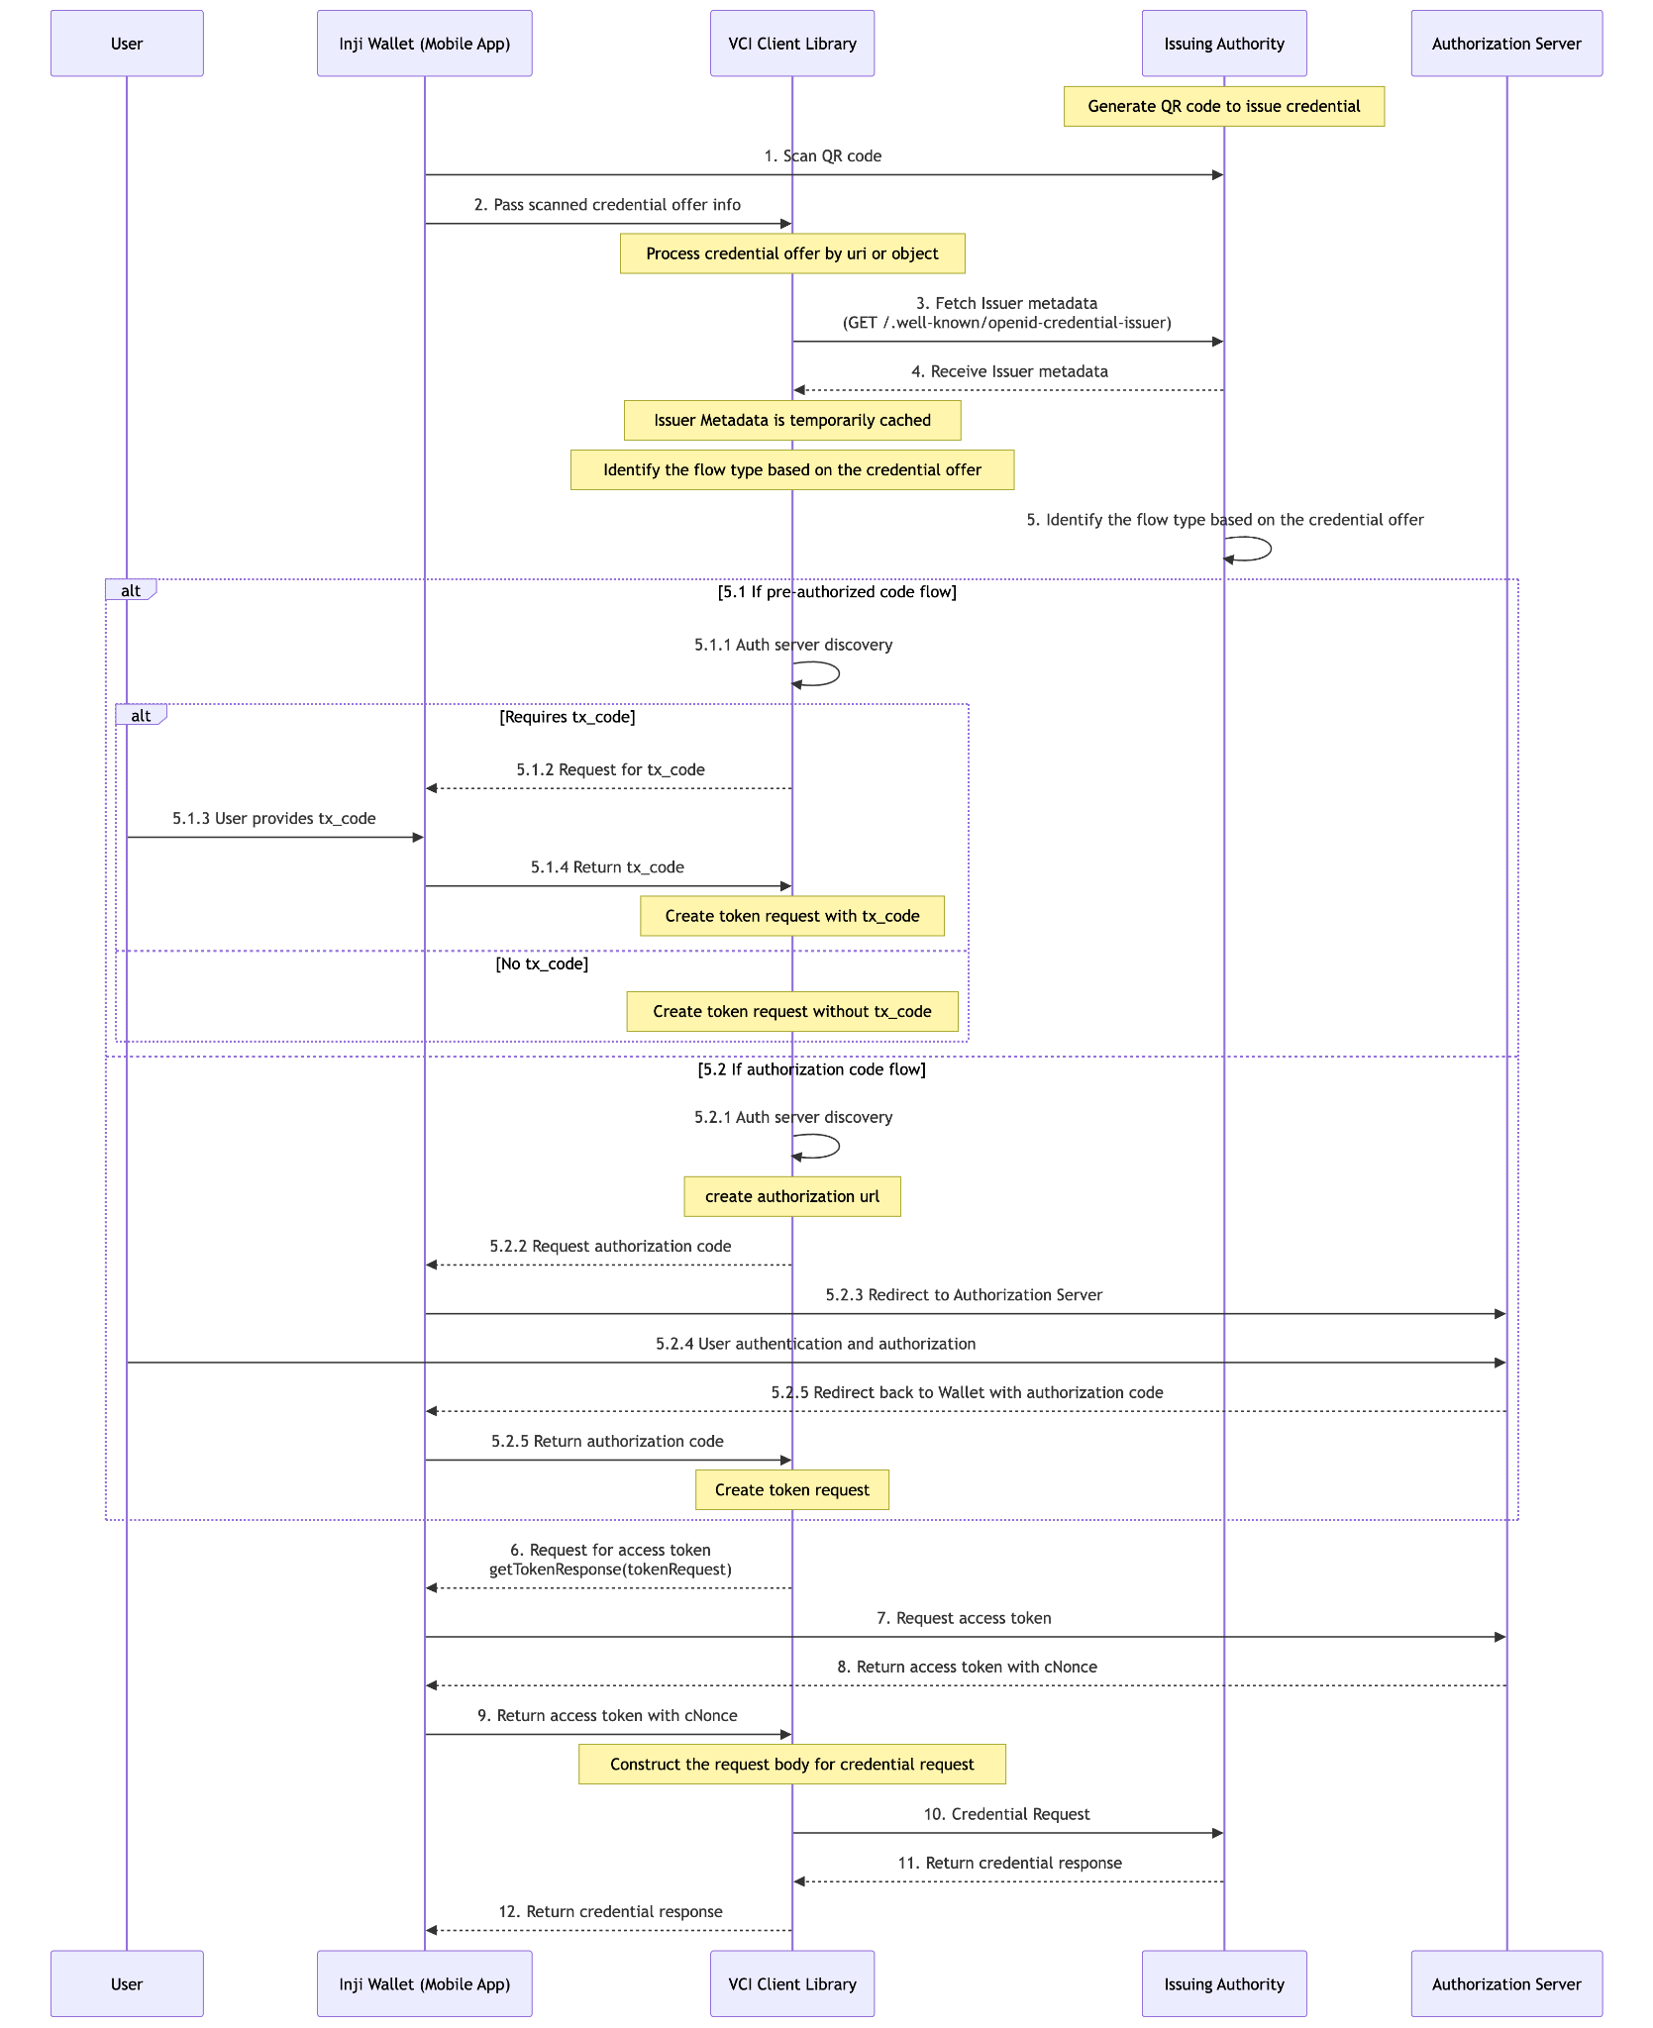
Notes:
Seq dia

Slide 6


DAY 2 · MODULE 6 · OPENID4VCI
Proof of possession
ISSUER
nonce / challenge
The wallet signs a fresh proof with its holder key. Certify validates possession before binding the credential.
This is not user login and not credential verification.
challenge
signed proof
WALLET KEY
private key protected
CERTIFY
proof validator
binds credential
Notes:
Keep authentication, holder proof, and credential signature validation as separate concepts.

Slide 7
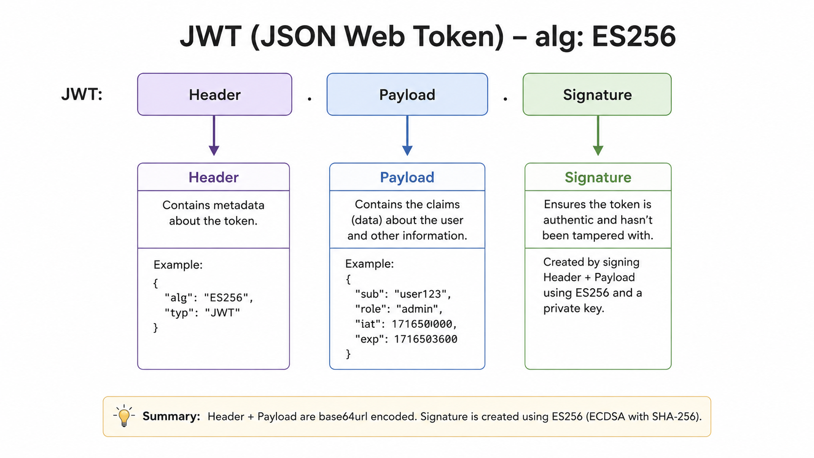
Notes:
Technical setup with custom wallet

Slide 8
DAY 2 · MODULE 6 · OPENID4VCI
The token endpoint
PRE-AUTHORIZED CODE
AUTHORIZATION CODE
Starts with
Credential offer
Interactive authorization
Primary grant
pre-authorized_code
authorization_code
Extra control
Optional transaction code
PKCE code verifier
Result
Access token
Access token
Notes:
The access token authorizes the credential API; it is not itself a credential.

Slide 9
DAY 2 · MODULE 6 · OPENID4VCI
The credential endpoint
REQUEST
RESPONSE
Authorization
Bearer access token
Token validated
Selection
credential_configuration_id
Configured credential
Binding
proofs / key proof
Holder binding applied
Outcome
Format-specific request
Credential(s) or deferred transaction
Notes:
The wallet validates before storage. Final 1.0 uses credential_configuration_id and proofs; draft-13 Certify payload names may differ.

Slide 10

DAY 2 · MODULE 7 · WALLET INTEGRATION
The wallet composes focused libraries
01 / EXPERIENCE
App UI
Handles direct user interactions and user intent capture.
02 / ORCHESTRATE
State + workflow
Orchestrates the user journey transitions and state machine.
03 / PROTOCOL
Inji libraries
Executes underlying cryptographic credential work and protocols.
MODULE QUESTION
Which responsibility belongs to the app, a reusable library, or the platform?
Notes:
Module 7 · 40 minutes.

Slide 11
DAY 2 · MODULE 7 · WALLET INTEGRATION
The mobile wallet is layered
Experience
Wallet UI
Android · iOS
Journey state
workflow
Issuer / BFF APIs
network edge
Bridge +
Credential Services
Openid4vp
sharing
VCI Client
issuance
VC Verifier
trust checks
vc-renderer
display
Other Services
Secure-
keystore
Pixelpass
QR Code
Bluetooth
Tuvali
FaceMatch
Notes:
The app orchestrates; specialized libraries and native services keep responsibility boundaries narrow.

Slide 12
DAY 2 · MODULE 7 · WALLET INTEGRATION
inji-vci-client
Wallet app
selects issuer + starts journey
CLIENT RESPONSIBILITIES
Discover metadata + configs
Parse credential offers
Coordinate grants + PKCE state
Request credentials
Coordinate host proof callback
Return credentials or errors
VCI client
protocol state + endpoint calls
Host callbacks
authorization · token · proof
Kotlin + Swift v0.7.0 implement drafts 13 · Migrating to 1.0
Notes:
Do not present unreleased DPoP changes as part of v0.7.0.

Slide 13
DAY 2 · MODULE 7 · WALLET INTEGRATION
PixelPass
01 / MAP
JSON + optional
profile mapper
02 / COMPACT
CBOR
Binary form
03 / COMPRESS
zlib
Fewer bytes
04 / ENCODE
Base45
QR transport
05 / DECODE
Reverse path
Structured output
Notes:
Exact pipeline: JSON → optional mapper → CBOR → zlib → Base45 → QR, and reverse for decode.

Slide 14






DAY 2 · MODULE 7 · WALLET INTEGRATION
Secure Keystore
APP
KEY GENERATION
Platform Protection
Generate keys in platform protection and sign without exporting private material.
sign request
Encrypt & Store
STORAGE SECURITY
Isolated Data
Data is stored separately in encrypted application storage.
PLATFORM KEY SERVICE
Uses private asymmetric key non-exportable
PROTOCOL LIBRARY
uses AES symmetric key protection
Notes:
The current wallet is cross-platform; avoid older Android-only architecture wording.

Slide 15

DAY 2 · MODULE 7 · WALLET INTEGRATION
FaceMatch SDK
01 / CAPTURE
Selfie
Camera
02 / READ
Credential portrait
Reference
03 / PREPARE
Local image
Inputs
04 / COMPARE
On-device
Similarity score
Notes:
Current FaceMatch guidance describes local comparison; liveness is not part of the active flow.

Slide 16
DAY 2 · MODULE 7 · WALLET INTERNALS
Dynamic credential rendering
01 / READ
02 / CHECK
03 / FETCH
04 / VERIFY
05 / FILL
06 / DRAW
renderMethod
renderSuite
The template
digestMultibase
JSON Pointers
Rendered SVG
From the credential
Must be svg-mustache
HTTP GET the SVG
SHA-256 over the SVG
{{/path/to/claim}}
Plus an embedded QR
IN THE CREDENTIAL
"renderMethod": [{
"type": "TemplateRenderMethod",
"renderSuite": "svg-mustache",
"template": "https://issuer.example/tmpl.svg",
"digestMultibase": "uZGVmYXVsdC1oYXNo..."
}]
<text>{{/credentialSubject/fullName}}</text>
Design consequences
The issuer controls the look without a wallet release
digestMultibase must start with u — base64url, no padding
{{/qrCodeImage}} is substituted with a generated QR, with a fallback image
The template is fetched over the network, so plan for offline: cache the SVG at issuance, not at display time. A credential that cannot render in a basement is a credential that does not work.
Notes:
Rendering looks cosmetic and is not. It is the only part of the credential the citizen actually sees, and it is issuer-controlled.
The credential carries a renderMethod block pointing at an SVG template on the issuer's server, plus a digest of that template. The wallet fetches the SVG, hashes it, compares against digestMultibase, and refuses to render on a mismatch. So the issuer can change the design without shipping a wallet update, but cannot have the template swapped underneath them.
Placeholders are JSON Pointers, not arbitrary expressions. Double brace, slash-separated path into the credential JSON. There is one special placeholder for the QR image, which the renderer generates from the credential and substitutes as a base64 PNG data URI, with a fallback image if generation fails.
Two things to raise with whoever owns the issuer side. First, the template URL has to stay up as long as credentials referencing it are in circulation, and it has to be reachable from consumer networks. Second, changing the template means changing the digest, which means credentials already issued will fail the check — so template versioning is an issuance-time decision, not a design-time one.
The offline point in the callout is the one to insist on. Cache the rendered output or at least the template when the credential is issued. Testing on office wifi will not surface this.
[5 min]

Slide 17
DAY 2 · MODULE 7 · WALLET INTERNALS
Offline sharing over Bluetooth
01 / ADVERTISE
02 / EXCHANGE
03 / CONNECT
04 / TRANSFER
05 / REPAIR
Verifier starts
QR carries the URI
Wallet scans, joins
Encrypt & chunk
Transfer report
Publishes a connect URI
name + verifier public key
Keys exchanged, channel secured
Compressed, 512-byte writes
Missing chunks re-sent
How the channel is bootstrapped
How it survives a bad link
OPENID4VP://connect?name=<NAME>&key=<PUBKEY>
A Chunker splits; an Assembler rebuilds
The QR is the out-of-band channel — it carries the verifier's public key
The receiver reports missing sequence numbers
The sender replays only those chunks
No network, no server, no shared session
Scope check before you design around it: Tuvali is pre-1.0, its API is explicitly expected to change, and the current version transfers a credential one way only — wallet to verifier. The full OpenID4VP-over-BLE request/response exchange is not implemented yet.
Notes:
Offline sharing is the feature that sells the wallet in low-connectivity contexts, so be precise about what actually works today.
The bootstrap is the interesting part. Bluetooth Low Energy has no trust model of its own, so the QR code does that job. The verifier advertises and encodes its name and public key into a connect URI. The wallet scans, extracts the key, and establishes an encrypted channel. The QR is functioning as the out-of-band channel that makes the pairing trustworthy.
Then the transport reality. A BLE characteristic write is capped around 512 bytes, so a credential has to be split. Tuvali encrypts and compresses first, tells the receiver the resulting size, then streams chunks. The receiver reports which sequence numbers are missing or corrupt and the sender replays just those. That repair loop is why this works at all across a crowded room.
Now the honest scoping, and do not soften it. The library's own README says it is under active development with no major version released and non-backward-compatible changes expected. And the implementation notes state that although the specification covers both request and response, the current version only transfers a credential from central to peripheral.
So if your use case is a verifier handing a request to a wallet offline and receiving a signed presentation back, that is not what ships today. Plan accordingly, and raise it upstream if it is on your critical path.
[5 min]

Slide 18
DAY 2 · MODULE 7 · WALLET INTERNALS
QR-code login is a different protocol
WHAT THE WALLET DOES
WHICH PROTOCOL
OPENID4VP://connect
Opens a Bluetooth channel to a nearby verifier
OpenID4VP over BLE — Tuvali
openid4vp://authorize
Presents a credential online to a remote verifier
OpenID4VP — inji-openid4vp
inji://…?linkCode=…
Authenticates a web session on the user's behalf
eSignet linked authorization
01 / SCAN
02 / LINK
03 / AUTHENTICATE
04 / CONSENT
05 / LOGGED IN
Website shows a QR
link-transaction
authenticate
consent
Browser advances
Carries linkCode + expiry
Code → linked transaction id
Wallet asserts the user
Scopes and claims approved
Site receives its tokens
No credential is presented and no vp_token exists in this flow. The wallet is acting as an authenticator for a web login, not as a holder proving a claim. Different endpoints, different trust model — do not let it get filed under OpenID4VP.
Notes:
This slide exists to prevent a specific confusion. Three different things arrive at the wallet as a QR code, and teams routinely assume they are one feature.
Walk the table. The wallet literally branches on the prefix — there is a guard for each of these three in the scan state machine. OPENID4VP://connect means Bluetooth. openid4vp://authorize means online presentation. A URL carrying a linkCode parameter means QR login.
The third is not OpenID4VP at all. It is eSignet's linked-authorization API: link-transaction, then authenticate, then consent. The wallet is standing in for a password. The website gets its tokens from eSignet in the normal OIDC way.
Make the distinction concrete: in QR login the relying party learns who you are because an identity provider vouches for you. In OpenID4VP the relying party learns a claim because an issuer vouched for it and you proved you hold it. Different trust model, different failure modes, different governance.
There is also a same-device variant of this flow via deep link, so the wallet has a separate guard for QR-login-via-deep-link. Same protocol, no camera.
Practical note for the room: if your programme only needs web login, you do not need credentials at all. Ask the question early, because it changes the scope enormously.
[5 min]

Slide 19
DAY 2 · MODULE 7 · WALLET INTERNALS
Backup and restore
01 / COLLECT
02 / STRIP
03 / ENCRYPT
04 / UPLOAD
05 / RESTORE
Read local store
Drop binding data
Passphrase key
Drive or iCloud
Download + decrypt
Credentials + issuer cache
Keys are removed here
Derived, then zipped
User's own cloud account
Credentials return unbound
What the backup contains
What it deliberately does not
The credential documents themselves
privateKey — set to null before export
myVCs metadata — the index of what is held
publicKey and walletBindingResponse — also nulled
Cached issuer .well-known configuration
Anything held in the hardware keystore
This is not an oversight. A hardware-backed key is non-exportable by design — if the backup could carry it, the keystore guarantee would be worthless. removeWalletBindingDataBeforeBackup makes that explicit. Restored credentials come back unbound and must be re-bound on the new device before they can be presented. Budget for that in your support model.
Notes:
Backup is where the security architecture and the user experience collide, so present it as a trade-off rather than a feature.
Walk the five steps. Step two is the one that matters: before anything is written out, the wallet nulls the private key, the public key and the wallet binding response on every credential. That is a named function in the codebase.
Why? Because the binding key lives in the platform keystore and is non-exportable. That is the guarantee the secure-storage slide makes. A backup that could extract it would break exactly the property the whole design rests on.
So state the consequence plainly, because users will meet it: restore gives you your credentials back, but they arrive unbound. They will display. They cannot be presented until the holder re-binds on the new device, which means going back to the issuer for a fresh binding.
That has real programme consequences. If a citizen loses a phone, restore alone does not put them back in business. Whatever re-binding path exists has to be as available as issuance was, and it needs to be in the support script.
Also note where the backup goes: the user's own Drive or iCloud account, not programme infrastructure. That is good for data minimisation and it means the programme cannot restore on a user's behalf.
[6 min]

Slide 20
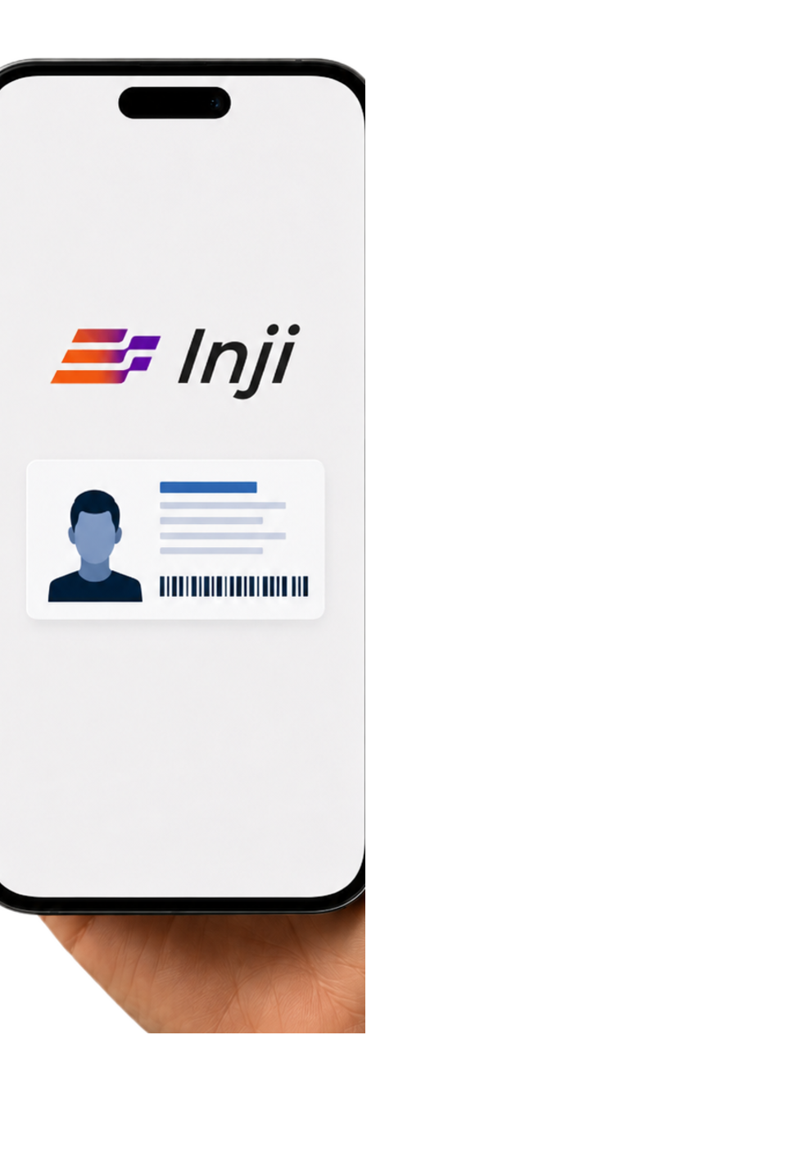
DAY 2 · MODULE 7 · WALLET INTEGRATION
Library responsibilities
OBTAIN
inji-vci-client
Discovers, authorizes, obtains credentials
PROTECT
Secure Keystore
Protects holder keys and signs proofs
DISPLAY
vc-renderer
SVG rendering
ENCODE
PixelPass
Compacts and encodes QR data
TRANSFER
Tuvali
Transfers credential data over BLE
SHARE
OpenId4vp
Shares verifiable presentation
Notes:
Close with the design rule: compose the wallet; do not reimplement the stack.

Slide 22





Verification with Inji
Day 3 · 1 hour
MODULE 8
OpenID4VP Deep Dive
MODULE 9
Wallet VP Library
MODULE 10
Verify SDK + Backend
OUTCOME
Present · Validate · Trust
Notes:
Day 3 follows the VERIFY stage of the credential lifecycle.
Outcome: trace a transaction-bound VP from request through validation and relying-party trust policy.

Slide 23
DAY 3 · VERIFICATION
Verification journey
01 / REQUEST
Verifier
asks
for information
02 / CONSENT
Wallet
matches
and explains
03 / PRESENT
Holder
signs
a fresh VP
04 / VALIDATE
Proof &
expiry
check status & binding
05 / DECIDE
Relying
party
applies policy
Notes:
Use this mental model for every route in the deck: OpenID4VP, QR scan/upload, and the optional DataShare reference path.

Slide 24
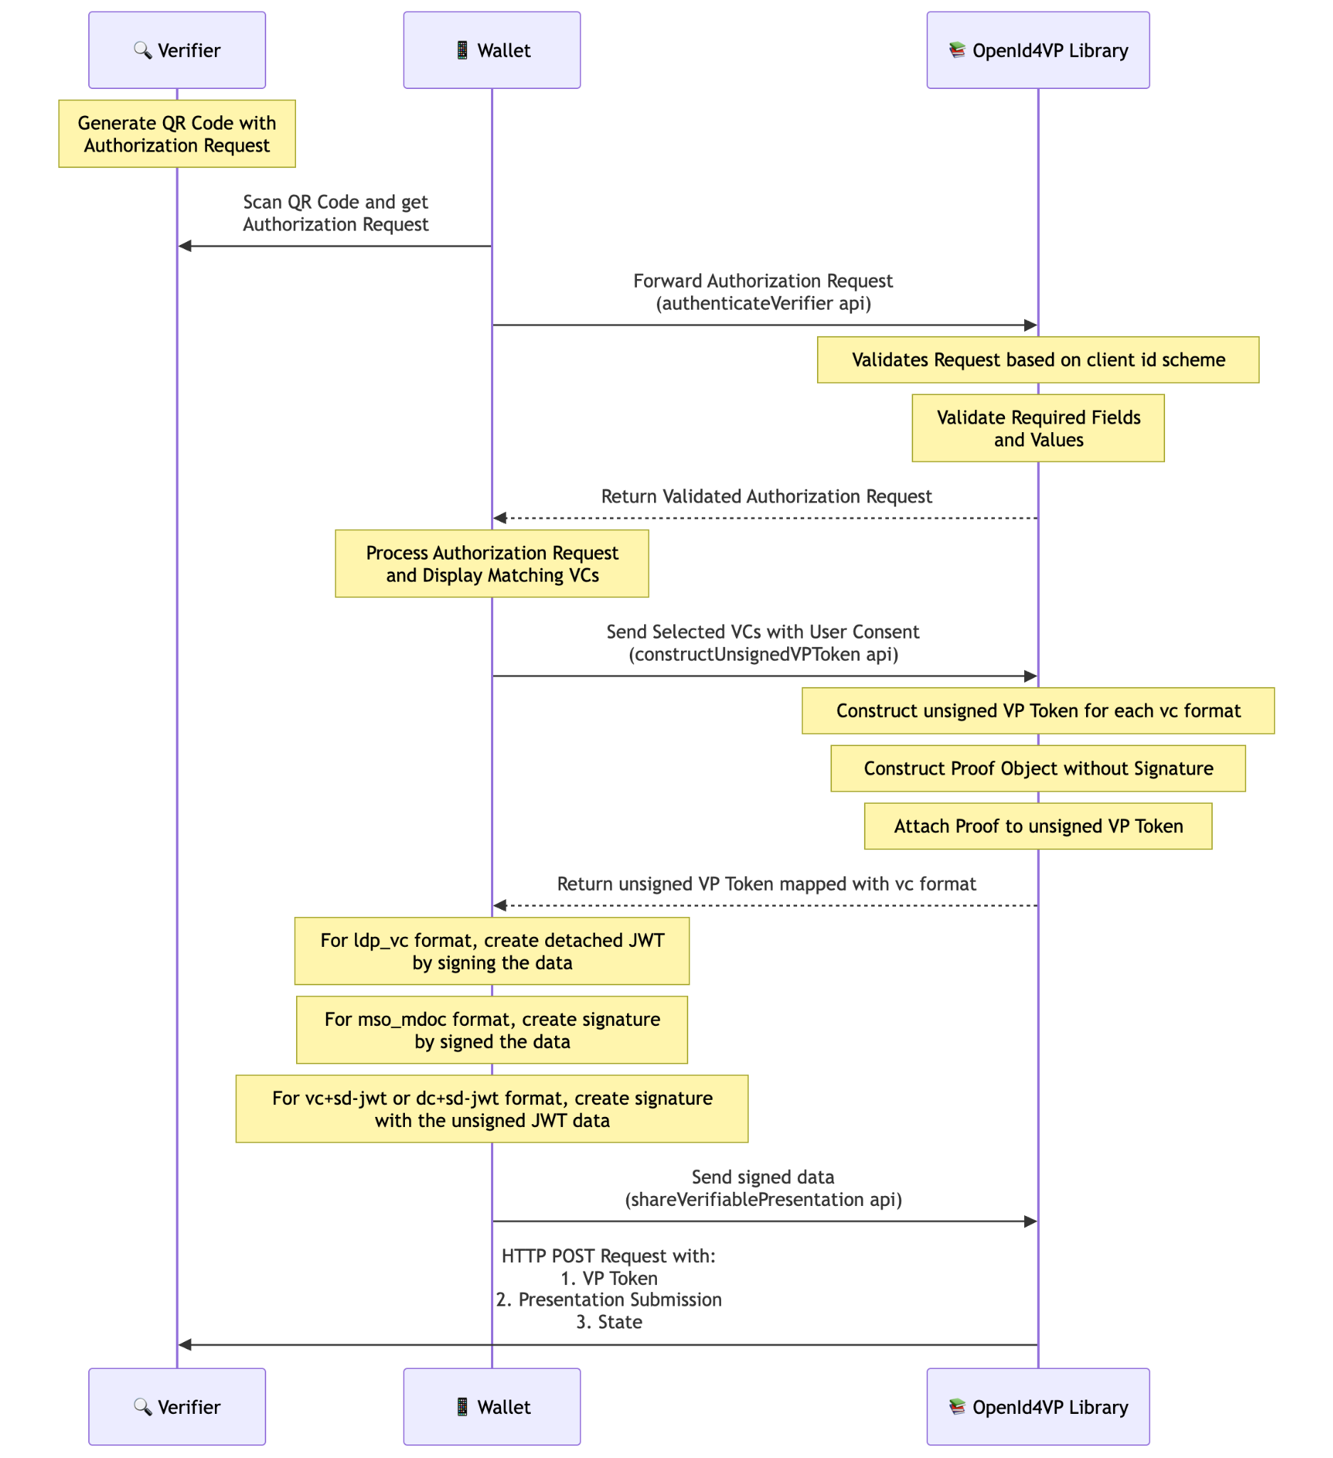
Notes:
Openid4vp with inji library.

Slide 25
DAY 3 · MODULE 8 · OPENID4VP
The authorization request
REQUEST ELEMENT
WHY IT EXISTS
Verifier
client_id + scheme
Identify and authenticate requester
Evidence
vp_token + credential query
Describe required credential data
Freshness
nonce + state
Bind response; prevent replay
Delivery
response_mode + response_uri
Return the response safely
Notes:
The request may be passed by value or referenced through request_uri, depending on implementation and version.
The verifier must validate the response against the original request context.

Slide 26
DAY 3 · MODULE 8 · OPENID4VP
Same-device and cross-device presentation
SAME-DEVICE
CROSS-DEVICE
01
Browser hands off
01
Verifier renders a QR
Verifier page opens openid4vp://authorize?...
Request by value, or a request_uri
02
OS routes the link
02
Phone scans it
Deep link / app link wakes the wallet
Wallet parses and authenticates the verifier
03
Wallet presents
03
Wallet presents
Consent, then POST to response_uri
Consent, then POST to response_uri
04
Browser resumes
04
Screen updates
Verifier polls or is pushed the result
Verifier correlates on state
SAME-DEVICE
CROSS-DEVICE
What carries the request
A URL the OS resolves to the wallet
A QR code the camera resolves
Why the response is separate
The browser is not the wallet — it cannot receive vp_token
The two devices share no session at all
What ties it back together
state, plus nonce inside the signed presentation
Identical — the protocol does not change
Notes:
The mechanics people expect to differ mostly do not, and that is the headline. Say it first: same-device and cross-device differ only in how the authorization request reaches the wallet. Everything after that is the same protocol.
Same-device: the verifier's web page invokes a custom scheme or an app link. The OS routes it to the wallet. Cross-device: the verifier paints a QR and the wallet's camera reads it. In both cases the wallet ends up holding an authorization request.
Now the part that surprises people. In neither flow does the response go back the way the request came. It is POSTed to response_uri. Even same-device, where a redirect back to the browser looks natural, the vp_token does not travel through the browser. direct_post exists precisely so the presentation never touches the user agent.
That is why state matters so much. The verifier's front end has no idea the presentation happened; it correlates through state and then polls or gets pushed the result.
For Brazil-style deployments the practical question is which one to build first. Cross-device is usually the safer default: it works when the credential holder and the relying party are not on the same machine, which is most counter and kiosk scenarios. Same-device needs app-link registration and per-platform testing.
[6 min]

Slide 27
DAY 3 · MODULE 8 · OPENID4VP
The request and the response, annotated
AUTHORIZATION REQUEST
AUTHORIZATION RESPONSE
GET /authorize?
client_id = did:web:verifier.example
client_id_scheme = did
response_type = vp_token
response_mode = direct_post
response_uri = https://verifier.example/cb
nonce = n-0S6_WzA2Mj
state = af0ifjsldkj
presentation_definition = { ... }
// presentation_definition, trimmed:
{ "id": "pd-1", "input_descriptors": [{
"id": "dob-only",
"format": { "vc+sd-jwt": { ... } },
"constraints": { "fields": [
{ "path": ["$.birthdate"] } ] } }] }
POST https://verifier.example/cb
Content-Type: application/x-www-form-urlencoded
vp_token = eyJhbGci...~WyJzNGxUX3g5...~eyJ0eXAi...
|__issuer JWT__|__disclosure__|__KB-JWT__|
presentation_submission = {
"id": "ps-1",
"definition_id": "pd-1",
"descriptor_map": [{
"id": "dob-only",
"format": "vc+sd-jwt",
"path": "$" }] }
state = af0ifjsldkj
// no redirect carries the vp_token.
// direct_post keeps the presentation
// out of the browser entirely.
nonce goes into the signed presentation; state stays outside it. state correlates the browser session and is not security-critical on its own — nonce is what makes the presentation unreplayable.
Notes:
Reference slide. Do not read it aloud. Put it up, give the room twenty seconds, then point at four things.
One: client_id and client_id_scheme travel together. The scheme tells the wallet how to authenticate the verifier's identity — resolve a DID, match a redirect URI, or look it up in a pre-registered list. Inji's released library supports exactly those three.
Two: response_mode is direct_post, so response_uri is where the answer goes. There is no redirect carrying the vp_token.
Three: the presentation_definition asks for one field. Look at the response: the vp_token carries the issuer JWT, exactly one disclosure, and the KB-JWT. That is selective disclosure, visible on the wire.
Four: presentation_submission is the map from the request's input_descriptor ids to where each credential landed in the vp_token. When there is one credential the path is just dollar-sign. With several it becomes an array index, and getting that wrong is the single most common integration bug in this protocol.
Flag the draft difference: this is the Presentation Exchange shape that the released Inji libraries implement. OpenID4VP 1.0 replaces presentation_definition with dcql_query and drops descriptor_map. Same idea, different field names.
[7 min]

Slide 28
DAY 3 · MODULE 8 · OPENID4VP
Credential queries
RELEASED INJI · DRAFT 23
OPENID4VP 1.0
Request field
presentation_definition
dcql_query
Query model
Presentation Exchange
Digital Credentials Query Language
Response mapping
descriptor_map + vp_token
credential query identifiers
Integration rule
Use exact release schema
Migrate and test explicitly
Notes:
Do not silently rename fields between Draft 23 and final 1.0.
Current Inji main branches contain V1/DCQL work; released v0.7.x libraries remain the Draft 23 training line.

Slide 29
DAY 3 · MODULE 8 · SELECTIVE DISCLOSURE
What the holder actually sends
AS ISSUED — every disclosure travels with the credential
Issuer-signed
JWT
~
given_name
~
family_name
~
birthdate
~
nationality
~
portrait
AS PRESENTED — the wallet drops the disclosures the verifier did not ask for
Issuer-signed
JWT
~
given_name
~
family_name
~
birthdate
~
nationality
~
portrait
KB-JWT
THE ISSUER SIGNS THIS — and only this
{ // issuer-signed JWT payload
"iss": "https://issuer.example",
"vct": "IdentityCredential",
"_sd_alg": "sha-256",
"_sd": [ "X9Hk2...", "pQ7mZ...", "Lr3Nv...",
"Ty8Wc...", "Bd4Qs..." ], // one digest per claim
"cnf": { "kid": "did:jwk:eyJrdHki..." }
}
Three parts, three jobs
Issuer-signed JWT — carries _sd digests, never the values
Disclosure — [salt, name, value], base64url, one per digest
KB-JWT — the holder's signature over this presentation
Withholding is deletion, not redaction. The wallet simply does not append that disclosure. Nothing is rewritten, nothing is re-signed, and the issuer's signature still verifies over exactly the bytes it signed.
Notes:
This is the slide that makes selective disclosure click, so do not rush it. Walk the two strips top to bottom.
Top strip: the credential as issued. The issuer-signed JWT, then one disclosure per selectively-disclosable claim, all joined by tilde characters. That whole string is what sits in the wallet.
Bottom strip: the same credential as presented when the verifier only asked for date of birth. Four disclosures are simply absent. The wallet did not rewrite the credential, did not ask the issuer for a new one, and did not re-sign anything. It concatenated fewer segments.
Then the code box. The issuer signs a payload that contains digests, not values. _sd is an array of hashes. _sd_alg names the hash. cnf names the holder key that will sign the KB-JWT later. There is no given_name field anywhere in the signed payload.
The KB-JWT appended at the end of the bottom strip is the holder binding proof, and it is the subject of the binding slide later in this module.
The point to land: selective disclosure costs the issuer nothing at presentation time. The issuer is offline. The holder does all the work, and the maths still holds. The next slide explains why.
[6 min]

Slide 30
DAY 3 · MODULE 8 · SELECTIVE DISCLOSURE
Why the verifier still trusts what is shown
01 / RECEIVE
02 / VERIFY
03 / HASH
04 / MATCH
05 / ACCEPT
Split on ~
Issuer signature
Each disclosure
Digest in _sd
Claim is genuine
JWT · disclosures · KB-JWT
Covers _sd
Using _sd_alg
No match → reject
Only what arrived
THE CHECK, IN FULL
disclosure = ["s4lT_x9", "birthdate", "1987-04-12"]
base64url(disclosure) -> "WyJzNGxUX3g5Iiw..."
sha-256( that string ) -> "Ty8Wc..."
"Ty8Wc..." IS IN _sd -> claim accepted
"Zz0Qq..." NOT IN _sd -> presentation rejected
What an attacker cannot do
Add a claim — its digest is not in _sd, and _sd is inside the signature
Change a value — the digest changes and stops matching
Forge the omission — a missing digest is unrevealed, never absent
INTEGRATION NOTE — VERIFIED IN THE RELEASED LIBRARY
inji-openid4vp does not trim disclosures for you. SdJwtVPTokenBuilder passes the credential string through verbatim, and limit_disclosure from the presentation definition is parsed but never applied. Selecting which disclosures to send is the wallet app's job.
Notes:
The question this slide answers is the one every verifier team asks: if the holder can delete parts of the credential, how is that not tampering?
Because the digests live inside the issuer's signature. The issuer signed an array of hashes. Removing a disclosure removes a preimage; it does not touch the array. The signature still verifies. Adding a claim means presenting a disclosure whose hash is not in the array, and the verifier rejects it.
So the trust boundary is: the issuer vouches for the set of possible claims. The holder chooses a subset. The verifier can prove the subset is authentic but learns nothing about what was withheld beyond the count of unmatched digests.
Say that last part plainly, because it is the honest limitation: the verifier does see how many claims exist, since _sd has a fixed length. It does not see what they are. If even the count is sensitive, decoy digests are the spec's answer.
The integration note is the practically important one and it is verified in the released code. The Inji library builds the KB-JWT and assembles the final token, but it hands back whatever SD-JWT string you gave it. If the wallet passes the full credential, the holder discloses everything while believing selective disclosure happened. Whoever writes the wallet owns that filtering step.
[6 min]

Slide 31
DAY 3 · MODULE 8 · OPENID4VP
Verifiable Presentation
VERIFIABLE CREDENTIAL
VERIFIABLE PRESENTATION
Purpose
Issuer-signed claim set
Holder response to one request
Binding
Issuer → subject
Holder → verifier + nonce
Lifetime
Reusable until expiry / status
Fresh per transaction
Verifier checks
Issuer proof + status
VP proof + embedded credentials
Notes:
A VP can carry one or more credentials or derived disclosures, depending on format.
OpenID4VP 1.0 defines vp_token as the presentation response parameter.

Slide 32
DAY 3 · MODULE 8 · OPENID4VP
Proving holder binding at presentation time
WHAT THE WALLET SIGNS
WHAT THE VERIFIER CHECKS AGAINST
ldp_vc
A Data Integrity Proof — challenge = nonce, domain = client_id, proofPurpose = authentication
The verificationMethod in the proof, resolved to the holder key
vc+sd-jwt
A KB-JWT — typ = kb+jwt, claims aud, nonce, iat, sd_hash
The cnf claim inside the issuer-signed JWT
mso_mdoc
A DeviceSignature over the session transcript [clientIdHash, responseUriHash, nonce]
deviceKeyInfo inside the issuer-signed MSO
AT ISSUANCE
IN THE CREDENTIAL
AT PRESENTATION
NON-REPUDIATION
Wallet proves key K
K is named by the issuer
Wallet signs with K again
Same key, both ends
Issuer binds the credential to K
cnf · deviceKeyInfo · subject id
Over this verifier's nonce
Presenter = the bound subject
In the released Kotlin library, UnsignedSdJwtVPTokenBuilder supports only cnf with a kid — a cnf carrying a raw jwk throws. Worth confirming against your issuer's output before interop testing.
Notes:
Module 6 showed binding at issuance. This is the other half, and without it the first half proves nothing.
Work the table by column, not by row. The middle column is what the wallet produces. The right column is where the verifier finds the key to check it against — and in every format that key came from inside the issuer's signature. That is the whole trick. The issuer says 'this credential belongs to key K'. The holder proves control of K, right now, against this verifier's nonce.
For ldp_vc the proof carries challenge and domain. Challenge is the nonce, domain is the client id. Inji's Proof class sets proofPurpose to authentication.
For SD-JWT it is the KB-JWT, and note sd_hash: it is a hash over the exact presented credential string, so the binding covers which disclosures were sent. You cannot lift a KB-JWT onto a different subset.
For mdoc the session transcript hashes the client id, the response uri and the nonce together, which binds the presentation to the channel as well as the moment.
Then the four-box chain at the bottom. That is the non-repudiation argument in one line: same key at both ends, so the presenter is demonstrably the subject the issuer bound the credential to. Without presentation-time binding, a stolen credential file would be enough.
Close on the red caveat. It is verified in the released library and it will bite during interop if the other side emits cnf with an embedded jwk.
[7 min]

Slide 33
DAY 3 · MODULE 8 · OPENID4VP
OpenID4VP summary
VERIFIER / RP
request + policy
RESPONSIBILITY BOUNDARY
Verifier / relying party creates the request
Wallet authenticates the request and asks consent
OpenID4VP library handles protocol objects + transport
Verify backend validates and stores the transaction
Relying party owns the final business decision
WALLET + OID4VP
consent + presentation
VERIFY + VC VERIFIER
validation + result
Notes:
OpenID4VP does not issue a credential and does not define the relying party's domain policy.

Slide 34
DAY 3 · MODULE 8 · OPENID4VP
Inji status
OPENID4VP 1.0
• Authorization request / response
• vp_token + DCQL
• Same-device + cross-device
RELEASED INJI LIBRARIES
• Kotlin v0.7.0
• Swift v0.7.1
• Draft 21 / 23
• Presentation Definition flow
Notes:
Standard: https://openid.net/specs/openid-4-verifiable-presentations-1_0.html
Released library versions were verified from local tags on 16 July 2026.

