Slide 1
🏗 AWS CLOUD PROJECT
// SYSTEM OVERVIEW
Smart Garbage
📷 Capture Image
📍 GPS Location
Detection System
☁️ Upload to S3
🤖 AI Analysis
AI-Powered | Serverless | AWS Cloud | Real-Time Analysis
🗃️ Store Results
AWS Lambda
S3
DynamoDB
👮 Admin Review
CloudFront
Rekognition
Terraform
Presented by: Abhishek Pawar | May 24, 2026

Slide 2
PROBLEM STATEMENT
Why do we need this system?
🗑️ Manual Reporting
🚫 No AI Verification
Citizens have no easy way to report garbage or sanitation issues to authorities.
Fake or duplicate complaints waste municipal resources and time.
📍 No Location Tracking
📋 No Centralized Dashboard
Reports lack precise GPS coordinates, making it hard for officials to locate issues.
Authorities lack a real-time overview of active complaints and their severity.
Our solution addresses ALL of these gaps with a fully serverless AWS architecture.

Slide 3
SOLUTION OVERVIEW
Smart Garbage Detection — How It Works
01
Capture
02
Locate
03
Upload
User opens app, captures image via camera or uploads a photo
Browser GPS API fetches precise coordinates & reverse geocodes address
Image + metadata sent to AWS S3 via presigned URL (secure, no auth needed)
04
Analyze
05
Store
06
Review
Lambda triggers AWS Rekognition + Gemini AI to classify garbage severity
Results saved in DynamoDB: location, severity, timestamp, AI message
Admin panel shows all reports with severity badge, location link & image

Slide 4
SYSTEM ARCHITECTURE
Fully Serverless AWS Architecture
🌐
🔗
⚡
🪣
🤖
→
→
→
→
Frontend
(CloudFront + S3)
API Gateway
HTTP API
Lambda
Functions
S3 Bucket
Image Storage
Rekognition
+ Gemini AI
🏗️
Terraform
IaC
🗄️
👮
📧
🌍
DynamoDB
Results Table
Admin Panel
Dashboard
OTP Auth
Verification
Geo API
Coordinates
All infrastructure provisioned with Terraform — repeatable, version-controlled, one-command deploy

Slide 5
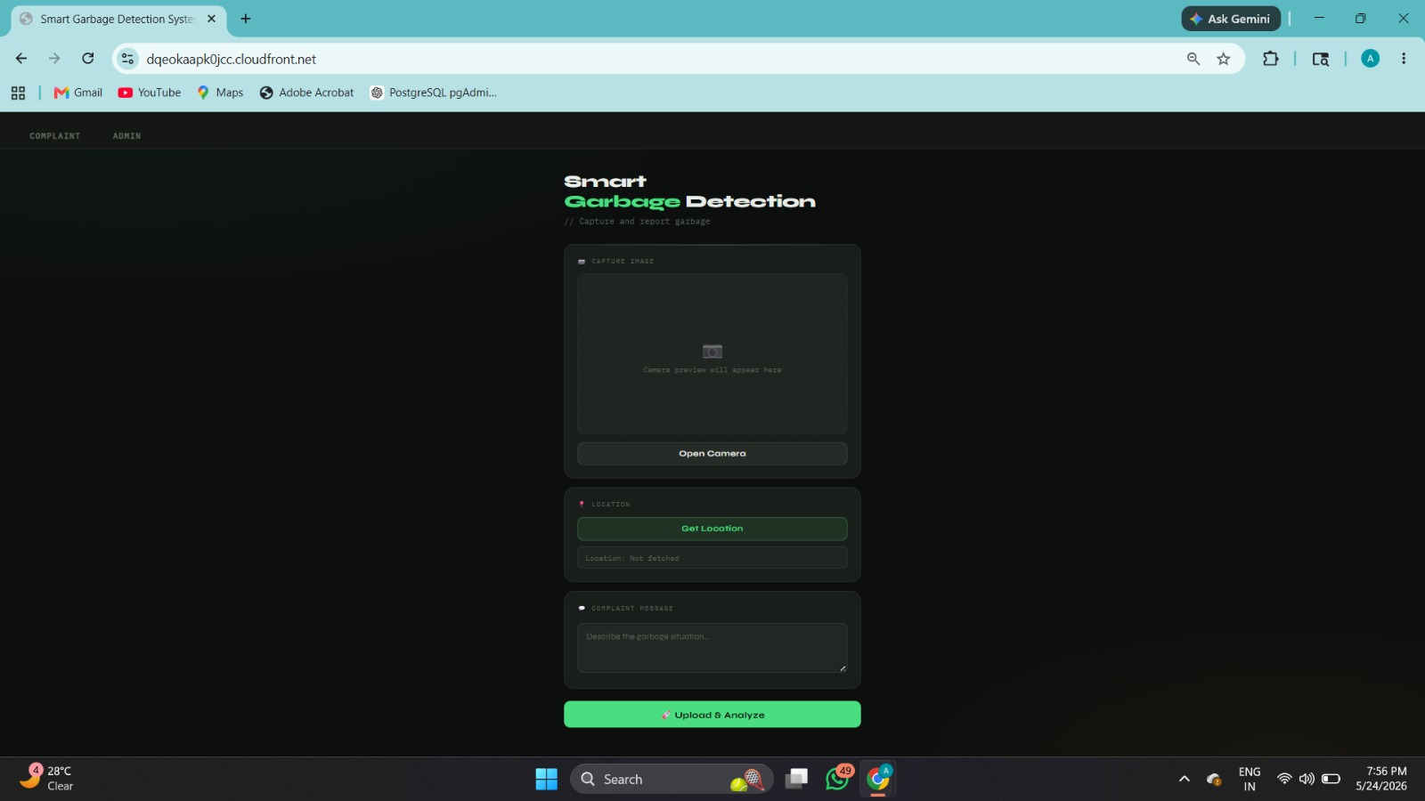
FRONTEND UI
Complaint Submission Interface
📷 Camera Capture
Open device camera directly in browser
📍 Auto Location
GPS fetches precise coordinates
🗺️ Reverse Geocode
Converts coords to readable address
📝 Complaint Message
User describes the situation
🚀 Upload & Analyze
One-click submission to AWS
⚡ Serverless
No backend server needed

Slide 6
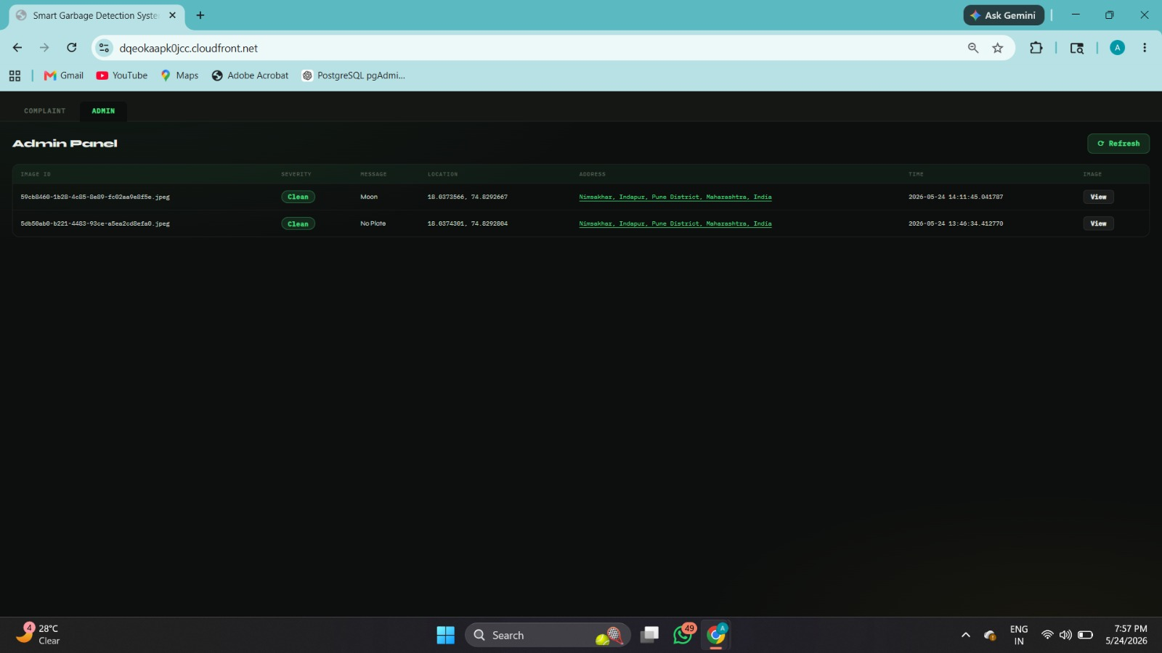
ADMIN PANEL
Real-Time Complaint Dashboard
🔐 OTP Protected
Admin access secured with OTP verification
📊 Severity Badge
Clean/Dirty label on each complaint
🗺️ Location Links
Clickable address links to Google Maps
🖼️ Image Viewer
View uploaded complaint images
⏱️ Timestamped
Exact date & time of submission

Slide 7
SECURITY — OTP VERIFICATION
Admin Access Protected by OTP
A custom OTP (One-Time Password) verification system was built to secure the Admin Panel. Without a valid OTP, no one can access the dashboard — even if they know the URL.
1
2
3
4
5
→
→
→
→
Admin Visits URL
OTP Triggered
Code Delivered
User Enters OTP
Verified ✅
Navigates to the Admin Panel route
System generates a one-time code
OTP sent via email/SMS to admin
Admin submits the code in UI
Access granted to full dashboard
🔐 WHY OTP?
OTP prevents unauthorized access to sensitive complaint data. Even if credentials are compromised, the admin account stays protected since OTP codes expire after use. This is built as a custom Lambda + API Gateway solution — no third-party auth library required.

Slide 8
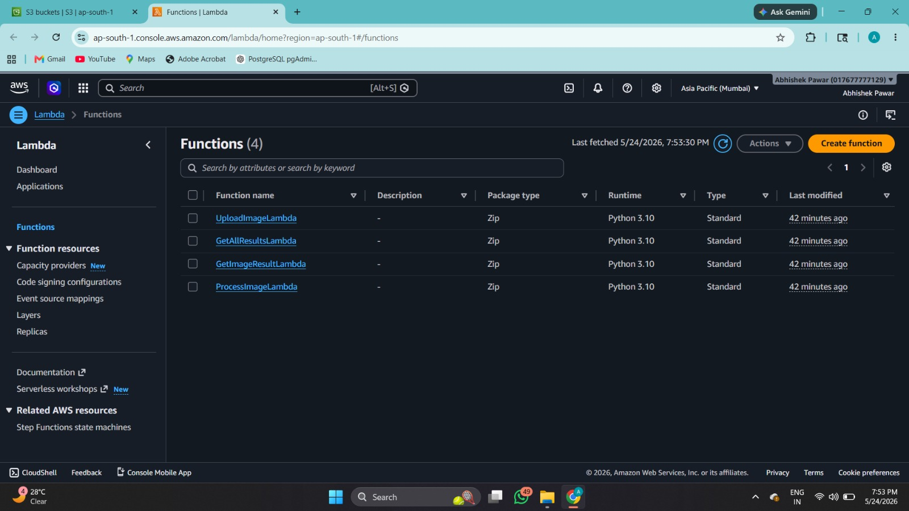
AWS LAMBDA FUNCTIONS
4 Serverless Functions — Python 3.10
⚡ UploadImageLambda
🔔 API Gateway GET /upload-url
Generates S3 presigned URL for secure image upload without exposing credentials.
⚡ ProcessImageLambda
🔔 S3 Object Created Event
S3 trigger → enhances image → runs Rekognition → calls Gemini AI → stores results.
⚡ GetImageResultLambda
🔔 API Gateway GET /result
Fetches analysis result from DynamoDB by ImageID. Handles Decimal serialization.
⚡ GetAllResultsLambda
🔔 API Gateway GET /all-results
Returns all complaint records for the Admin Panel dashboard with full metadata.

Slide 9
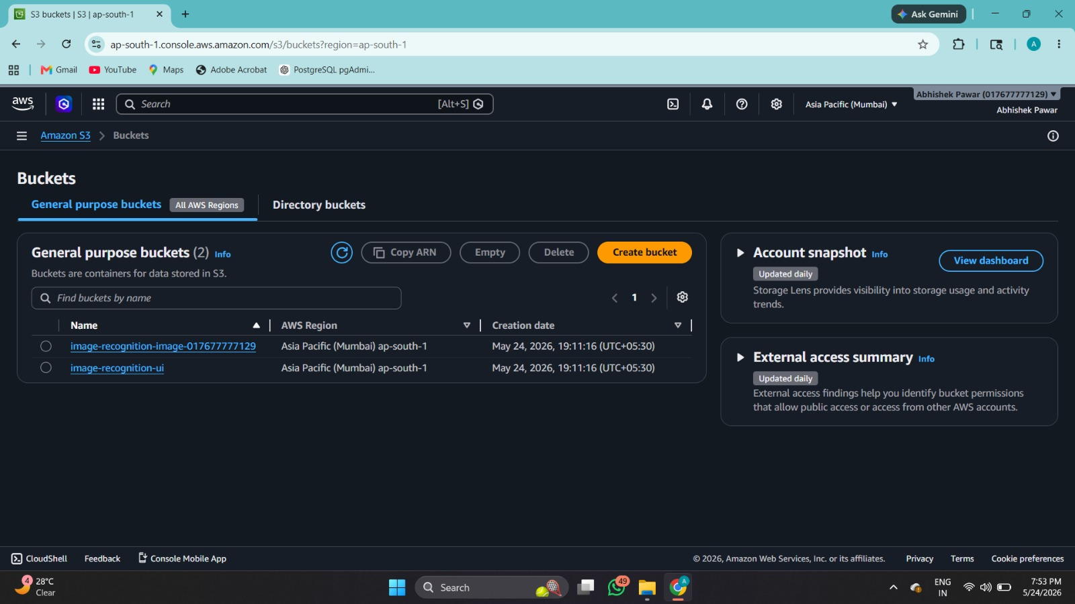
AWS S3 — OBJECT STORAGE
Two S3 Buckets for Separation of Concerns
🪣 image-recognition-image-017677777129
🌐 image-recognition-ui
Stores all uploaded complaint images and AI-enhanced versions under the /enhanced/ prefix. S3 event triggers ProcessImageLambda on upload.
Hosts the static frontend (HTML, CSS, JS). Served globally via CloudFront CDN for low latency. No web server required.
• User uploaded images
• S3 Event Trigger
• index.html
• script.js
• Enhanced images (Clipdrop AI)
• Presigned URL access
• style.css
• CloudFront origin

Slide 10
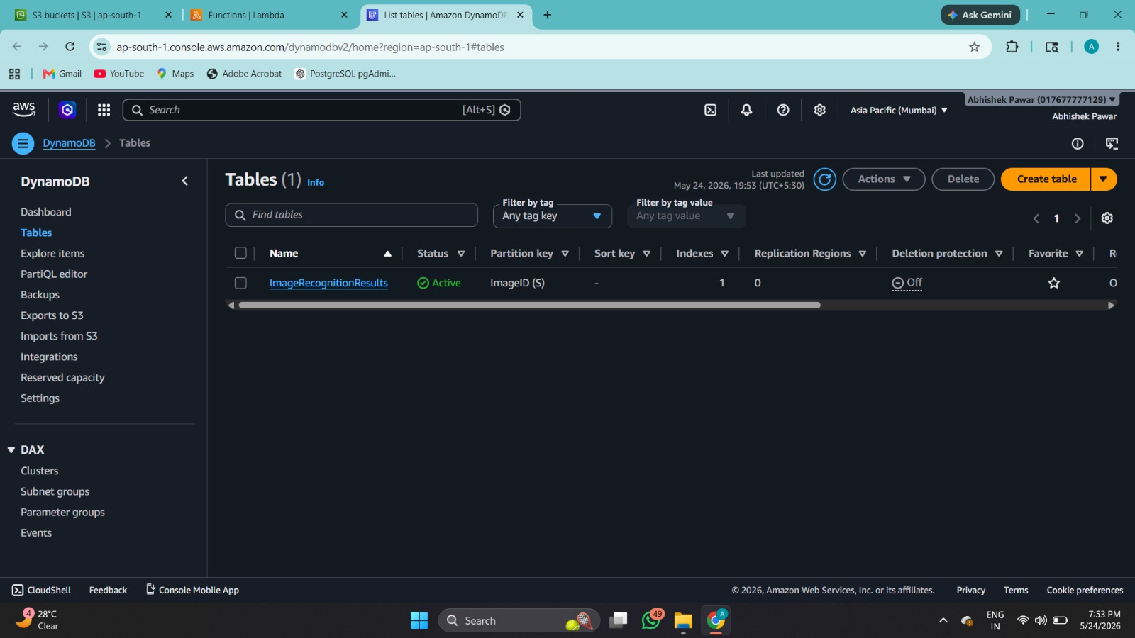
AWS DYNAMODB
NoSQL Database — Pay-Per-Request
ImageRecognitionResults — Table Schema
Field | Type | Description
ImageID | String (PK) | Unique UUID filename — Partition key for the table
severity | String | Garbage severity level — e.g. Clean / Dirty / Severe
message | String | Complaint message entered by the user describing the issue
location | String | GPS coordinates — latitude & longitude (e.g. 18.03, 74.82)
address | String | Reverse geocoded human-readable address string
time | String | ISO datetime timestamp of when the complaint was submitted

Slide 11
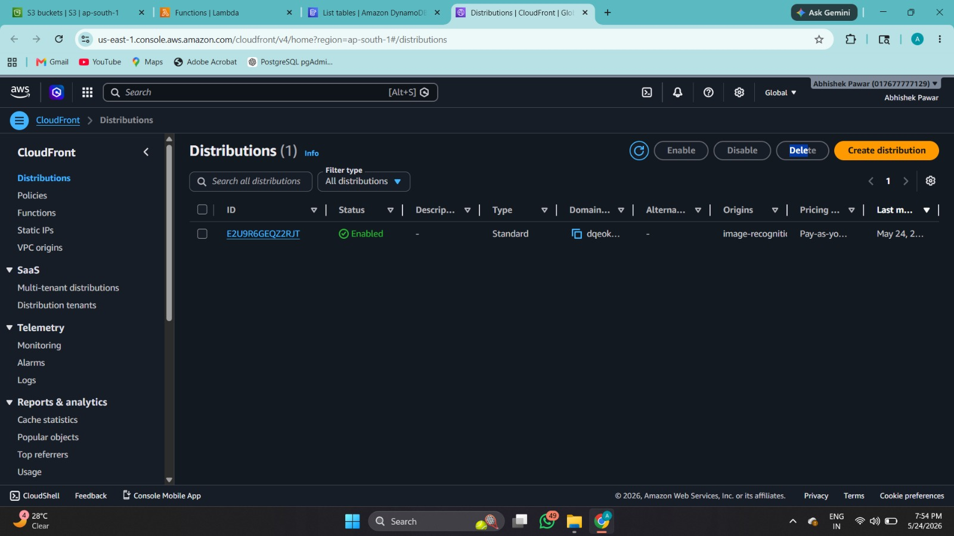
AWS CLOUDFRONT
Global CDN + HTTPS for the Frontend
🔒 Free HTTPS
🌍 Global CDN
↩️ HTTP → HTTPS
CloudFront default certificate — no extra cost for SSL
Content cached at edge locations worldwide — fast load
All HTTP requests redirected to secure HTTPS automatically
🔗 S3 Origin
⚡ IPv6 Enabled
🆔 Distribution ID
S3 bucket serves as origin, no public bucket access needed
Future-proof IPv6 support for modern browsers
E2U9R6GEQZ2RJT — Active, Standard, Pay-as-you-go

Slide 12
INFRASTRUCTURE AS CODE — TERRAFORM
One Command to Deploy Everything
$ terraform init && terraform plan && terraform apply
apigateway.tf
HTTP API + routes for /upload-url and /result endpoints with CORS
cloudfront.tf
CDN distribution linked to S3 UI bucket with HTTPS redirect
dynamoDB.tf
ImageRecognitionResults table — PAY_PER_REQUEST, ImageID partition key
iam.tf
Lambda execution roles with S3, DynamoDB, Rekognition permissions
lambda/*.tf
All 4 Lambda functions from zip files with env vars injected
✅ AWS Provider: 6.35.1 | Region: ap-south-1 (Mumbai) | Fully version-controlled

Slide 13
AI INTEGRATION
2 AI Services Working Together
👁️
✨
AWS Rekognition
Clipdrop Super-Resolution
Face & Emotion Detection
AI Image Enhancement
Detects faces in uploaded complaint images and classifies emotions (HAPPY, CALM, DISGUSTED, etc.) with confidence scores. The result is stored in DynamoDB along with face count and severity.
Super-resolution API pre-processes and enhances the uploaded image before sending it to Rekognition. This improves detection accuracy for low-quality or blurry images without needing OpenCV.
✓ detect_faces() API call
✓ Returns ALL face attributes
✓ super-resolution/v1 API
✓ Improves image clarity
✓ Confidence % scoring
✓ Works on enhanced image
✓ Saved under /enhanced/
✓ Runs before Rekognition
✓ Supports multiple faces
✓ No ML training required
✓ REST API — no OpenCV
✓ Free tier available

Slide 14
TECHNOLOGY STACK
Technologies Used
Frontend
Backend (AWS)
✓ HTML5 / CSS3
✓ Vanilla JavaScript
✓ AWS Lambda (Python 3.10)
✓ API Gateway HTTP
✓ Browser Camera API
✓ Geolocation API
✓ Amazon S3
✓ Amazon DynamoDB
✓ Fetch / Async-Await
✓ Amazon Rekognition
AI & External
DevOps & IaC
✓ AWS Rekognition
✓ Clipdrop Super-Res
✓ Terraform
✓ AWS CloudFront CDN
✓ Reverse Geocoding API
✓ Custom OTP System
✓ S3 Static Hosting
✓ ZIP Package Deploy
✓ Presigned URL Auth
✓ IAM Role Management

Slide 15
PROJECT CONCLUSION
What We Built
✅ Fully serverless — no servers to manage or maintain
🚀 Future Enhancements
✅ AI-powered garbage analysis using AWS Rekognition + Clipdrop
📱 Native mobile app (React Native)
✅ Secure admin panel with custom OTP verification
📊 Analytics dashboard with charts
🗺️ Map view with complaint pins
✅ Global delivery via CloudFront CDN with free HTTPS
🔔 Push notifications for updates
✅ Infrastructure provisioned with Terraform (one command)
🤖 Custom ML model training
✅ Real-time dashboard with image view, severity, GPS location
🏙️ Multi-city / multi-ward support
📈 Trend analysis & heat maps
Smart Garbage Detection System | Built on AWS | Abhishek Pawar | May 2026

