Slide 1

COMP 264 Cloud Machine Learning
Group 6
Presented by :
Abhi Patel
Jiya Kelawala
Krunal Parmar
Jainil Patel
Nidhi Trivedi
Prof. Mayy Habayeb
Date: April 19,2022

Slide 2
Introduction
organizations collect and store information about their potential clients or helpful contacts in the datastore
Business cards are still well-known way to get this information
Inputting this information manually in the data store is time consuming and tedious work

Slide 3
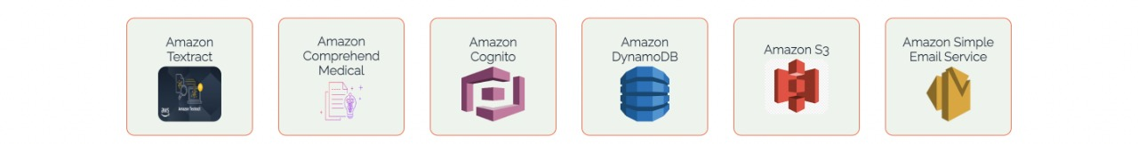
AWS Cloud Services
To authenticate user accounts
To recognize text from images
To store images of cards
To identify entities from the text
To send information of card to the entered email
To store and retrieve the data

Slide 4
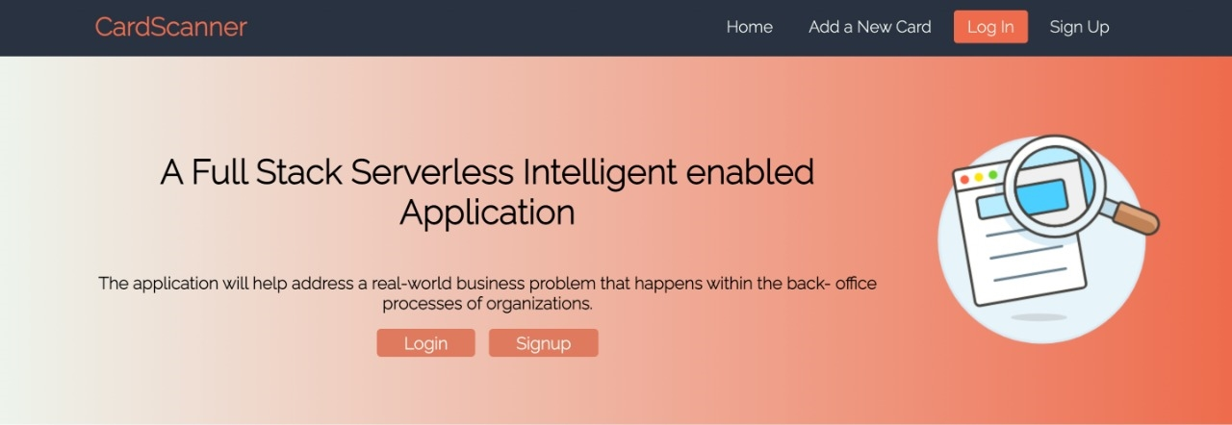
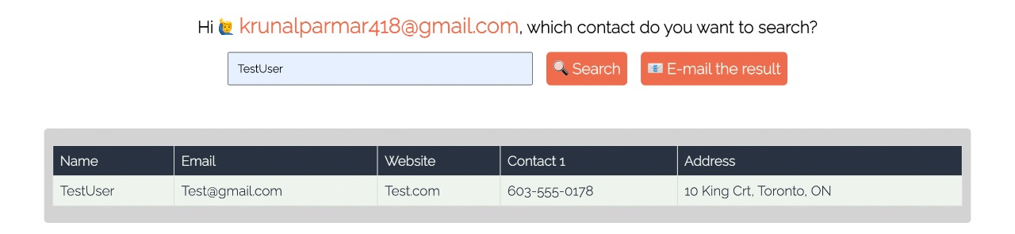
Creativity and Extra Features
Authentication (AWS Cognito)
Display list of all contacts
Email (AWS Simple email service)

Slide 5





Other Technologies
To create the back end of the application
To interact directly with the AWS services
To create an interactive User Interface
To create re-usable component
To implement virtual DOM
To create endpoints and back end server
To access AWS services through Python

Slide 6
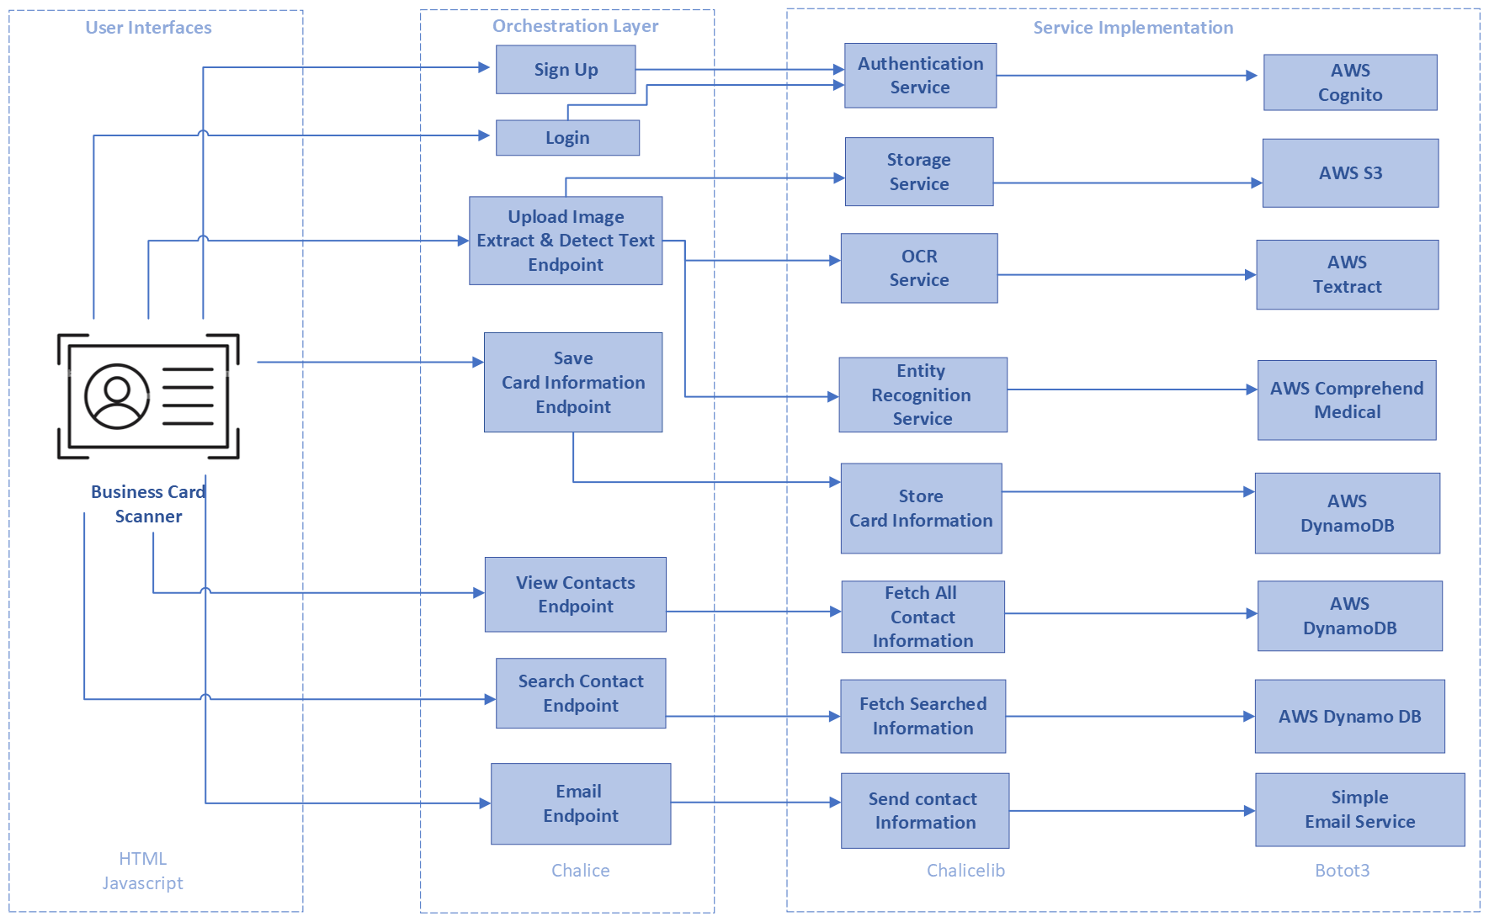
The architecture of the Application

Slide 7
Conclusion
The application is solving the problem of entering information of the Business cards manually into the datastore
Multiple cloud services have been used to implement several AI services to build this application.
NLP technologies like OCR recognition and entity detection have been included to fetch relevant information from the images.
React.js and Python are the pillar of the application to develop a full-stack application that provides a smooth experience to users.
Authentication and email service are added as extra features in this application.
Application is providing end-to-end support for storing information of the card; however, there are still various chances for enhancements.

