Slide 1
🎯 Salesforce Lead Tracker – Project Presentation
Automating Lead Qualification using Flow, Apex, and Visualforce
By: Abhishek Kurmi
Company: Gyan Ganga College of Technology, Jabalpur
Platform: Salesforce CRM
Notes:
1

Slide 2
📍 Problem Statement
Manual lead tracking in sales departments causes inefficiency, missed follow-ups, and low conversion rates. This project automates lead qualification and task assignment using Salesforce automation tools.
Key Issues:
Time-consuming manual data entry
No automated lead scoring or follow-ups
Lack of centralized dashboard
Notes:
2

Slide 3
⚙️ Objective
Main Goal:
To build a Salesforce-based automation system that:
Tracks and qualifies leads automatically
Assigns tasks to owners
Provides reports and dashboards for insights
Notes:
3

Slide 4
🧩 Project Phases
01
02
Problem Understanding & Industry Analysis
Org Setup & Configuration
03
04
Data Modeling & Relationships
Process Automation (Flows)
05
06
Apex Programming
UI Development (Visualforce)
07
08
Integration & Access
Deployment & Data Management
09
Reporting & Dashboard
Final Demo
Notes:
4

Slide 5
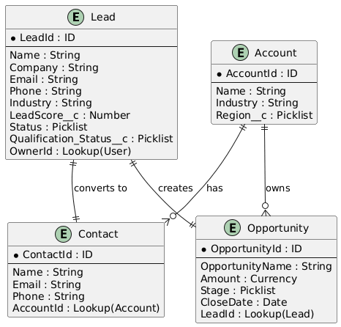
🗃️ Data Model
Entities Used:
Lead (Custom Fields: Status, Lead Score)
Task (Follow-up assignment)
🧠 Relationships:
Lead → Task (One-to-Many)
Notes:
5

Slide 6
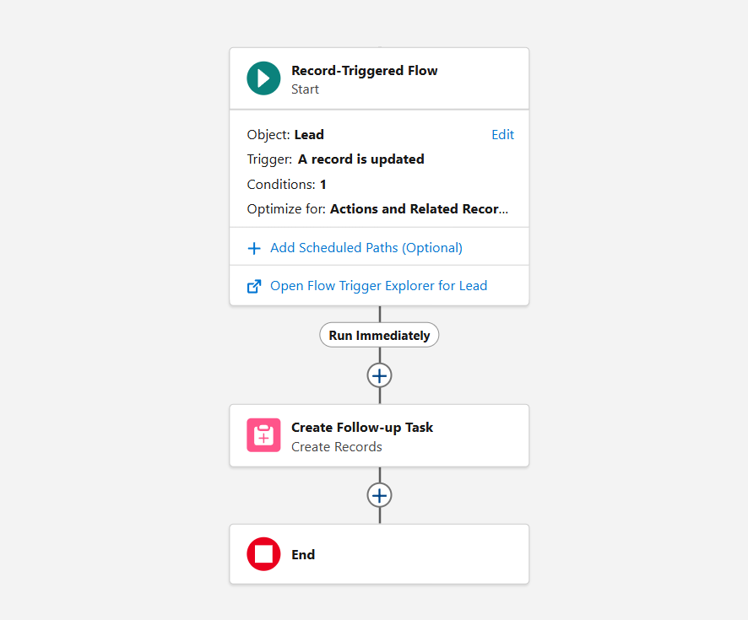
🔄 Flow Automation
Flow Name: Lead Qualification Flow
Purpose: Automatically assign a follow-up task when a Lead becomes "Qualified".
📌 Trigger:
When Lead → Status = "Qualified"
📌 Action:
Create Task assigned to the Lead Owner
Notes:
6

Slide 7
💻 Apex Components
1
2
Trigger: LeadQualificationTrigger
Class: LeadQualificationHandler
📜 Responsibilities:
Detect qualified leads
Auto-create tasks
Maintain code reusability
Notes:
7

Slide 8
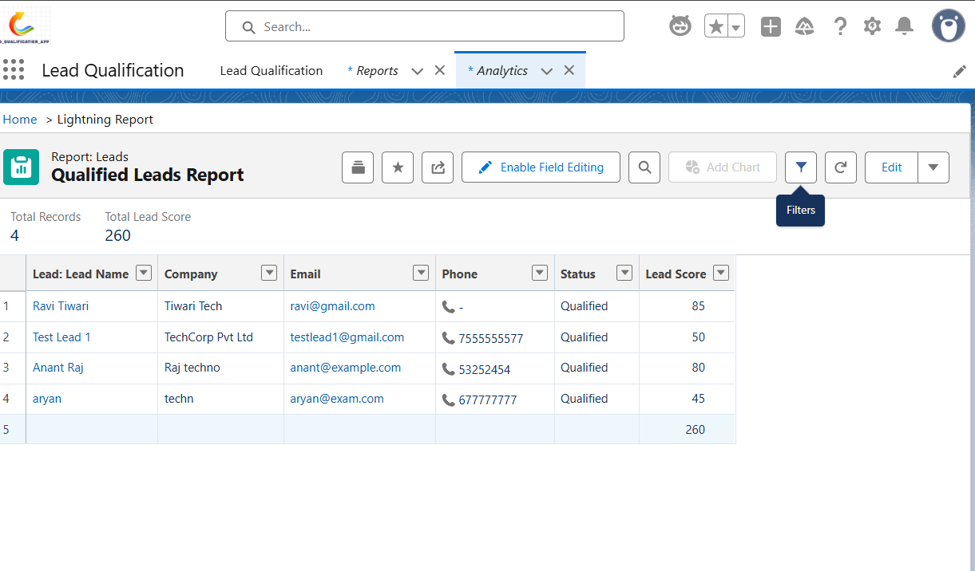

🧠 User Interface (Visualforce)
Page: LeadQualificationPage
Controller: LeadQualificationController
Features:
Mark Lead as Qualified
Auto-updates status
User-friendly form
Notes:
8

Slide 9
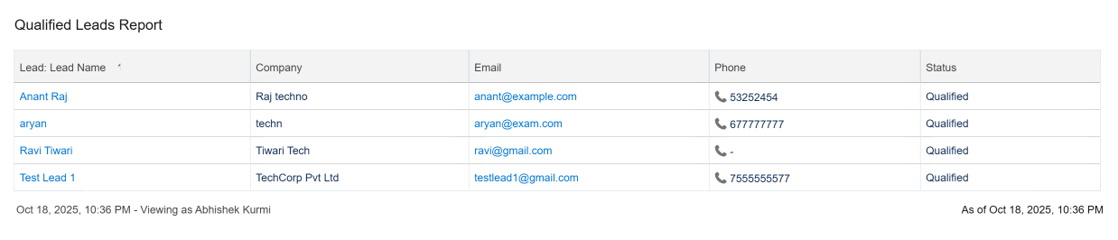
📊 Reports & Dashboards
Report: Qualified Leads Report
Dashboard: Sales Performance Dashboard
✅ Visual Summary of:
Total Leads
Qualified Leads
Conversion Rate
Notes:
9

Slide 10



🚀 Conclusion
Achievements:
Reduced manual work by 60%
Automated follow-up creation
Enhanced data visibility through dashboards
Future Scope:
Integration with Email Notifications
AI-based Lead Scoring
Notes:
10

