Slide 1
Project 1: Implementation of Spatio-Temporal Wafer-Level Correlation Modeling with Progressive Sampling with Wafer-based clustering
Abhishek M Patil – amp170830
Shri Prakash – sxp175131

Slide 2
Outline
Introduction
Models used
Problem Statement
Implementation
Experiment Results
Conclusion

Slide 3
Introduction
ICs need to be tested to check if meeting spec limits
Specification-based testing
Expensive and time-consuming
Need a way to reduce test cost and time
Solution?
Predict measurements of specification tests at untested die from a small set of tested die using statistical methods
How ?
Concept :
Identify spatial correlation by relying only on subset of die measurements and predict performance outcomes at unobserved die location
Which model to use ?
There exists spatial correlation between measurements among the die because of the process variation
One of the proven correlation based statistical model is Gaussian process(GP)
Notes:
Just quickly go through the problem and start explaining about Gaussian process model

Slide 4

Gaussian Process Model
A Gaussian process is fully specified by its mean function and its kernel-based covariance function ‘K’ denoted by where x is the input co-ordinate and f(x) is the output ie; the measurement value.
The basic assumption is that if vectors x and x’ are similar, then f (x) and f (x’) should be similar, too.
The squared exponential covariance function K(x, x’) denoted by returns a measure of the similarity of x and x’ and encodes how similar f (x) and f (x’) should be.
Notes:
Explain intuitively. Say about prior distribution obtained through covariance function, observed points, then posterior distribution with predictive mean

Slide 5
Gaussian Process Model studied in this project:
Spatio-Temporal Wafer-Level Correlation Modeling with Progressive Sampling*
2 key enhancements
Progressive Sampling
Spatio-temporal feature inclusion
An iterative sampling approach to select training samples which better represent the spatial variation pattern across a wafer
Wafers within the same lot, exhibit similar intra-wafer spatial variation and also exhibit time-dependent inter-wafer variation
*Ahmadi, K. Huang, S. Natarajan, J. M Carulli, and Y. Makris, “Spatio-temporal wafer-level correlation modeling with
progressive sampling: A pathway to HVM yield estimation,” in IEEE International Test Conference, 2014, pp. 1–10.
Notes:
Explain the 2 enhancements of GP model briefly

Slide 6
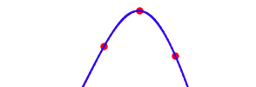


Problem Statement:
Wafer time
index
C2(3,4,1)
Single GP Model built with
GP-SP-PS across all the 3 wafers in a lot
w2
y
x
C3(3,4,2)
C1(3,4,0)
200
w3
If there is a noticeable shift in process variations across the wafers within a lot applying a single gaussian process model with progressive sampling and spatio-temporal feature enhancements might not give best prediction accuracy of probe test measurements.
w1
Test die predicted value will be not be accurate because of high covariance with the C2.
F(x)
100
95
Test die location
C4(4,4,0)
Covariance values
K(c4,c1) = 0.99
K(c4,c2) = 0.98
K(c4,c3) = 0.97
x
w1
w3
F(x)
100
95
Test die Predicted value more accurate because of 2 different models
x
C1(3,4,0)
C3(3,4,2)
2 GP Models :
One with w1 and w3 data
Other one with only w2 data
Variation of measurements across 3 wafers
Notes:
Our improvement towards previous model. Explain what exactly we are doing

Slide 7
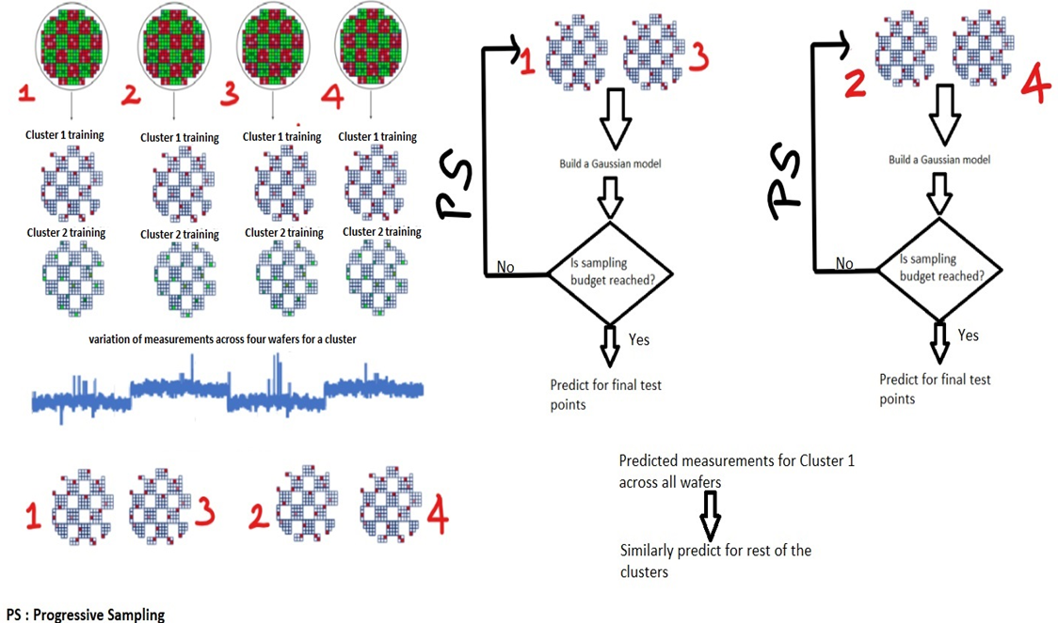
Implementation :
Notes:
Just go through the steps shown in the g=fig 1 by 1. Start by saying consider 4 wafers, Cluster 1st wafer using k-means and same clusters are used across wafers.
Select 1st cluster and same training points across wafers and then the rest.

Slide 8
Experimental Results
Effectiveness of the implemented method was evaluated on given probe test data set consisted of 102 probe tests and a total of 23 wafers with wafer containing around 2300 devices.
Python platform was used for evaluation, sklearn library was used for k-mean clustering.
Library for gaussian model was written on our own.
To avoid overfitting regularization technique is incorporated in the GP model with additive noise.
The optimal hyperparameter value l (length scale) and sigma(additive noise) were found using 5 fold cross validation.
Error metric used for assessing the accuracy of the models: where t is the probe test outcome for a die, t’ is the corresponding predicted value for that die
Variants of the algorithms evaluated:
Gaussian Process with spatio-temporal and Progressive Sampling (GP-ST-PS) without inter-wafer or intra-wafer clustering.
Gaussian Process with spatio-temporal and Progressive Sampling (GP-ST-PS) with only intra-wafer clustering.
Gaussian Process with spatio-temporal and Progressive Sampling (GP-ST-PS) with both inter-wafer and intra-wafer clustering.
Notes:
Self-explanatory

Slide 9
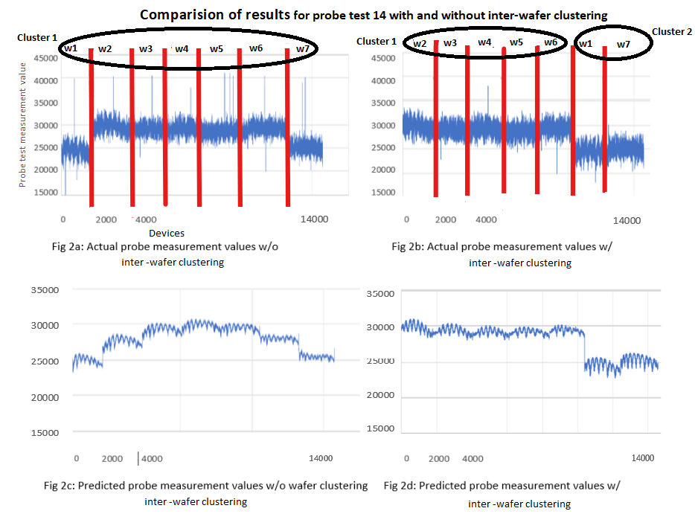
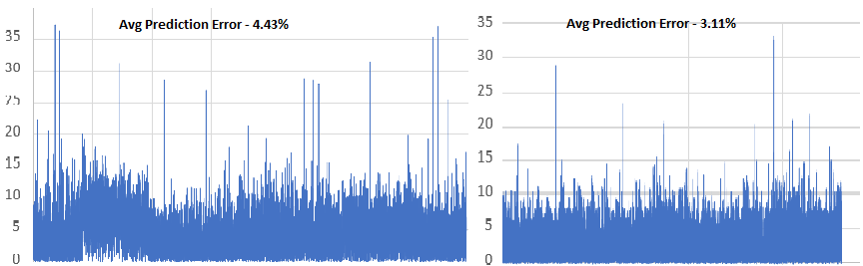
Comparison of with and without inter-wafer clustering for probe test 14
Notes:
Explain what the left hand side and RHS graphs are and say that this for 7 wafers only.

Slide 10
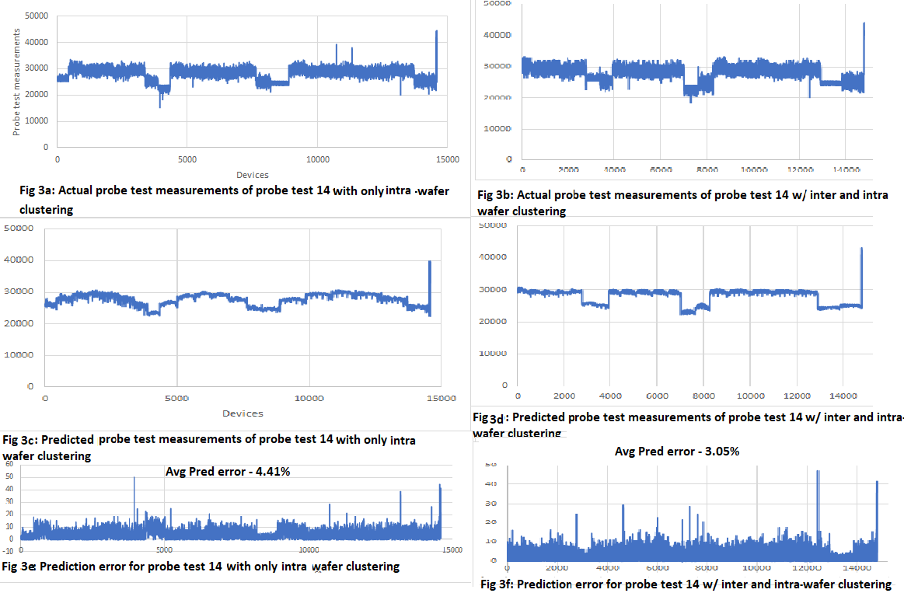
Comparison of with only intra-wafer clustering and with both inter-intra wafer clustering for probe test 14
Notes:
Similarly for with only intra-wafer clustering

Slide 11


Comparison between baseline GP-ST-PS model without any clustering ,with GP-ST-PS with only inter wafer clustering (for 80% of probe tests)
The results shown here are for first 7 wafers only due to computational constraints.
As seen from the graph for some of the probe tests the avg prediction error percentage reduced.
This is due to the fact that variation in measurements across the wafers.
Notes:
Comparisons

Slide 12
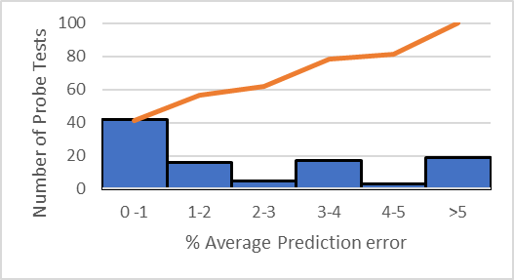
Results of GP-ST-PS with inter wafer and intra-wafer clustering for all the 23 wafers
Above 80% of probe tests are below 4% error.

Slide 13
Conclusion
In this project we first implemented wafer spatial modelling using Gaussian process model along with key enhancements namely progressive sampling and spatio-temporal feature inclusion.
Further to handle within wafer and in-lot process variation we added a intra and inter-wafer clustering-based approach to the previous model
The results were compared for 80% of the probe tests between the two models and improvement in average prediction accuracy was shown.
Further we showed that the average prediction error for all the probe tests for the improved model is less than 4% for over 80% of the probe tests

Slide 14
Questions?

