Slide 1
SALARY PREDICTION OF GRADUATES
Under Guidance of: Under-Taken By:
Mr. Shashank Shirude Abhishek Prasoon
Apoorv Jain
Harshit Bharrdwaj
Sudeep Kadyan
Urvashi Panwar

Slide 2
Building Machine Learning model to predict the likelihood of the salary class of engineering graduates. Exploring and finding the factors that influences the salary of the candidates.
PROBLEM STATEMENT

Slide 3
WHY IT IS IMPORTANT PROBLEM
Breaking stereotype of the society
Organization use
For candidate’s prospective, he/she will be aware of right salary based on their profile.

Slide 4
DATASET CONSIDERED
For every engineer, AMEO dataset provides anonymised bio data information along with their respective skill scores and employment outcome information. Specifically, the following information is available for every engineer:
Scores on Aspiring Minds' AMCAT - a standardized test of job skills. The test includes cognitive, domain and personality assessments.
Personal information like gender and date of birth.
Pre-university information like 10th and 12th grade marks, board of education and 12th grade graduation year.

Slide 5
DATASET CONSIDERED (cont..)
University information like GPA, college major, college reputation proxy, graduation year and college location.
The following employment outcome information is available for every engineer:
First job annual salary
First job title
First job location
Date of joining and leaving of first job

Slide 6
EXPLORATORY DATA ANALYTICS PERFORMED
Importing data
Checking null values
Checking Datatypes
Analyzing data description
Feature engineering
Feature visualization
Dropping irrelevant features

Slide 7
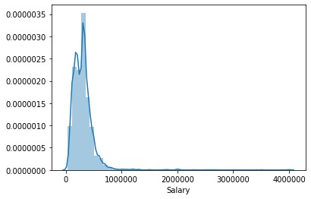
We have classified target variable ‘Salary’ into 3 classes based on it’s distribution

Slide 8
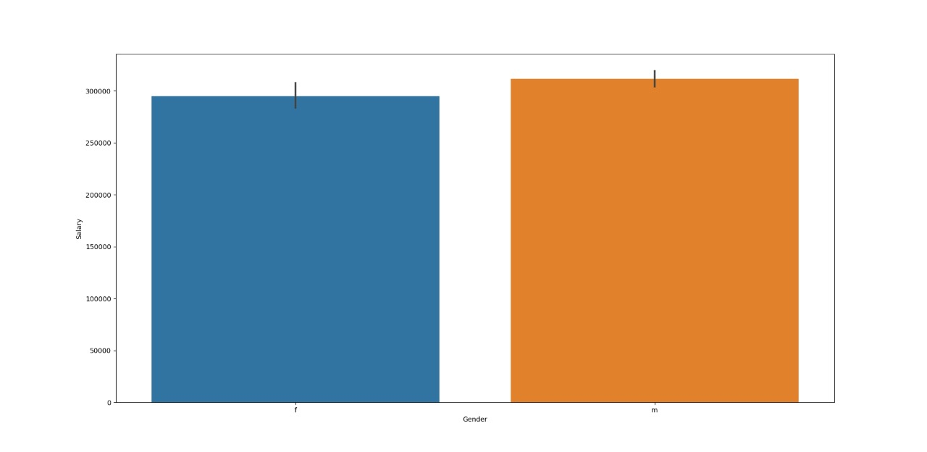
Salary Range between Gender

Slide 9
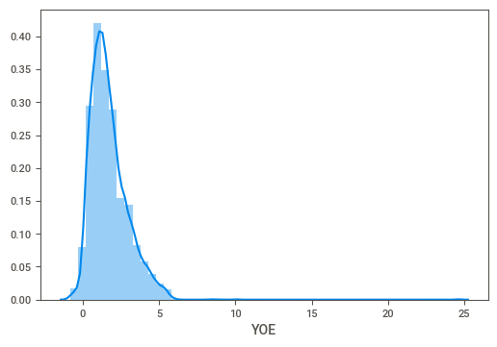
Distribution of ‘Year of Experience’

Slide 10
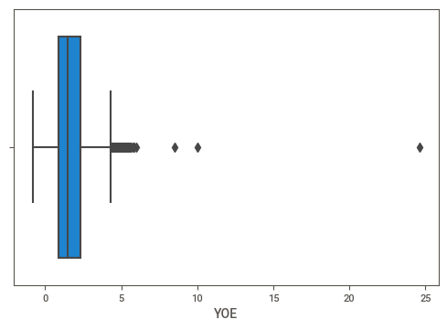
Year of Experience (Outliers)

Slide 11
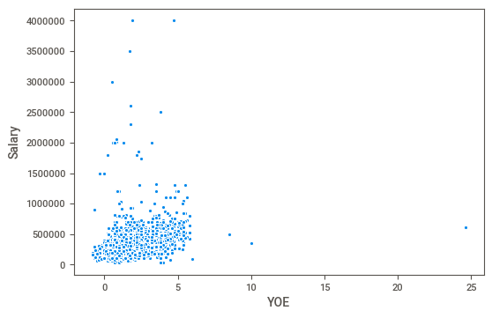
Scatter plot between Years of experience and Salary

Slide 12
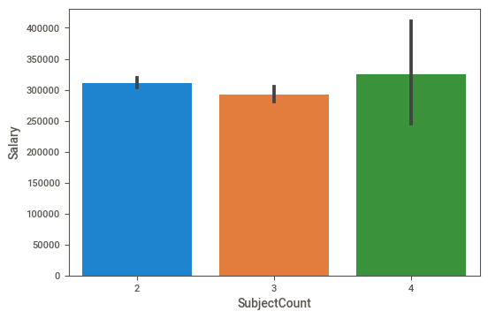
Bar plot between SubjectCount and Salary

Slide 13
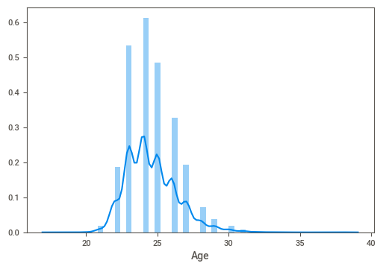
Distribution of Age

Slide 14
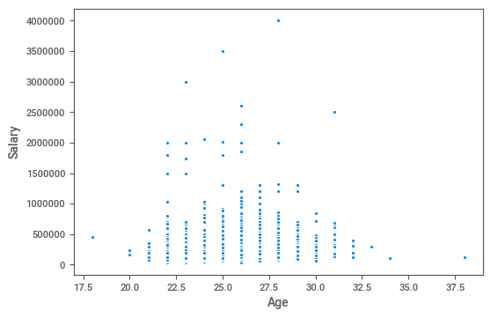
Scatter plot between Age and Salary

Slide 15
FURTHER PLAN
Made the base models using different algorithms to compare the performance of the model.
Making clusters of the target variable ‘Salary’ to find the clusters.
Identifying and labeling the different clusters formed.
Treating categorical features for missing values and then encoding the data.
Finding the relevant features.

Slide 16
FURTHER PLAN (Cont…)
Building the models using different algorithms, compare the performance of the models, and find the best algorithm.
Fine tuning the model.
Perform data manipulation and find the factors that affect the salary of the candidates.
Find the meaningful insights based on the dataset and make a project file and report.

Slide 17
Thanks!

