Slide 1

Outlier Detection and Info-Extraction
Presented by:-
Abhipray Sharma
Under the guidance of
Ujjwal Jha
Arka Prava Bandyopadhyay

Slide 2
TASK 1 Info-Extraction from pdf
The objective of this task was to extract specific codes from a pdf file containing tabular list of diseases and injuries. It contains the codes of diseases along with specific headers within each disease code like INCLUDES, EXCLUDES1, EXCLUDES2, etc. My task was to extract the codes of these diseases along with the codes in its EXCLUDES1 header and then export them to an excel file.
Python library that was used for this was Pdfplumber and the algorithm built is written in the file Info_Extraction.ipynb and the final exported dataset is present in pdf_extraction.xlsx

Slide 3
Task 2: Outlier Detection in Healthcare Database.

Slide 4
Business Problem
Here we will analyze and detect “Healthcare Provider Fraud” where the provider fills in all the details and makes a claim on behalf of the beneficiary.
Statistics show that 15% of the total Medicare expense is caused due to fraud claims.
Healthcare fraud and abuse take many forms. Some of the most common types of frauds by providers are: a) Billing for services that were not provided. b) Duplicate submission of a claim for the same service. c) Misrepresenting the service provided. d) Charging for a more complex or expensive service than what was actually provided. e) Billing for a covered service when the service actually provided was not covered.

Slide 5
Objective
Use of unsupervised learning was chosen due to a lack to labeled data in the healthcare industry.
Even though the dataset we will be using is a labeled database, but due to industry requirements we will remove its labels and then treat it as an unlabeled dataset to extract outlier points. This label data column will just be used for the evaluation purposes.
Our target will involve hitting a high precision, which will be our evaluation criteria rather than recall due to business constraints as we would rather avoid labelling any non-fraudulent data as fraudulent.
Using unsupervised learning techniques for outlier detection with a target of high precision to extract some useful features.

Slide 6
Dataset Introduction
For this task the dataset that we used was a Kaggle dataset.
It contains 3 datafiles, with In-Patient, Out-Patient and Medical Beneficiary details.
In-Patient data consists of claim details made by Patients that were admitted by the provider.
Out-Patient data consists of claim details made by patients that were not admitted by the provider.
Medical Beneficiary file consists of details of each individual Beneficiary including medical history, annual reimbursement, etc.

Slide 7
Dataset Analysis and Feature Engineering.

Slide 8
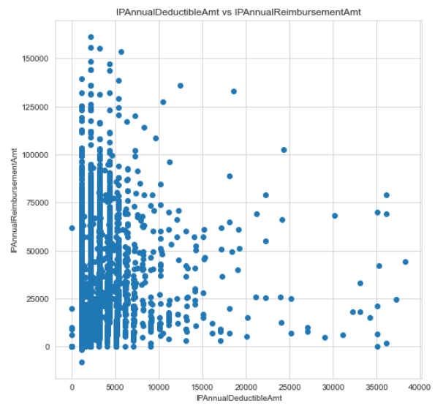
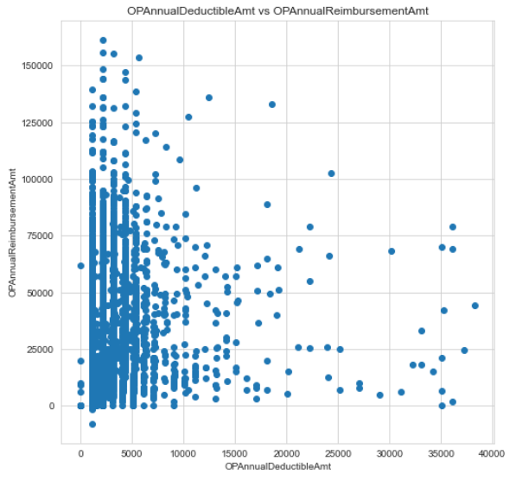
# IPAnnualDeductibleAmt indicated the amount paid by the beneficiary annually for inpatient claim
# IPAnnualReimbursementAmt indicates the reimbursement amount the beneficiary is eligible for per annum.
# Potential erroneous points can lie at the extremities i,e, even though the deductible amount is zero, they got high reimbursements and vice versa.

Slide 9
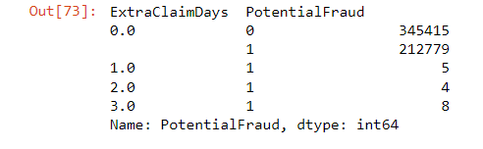
Other Observations from the data..
Another important feature that came out was the claim duration and hospitality duration which was extracted from start and end dates Hospital Admission and Claims, respectively. One possible discrepancy can be the fact when Claim Days are more than the hospitality duration, which in end would turn out to be feature of great importance as all the data entries in which Claim duration > hospitality duration turned out to be outlier points.
OTHER PLAUSIBLE REASONS FOR FRAUD :-
1. Fraud can be at a provider level, as provider fills and submits the claim so we will group by provider and take mean of reimbursed, deducted, etc. If average claim amount or claim period is high for a provider that is suspicious.
2. Beneficiaries also associated with fraudulent activity. So, group the dataframe by Beneficiary Id and take mean. If average claim amount is high for a beneficiary, then this is suspicious.
3. Physicians also associate with fraud so groupBy() physicians also.
4. This extensive clubbing up of features will result to a dataset with in total 245 features exported to Final_Train.csv.

Slide 10
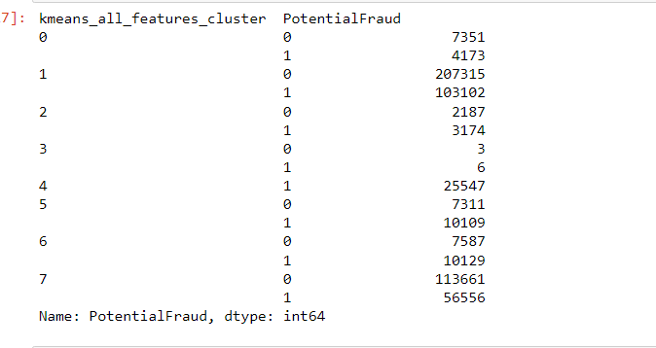
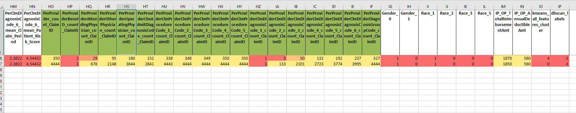
Observations:
When we apply Clustering algorithm to the whole dataset, we see that Cluster 4 has pure fraudulent data and various other clusters like 5 and 6 have significant percentage of fraudulent data and hence here are some features within this dataset that are leading to this anomalous behavior.
Next on comparative analysis of all the most fraudulent and the least fraudulent cluster we see that there are 20 features that are mentioned in the upcoming slides that are primarily responsible for this fraudulent behavior.
Applying Kmeans on the whole dataset.
Comparative study of the least and the most fraudulent clusters and the features marked green are the ones which show maximum deviation and hence fraudulent behavior is primarily dependent on these features.

Slide 11
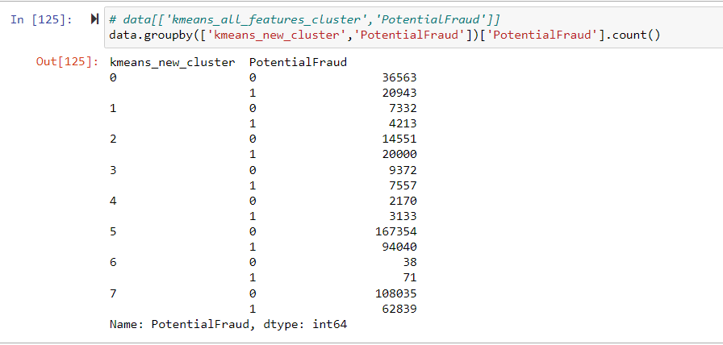
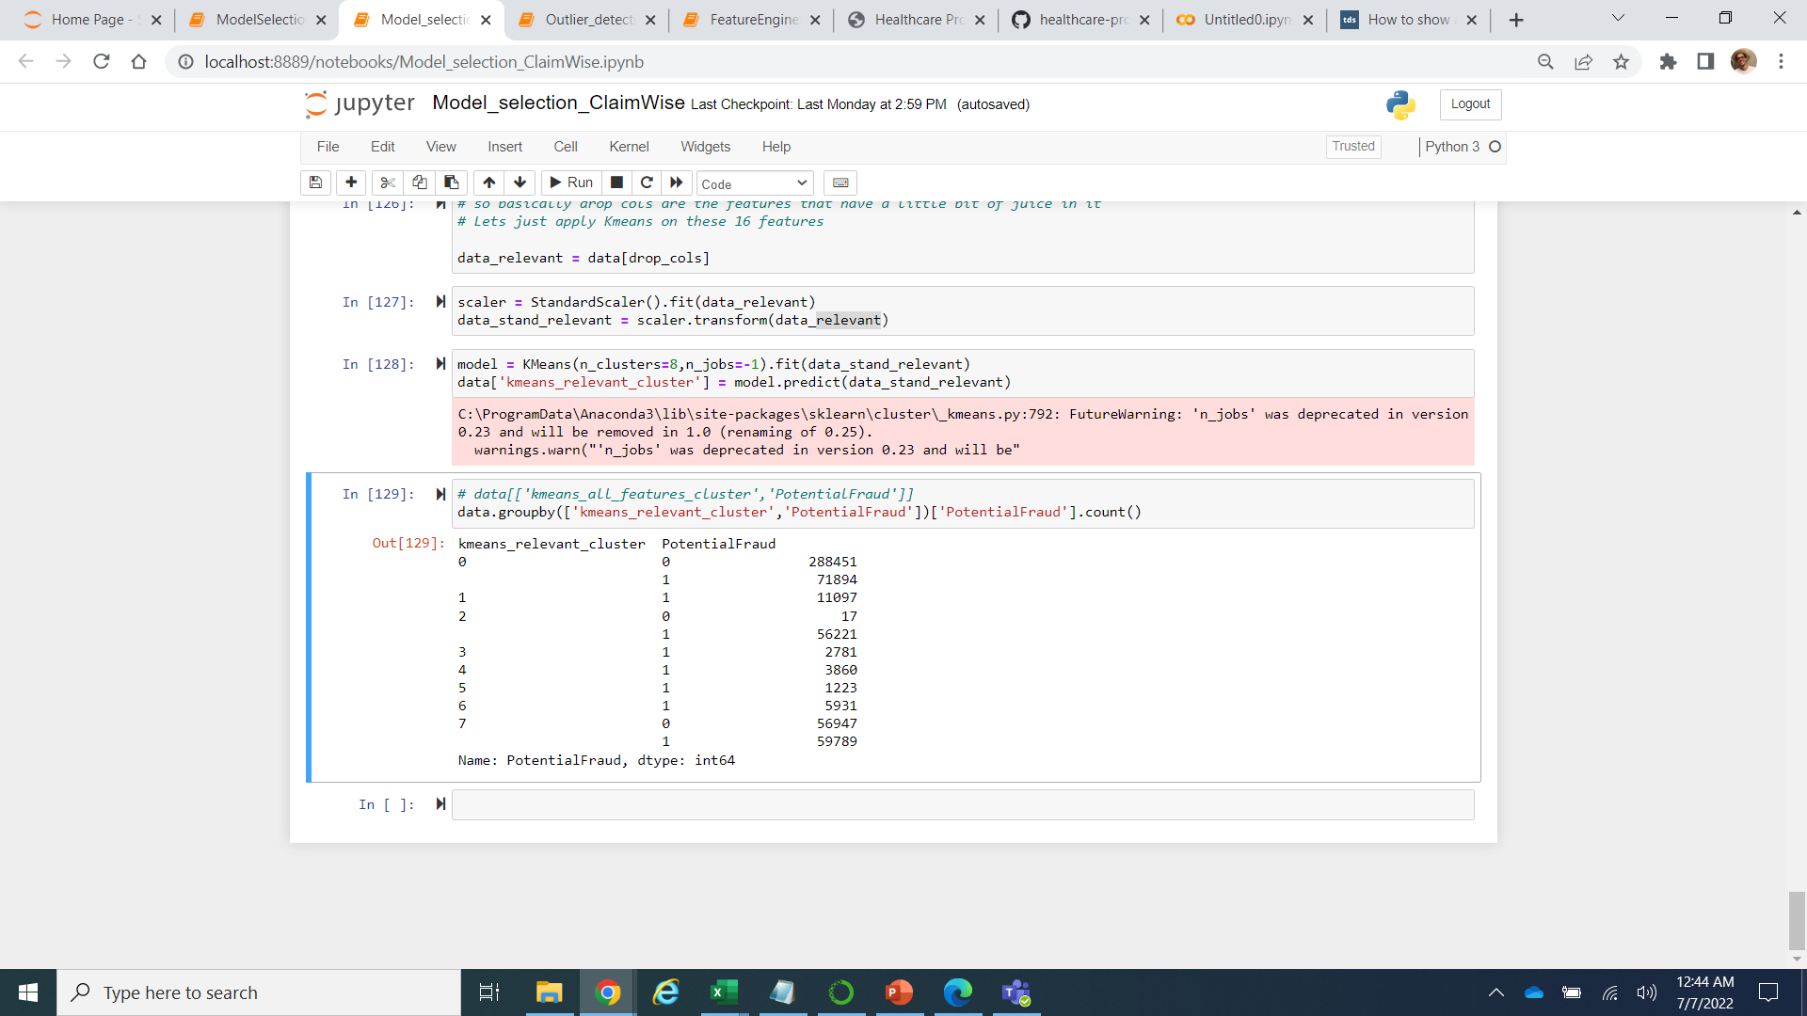
Applying Kmeans on the whole dataset except relevant features extracted
Applying Kmeans on the relevant features
Now just to solidify our hypothesis that most of the fraudulent behavior is because of these 20 features, I applied clustering over the whole dataset except those relevant features and find that there is really no cluster that has a majority of fraudulent or non-fraudulent points and hence the remaining features do not have much juice remaining in them
Next, I applied clustering over only the relevant features and found some very clean clusters with majority fraudulent points.

Slide 12
Relevant Features extracted.
PerProvider_count_ClaimID
PerProviderBeneID_count_ClaimID
PerProviderAttendingPhysician_count_ClaimID
PerProviderOtherPhysician_count_ClaimID
PerProviderOperatingPhysician_count_ClaimID
PerProviderClmAdmitDiagnosisCode_count_ClaimID
PerProviderClmProcedureCode_1_count_ClaimID
PerProviderClmProcedureCode_2_count_ClaimID
PerProviderClmProcedureCode_3_count_ClaimID
PerProviderClmProcedureCode_4_count_ClaimID
PerProviderClmProcedureCode_5_count_ClaimID
PerProviderClmDiagnosisCode_1_count_ClaimID
PerProviderClmDiagnosisCode_2_count_ClaimID
PerProviderClmDiagnosisCode_3_count_ClaimID
PerProviderClmDiagnosisCode_4_count_ClaimID
PerProviderClmDiagnosisCode_5_count_ClaimID
PerProviderClmDiagnosisCode_6_count_ClaimID
PerProviderDiagnosisGroupCode_count_ClaimID
These are the features that primarily result to fraudulent behavior and hence can now be used at scale on Elevance Healthcare database to expediate the outlier detection process.

Slide 13
Using Semi-supervised learning techniques..
Semi-supervised learning is used when we have plenty of unlabeled instances and very few labeled instances.
First, we train a random forest model on a sample of 50 labeled instances from dataset and get a classification report.
Secondly, we will divide our dataset into 50 clusters and use then using the centroids of those clusters as their representation and then train the data to improve upon the accuracy.
Lastly, we will apply some label propagation to about 20 percentile distance from the centroids of the clusters to improve upon that accuracy further.
Another major industry problem that is prominent is a lack of enough labeled data and the tedious task of labelling the data.

Slide 14
Thank you..

