Slide 1

Major Project Presentation
ISL DETECTION AND TRANSLATION
Name | Registration no.
Mrinal Raj | 2301020029
Rittika Ghosh | 2301020038
Abhipsa Mohapatra | 2301020484
Pratyush Panigrahi | 2301020548
Guided By:
Dr. Madhusmita Sahu

Slide 2
Outline
Overview of topics covered in this presentation
01. Introduction & Motivation
Background of ISL, problem statement, key challenges & objectives
02. Literature Study
Comparative survey of existing ISL models, methodologies, and limitations
03. Technical Details
Data pipeline, 3D hand landmark extraction, landmark normalization, dual models (Dense NN + LSTM), prediction stabilization, and Windows SAPI TTS
04. Results & Discussion
Model performance evaluation, 99.75% static & 100% dynamic accuracy, classification reports, and latency analysis
05. Conclusion & Future Scope
Summary of achievements, current constraints, and future expansion roadmap
06. References
Academic citations and research literature

Slide 3
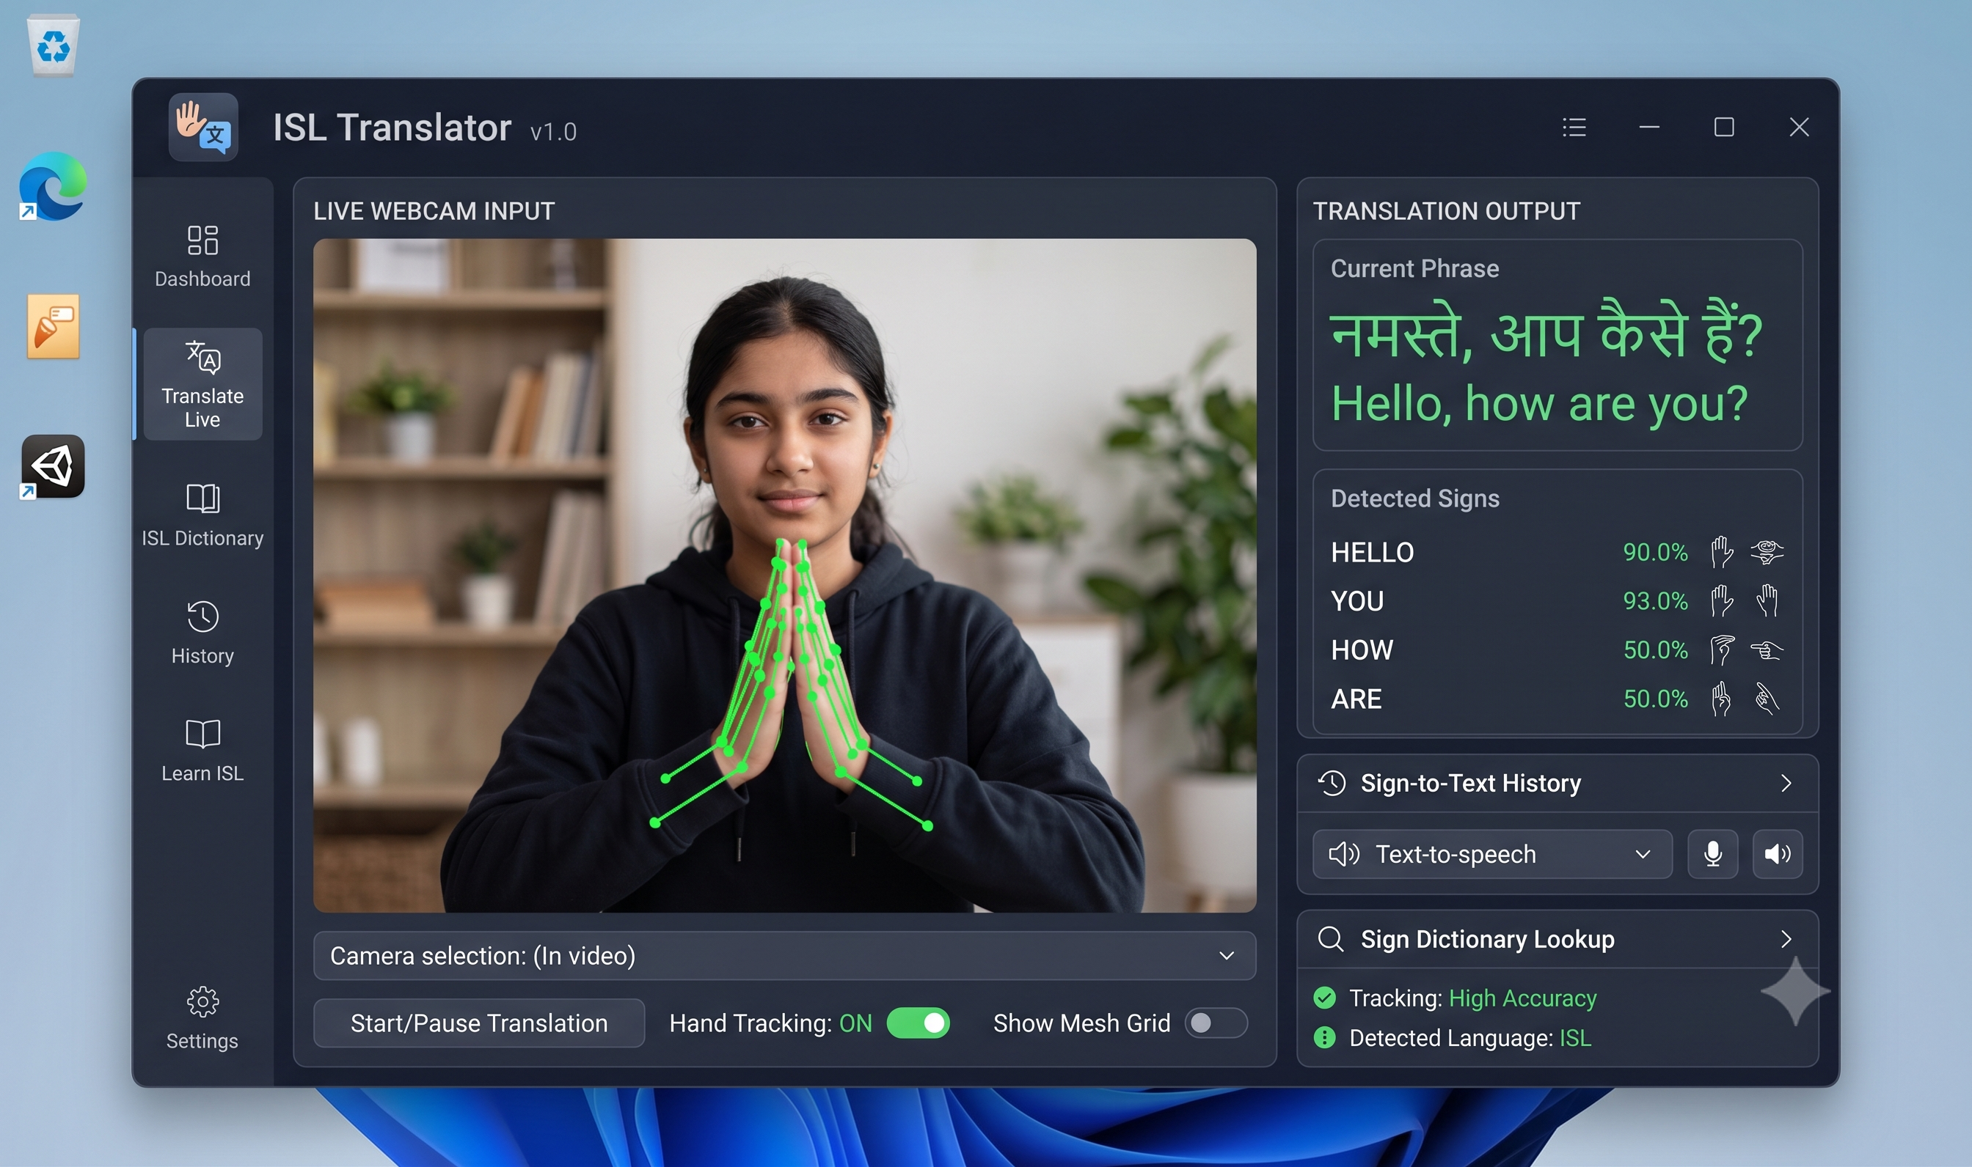
1. Introduction & Motivation
Indian Sign Language (ISL) Recognition System
Background & Motivation
• ~1.8 Million deaf individuals in India (Census 2011) ~5 to 7 million.
• ISL is a predominantly 2-handed sign language with distinct grammar
• Severe shortage of human interpreters creates communication barriers
Problem Statement
• Existing solutions require expensive depth cameras or sensor gloves
• Need for a lightweight, software-only system operating via webcam
Core Objectives
• MediaPipe 3D HandLandmarker feature extraction (126 features)
• Dual model pipeline: Dense NN (Static) + LSTM (Dynamic)
• Asynchronous Windows SAPI Text-to-Speech translation output
• Responsive CustomTkinter desktop GUI

Slide 4
2. Literature Study
Comparative summary of existing ISL recognition research
Sl. No. | Journal, Publisher & Year | Title & Author | Methodology | Findings | Limitations
1 | Multimedia Tools & Applications (Springer, 2024) | Automatic ISL Recognition using MediaPipe & LSTM (Khartheesvar et al.) | MediaPipe Holistic + 2-layer LSTM sequence model | High accuracy on isolated dynamic ISL signs | High computational cost due to full holistic mesh extraction
2 | Electronics (MDPI, 2024) | Isolated ISL Recognition via Hybrid CNN-LSTM (Kumari & Anand) | 3D CNN feature extractor + Attention LSTM | Effective spatial-temporal frame weighting | High RAM & processing overhead from raw RGB frames
3 | Electronics (MDPI, 2022) | DeepSign: Sign Language Detection (Kothadiya et al.) | OpenPose keypoints + Dense Neural Network | Low parameter count for static poses | Fails under hand self-occlusion; poor dynamic gesture handling
4 | Information (MDPI, 2023) | LiST: Lightweight Framework for ISL (Al-Qurishi et al.) | Lightweight 2D CNN + GRU sequence decoder | Reduced model latency for mobile devices | Limited vocabulary; sensitive to lighting variations
5 | Array (Elsevier, 2023) | ISL Recognition using SURF with SVM & CNN (Sahoo et al.) | SURF descriptor + hybrid SVM & CNN classifier | Robust static hand posture classification | Segmentation fails under varying skin tones or shadows

Slide 5
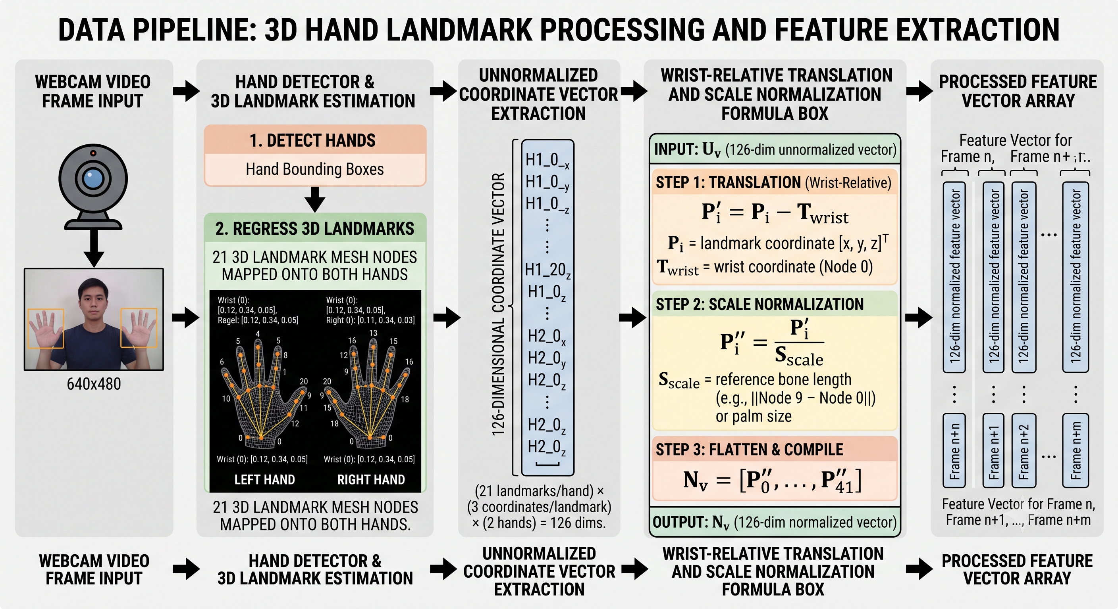
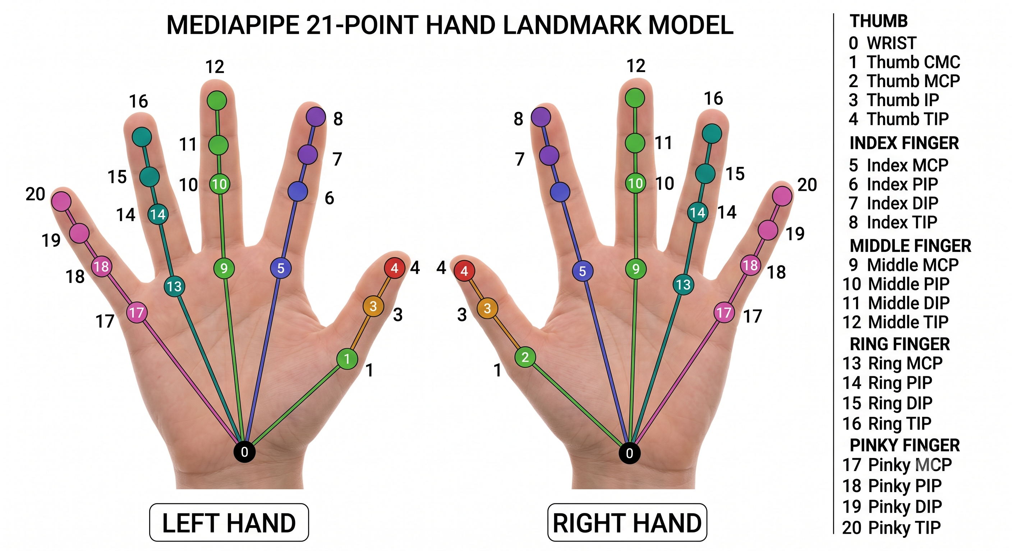
3. Technical Details — Feature Pipeline & Normalization
System Architecture (Part 1)
MediaPipe 3D Hand Landmarks
• 21 3D landmarks (x, y, z) extracted per hand
• 2 hands x 21 landmarks x 3 coordinates = 126 features/frame
• Single-hand detections are zero-padded to maintain 126-D shape
Wrist-Relative Normalization
• Translation Invariance: Subtract wrist position (L₀) from all 21 points
• Scale Invariance: Divide by max Euclidean distance from wrist
• Math: L̂ᵢ = (Lᵢ - L₀) / maxⱼ ||Lⱼ - L₀||
Data Collection & Augmentation
• Static dataset: 500 frames collected per sign class
• Dynamic dataset: 50 sequences x 30 frames per sign class (~1 sec)
• 3x Data Augmentation: Gaussian noise (σ=0.01), scaling, translation

Slide 6
3. Technical Details — Feature Pipeline & Normalization
System Architecture (Part 1)

Slide 7
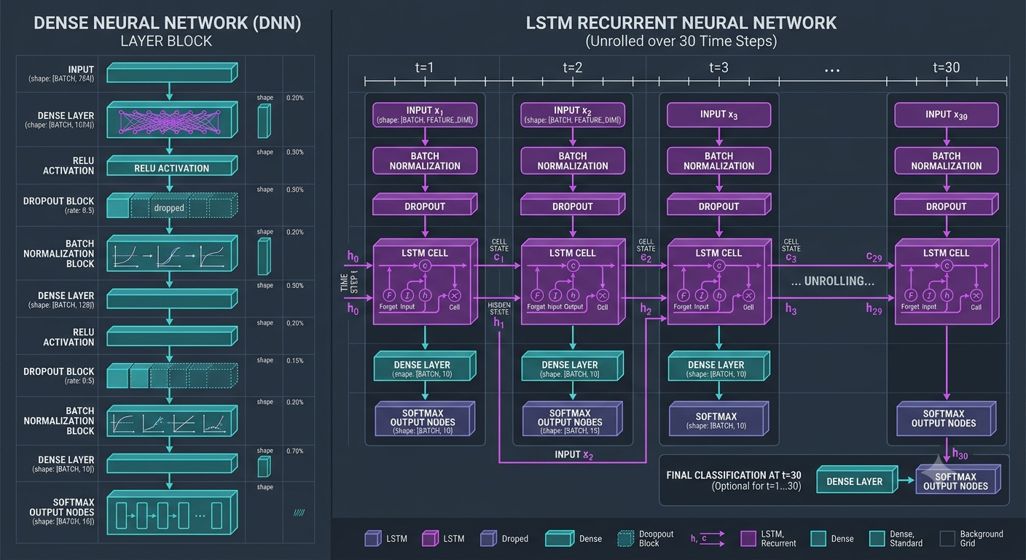
3. Technical Details — Dual Model Architectures
System Architecture (Part 2)
Why Dual Architectures?
• Static Signs (Namaste): Classified from single frames
• Dynamic Signs (Hello, Thank You, Bye, Sorry): Classified over temporal motion
Static Model — Dense Neural Network
• Input: (126,) normalized feature vector
• Architecture: Dense(256) → BatchNorm → Dropout(0.3) → Dense(128) → BatchNorm → Dropout(0.3) → Dense(64) → Softmax(N)
• Size: ~75,781 parameters (296 KB)
Dynamic Model — LSTM Network
• Input: (30, 126) sequence over 30 consecutive frames
• Architecture: LSTM(128, return_seq=True) → Dropout(0.3) → LSTM(64) → Dropout(0.3) → Dense(64) → Dense(32) → Softmax(N)
• Captures temporal velocity and direction of hand motion

Slide 8
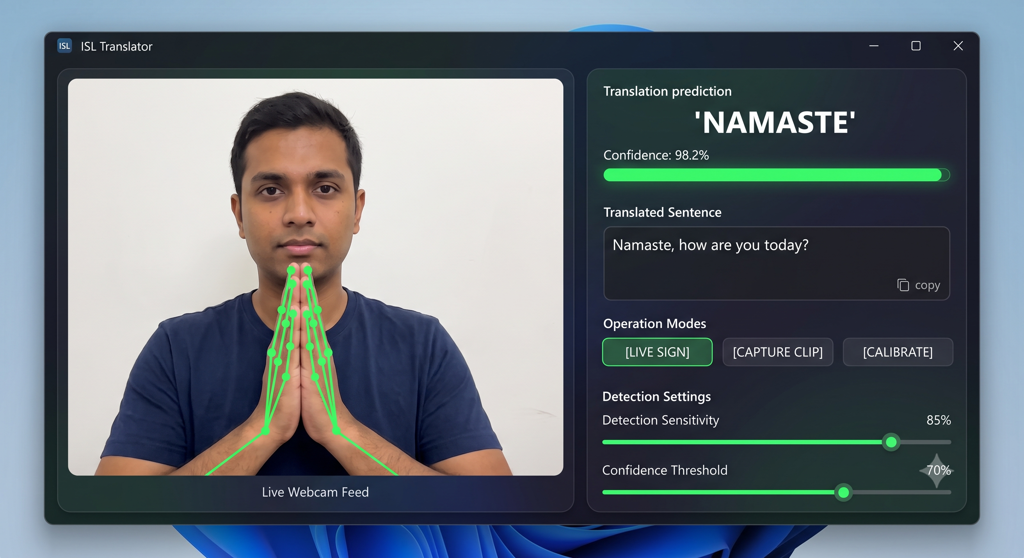
3. Technical Details — Real-Time Inference & TTS
System Architecture (Part 3)
Prediction Stabilization Engine
• 5-Frame Rolling Buffer: Requires identical predictions over 5 frames
• Confidence Threshold: Confirms sign only if confidence > 0.6 / 0.7
• Prevents flickering during hand transition movements
Asynchronous Windows SAPI Speech
• Bypasses pyttsx3 freezing by using Windows native SAPI (SpVoice)
• Uses SVSFlagsAsync for non-blocking voice output during video capture
• Cooldown period of 1.0s prevents repetitive word playback
CustomTkinter Desktop Application
• Threaded architecture: Background thread handles camera & inference
• Main thread renders CustomTkinter GUI smoothly at ~30 FPS
• Native controls for sentence clearing, mode toggle, volume & rate sliders

Slide 9
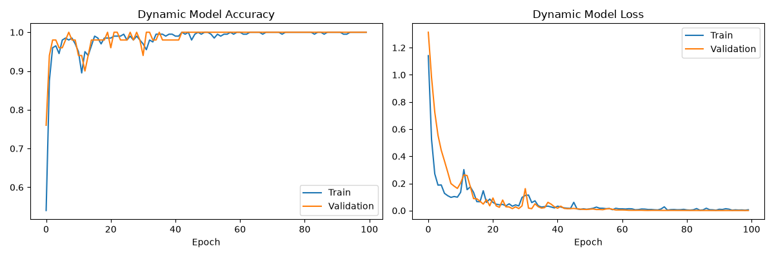
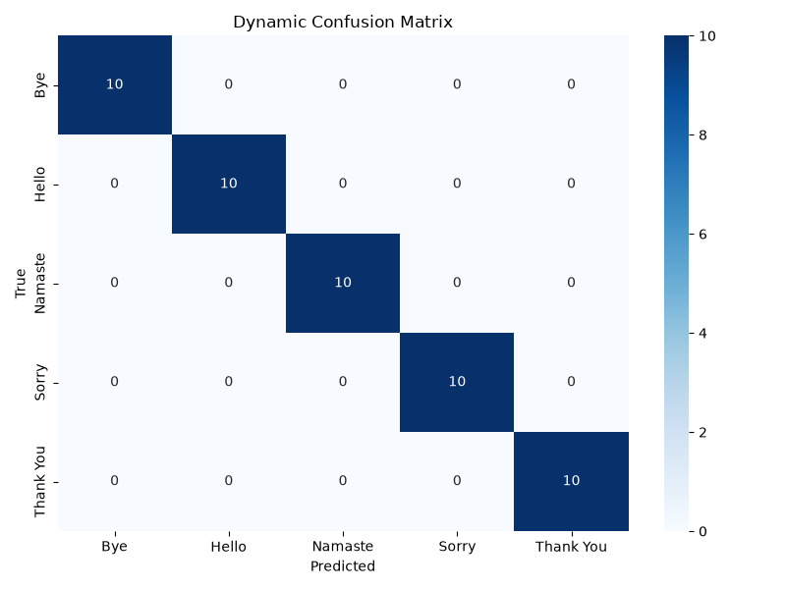
4. Results & Discussion
Model performance, accuracy, and real-time latency evaluation
Experimental Performance Summary
• Static Model (Dense NN): 99.75% Test Accuracy (Early stopped at epoch 6)
• Dynamic Model (LSTM): 100.00% Test Accuracy (Best weights at epoch 93)
• Inference Latency: ~3ms per frame (Static), ~12ms per sequence (LSTM)
Classification Report (Precision / Recall / F1)
• Hello: Precision 1.00 | Recall 1.00 | F1-Score 1.00
• Namaste: Precision 1.00 | Recall 1.00 | F1-Score 1.00
• Bye: Precision 1.00 | Recall 1.00 | F1-Score 1.00
• Thank You: Precision 1.00 | Recall 1.00 | F1-Score 1.00
• Sorry: Precision 1.00 | Recall 1.00 | F1-Score 1.00
Key Discussion Insights
• Wrist normalization successfully eliminated distance/scale variance
• Zero false-positive triggers observed in dynamic stability buffer

Slide 10
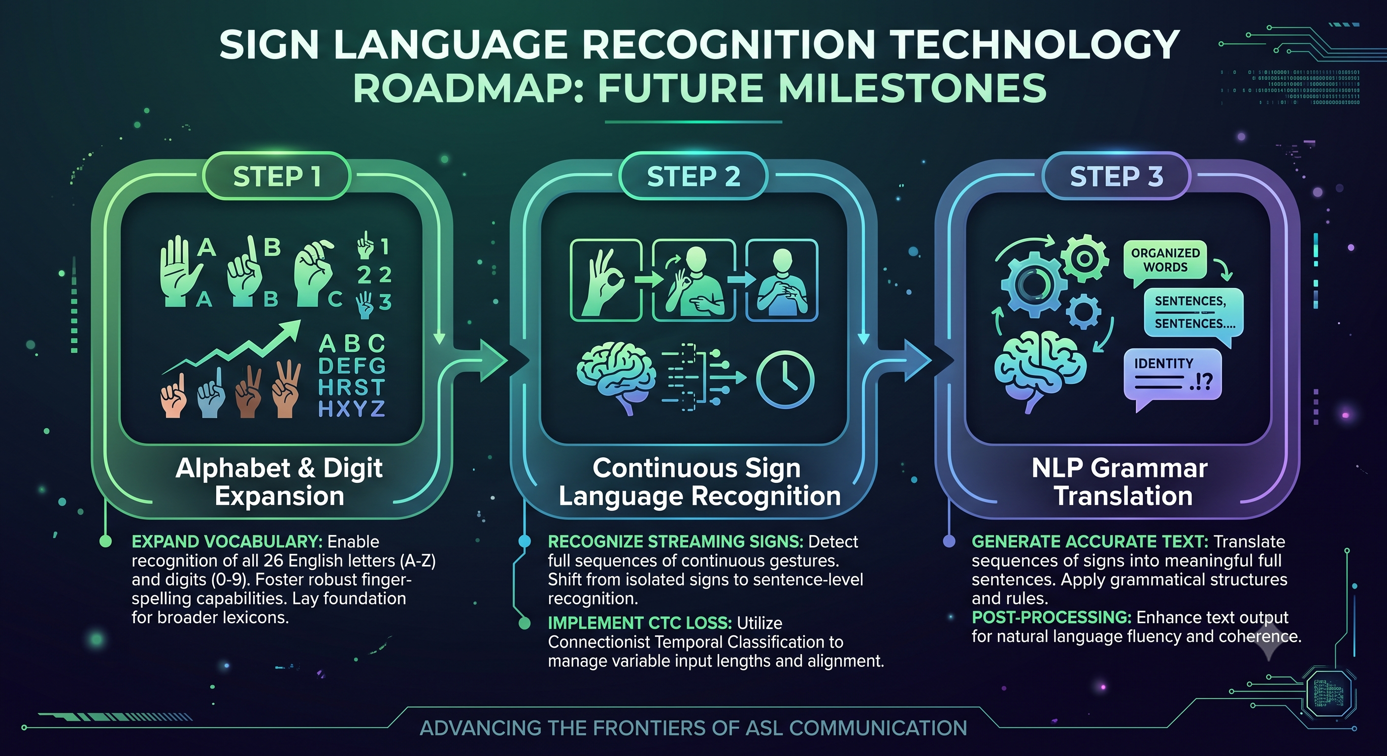
5. Conclusion & Future Scope
Project contributions and future development roadmap
Project Summary & Contributions
• Built a complete, real-time vision-based ISL translation system
• Achieved 99.75% static accuracy and 100.00% dynamic sequence accuracy
• Lightweight 126-D feature pipeline runs smoothly on standard CPUs
• Delivered a responsive CustomTkinter GUI with Windows SAPI TTS integration
Current Limitations
• Vocabulary currently covers 5 core dynamic/static phrases
• Requires visible hands in webcam view without heavy motion blur
Future Expansion Roadmap
1. Vocabulary Expansion: Extend to full ISL Alphabets (A-Z) & Numbers (0-9)
2. Continuous Sign Recognition: Integrate Connectionist Temporal Classification (CTC)
3. NLP Translation Layer: Add Transformer for ISL gloss to English grammar translation

Slide 11
6. References
Academic research publications and literature citations
1. Khartheesvar, G., et al. (2024). "Automatic Indian Sign Language Recognition using MediaPipe Holistic and LSTM Network". Multimedia Tools and Applications, Springer (SCI). DOI: 10.1007/s11042-023-17361-y
2. Al-Qurishi, M., et al. (2023). "LiST: A Lightweight Framework for Continuous ISL Translation". Information, MDPI (Scopus). DOI: 10.3390/info14020079
3. Kumari, D., & Anand, R. S. (2024). "Isolated Video-Based Sign Language Recognition Using Hybrid CNN-LSTM with Attention". Electronics, MDPI (SCI). DOI: 10.3390/electronics13071229
4. Kothadiya, D., et al. (2022). "DeepSign: Sign Language Detection and Recognition Using Deep Learning". Electronics, MDPI (SCI). DOI: 10.3390/electronics11111780
5. IEEE Access. (2025). "Real-Time Sign Language-to-Speech Translation with AI-Powered Wearable Technology". IEEE Access, (SCI). DOI: 10.1109/ACCESS.2025.3602794
6. JSIR. (2022). "Real-time Static and Dynamic Sign Language Recognition using Deep Learning". Journal of Scientific and Industrial Research, (SCI). DOI: 10.56042/jsir.v81i11.60865
7. IEEE MysuruCon. (2021). "Evaluation of Machine Learning Models for Real-Time Sign Recognition". IEEE MysuruCon 2021. DOI: 10.1109/MysuruCon52639.2021.9641518
8. Sahoo, S., et al. (2023). "Indian Sign Language Recognition Using SURF with SVM and CNN". Array, Elsevier (Scopus). DOI: 10.1016/j.array.2023.100257

