Slide 1
Contract Testing An Introduction
.
Abhinandan Bhadauria
Restricted

Slide 2
Agenda
Related Terminology
Test Flow
Example Demo
Introduction

Slide 3

Introduction

Slide 4
Introduction
What is Contract (or Pact) Testing?
Testing technique for testing endpoints (API)
Primarily used for applications that are isolated.
Messages sent or received confirms that they are adhering to a written Pact or Contract
It’s Consumer driven, means the API owner/provider cannot change the behavior before consumer adapts the new expectations.

Slide 5

Related Terminology

Slide 6
Related Terminology
Provider
Who owns the API endpoint and defines the response from the API
Consumer
Who calls/uses the API endpoint and expect a predefined response.
Mock Pact Server (or Mock Provider)
A server which is configured for the Consumer to interact via mocked endpoint with expected response
Pact File
An autogenerated json file which represents the expected response from Provider for an API endpoint (like written contract)
Pact Broker (Optional)
Stores the Pact File, and validates the API behavior against the Pact File at Provider side
The validation can also be done with pact file stored on local folder (same used is used for Demo)

Slide 7

Test Flow

Slide 8
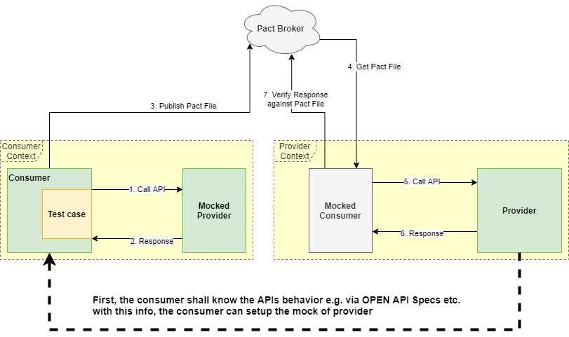
Test Flow

Slide 9

Example Demo

Slide 10
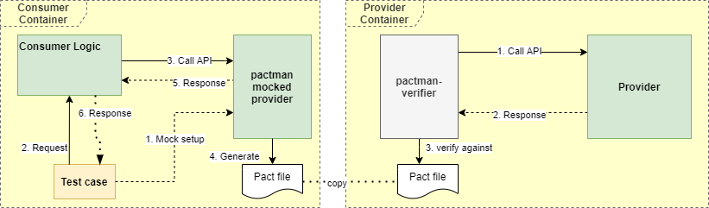
Demo Setup - python
Python provides pactman library: https://pypi.org/project/pactman/
Verify with container hostname
pactman-verifier -l Consumer-Provider-pact.json Provider http://provider-pact-demo:50010 http://provider-pact-demo:50010/_pact/provider_states
Verify with host port mapping
pactman-verifier -l Consumer-Provider-pact.json Provider http://139.24.139.214:50010/ http://139.24.139.214:50010/_pact/provider_states
Repository of the demo:
https://code.siemens.com/sim-edge-agnostic/python-pact-demo

Slide 11

Thank you!
Contact
Abhinandan Bhadauria
Abhinandan.Bhadauria@siemens.com
ADV D AA DDI HMI-RT EC-APPS

