Slide 1

ML-Assisted Portfolio Optimization Under Realistic Trading Constraints
From Return Prediction to Realistic Capital Allocation
Optimization Course Project
~ Abhinav Pullela
~ Y B Siddharth
Core Insight: Predicting returns is only half the problem. The real challenge is deciding how to optimally allocate capital while balancing return, risk and real-world trading constraints.

Slide 2
MOTIVATION
Predicting Returns Is Not Enough
The Investor's Challenge
Two Distinct Sub-Problems
Many Assets, Different Risk Profiles
Machine Learning
Different assets have different expected returns and risk, so selecting investments requires a principled allocation strategy.
Estimate expected returns μ̂ from historical market data and derived price/volume signals.
Correlation Matters
Assets move together. Ignoring correlations can create concentrated and fragile portfolios.
Mathematical Optimization
Given μ̂ and the covariance structure Σ, choose portfolio weights w subject to all binding constraints.
Real-World Constraints
Transaction costs, position limits, cardinality limits, and turnover make real portfolio allocation more complex.
Given predicted returns and asset risk, what portfolio allocation is optimal under realistic conditions?

Slide 3
DATA
Real Market Data: What We Will Use
Dataset Specification
Dimension | Details
Asset Universe | 29 NSE stocks for the primary experiment, with the larger Kaggle universe considered for supplementary historical analysis.
Time Period | Sept 2021 – Sept 2026 (~5 years)
Frequency | Daily
Data Source | NSE Indian equity data (Primary) | Kaggle historical Indian stock data (Secondary)
Core/Raw Variables | OHLC prices, adjusted prices, volume, turnover/trading activity, NIFTY 50 and India VIX where available

Slide 4
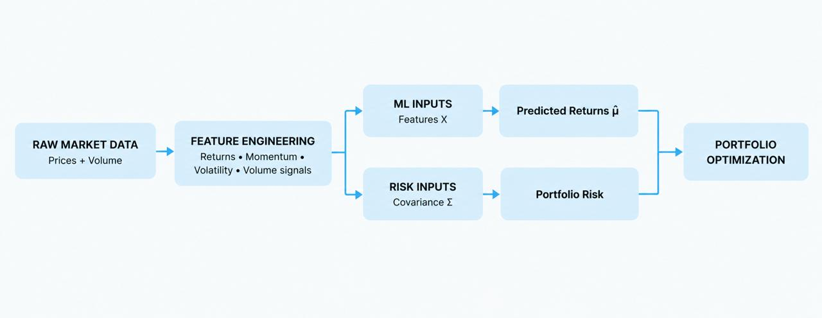



DATA
Real Market Data: How It Becomes Model Inputs
Dataset Application
Model Inputs
Temporal Data Split Strategy
Data is split chronologically to separate model development from final out-of-sample evaluation.
Training
Validation
Backtesting
Model learning period. Feature patterns and return signals extracted here.
Hyperparameter tuning and model selection. No future data contamination.
Unseen data. Portfolio performance evaluated here as a true out-of-sample test.

Slide 5
OPTIMIZATION FORMULATION
From Idealized to Realistic Portfolio Optimization
Easy Problem: Convex Mean-Variance Optimization
maximize: μ̂ᵀw − λ · wᵀΣw
subject to: Σ wᵢ = 1
wᵢ ≥ 0
Balance predicted return against portfolio risk while remaining fully invested and long-only
μ̂ = ML-predicted expected returns vector
Σ = covariance matrix encoding asset risk structure
w = portfolio weight vector (decision variable)
λ = risk-aversion parameter (controls return/risk tradeoff)
Hard Problem: Add Realistic Trading Constraints
Transaction Costs
Cardinality Constraints
Position Limits
Turnover Constraints
Account for the cost of buying and selling assets.
Limit the number of assets held.
Limit exposure to individual assets
Limit portfolio rebalancing.
Core research question: How much do realistic constraints change the optimal portfolio and its performance ?

Slide 6
RESEARCH PLAN
What We Will Investigate
Planned Comparison Framework
1
2
3
4
Simple Baseline
Traditional Optimization
ML + Easy Optimization
ML + Realistic Constraints
Equal-weight or market-cap-weight portfolio - No prediction, no optimization.
Establish a benchmark floor.
Mean-variance optimization using historical sample mean - No ML
Isolates the value of ML prediction.
ML-predicted returns fed into convex mean-variance optimizer. No trading constraints.
Measure the benefit of predicted returns.
Full pipeline with transaction costs, cardinality, position limits, and turnover bounds.
*Final constraint set will be selected based on data and implementation feasibility.
Evaluation Metrics
Return — Annualized portfolio return on the backtesting period
Sharpe Ratio — Risk-adjusted return (return per unit of volatility)
Max Drawdown — Largest peak-to-trough loss, a key tail risk measure
Turnover & Costs — Total rebalancing activity and realized transaction costs
Planned/Potential Extension
Regime-aware optimization: use market conditions such as normal and high-volatility periods to investigate whether adapting risk aversion $λ$improves portfolio robustness.

Slide 7
