Slide 1
Data Cleaning
STAGE 1 - CONVERSIONS

Slide 2
# IMPORT BY USING THE SUITABLE ENCODING fifa = read.csv("raw_downloaded_data.csv",fileEncoding="UTF-8-BOM") #LIBRARY TO PLAY WITH STRINGS library("stringr") #TO PREVENT SCIENTIFIC NOTATION options(scipen = 999)

Slide 3
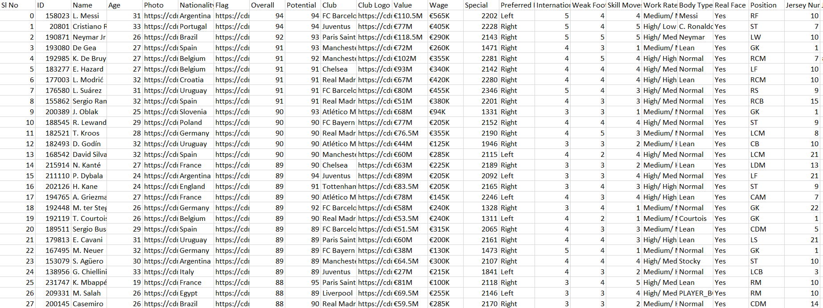

Slide 4
#REMOVE "€" FROM THE CURRENCY COLUMNS fifa$Release.Clause = lapply(fifa$Release.Clause, function(x){gsub("€", "", x)}) fifa$Value = lapply(fifa$Value, function(x){gsub("€", "", x)}) fifa$Wage = lapply(fifa$Wage, function(x){gsub("€", "", x)})

Slide 5
#CONVERT CURRENCY(FROM 'K' AND 'M') TO NUMBERS fifa$Value = lapply(fifa$Value, function(i) { if(isTRUE(str_detect(i, "K"))){ a= strsplit(as.character(i[[1]][1]), "[[:upper:]]") b = as.double(a[[1]][1]) c = b*1000 return(c) } else if (isTRUE(str_detect(i, "M"))){ a= strsplit(as.character(i[[1]][1]), "[[:upper:]]") b = as.double(a[[1]][1]) c = b*1000000 return(c) } else{ return(i) } } ) fifa$Wage = lapply(fifa$Wage, function(i) { if(isTRUE(str_detect(i, "K"))){ a= strsplit(as.character(i[[1]][1]), "[[:upper:]]") b = as.double(a[[1]][1]) c = b*1000 return(c) } else if (isTRUE(str_detect(i, "M"))){ a= strsplit(as.character(i[[1]][1]), "[[:upper:]]") b = as.double(a[[1]][1]) c = b*1000000 return(c) } else{ return(i) } } ) fifa$Release.Clause = lapply(fifa$Release.Clause, function(i) { if(isTRUE(str_detect(i, "K"))){ a= strsplit(as.character(i[[1]][1]), "[[:upper:]]") b = as.double(a[[1]][1]) c = b*1000 return(c) } else if (isTRUE(str_detect(i, "M"))){ a= strsplit(as.character(i[[1]][1]), "[[:upper:]]") b = as.double(a[[1]][1]) c = b*1000000 return(c) } else{ return(i) } } )

Slide 7
#CONVERT HEIGHTS FROM INCHES TO CENTIMETERS fifa$Height = lapply(fifa$Height, function(i) { a = strsplit(as.character(i), "[[:punct:]]")[[1]][1] b = strsplit(as.character(i), "[[:punct:]]")[[1]][2] return (as.integer(a)*30.48 + as.integer(b)*2.54) } )

Slide 9
#CONVERT WEIGHTS FROM LBS TO KG fifa$Weight = lapply(fifa$Weight, function(i) { a= strsplit(as.character(i[[1]][1]), "[[:lower:]]") b = as.double(a[[1]][1]) c = round(b*0.45359237, digits=2) return(c) } )

Slide 11
#CONVERT LIST(EVERY CELL) TO NUMERIC fifa$Value = unlist(lapply(fifa$Value, as.numeric)) fifa$Wage = unlist(lapply(fifa$Wage, as.numeric)) fifa$Height = unlist(lapply(fifa$Height, as.numeric)) fifa$Weight = unlist(lapply(fifa$Weight, as.numeric)) fifa$Release.Clause = unlist(lapply(fifa$Release.Clause, as.numeric)) #WRITE THE CLEANED DATA INTO A NEW FILE write.csv(fifa, "0_raw_downloaded_data.csv", row.names = FALSE)

Slide 12
Data Cleaning
STAGE 2 – DELETIONS AND REPLACEMENT

Slide 13
# DELETING THE UNECCESSARY ROWS fifa <- fifa[, -c(2,5,7,11,14,16,17,18,19,21,24,25,26,29,30,31,32,33,34,35,36,37,38,39,40,41,42,43,44,45,46,47,48,49,50,51,52,53,54)]

Slide 14
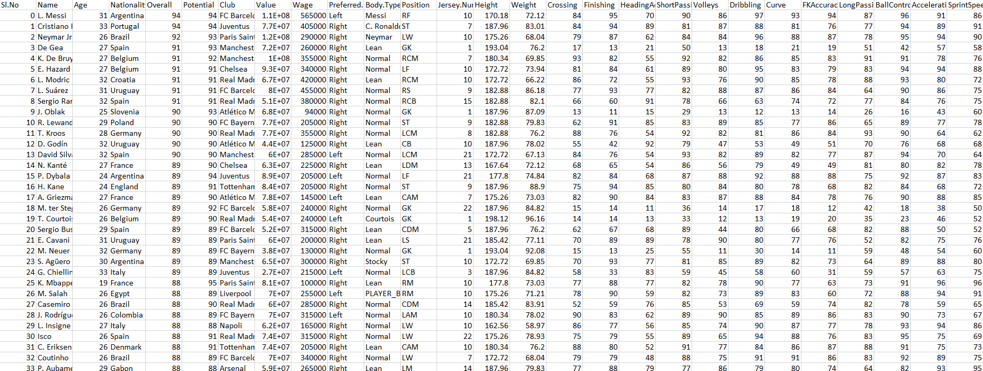

Slide 15
#CHECK FOR THE CLASS sapply(colnames(fifa), function(x) class(fifa[[x]]))
## Sl.No Name Age Nationality ## "integer" "factor" "integer" "factor" ## Overall Potential Club Value ## "integer" "integer" "factor" "integer" ## Wage Preferred.Foot Body.Type Position ## "integer" "factor" "factor" "factor" ## Jersey.Number Height Weight Crossing ## "integer" "numeric" "numeric" "integer" ## Finishing HeadingAccuracy ShortPassing Volleys ## "integer" "integer" "integer" "integer" ## Dribbling Curve FKAccuracy LongPassing ## "integer" "integer" "integer" "integer" ## BallControl Acceleration SprintSpeed Agility ## "integer" "integer" "integer" "integer" ## Reactions Balance ShotPower Jumping ## "integer" "integer" "integer" "integer" ## Stamina Strength LongShots Aggression ## "integer" "integer" "integer" "integer" ## Interceptions Positioning Vision Penalties ## "integer" "integer" "integer" "integer" ## Composure Marking StandingTackle SlidingTackle ## "integer" "integer" "integer" "integer" ## GKDiving GKHandling GKKicking GKPositioning ## "integer" "integer" "integer" "integer" ## GKReflexes Release.Clause ## "integer" "integer"

Slide 16
#REPLACING CATEGORICAL MISSING VALUE for (j in which(fifa$Name == '')) { fifa$Name[j] <-fifa$Name[j-1] } for (j in which(fifa$Nationality == '')) { fifa$Nationality[j] <-fifa$Nationality[j-1] } for (j in which(fifa$Club == '')) { fifa$Club[j] <-fifa$Club[j-1] } for (j in which(fifa$Preferred.Foot == '')) { fifa$Preferred.Foot[j] <-fifa$Preferred.Foot[j-1] } for (j in which(fifa$Body.Type == '')) { fifa$Body.Type[j] <-fifa$Body.Type[j-1] } for (j in which(fifa$Position == '')) { fifa$Position[j] <-fifa$Position[j-1] }

Slide 17
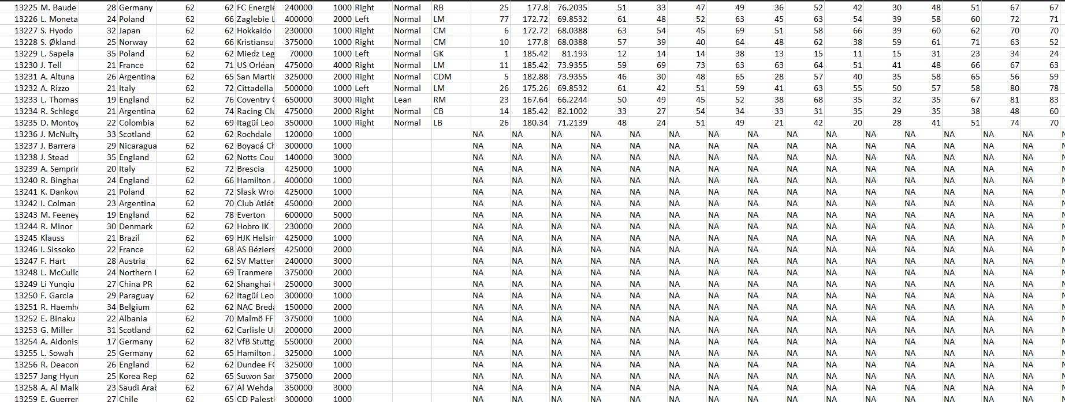

Slide 18
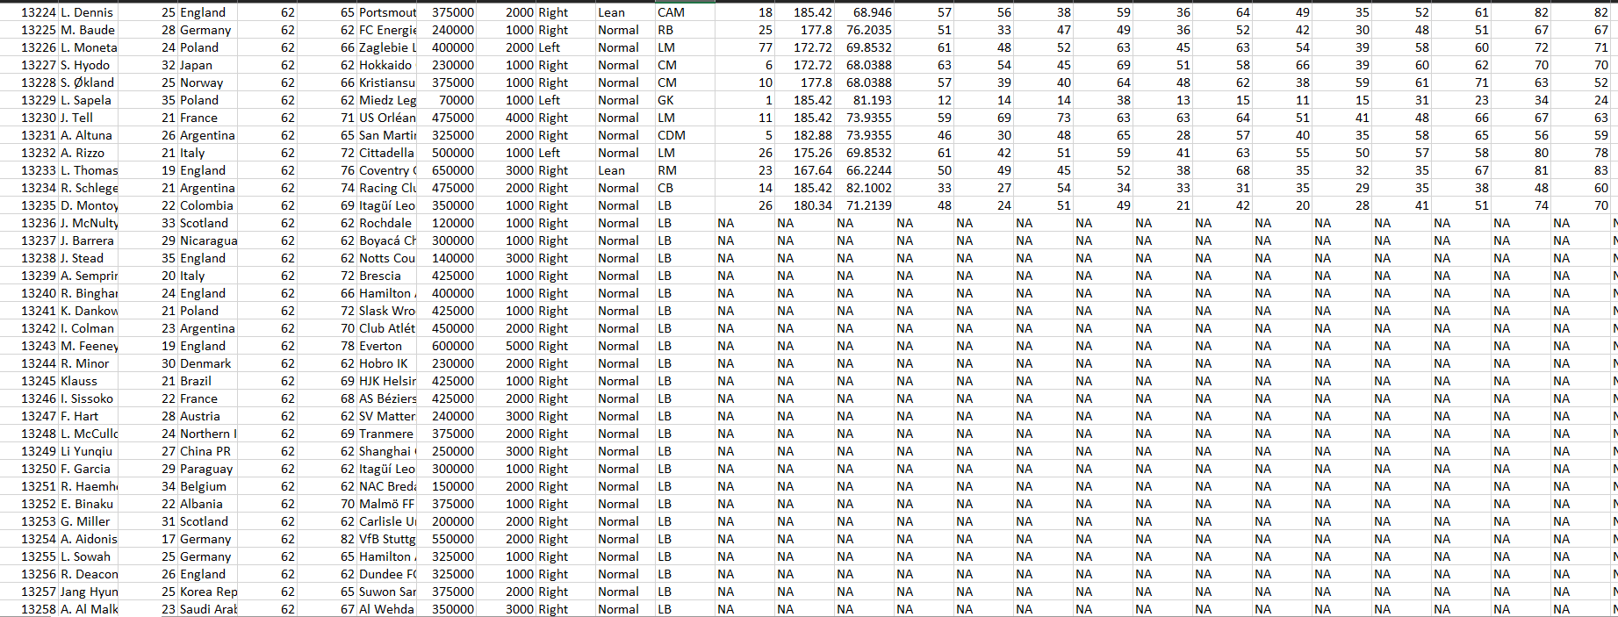

Slide 19
#REPLACING NUMERICAL MISSING VALUES for(i in c(8,9, 14:50)) { fifa[is.na(fifa[,i]), i] <-mean(fifa[,i], na.rm = TRUE) } for(i in c(3,5,6,13)) { if(i!=12){ fifa[is.na(fifa[,i]), i] <-as.integer(mean(fifa[,i], na.rm = TRUE)) } }

Slide 21
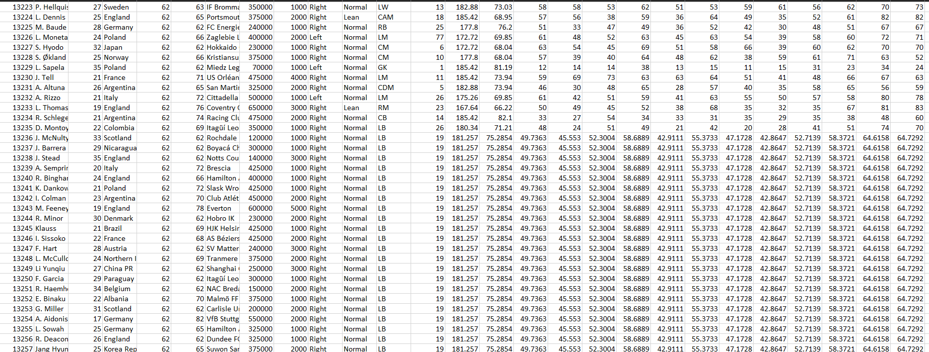

Slide 22
#CHECK IF THERE IS ANY MISSING VALUES print(any(is.na(fifa)))
## [1] FALSE
#VIEW THE CLEANED DATA View(fifa) #WRITE THE CLEANED DATA INTO A NEW FILE write.csv(fifa, "1_cleaned_data.csv", row.names = FALSE)

Slide 23
Normalization
Normalization, Standardization

Slide 24
# IMPORT THE DATASET fifa = read.csv( "1_cleaned_data.csv") #SELECTS NUMERICAL COLUMNS ONLY library("dplyr")
## ## Attaching package: 'dplyr'
## The following objects are masked from 'package:stats': ## ## filter, lag
## The following objects are masked from 'package:base': ## ## intersect, setdiff, setequal, union
numfifa = select_if(fifa, is.numeric)

Slide 25
#NORMALIZE FUNTION USING MIN-MAX VALUES normalize <- function(x){ return ((x-min(x))/(max(x)-min(x))) } #NORMALIZING THE DATA USING USER-DEFINED NORMALIZED FUNCTIONS ((x-min)/range) mmfifa <- as.data.frame(lapply(numfifa, normalize)) write.csv(mmfifa, "2_minmax.csv", row.names = FALSE)

Slide 26
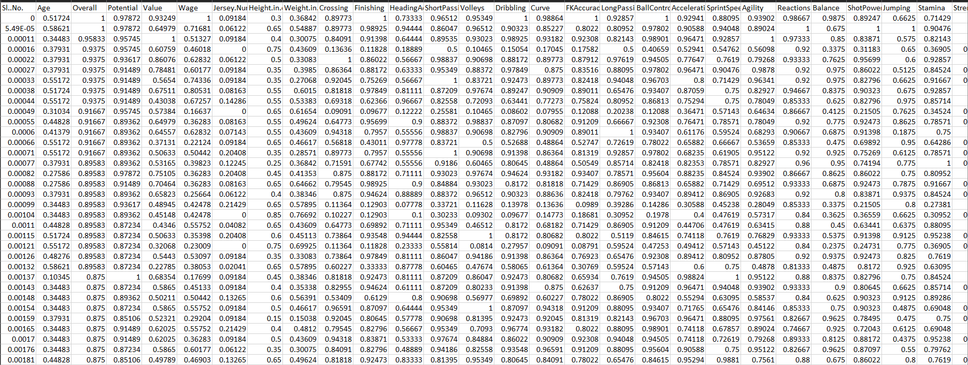

Slide 27
#STANDARDIZATION ((x-mean)/sd) library("clusterSim")
## Loading required package: cluster
## Loading required package: MASS
## ## Attaching package: 'MASS'
## The following object is masked from 'package:dplyr': ## ## select
sfifa = data.Normalization(numfifa, type="n1", normalization = "column") write.csv(sfifa, "2_standard.csv", row.names = FALSE)

Slide 28
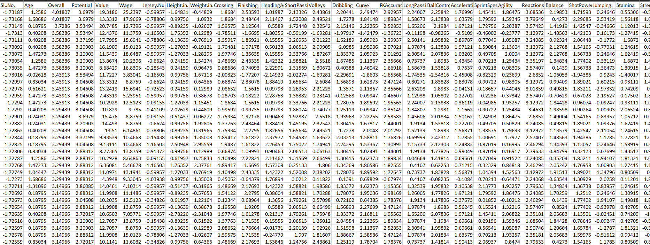

Slide 29
#NORMALIZATION ((x-mean)/sqrt(sum((x-mean)^2))) nfifa = data.Normalization(numfifa, type="n12", normalization = "column") write.csv(nfifa, "2_norm.csv", row.names = FALSE)

Slide 30
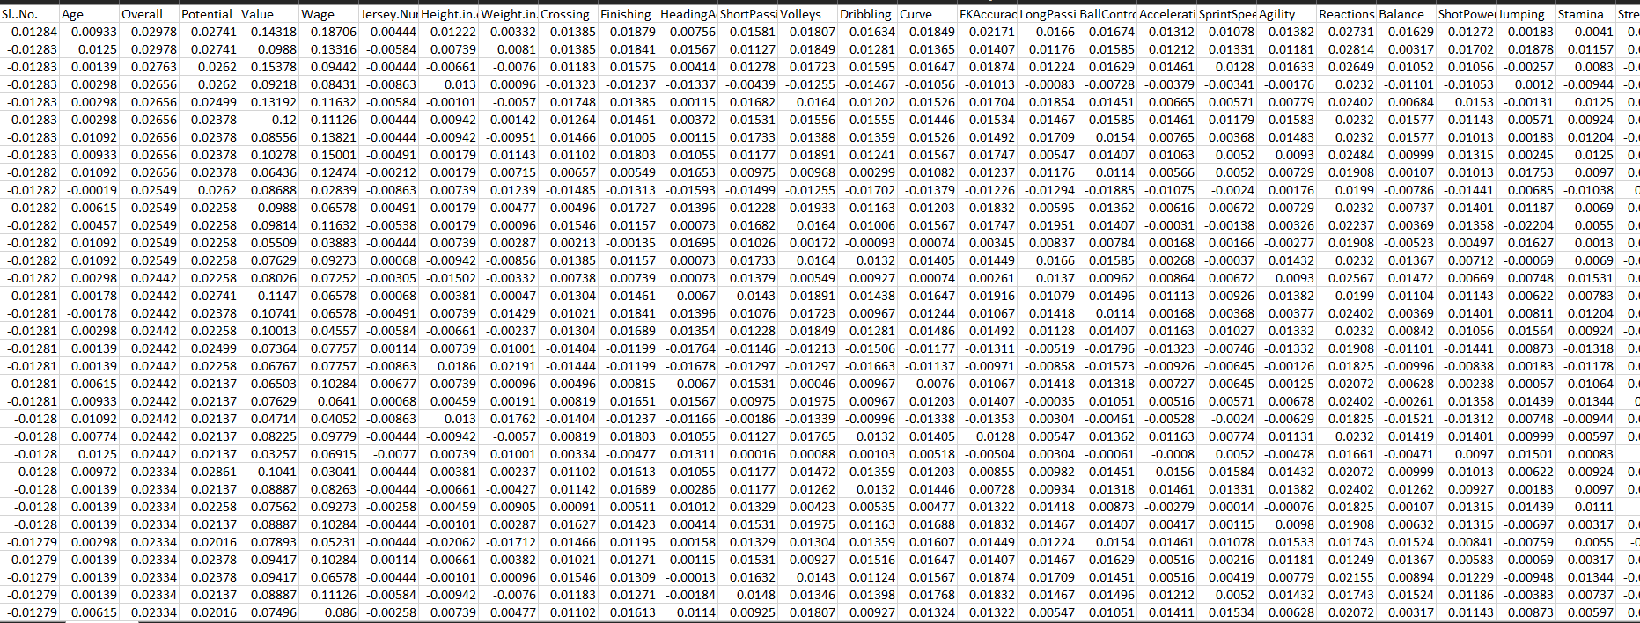

Slide 31
#NORMALIZING THE DATA THROUGH NATURAL LOGARITHMS logfifa = as.data.frame(lapply(numfifa, log)) write.csv(logfifa, "2_log.csv", row.names = FALSE)

Slide 32
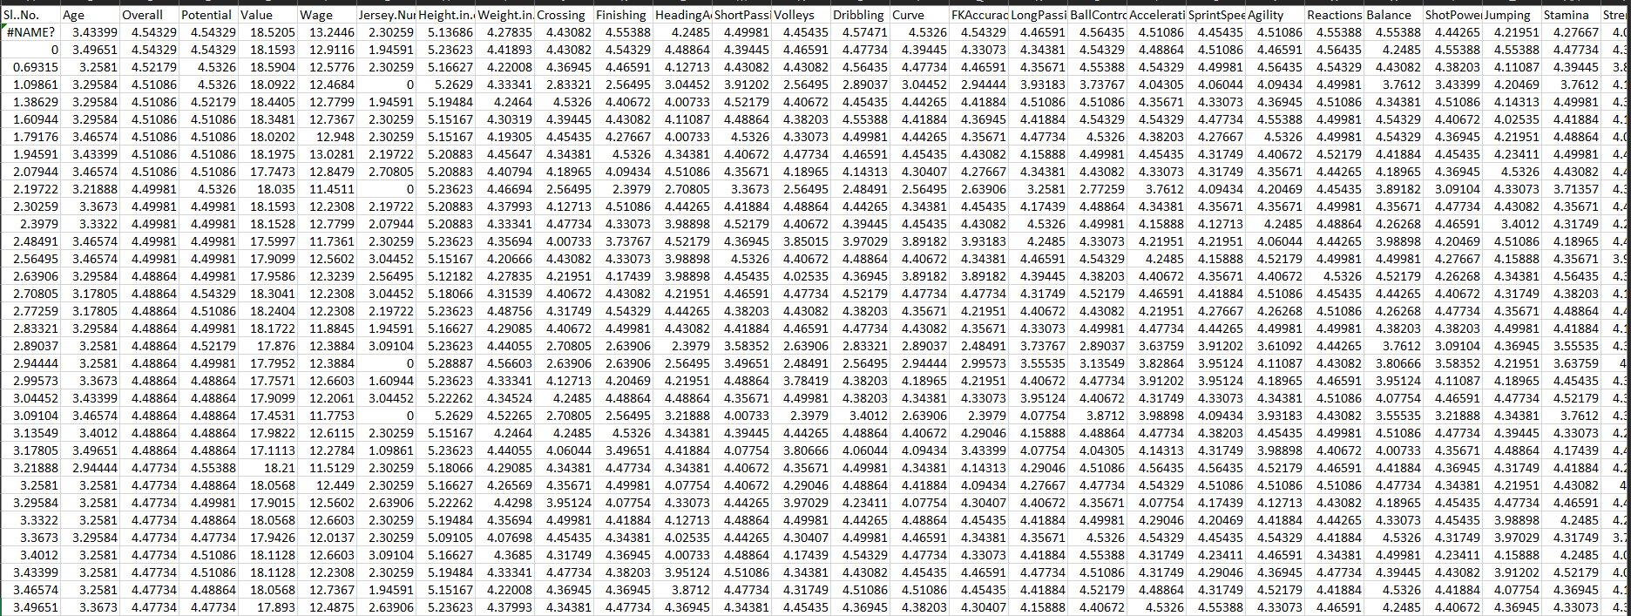

Slide 33
Normalization
Normality Test

Slide 34
# This library is already loaded: library("dplyr") library("ggpubr")
## Loading required package: ggplot2
## Loading required package: magrittr

Slide 35
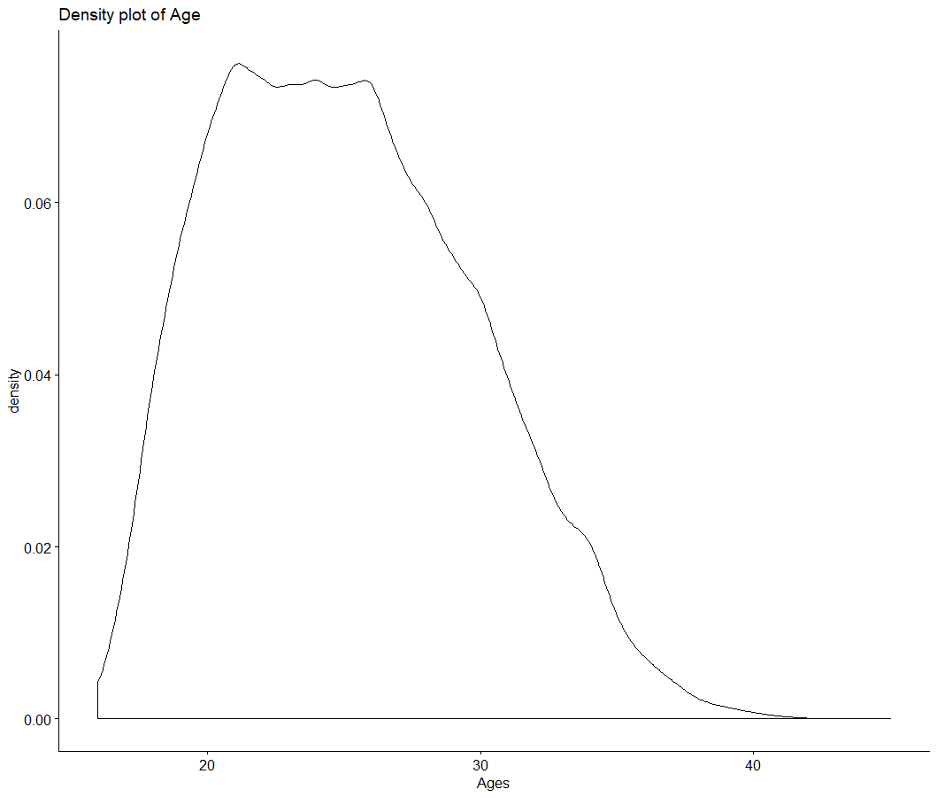
#DENSITY PLOT OF AGE print(ggdensity(fifa$Age, main="Density plot of Age", xlab = "Ages"))
Notes:
MUST BE BELL SHAPED

Slide 36
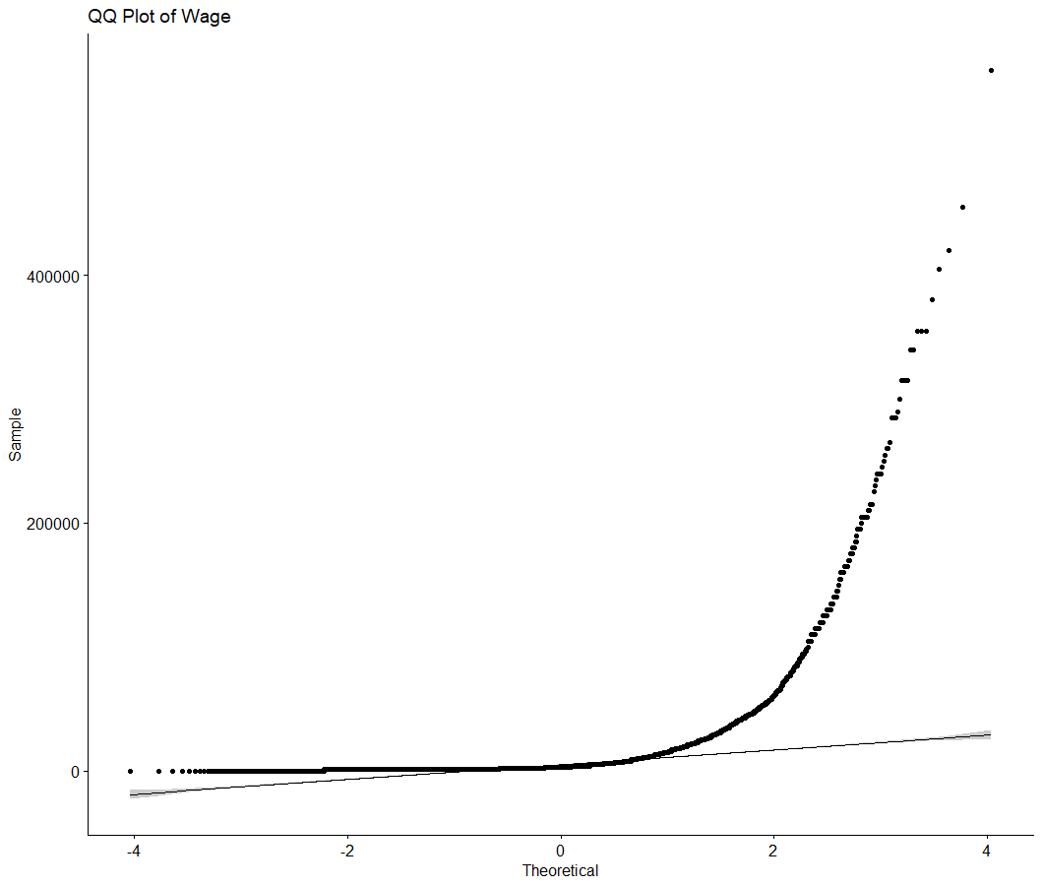
#QQ PLOT OF WAGE print(ggqqplot(fifa$Wage, main="QQ Plot of Wage"))
Notes:
MUST COINCIDE WITH THE STRAIGHT LINE

Slide 37
Graph Visualization

Slide 38
fifa = read.csv("1_cleaned_data.csv") library(ggplot2) theme_set(theme_classic()) options(scipen = 999)
library("ggpubr")
## Loading required package: magrittr

Slide 39
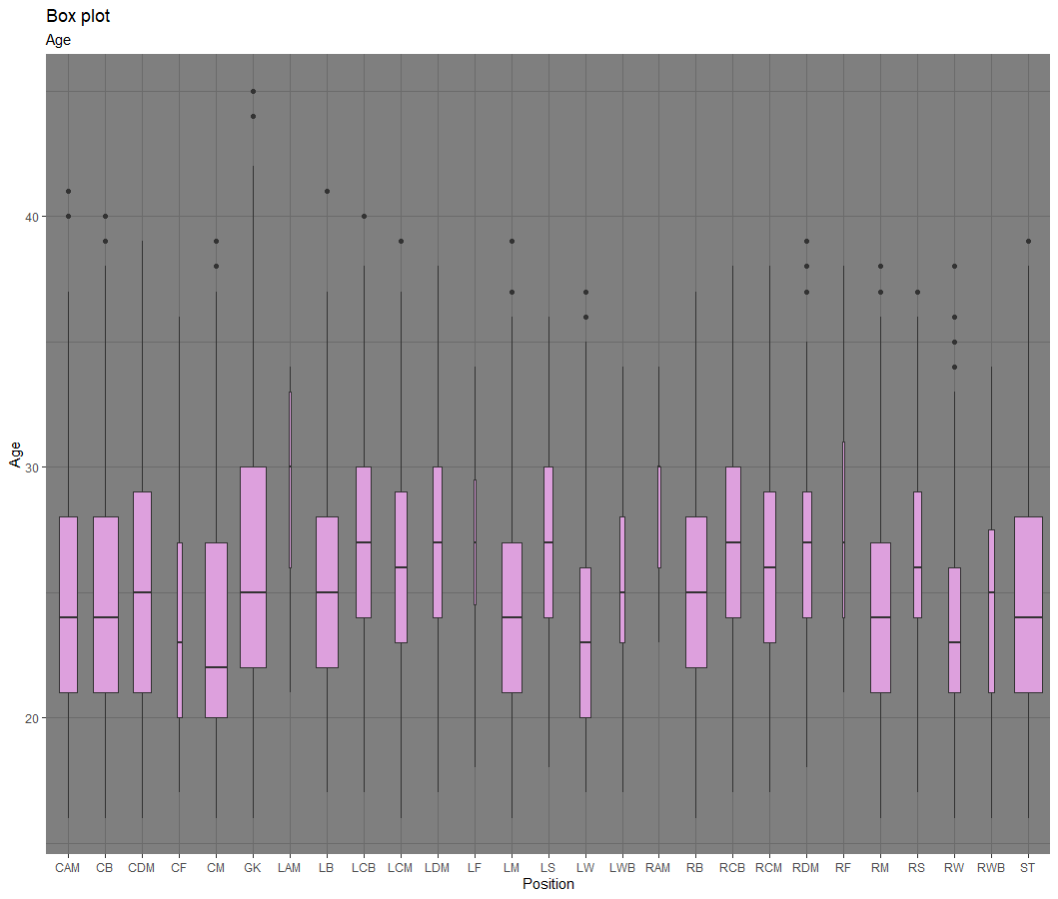
# BOXPLOT OF AGE VS POSITION print(ggplot(fifa, aes(Position, Age)) + geom_boxplot(varwidth=T, fill="plum") + labs(title="Box plot", subtitle="Age"))
GK has the wide range of players
Players need to be above 20 for RF
Oldest players choose GK

Slide 40
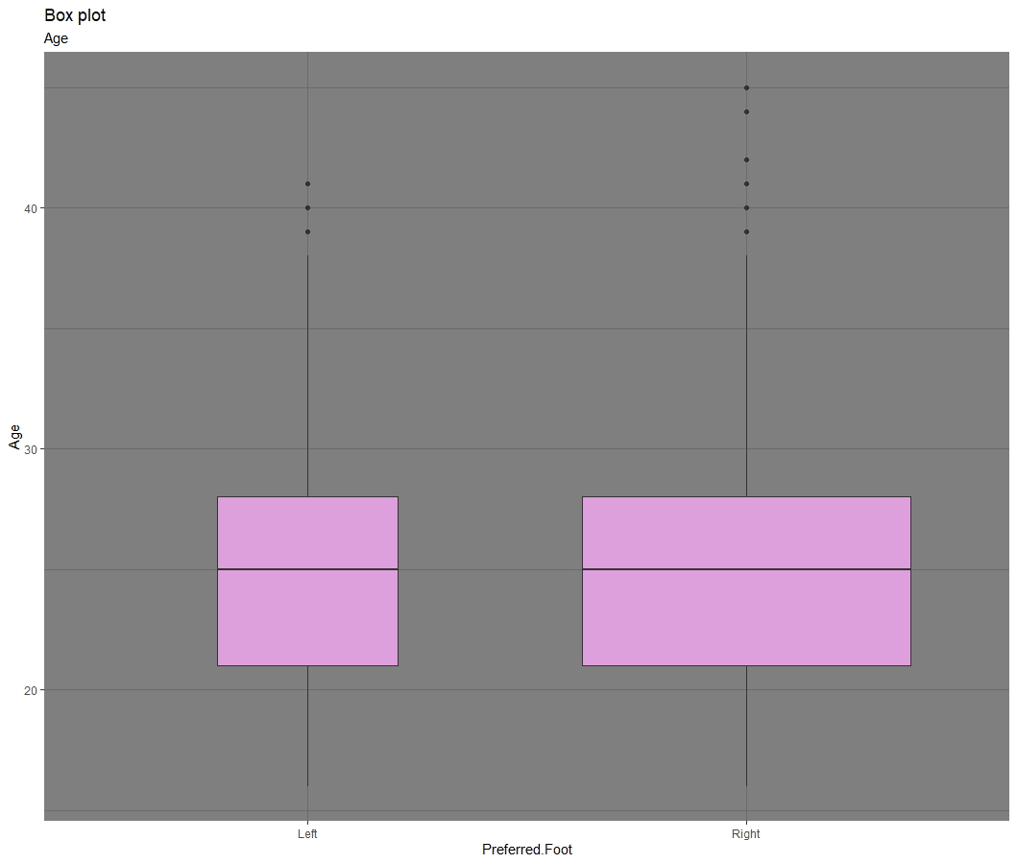
# BOXPLOT OF AGE VS PREFERRED FOOT print(ggplot(fifa, aes(Preferred.Foot, Age)) + geom_boxplot(varwidth=T, fill="plum") + labs(title="Box plot",subtitle="Age"))
More outliers in the Right Preferred Foot

Slide 41
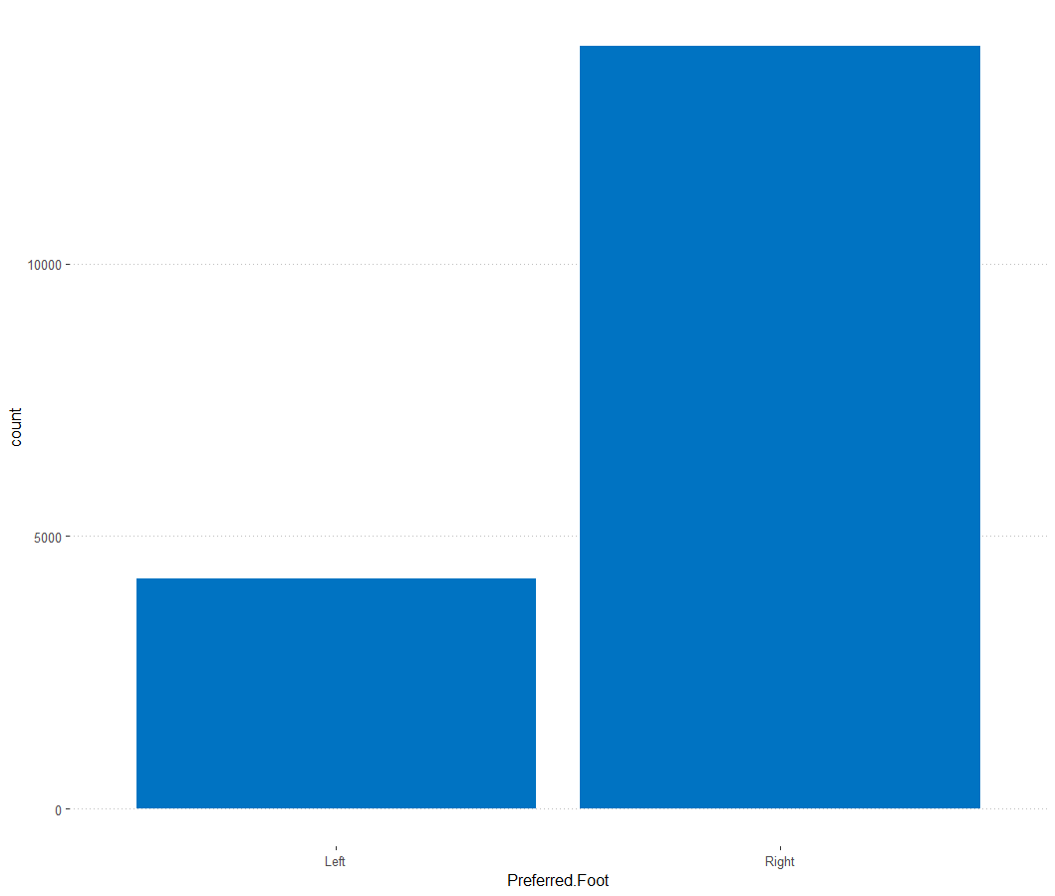
# FREQUENCY GRAPH FOR PREFFERED FOOT library("ggpubr")
print(ggplot(fifa, aes(Preferred.Foot)) +geom_bar(fill = "#0073C2FF") +theme_pubclean())
More than 70% players are right footed players

Slide 42
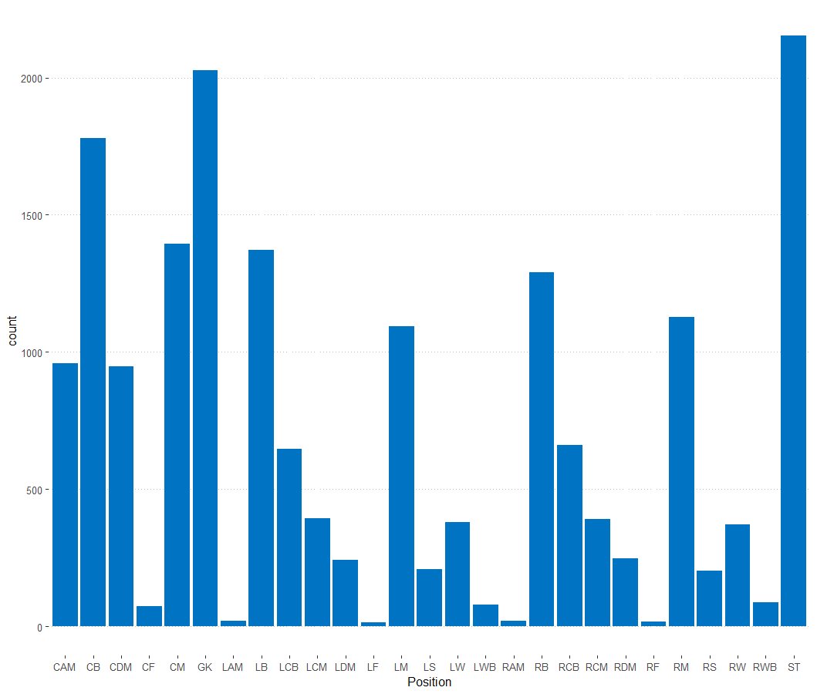
# FREQUENCY GRAPH FOR POSITION print(ggplot(fifa, aes(Position)) +geom_bar(fill = "#0073C2FF") +theme_pubclean())
Only few choose LAM, LF, RAM, RF

Slide 43
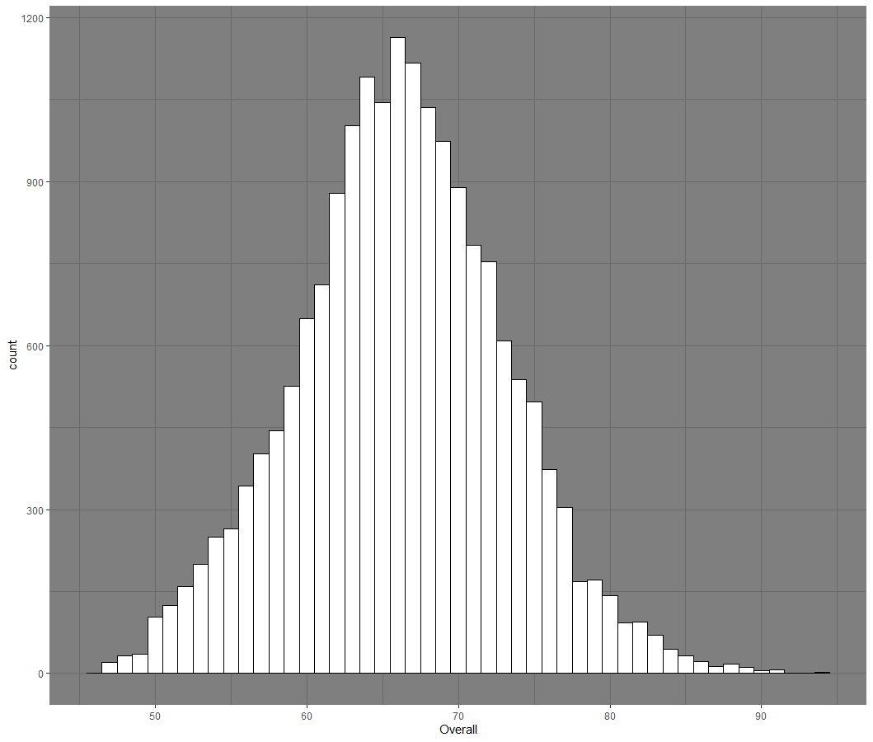
# HISTOGRAM ON OVERALL ggplot(fifa, aes(x=Overall)) + geom_histogram(binwidth=1, color="black", fill="white")
Follows normal distribution
More than 60% of players fall between 60-75

Slide 44
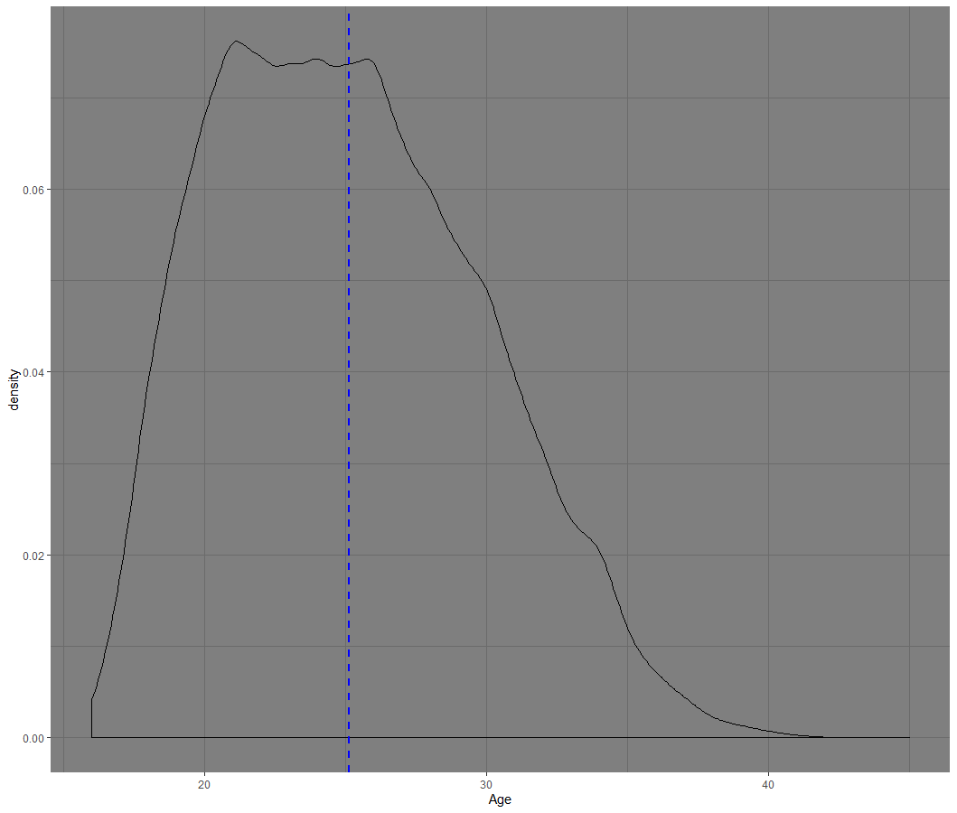
# DENSITY PLOT OF AGE print(ggplot(fifa, aes(x=Age)) + geom_density()+geom_vline(aes(xintercept = mean(Age)),color="blue", linetype="dashed", size=1))
Follows normal distribution
Mean is around 25

Slide 45
Correlations

Slide 46
fifa = read.csv("1_cleaned_data.csv") options(scipen = 999) library("GGally")
## Loading required package: ggplot2
## Registered S3 method overwritten by 'GGally': ## method from ## +.gg ggplot2
#HEAT MAP print(ggcorr(fifa))
## Warning in ggcorr(fifa): data in column(s) 'Name', 'Nationality', 'Club', ## 'Preferred.Foot', 'Body.Type', 'Position' are not numeric and were ignored

Slide 47
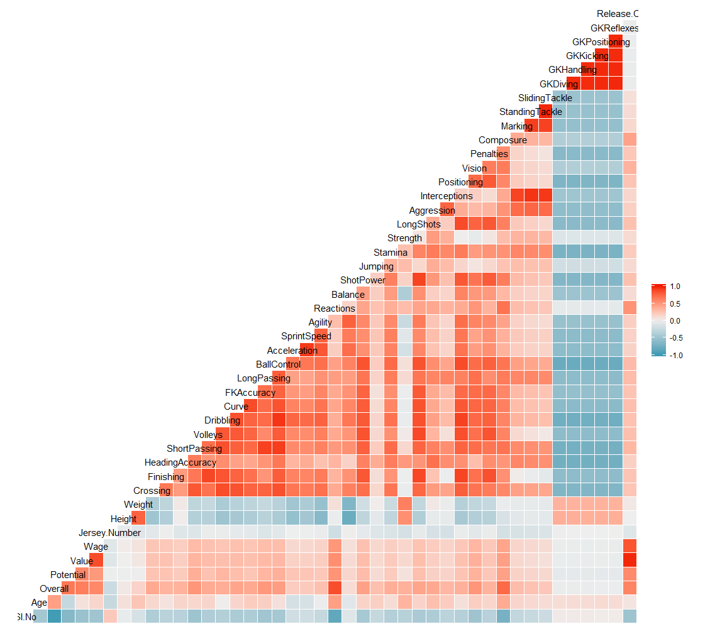
HEAT MAP

Slide 48
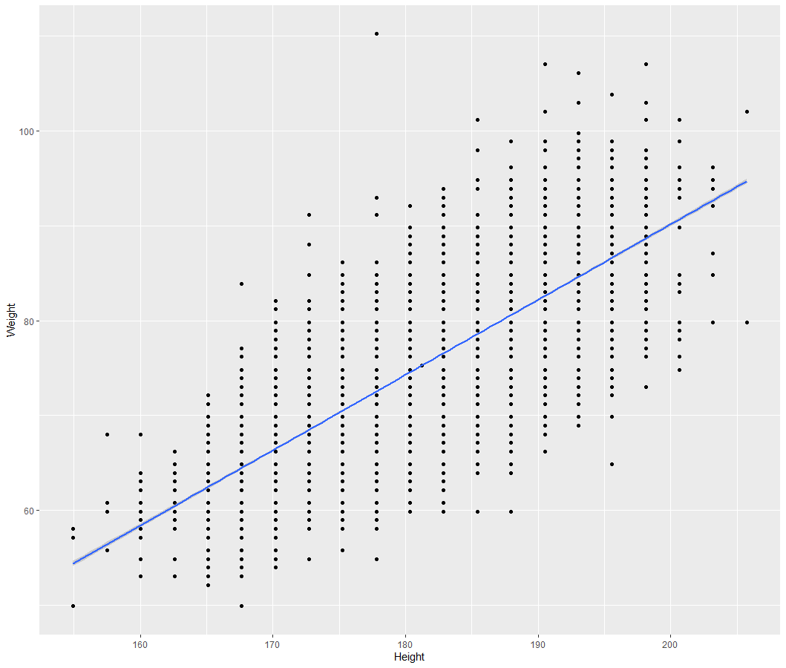
#SCATTER PLOT FOR HEIGHT VS WEIGHT print(ggplot(fifa, aes(x=Height, y =Weight)) + geom_point() + geom_smooth(method = lm))
Correlation:
Positive
Weak
Linear

Slide 49
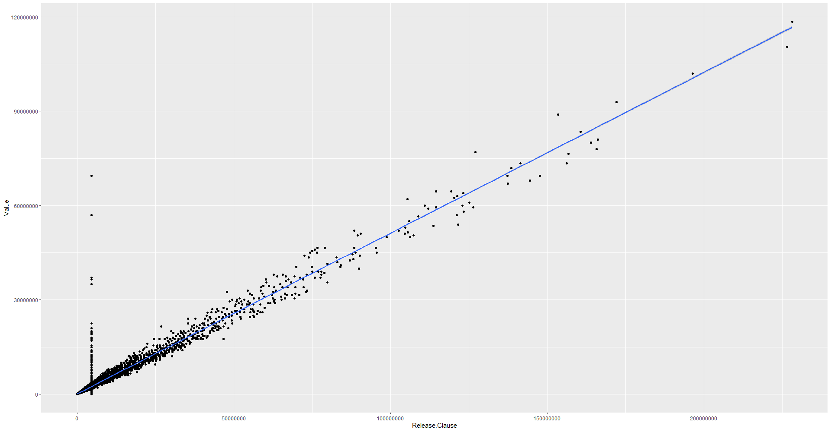
#SCATTER PLOT print(ggplot(fifa, aes(x=Release.Clause, y =Value)) + geom_jitter()+geom_smooth(method = lm))
Correlation:
Positive
Strong
Linear

Slide 50
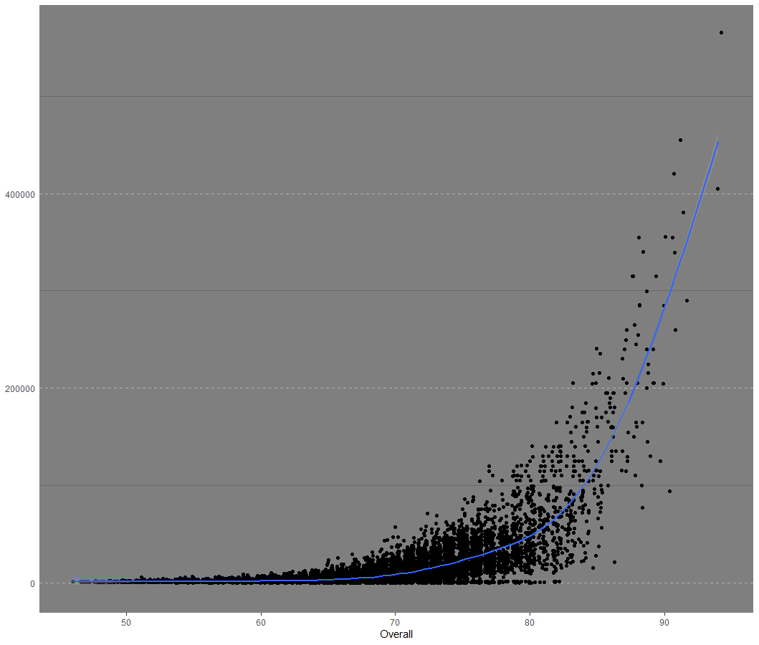
#SCATTER PLOT FOR OVERALL VS WAGE print(ggplot(fifa, aes(x=Overall, y =Wage)) + geom_jitter()+geom_smooth()) +theme_cleveland()
## `geom_smooth()` using method = 'gam' and formula 'y ~ s(x, bs = "cs")'
Correlation:
Positive
Exponential

Slide 51
#PEARSON CORRELATION COEFFICIENT print(cor(fifa$Release.Clause,fifa$Value, method = "pearson", use = "complete.obs"))
## [1] 0.9720409
#PEARSON TEST FOR ASSOCIATION/CORRELATION BETWEEN SAMPLES print(cor.test(fifa$Release.Clause,fifa$Value, method="pearson"))
## ## Pearson's product-moment correlation ## ## data: fifa$Release.Clause and fifa$Value ## t = 558.53, df = 18204, p-value < 0.00000000000000022 ## alternative hypothesis: true correlation is not equal to 0 ## 95 percent confidence interval: ## 0.9712286 0.9728307 ## sample estimates: ## cor ## 0.9720409

Slide 52
#KENDALL CORRELATION COEFFICIENT print(cor(fifa$Release.Clause,fifa$Value, method = "kendall", use = "complete.obs"))
## [1] 0.8243123
#KENDALL TEST FOR ASSOCIATION/CORRELATION BETWEEN SAMPLES print(cor.test(fifa$Release.Clause,fifa$Value, method="kendall"))
## ## Kendall's rank correlation tau ## ## data: fifa$Release.Clause and fifa$Value ## z = 165.09, p-value < 0.00000000000000022 ## alternative hypothesis: true tau is not equal to 0 ## sample estimates: ## tau ## 0.8243123

Slide 53
#SPREARMAN CORRELATION COEFFICIENT print(cor(fifa$Release.Clause,fifa$Value, method = "spearman", use = "complete.obs"))
## [1] 0.9002106
#SPEARMAN TEST FOR ASSOCIATION/CORRELATION BETWEEN SAMPLES print(cor.test(fifa$Release.Clause,fifa$Value, method="spearman"))
"spearman"): Cannot compute exact p-value with ties
## ## Spearman's rank correlation rho ## ## data: fifa$Release.Clause and fifa$Value ## S = 100363716365, p-value < 0.00000000000000022 ## alternative hypothesis: true rho is not equal to 0 ## sample estimates: ## rho ## 0.9002106

Slide 54
Hypothesis Testing

Slide 55
fifa= read.csv("2_standard.csv") View(fifa) # We know that the mean of the standardized data should be 0 and the sd should be 1 print(sd(fifa$Overall))
## [1] 1
print(mean(fifa$Overall))
## [1] 2.149407e-17

Slide 56
# One sample t-test--------------------------- # Ho : Mean = 0 [Null Hypothesis] # H1 : Mean != 0 [Alternate Hypothesis] t.test(fifa$Overall, mu = 0)
## ## One Sample t-test ## ## data: fifa$Overall ## t = 2.9002e-15, df = 18205, p-value = 1 ## alternative hypothesis: true mean is not equal to 0 ## 95 percent confidence interval: ## -0.01452679 0.01452679 ## sample estimates: ## mean of x ## 2.149407e-17

Slide 57
# One sample t-test---------------------------
# Ho : Mean =< 0 [Null Hypothesis] # H1 : Mean > 0 [Alternate Hypothesis] t.test(fifa$Value,alternative = 'greater', mu = 0)
## ## One Sample t-test ## ## data: fifa$Value ## t = 2.7216e-15, df = 18205, p-value = 0.5 ## alternative hypothesis: true mean is greater than 0 ## 95 percent confidence interval: ## -0.01219108 Inf ## sample estimates: ## mean of x ## 2.017087e-17

Slide 58
# Two sample t-test--------------------------- # Ho : Mean1 = Mean2 => (Mean1 - Mean2) = 0 [Null Hypothesis] # H1 : Mean1 != Mean2 [Alternate Hypothesis] t.test(fifa$Overall,fifa$Potential,alternative = 'two.sided', mu = 0)
## ## Welch Two Sample t-test ## ## data: fifa$Overall and fifa$Potential ## t = 5.9323e-14, df = 36410, p-value = 1 ## alternative hypothesis: true difference in means is not equal to 0 ## 95 percent confidence interval: ## -0.0205433 0.0205433 ## sample estimates: ## mean of x mean of y ## 2.149407e-17 -6.002743e-16

Slide 59
# Two sample t-test---------------------------
# Ho : (Mean1 - Mean2) =< 0 [Null Hypothesis] # H1 : (Mean1 - Mean2) > 0 [Alternate Hypothesis] t.test(fifa$Overall,fifa$Potential,alternative = 'greater', mu = 0)
## ## Welch Two Sample t-test ## ## data: fifa$Overall and fifa$Potential ## t = 5.9323e-14, df = 36410, p-value = 0.5 ## alternative hypothesis: true difference in means is greater than 0 ## 95 percent confidence interval: ## -0.01724035 Inf ## sample estimates: ## mean of x mean of y ## 2.149407e-17 -6.002743e-16

Slide 60
# Chi square test for independence tab = table(fifa$Overall,fifa$Wage) chisq.test(fifa$Overall,fifa$Wage,correct = T)
## Warning in chisq.test(fifa$Overall, fifa$Wage, correct = T): Chi-squared ## approximation may be incorrect
## ## Pearson's Chi-squared test ## ## data: fifa$Overall and fifa$Wage ## X-squared = 130713, df = 6721, p-value < 2.2e-16

