Slide 1
Data Cleaning
STAGE 1 - CONVERSIONS

Slide 2
# IMPORT BY USING THE SUITABLE ENCODING fifa = read.csv("raw_downloaded_data.csv",fileEncoding="UTF-8-BOM") #LIBRARY TO PLAY WITH STRINGS library("stringr") #TO PREVENT SCIENTIFIC NOTATION options(scipen = 999)

Slide 3
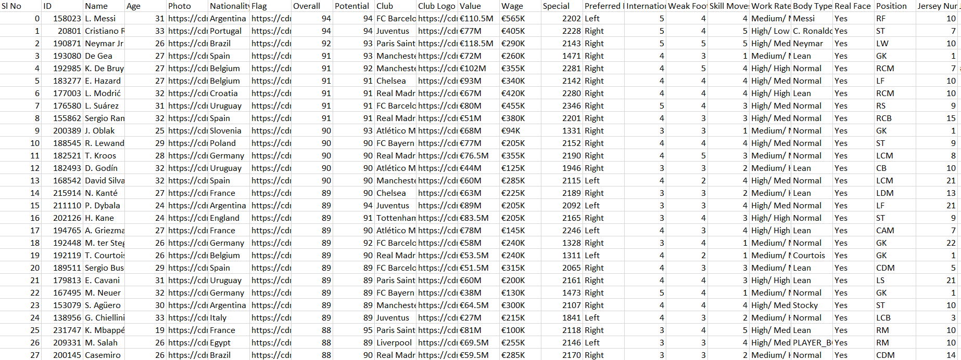

Slide 4
#REMOVE "€" FROM THE CURRENCY COLUMNS fifa$Release.Clause = lapply(fifa$Release.Clause, function(x){gsub("€", "", x)}) fifa$Value = lapply(fifa$Value, function(x){gsub("€", "", x)}) fifa$Wage = lapply(fifa$Wage, function(x){gsub("€", "", x)})

Slide 5
#CONVERT CURRENCY(FROM 'K' AND 'M') TO NUMBERS fifa$Value = lapply(fifa$Value, function(i) { if(isTRUE(str_detect(i, "K"))){ a= strsplit(as.character(i[[1]][1]), "[[:upper:]]") b = as.double(a[[1]][1]) c = b*1000 return(c) } else if (isTRUE(str_detect(i, "M"))){ a= strsplit(as.character(i[[1]][1]), "[[:upper:]]") b = as.double(a[[1]][1]) c = b*1000000 return(c) } else{ return(i) } } ) fifa$Wage = lapply(fifa$Wage, function(i) { if(isTRUE(str_detect(i, "K"))){ a= strsplit(as.character(i[[1]][1]), "[[:upper:]]") b = as.double(a[[1]][1]) c = b*1000 return(c) } else if (isTRUE(str_detect(i, "M"))){ a= strsplit(as.character(i[[1]][1]), "[[:upper:]]") b = as.double(a[[1]][1]) c = b*1000000 return(c) } else{ return(i) } } ) fifa$Release.Clause = lapply(fifa$Release.Clause, function(i) { if(isTRUE(str_detect(i, "K"))){ a= strsplit(as.character(i[[1]][1]), "[[:upper:]]") b = as.double(a[[1]][1]) c = b*1000 return(c) } else if (isTRUE(str_detect(i, "M"))){ a= strsplit(as.character(i[[1]][1]), "[[:upper:]]") b = as.double(a[[1]][1]) c = b*1000000 return(c) } else{ return(i) } } )

Slide 7
#CONVERT HEIGHTS FROM INCHES TO CENTIMETERS fifa$Height = lapply(fifa$Height, function(i) { a = strsplit(as.character(i), "[[:punct:]]")[[1]][1] b = strsplit(as.character(i), "[[:punct:]]")[[1]][2] return (as.integer(a)*30.48 + as.integer(b)*2.54) } )

Slide 9
#CONVERT WEIGHTS FROM LBS TO KG fifa$Weight = lapply(fifa$Weight, function(i) { a= strsplit(as.character(i[[1]][1]), "[[:lower:]]") b = as.double(a[[1]][1]) c = round(b*0.45359237, digits=2) return(c) } )

Slide 11
#CONVERT LIST(EVERY CELL) TO NUMERIC fifa$Value = unlist(lapply(fifa$Value, as.numeric)) fifa$Wage = unlist(lapply(fifa$Wage, as.numeric)) fifa$Height = unlist(lapply(fifa$Height, as.numeric)) fifa$Weight = unlist(lapply(fifa$Weight, as.numeric)) fifa$Release.Clause = unlist(lapply(fifa$Release.Clause, as.numeric)) #WRITE THE CLEANED DATA INTO A NEW FILE write.csv(fifa, "0_raw_downloaded_data.csv", row.names = FALSE)

Slide 12
Data Cleaning
STAGE 2 – DELETIONS AND REPLACEMENT

Slide 13
# DELETING THE UNECCESSARY ROWS fifa <- fifa[, -c(2,5,7,11,14,16,17,18,19,21,24,25,26,29,30,31,32,33,34,35,36,37,38,39,40,41,42,43,44,45,46,47,48,49,50,51,52,53,54)]

Slide 14
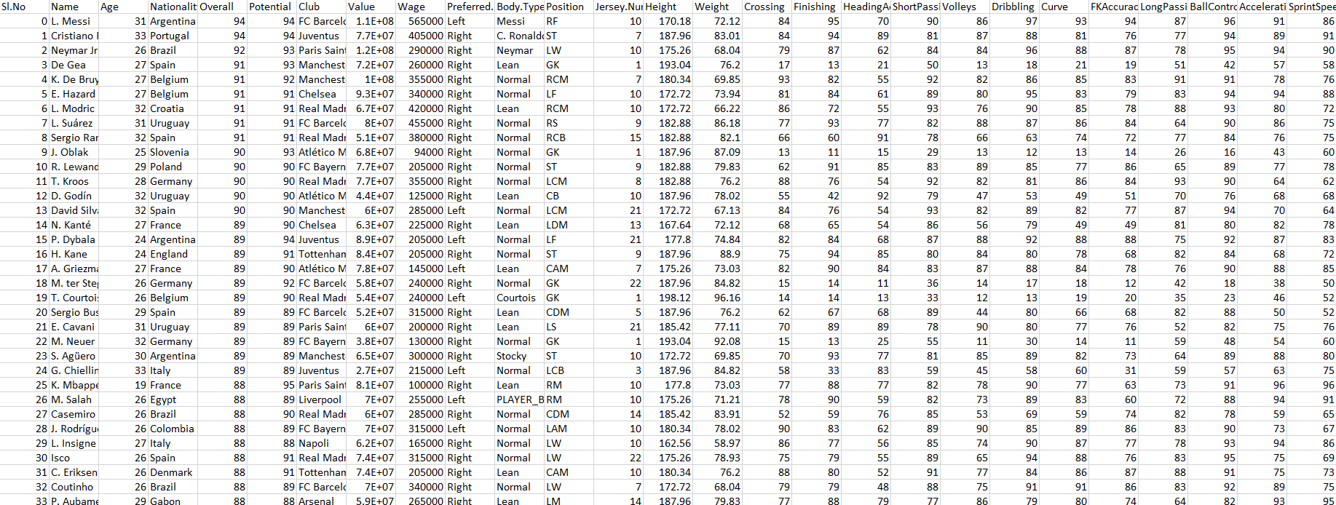

Slide 15
#CHECK FOR THE CLASS sapply(colnames(fifa), function(x) class(fifa[[x]]))
## Sl.No Name Age Nationality ## "integer" "factor" "integer" "factor" ## Overall Potential Club Value ## "integer" "integer" "factor" "integer" ## Wage Preferred.Foot Body.Type Position ## "integer" "factor" "factor" "factor" ## Jersey.Number Height Weight Crossing ## "integer" "numeric" "numeric" "integer" ## Finishing HeadingAccuracy ShortPassing Volleys ## "integer" "integer" "integer" "integer" ## Dribbling Curve FKAccuracy LongPassing ## "integer" "integer" "integer" "integer" ## BallControl Acceleration SprintSpeed Agility ## "integer" "integer" "integer" "integer" ## Reactions Balance ShotPower Jumping ## "integer" "integer" "integer" "integer" ## Stamina Strength LongShots Aggression ## "integer" "integer" "integer" "integer" ## Interceptions Positioning Vision Penalties ## "integer" "integer" "integer" "integer" ## Composure Marking StandingTackle SlidingTackle ## "integer" "integer" "integer" "integer" ## GKDiving GKHandling GKKicking GKPositioning ## "integer" "integer" "integer" "integer" ## GKReflexes Release.Clause ## "integer" "integer"

Slide 16
#REPLACING CATEGORICAL MISSING VALUE for (j in which(fifa$Name == '')) { fifa$Name[j] <-fifa$Name[j-1] } for (j in which(fifa$Nationality == '')) { fifa$Nationality[j] <-fifa$Nationality[j-1] } for (j in which(fifa$Club == '')) { fifa$Club[j] <-fifa$Club[j-1] } for (j in which(fifa$Preferred.Foot == '')) { fifa$Preferred.Foot[j] <-fifa$Preferred.Foot[j-1] } for (j in which(fifa$Body.Type == '')) { fifa$Body.Type[j] <-fifa$Body.Type[j-1] } for (j in which(fifa$Position == '')) { fifa$Position[j] <-fifa$Position[j-1] }

Slide 17
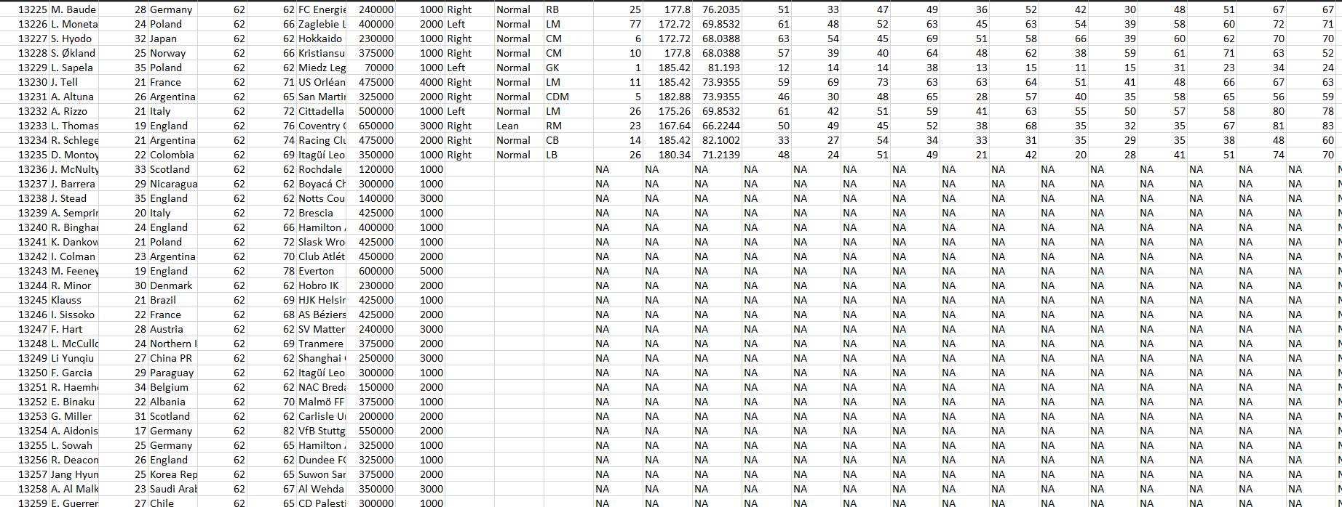

Slide 18
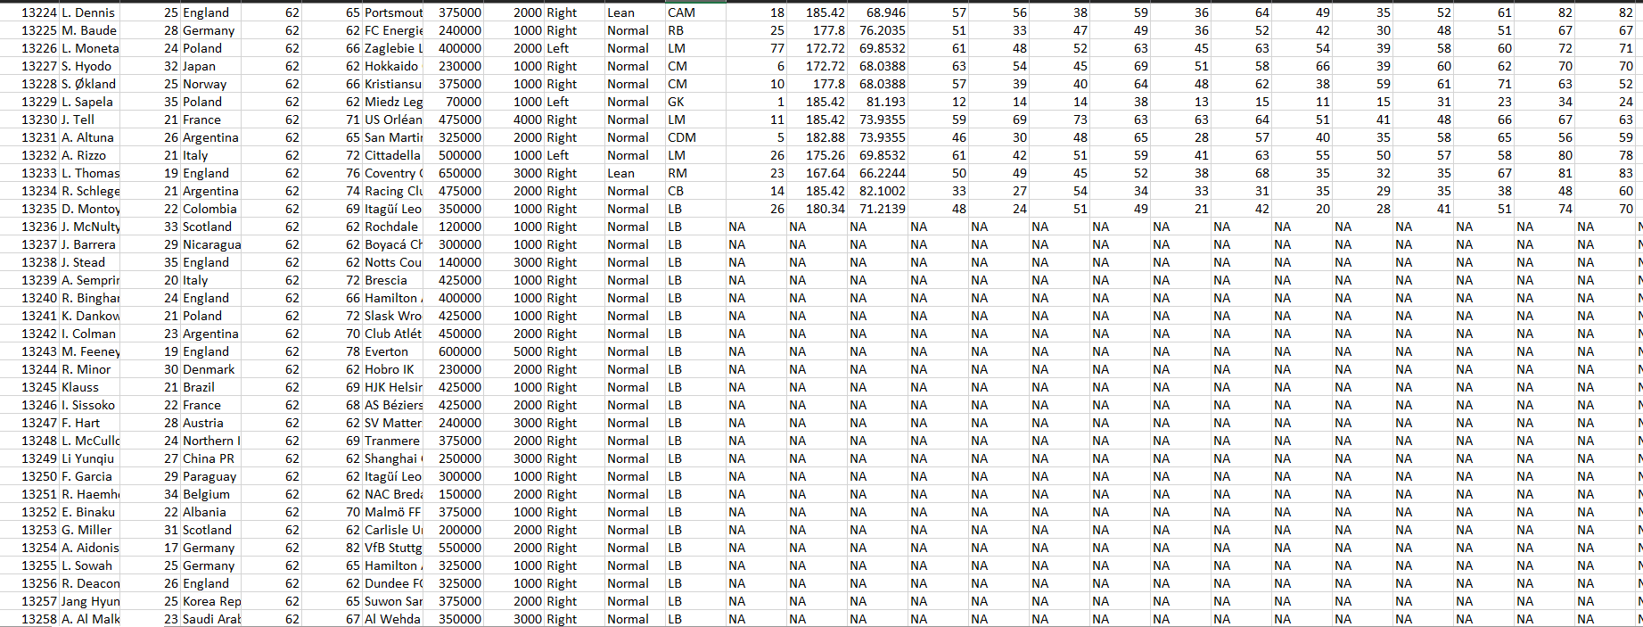

Slide 19
#REPLACING NUMERICAL MISSING VALUES for(i in c(8,9, 14:50)) { m <- mean(fifa[,i], na.rm = TRUE) fifa[is.na(fifa[,i]), i] <-m fifa[[i]] = lapply(fifa[[i]], function(x){replace(x,x==0,m)}) fifa[[i]] = unlist(lapply(fifa[[i]], as.numeric)) } for(i in c(3,5,6,13)) { m=as.integer(mean(fifa[,i], na.rm = TRUE)) fifa[is.na(fifa[,i]), i] <-m fifa[[i]] = lapply(fifa[[i]], function(x){replace(x,x==0,m)}) fifa[[i]] = unlist(lapply(fifa[[i]], as.numeric)) }

Slide 21
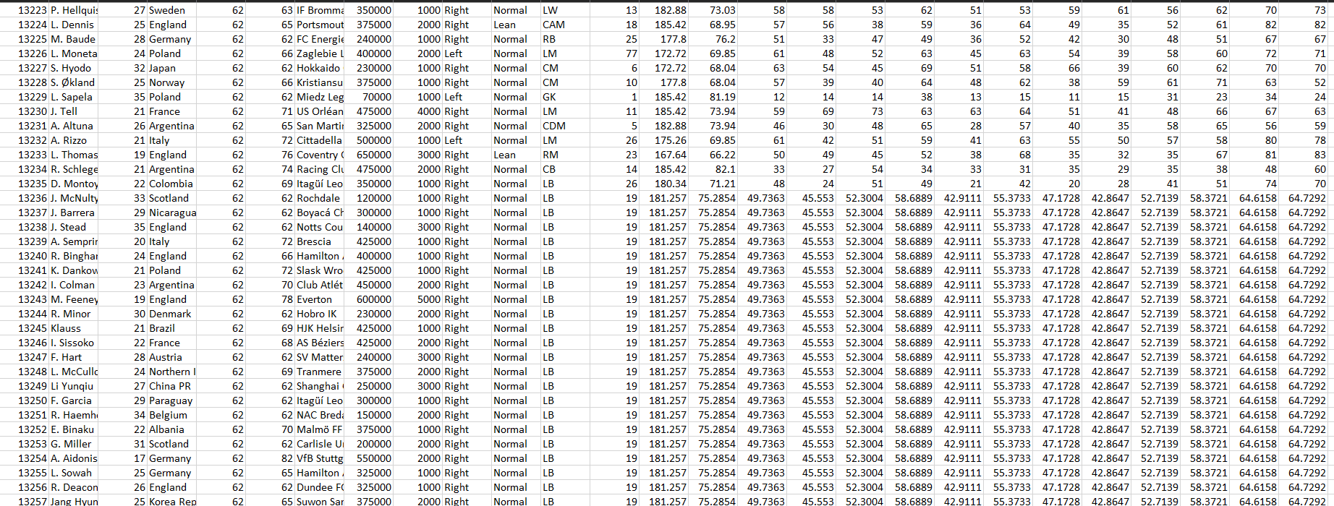

Slide 22
#CHECK IF THERE IS ANY MISSING VALUES print(any(is.na(fifa)))
## [1] FALSE
#VIEW THE CLEANED DATA View(fifa) #WRITE THE CLEANED DATA INTO A NEW FILE write.csv(fifa, "1_cleaned_data.csv", row.names = FALSE)

Slide 23
Normalization
Normalization, Standardization

Slide 24
# IMPORT THE DATASET fifa = read.csv( "1_cleaned_data.csv") #SELECTS NUMERICAL COLUMNS ONLY library("dplyr")
## ## Attaching package: 'dplyr'
## The following objects are masked from 'package:stats': ## ## filter, lag
## The following objects are masked from 'package:base': ## ## intersect, setdiff, setequal, union
numfifa = select_if(fifa, is.numeric)

Slide 25
#NORMALIZE FUNTION USING MIN-MAX VALUES normalize <- function(x){ return ((x-min(x))/(max(x)-min(x))) } #NORMALIZING THE DATA USING USER-DEFINED NORMALIZED FUNCTIONS ((x-min)/range) mmfifa <- as.data.frame(lapply(numfifa, normalize)) write.csv(mmfifa, "2_minmax.csv", row.names = FALSE)

Slide 26
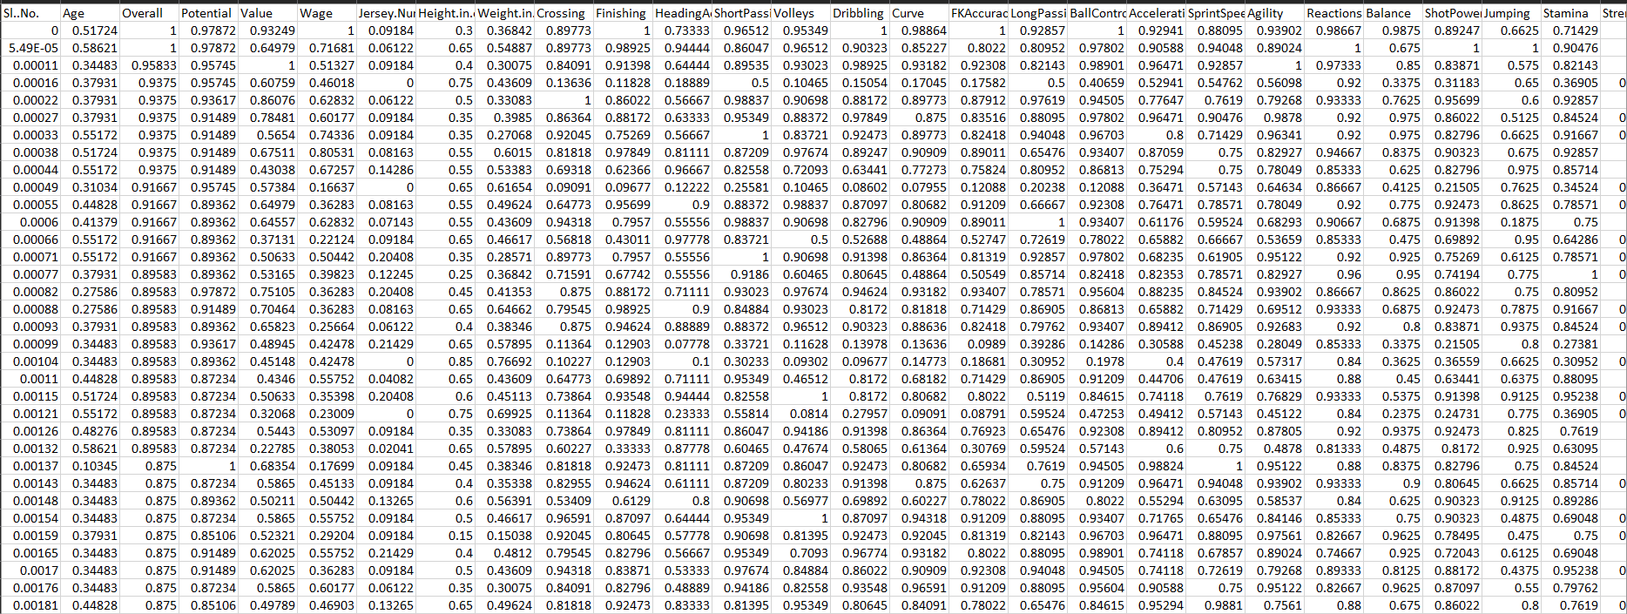

Slide 27
#STANDARDIZATION ((x-mean)/sd) library("clusterSim")
## Loading required package: cluster
## Loading required package: MASS
## ## Attaching package: 'MASS'
## The following object is masked from 'package:dplyr': ## ## select
sfifa = data.Normalization(numfifa, type="n1", normalization = "column") write.csv(sfifa, "2_standard.csv", row.names = FALSE)

Slide 28
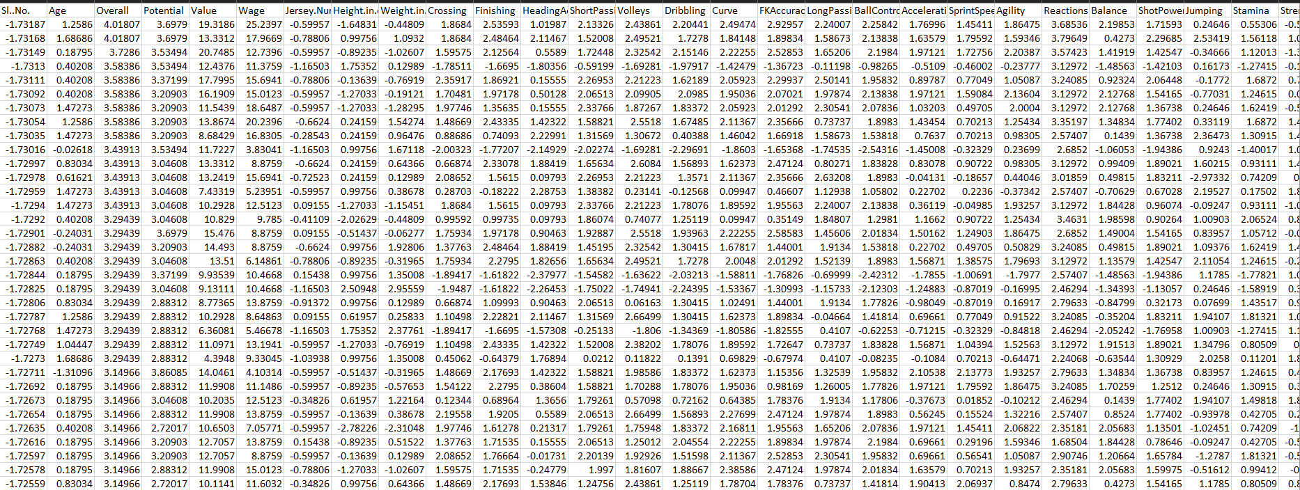

Slide 29
#NORMALIZATION ((x-mean)/sqrt(sum((x-mean)^2))) nfifa = data.Normalization(numfifa, type="n12", normalization = "column") write.csv(nfifa, "2_norm.csv", row.names = FALSE)

Slide 30
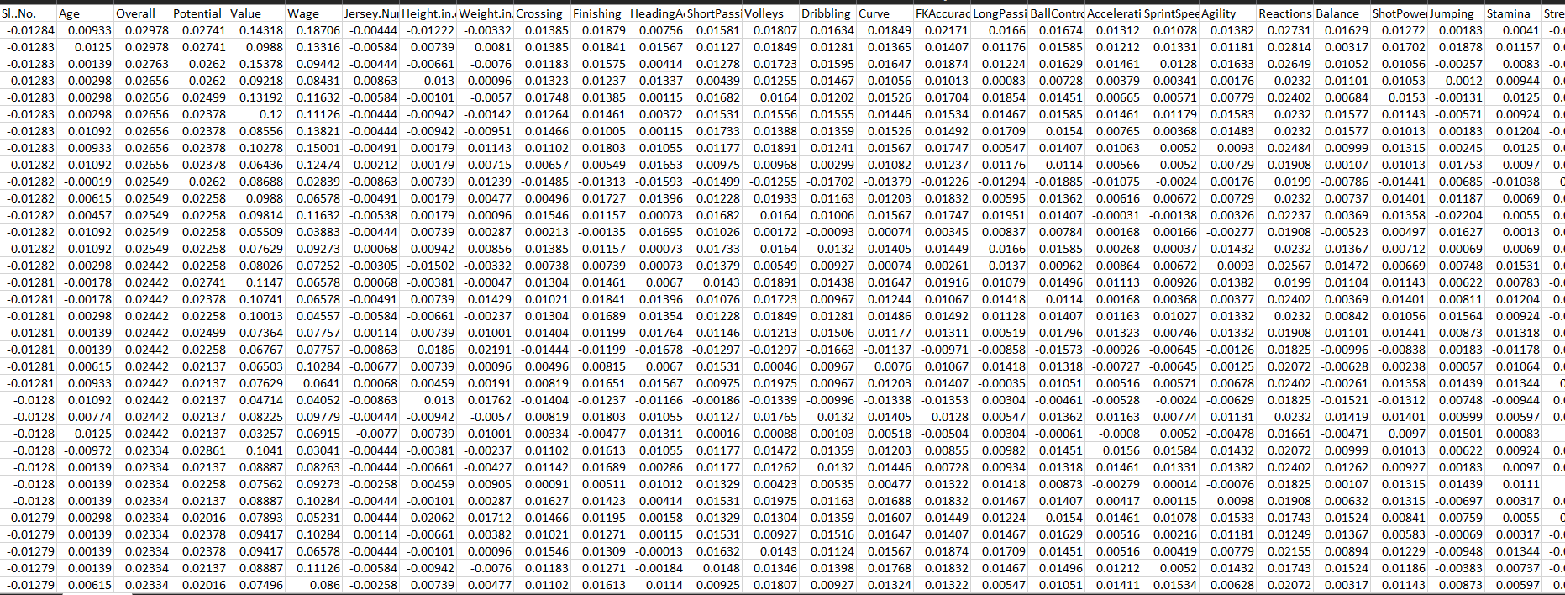

Slide 31
#NORMALIZING THE DATA THROUGH NATURAL LOGARITHMS logfifa = as.data.frame(lapply(numfifa, log)) write.csv(logfifa, "2_log.csv", row.names = FALSE)

Slide 32
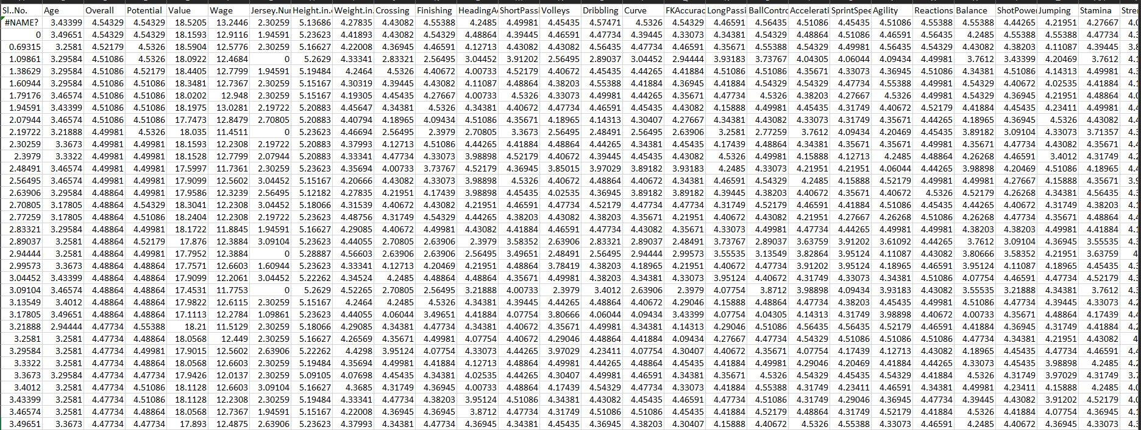

Slide 33
Normalization
Normality Test

Slide 34
# This library is already loaded: library("dplyr") library("ggpubr")
## Loading required package: ggplot2
## Loading required package: magrittr

Slide 35
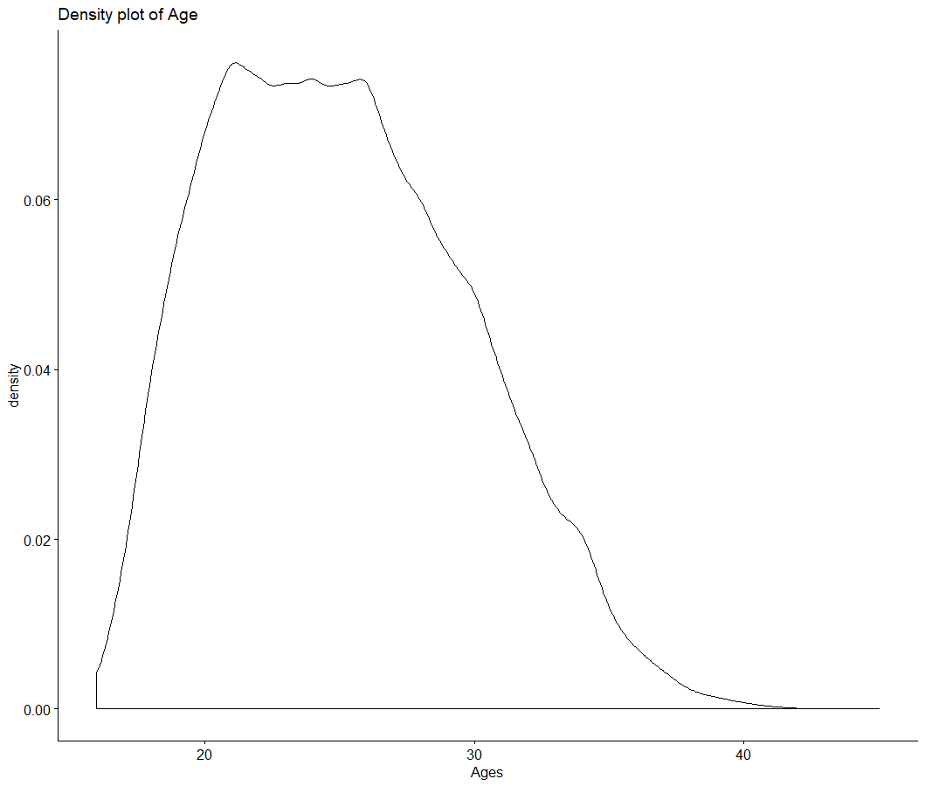
#DENSITY PLOT OF AGE print(ggdensity(fifa$Age, main="Density plot of Age", xlab = "Ages"))
Notes:
MUST BE BELL SHAPED

Slide 36
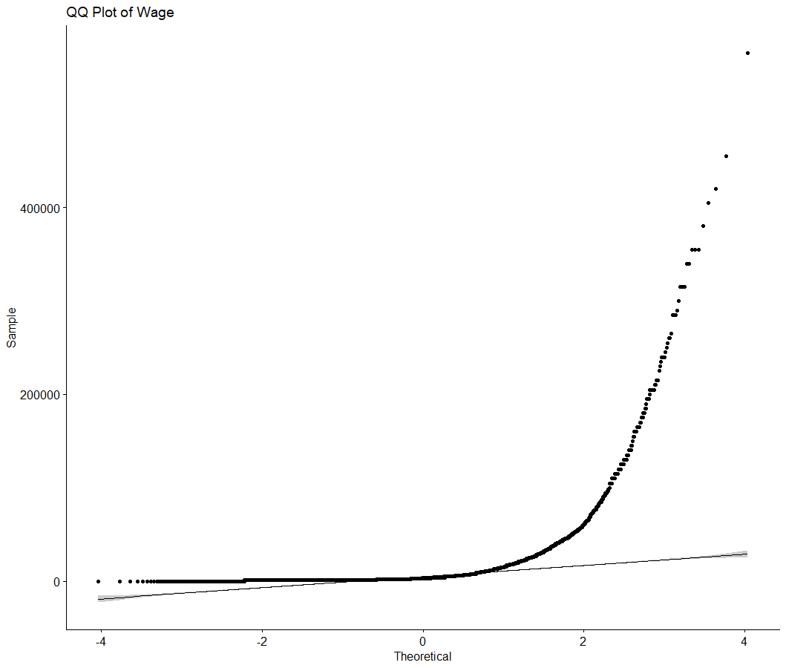
#QQ PLOT OF WAGE print(ggqqplot(fifa$Wage, main="QQ Plot of Wage"))
Notes:
MUST COINCIDE WITH THE STRAIGHT LINE

Slide 37
Graph Visualization

Slide 38
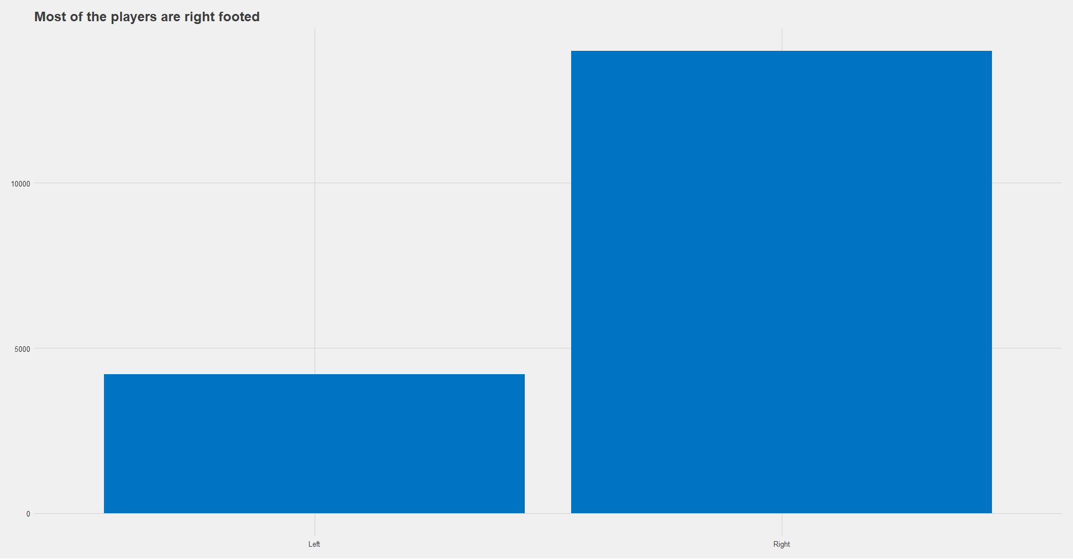
#FREQUENCY PLOT OF FOOT PREFERRENCE print(ggplot(fifa, aes(Preferred.Foot)) +geom_bar(fill = "#0073C2FF") + ggtitle("Most of the players are right footed") + theme_fivethirtyeight())

Slide 39
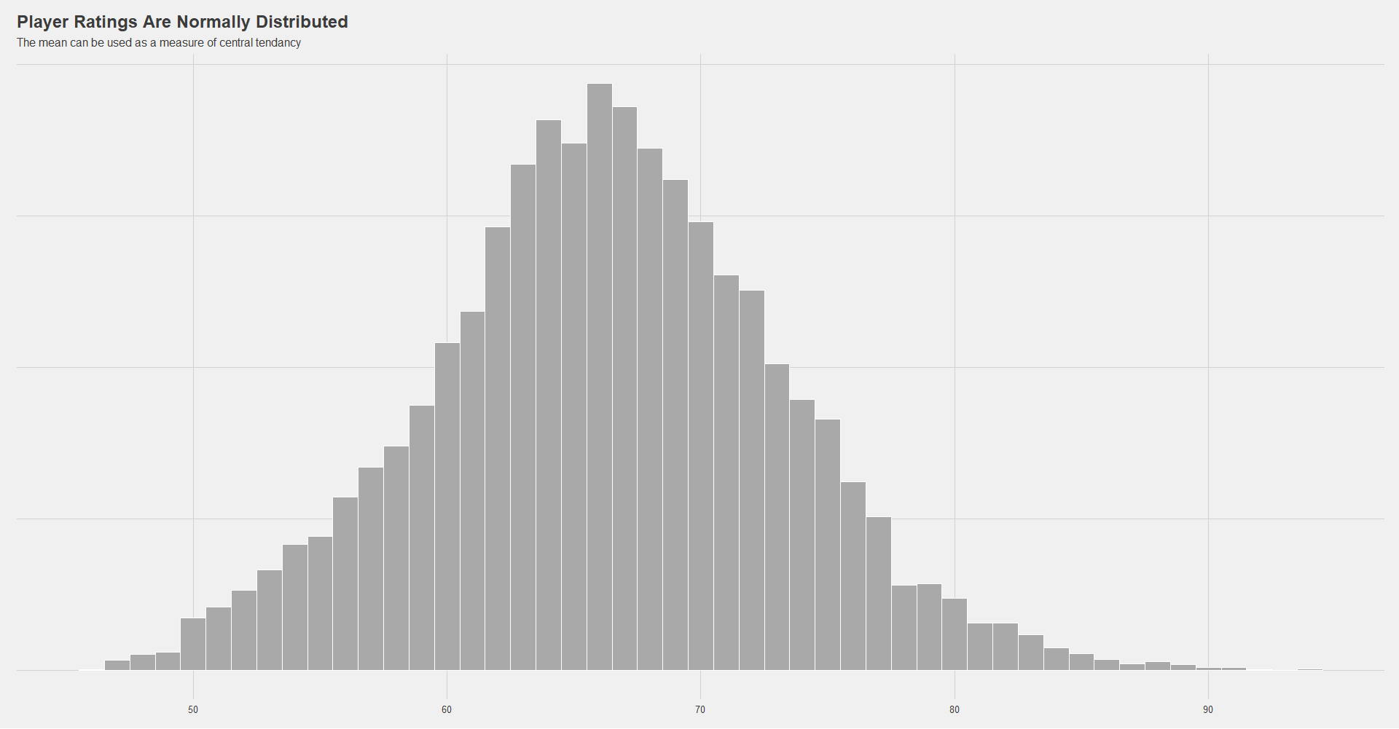
#HISTOGRAM OF PLAYER RATING print(fifa %>% ggplot(aes(x= Overall)) + geom_histogram(color = "white", fill = "darkgrey", binwidth = 1) + ggtitle("Player Ratings Are Normally Distributed", subtitle = "The mean can be used as a measure of central tendancy") + theme_fivethirtyeight() + theme(axis.text.y = element_blank()))

Slide 40
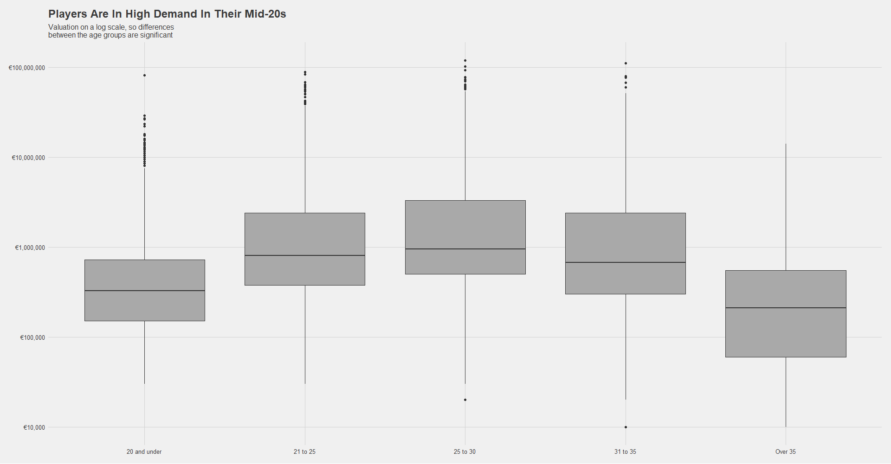
#BOXPLOT OF AGE VS VALUE
print(fifa %>% ggplot(aes(x= AgeGroup, y= Value)) + geom_boxplot(fill = "darkgrey") + scale_y_log10(labels = dollar_format(prefix = "€")) + ggtitle("Players Are In High Demand In Their Mid-20s", subtitle = "Valuation on a log scale, so differences \nbetween the age groups are significant") + theme_fivethirtyeight())

Slide 41
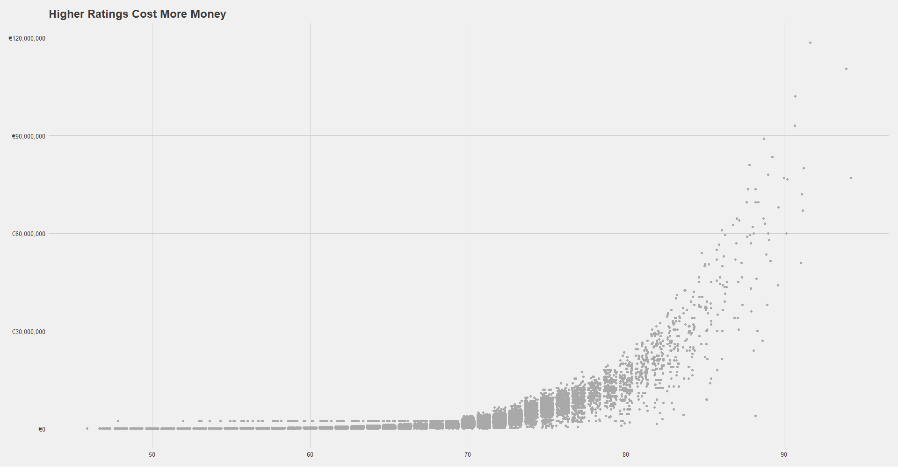
#SCATTERPLOT OF VALUE VS OVERALL RATING print(fifa %>% ggplot(aes(x= Overall, y= Value)) + geom_point(position = "jitter", color = "darkgrey") + ggtitle("Higher Ratings Cost More Money") + scale_y_continuous(labels = dollar_format(prefix = "€")) + theme_fivethirtyeight())

Slide 42
# FREQUENCY PLOT OF TEAM VS TOTAL WAGE print(fifa %>% group_by(Club) %>% summarise(TotalWages = sum(Wage, na.rm = T),) %>% arrange(desc(TotalWages)) %>% head(n= 20) %>% ggplot(aes(x= reorder(Club, TotalWages), y= TotalWages)) + geom_col(colour = "black") + scale_y_continuous(labels = dollar_format(prefix = "€")) + coord_flip() + ggtitle("The 20 highest wage bills in FIFA19 and how much one rating point costs in wages") + theme_fivethirtyeight() + theme(legend.position = "none"))

Slide 43
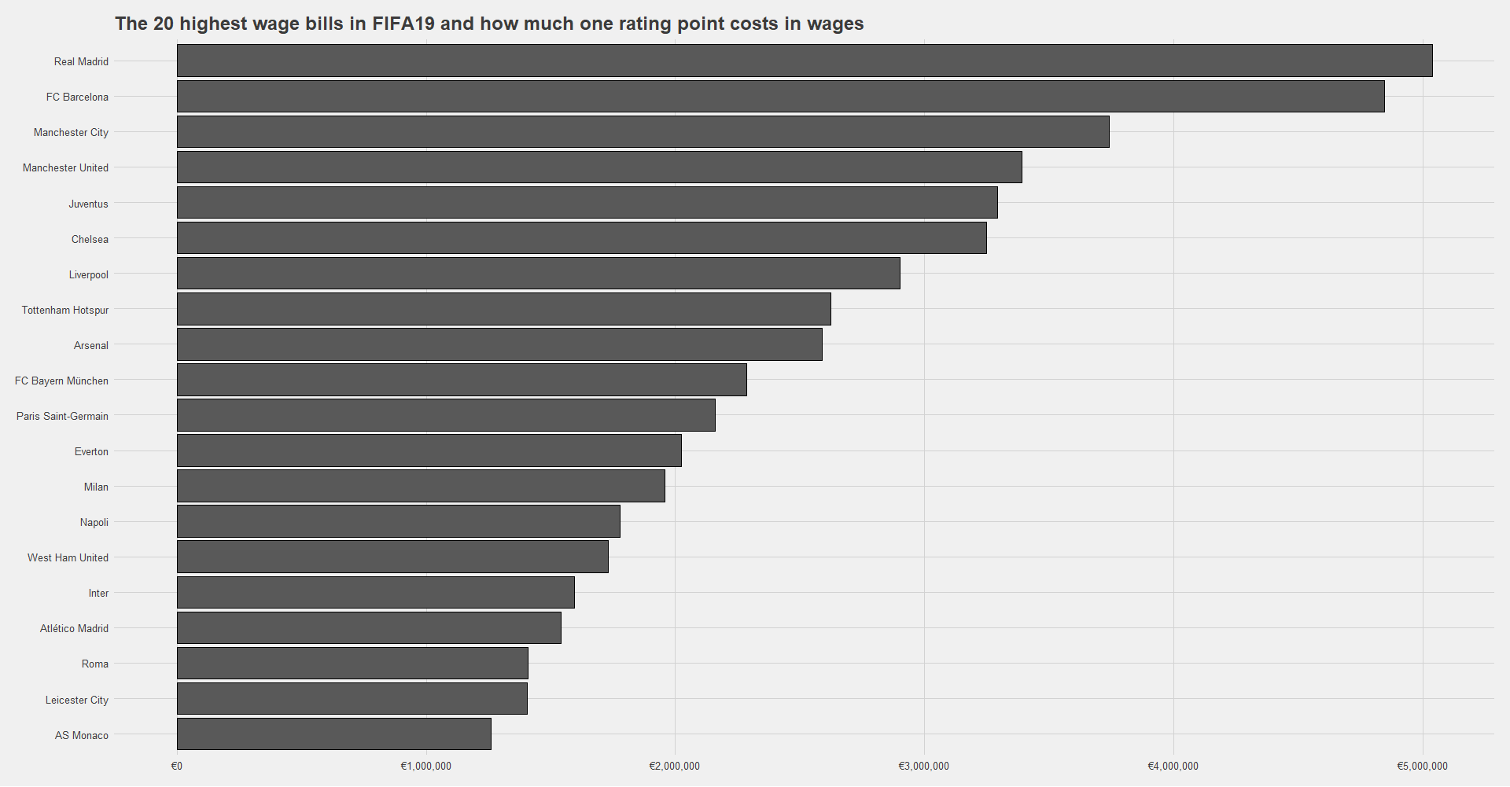

Slide 44
Correlations & Simple Regression

Slide 45
fifa = read.csv("1_cleaned_data.csv") options(scipen = 999) library("GGally")
## Loading required package: ggplot2
## Registered S3 method overwritten by 'GGally': ## method from ## +.gg ggplot2
#HEAT MAP print(ggcorr(fifa))
## Warning in ggcorr(fifa): data in column(s) 'Name', 'Nationality', 'Club', ## 'Preferred.Foot', 'Body.Type', 'Position' are not numeric and were ignored

Slide 46
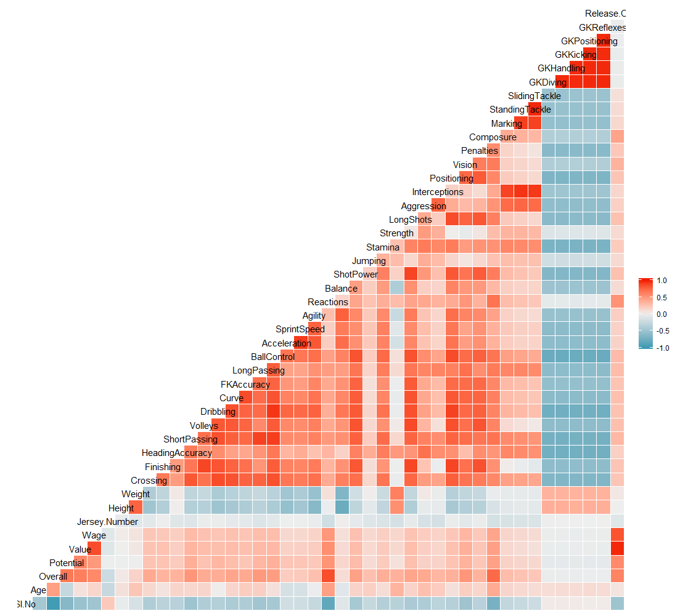
HEAT MAP

Slide 47
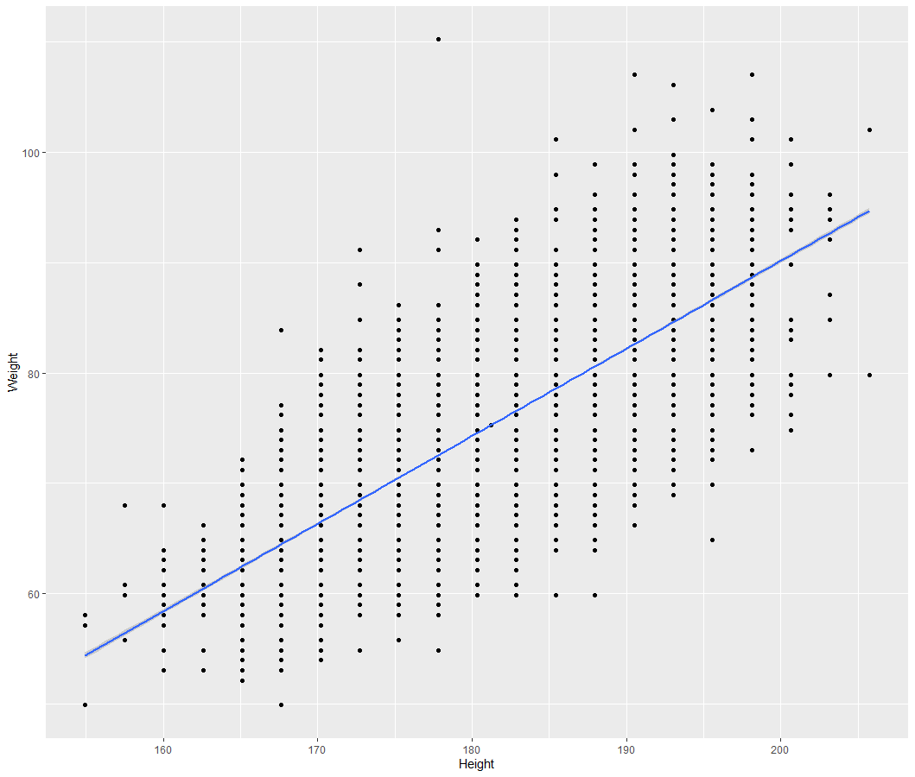
#SCATTER PLOT FOR HEIGHT VS WEIGHT print(ggplot(fifa, aes(x=Height, y =Weight)) + geom_point() + geom_smooth(method = lm))
Correlation:
Positive
Weak
Linear

Slide 48
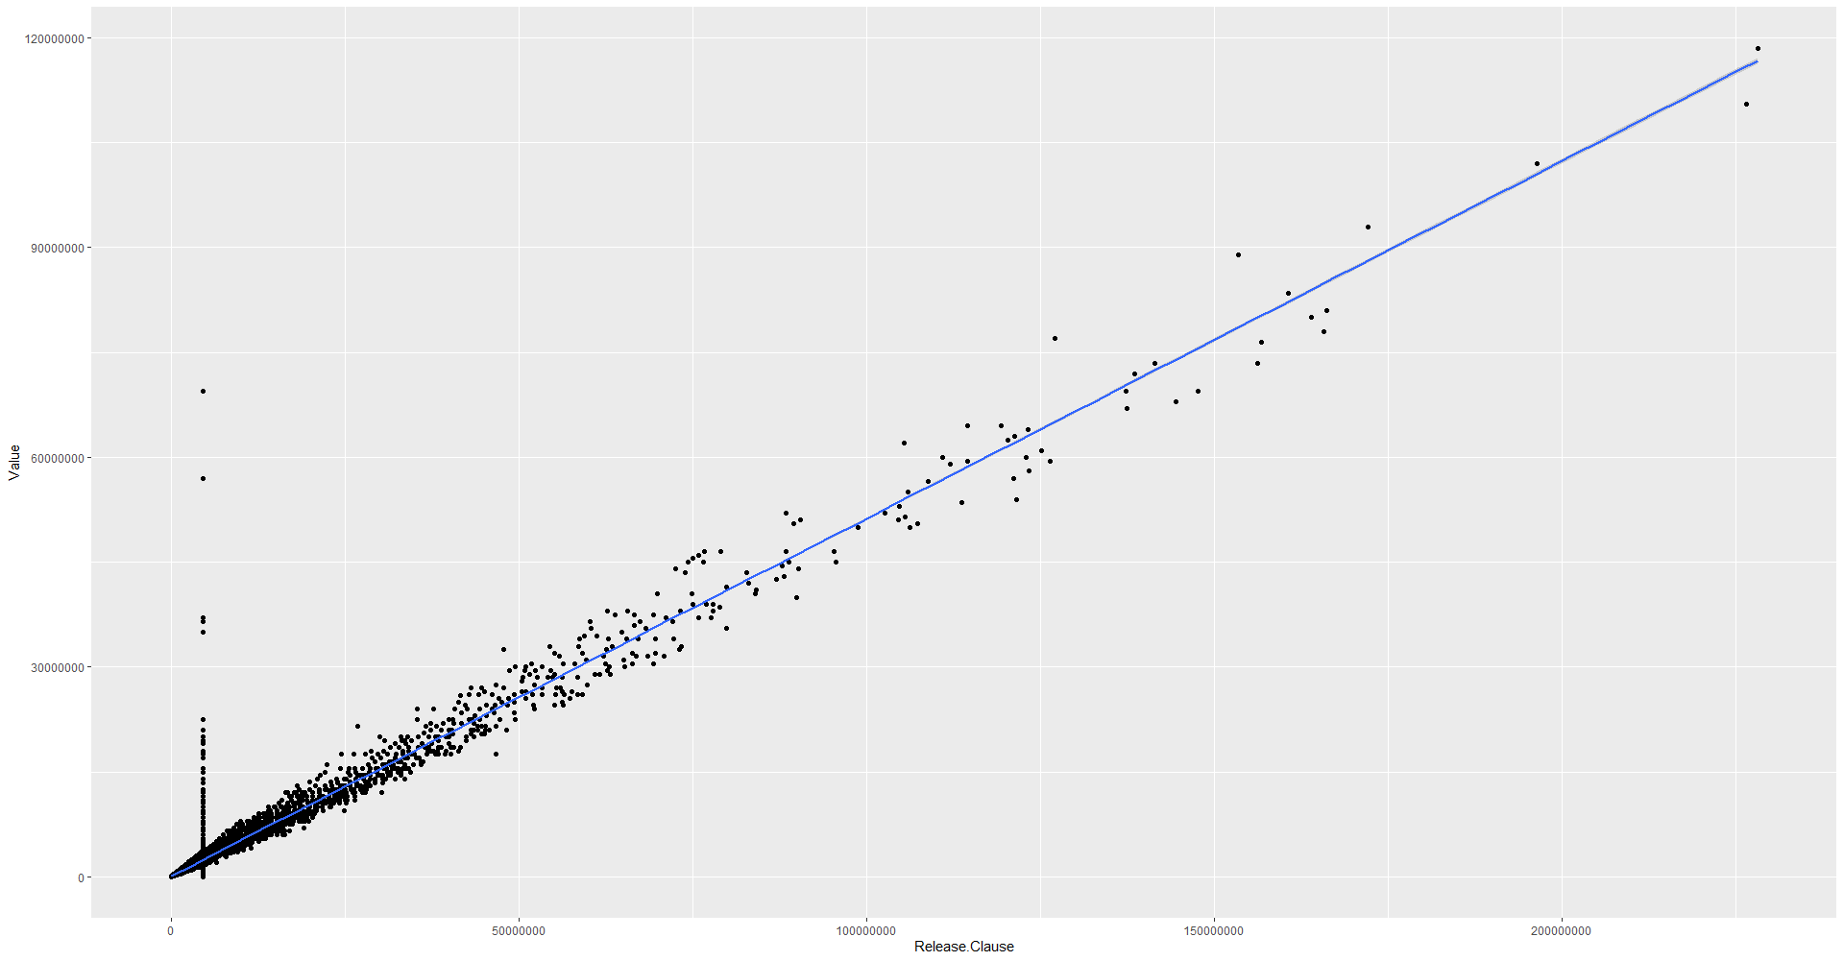
#SCATTER PLOT print(ggplot(fifa, aes(x=Release.Clause, y =Value)) + geom_jitter()+geom_smooth(method = lm))
Correlation:
Positive
Strong
Linear

Slide 49
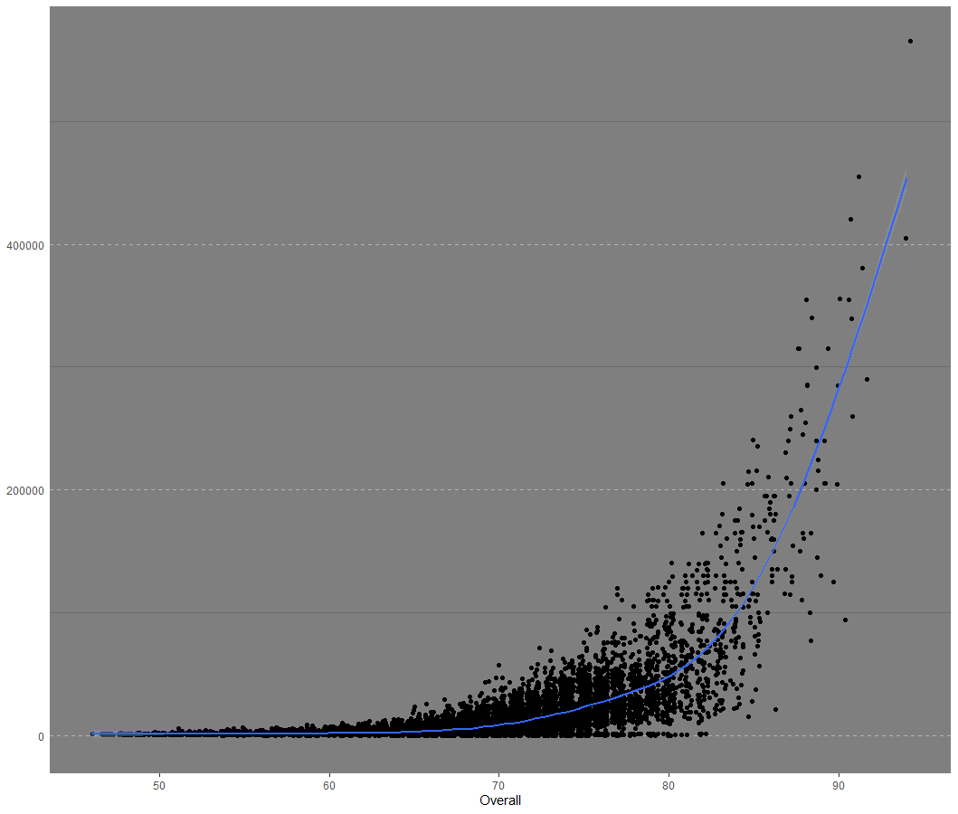
#SCATTER PLOT FOR OVERALL VS WAGE print(ggplot(fifa, aes(x=Overall, y =Wage)) + geom_jitter()+geom_smooth()) +theme_cleveland()
## `geom_smooth()` using method = 'gam' and formula 'y ~ s(x, bs = "cs")'
Correlation:
Positive
Exponential

Slide 50
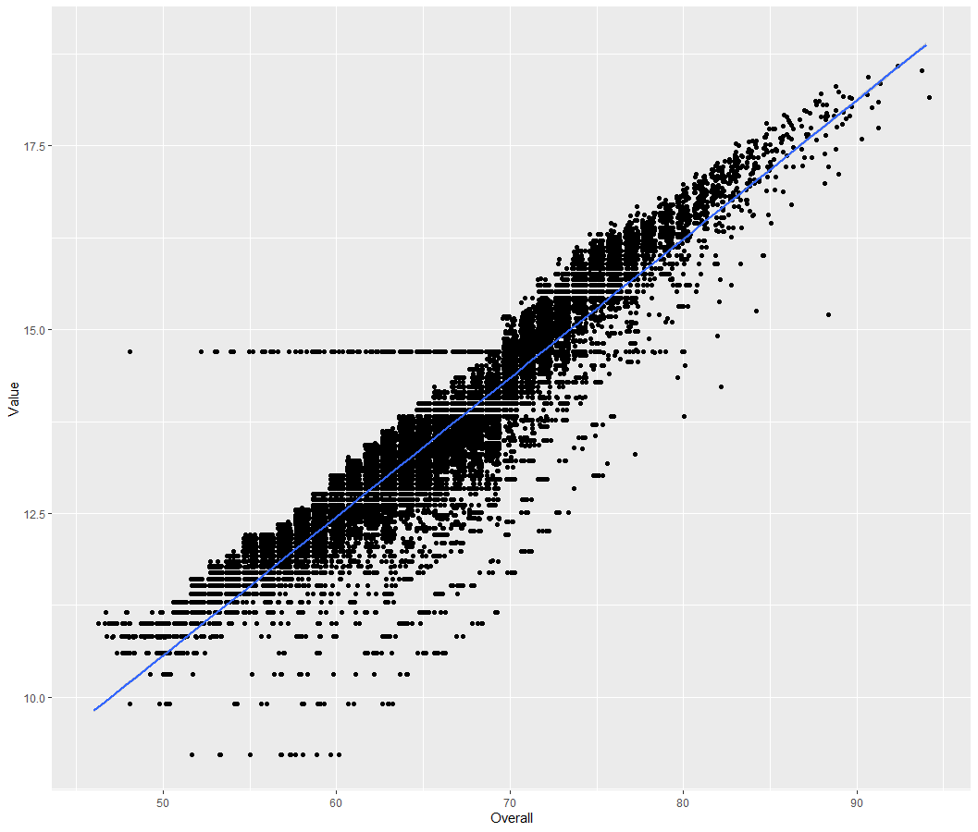
##CORRELATION #SCATTER PLOT BETWEEN LOG(VALUE) VS OVERALL print(ggplot(fifa, aes(x=Overall, y =unlist(lapply(lapply(fifa$Value, log), as.numeric))))+ylab("Value") + geom_jitter()+geom_smooth(method = lm))

Slide 51
#PEARSON CORRELATION TEST print(cor.test(unlist(lapply(lapply(fifa$Value, log), as.numeric)), fifa$Overall, method="pearson"))
## ## Pearson's product-moment correlation ## ## data: unlist(lapply(lapply(fifa$Value, log), as.numeric)) and fifa$Overall ## t = 343.89, df = 18204, p-value < 0.00000000000000022 ## alternative hypothesis: true correlation is not equal to 0 ## 95 percent confidence interval: ## 0.9289499 0.9328261 ## sample estimates: ## cor ## 0.9309142

Slide 52
#CREATING THE TRAINING AND TEST DATA set.seed(100) trainingRows<-sample(1:nrow(fifa), 0.8*nrow(fifa)) trainingData<-fifa[trainingRows, ] testData<-fifa[-trainingRows, ] #FIT THE MODEL ON TRAINING DATA AND PREDICT ON TEST DATA model = lm(log(Value)~Overall, data = trainingData) predictedData = predict(model,testData) predictedData = exp(predictedData)

Slide 53
#REVIEW DIAGNOSTIC MEASURES summary(model)
## ## Call: ## lm(formula = log(Value) ~ Overall, data = trainingData) ## ## Residuals: ## Min 1Q Median 3Q Max ## -3.2437 -0.2204 0.0497 0.3128 4.5086 ## ## Coefficients: ## Estimate Std. Error t value Pr(>|t|) ## (Intercept) 1.117921 0.040926 27.32 <0.0000000000000002 *** ## Overall 0.188936 0.000614 307.69 <0.0000000000000002 *** ## --- ## Signif. codes: 0 '***' 0.001 '**' 0.01 '*' 0.05 '.' 0.1 ' ' 1 ## ## Residual standard error: 0.5104 on 14562 degrees of freedom ## Multiple R-squared: 0.8667, Adjusted R-squared: 0.8667 ## F-statistic: 9.467e+04 on 1 and 14562 DF, p-value: < 0.00000000000000022

Slide 54
##CALCULATE PREDICTION ACCURACY AND ERROR RATES diff = data.frame(cbind(actuals=testData$Value, predicteds=predictedData)) #CORERLATION ACCURACY correlation_accuracy<-cor(diff) print(correlation_accuracy)
## actuals predicteds ## actuals 1.0000000 0.9395014 ## predicteds 0.9395014 1.0000000
#MIN-MAX ACCURACY CALCULATION min_max_accuracy <-mean(apply(diff, 1, min)/apply(diff,1,max)) print(min_max_accuracy)
## [1] 0.7325135

