Slide 1
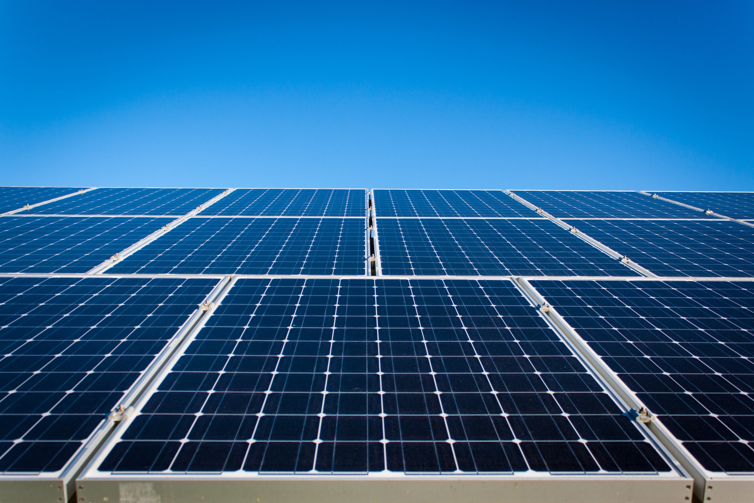
Autonomous peer-to-peer energy orchestration via multi- Agent Systems

Slide 2
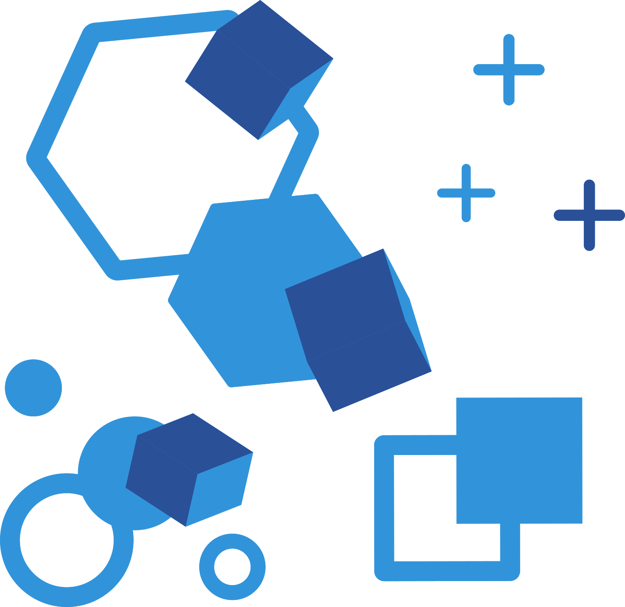
The Problem
  The Trillion-Unit Loss:
  India lost 2.3 Terawatt units of solar generation in 2025 alone due to grid inflexibility. That is enough electricity to power 4 lakh Indian households for an entire year
  The Financial Drain:
  DISCOMs (power companies) had to pay roughly ₹6,000 Crore in compensation to solar plants for power that was generated but never used.
  The Midday Crisis:
  India reached 51% clean energy capacity in 2025, but the power grid cannot handle excess daytime solar energy, leading to wastage of clean power.

Slide 3
  The Fixed-Price Trap:
  Currently, residential solar owners sell excess power back to the grid at fixed, low rates (Net Metering), regardless of when the grid actually needs it.
  Zero Control:
  Homeowners have no way to sell their surplus energy directly to a neighbour who might need it for an EV charger or AC during peak hours.
  The Missing Link:
  There is no "middleman" that can negotiate prices in real-time , electricity remains a "dumb" commodity rather than a dynamic market.

Slide 4
The Solution Project
  Autonomous Orchestration:
  Replaces slow, centralized grid control with Multi-Agent Systems where every home, battery, and EV acts as an intelligent, independent agent.
  Predictive Intelligence:
  Integrates Copernicus Sentinel-2 satellite data to forecast cloud cover and solar generation, allowing agents to negotiate trades before the sun goes down.
  Grid-Aware Governance:
  A dedicated Governance Agent uses PyPSA to check every trade against real-world physics , preventing local blackouts before they happen.
.

Slide 5
Blockchain Trade Settlement:
Energy is traded through a local blockchain using smart contracts on a Hardhat local node for secure and automatic transactions.
Federated Learning:
Trains AI models across multiple homes and devices without sharing personal energy data, ensuring privacy and secure collaboration.
Privacy-First Edge AI:
All decision-making happens locally using Ollama (LLaMA 3.1) your private energy data never leaves your home to a vulnerable cloud server.

Slide 6
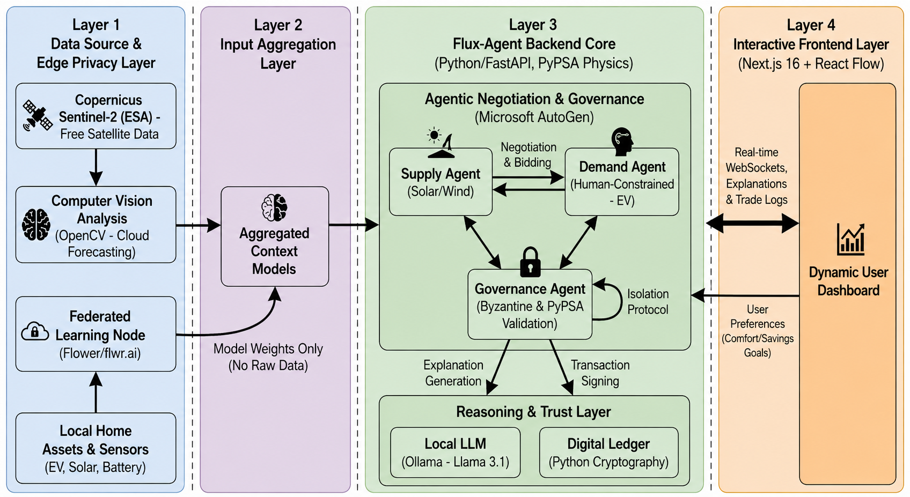
Architectural Diagram

Slide 7
Working :
How Microsoft AutoGen Orchestrates the Trade.
Step 1: Context Aggregation: Sentinel-2 data , Smart Meter data are fused into a single JSON context.
  Step 2: The Negotiation : Supply Agent: "I have 5kWh excess predicted for the next hour. Asking price: ₹4.50/kWh.“
    Demand Agent (EV): "My car needs to reach 80% by 5 PM. I bid ₹4.20/kWh."
  Step 3: Governance Filter (The Guardrail): The Governance Agent runs a quick power-flow study.
    Verdict: "Trade Approved. Transferring 5kWh will not exceed local transformer limits.
  Step 4: LLM Explanation: Ollama (LLaMA 3.1) generates a simple log: "Sold 5 units to Neighbor at ₹4.35 to maximize your battery life for the evening peak."
Link: https://p2p-trading-nrj4iz7e0-abhirajs-projects-1d7aabae.vercel.app/

Slide 8

The Point-to-Point Negotiation
Autonomous Financial Settlement in Milliseconds.
  Step 1:
  The AI Handshake The Buyer Agent broadcasts a need; the Seller Agent analyzes excess and offers a bid price based on a Reliability Score.
  Step 2:
  Smart Contract Funds are automatically locked in a Smart Contract to guarantee payment once the energy flow is verified.
  Step 3:
  Physical Delivery The Smart Meters confirm the physical transfer of kWh across the local microgrid lines.
  Step 4:
  Blockchain Settlement The transaction is recorded on a Distributed Ledger for 100% transparency and security, releasing the money to the seller instantly.

Slide 9
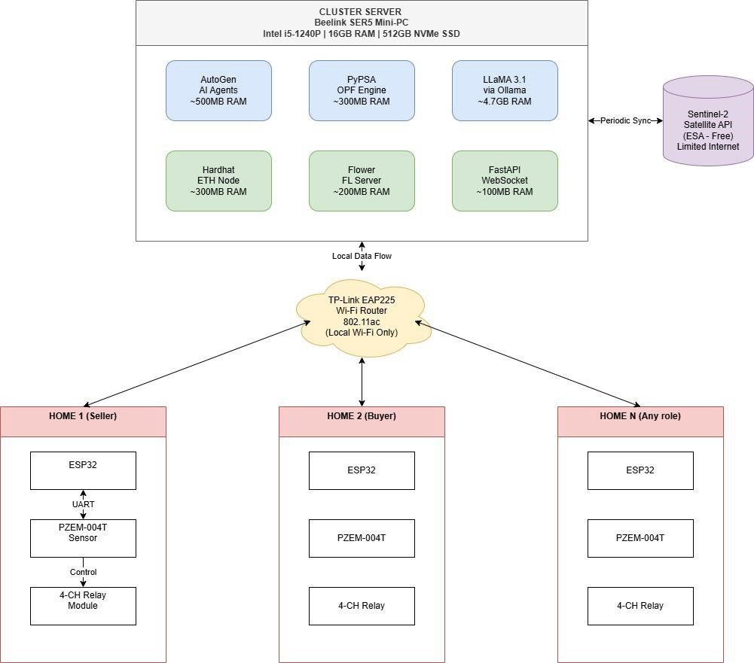
Hardware Components

Slide 10
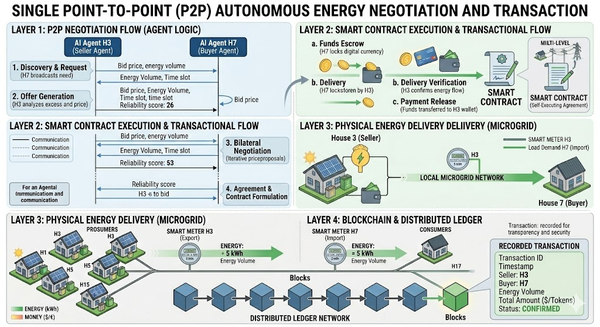

Slide 11
Market Sizing
TAM
TAM · SAM · SOM
₹1,253 Cr/yr
India already has 26.75 GW of rooftop solar capacity (MNRE, Apr 2026), creating revenue opportunities through surplus energy trading fees and premium subscriptions.
India P2P Energy
Trading Platform
SAM
₹313 Cr/yr
3,000+ gated communities across India, including 1,400 and apartments and RWAs in Bengaluru, covering a market of 3.5 lakh households.
SOM
₹3–18 Cr/yr
Year 1: 50 clusters covering 100 households each at ₹6,067 per node; Year 3 expansion to 300 clusters across Whitefield and Sarjapur.
Sources: MNRE Apr 2026 · Ember Jan 2026
Mercom India 2025 · DERC Order Feb 2026
BAF 2025 · Rentechdigital May 2025

Slide 12
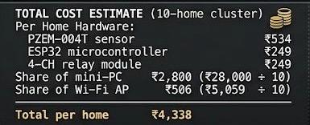
Value Proposition
Cost structure
Every unit traded gives you earn ₹0.42 platform fee
1 home trades 5 units/day
5 × ₹0.42 × 365 days = ₹766/year in fees alone
+ ₹2,161 hardware margin (one-time)
+ ₹2,650 subscription/year
+ ₹500 AMC/year
─────────────────────────────────
Year 1 earning per home ₹6,077
₹4,338 cost ÷ ₹6,077 earned = under 9 months to break even
Every rupee after that is pure profit.

Slide 13
MVP ROADMAP
M1
M2
M3
M4
M5
M6
M7
M8
M9
M10
M11
M12
M13
M14
M15
M16
M17
M18
FOUNDATION
Company and DPDP
Foundation
MCA · legal
RWA site and MoU
BAF outreach
HARDWARE
Procure and calibrate nodes
Hardware
ESP32 · PZEM · relay
SOFTWARE
Multi-agent engine
Supply · Demand · Governance
Software
OPF and SAI pipeline
IEEE 33-bus · Sentinel-2
Federated learning
Flower framework
Local blockchain and LLM
Hash-chain · Mistral 7B
Dashboard
LAN-only · WhatsApp
REGULATORY BLOCKERS
BESCOM empanelment
Regulatory blocker
No SLA · est. M3–M7
Smart meter install
60–120 days/node
DISCOM billing API
Integration
Legacy IT · M8–M12
INTEGRATION and TESTING
Lab simulation and audit
Testing
15-node · DPDP check
Field pilot · 5 prosumers
Live trades · Whitefield RWA
Live pilot

Slide 14
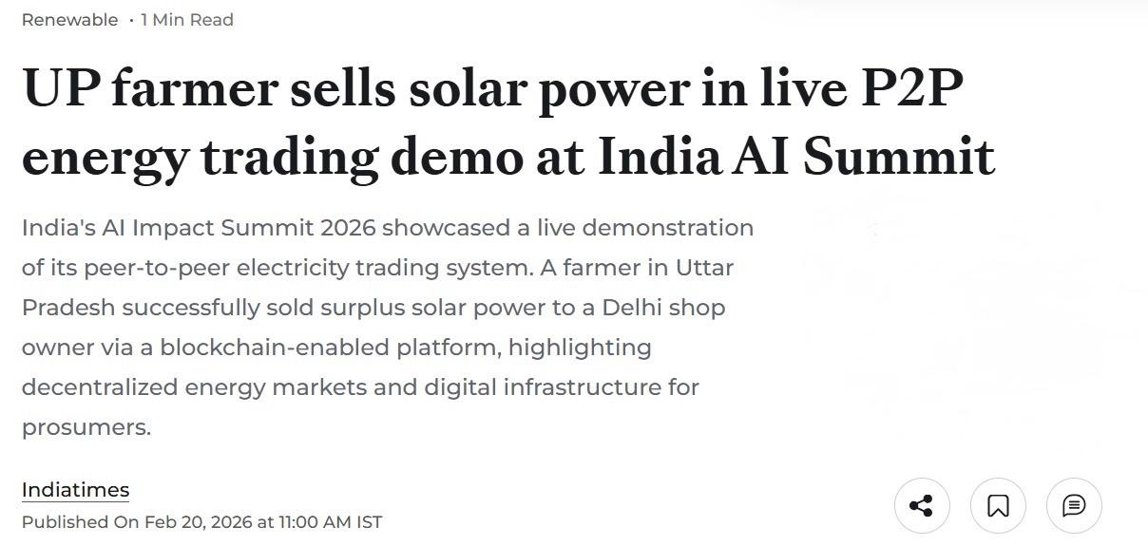
Existing Technologies in India
https://energy.economictimes.indiatimes.com/news/renewable/up-farmer-sells-solar-power-in-live-p2p-energy-trading-demo-at-india-ai-summit/128593177

Slide 15
Conclusion
Miragex isn't just a software project; it's a solution to India's ₹6,000 Crore solar wastage problem. By combining Agentic AI with Edge Privacy, we are creating a self-healing, profitable energy network for a sustainable future.

Slide 16

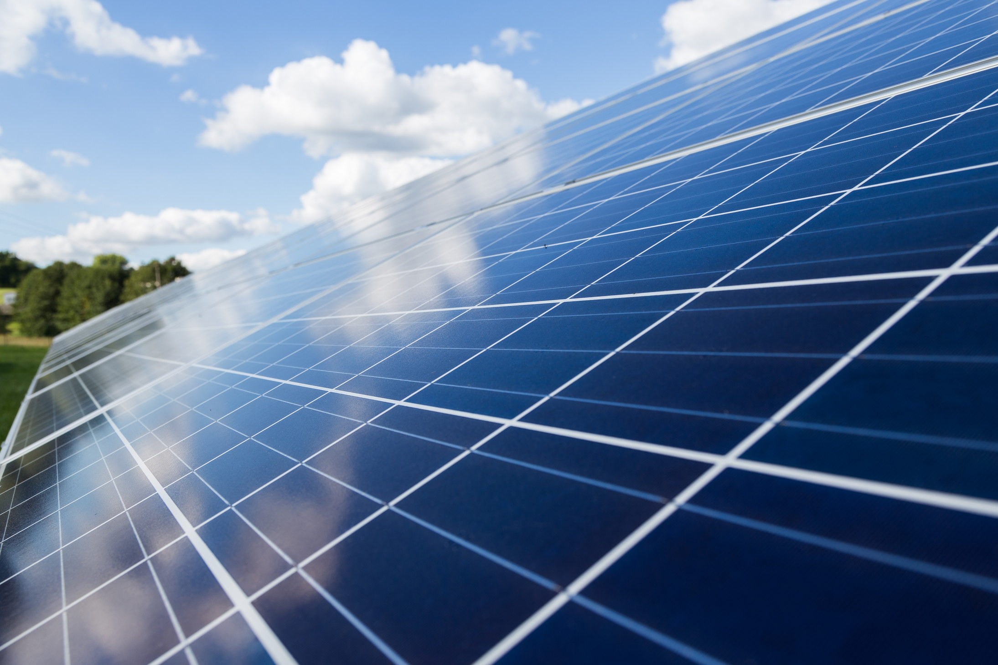


Abhiraj Bambhore
Thank You
Very Much!
Contact Us
  +91 9611941155
  abhirajbambhore@gmail.com

