Slide 1

Miragex- A Multi-Agentic Energy Trading Platform
A decentralized platform that lets homes with solar panels sell surplus energy directly to nearby neighbors who need it

Slide 2




MIRAGEX • SLIDE 1 OF 3
How MIRAGEX works on the field
User journey
1
2
3
4
Sensor reads energy
PZEM-004T measures voltage, current, and power at each home
Trade settles
Approved trade is recorded on the local blockchain in real time
Data reaches server
ESP32 sends readings to the cluster server; solar and demand are forecast
Agents negotiate
AI agents match buyers and sellers; grid safety is validated
Deployment
Beelink SER5 cluster server, with an ESP32, a PZEM-004T sensor, and a relay module at each home, connected over a local TP-Link EAP225 Wi-Fi network. Trades settle on a local Hardhat Ethereum node. Internet is used only to fetch Sentinel-2 satellite data periodically.
Metrics & impact
22.5%
20%
340 ms
0.18 kWh
FULL
cluster efficiency gain
solar curtailment reduction
average trade latency
forecast error (MAE)
data privacy compliance

Slide 3
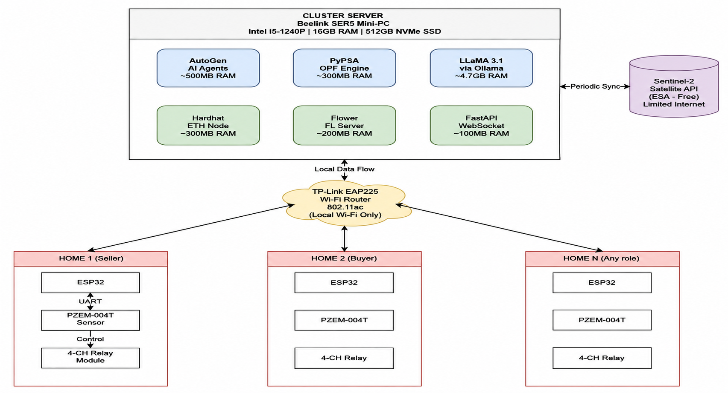
Hardware Architecture:

Slide 4
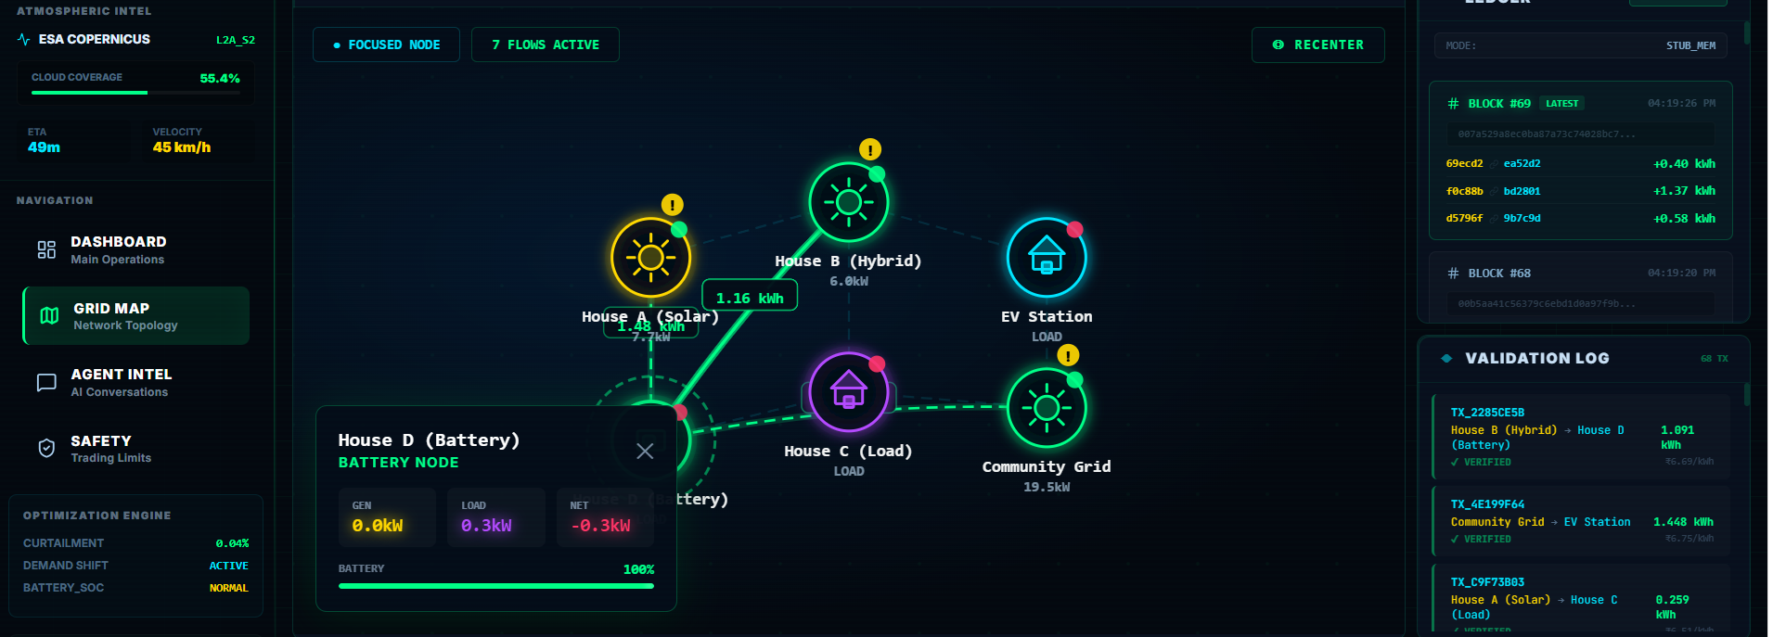
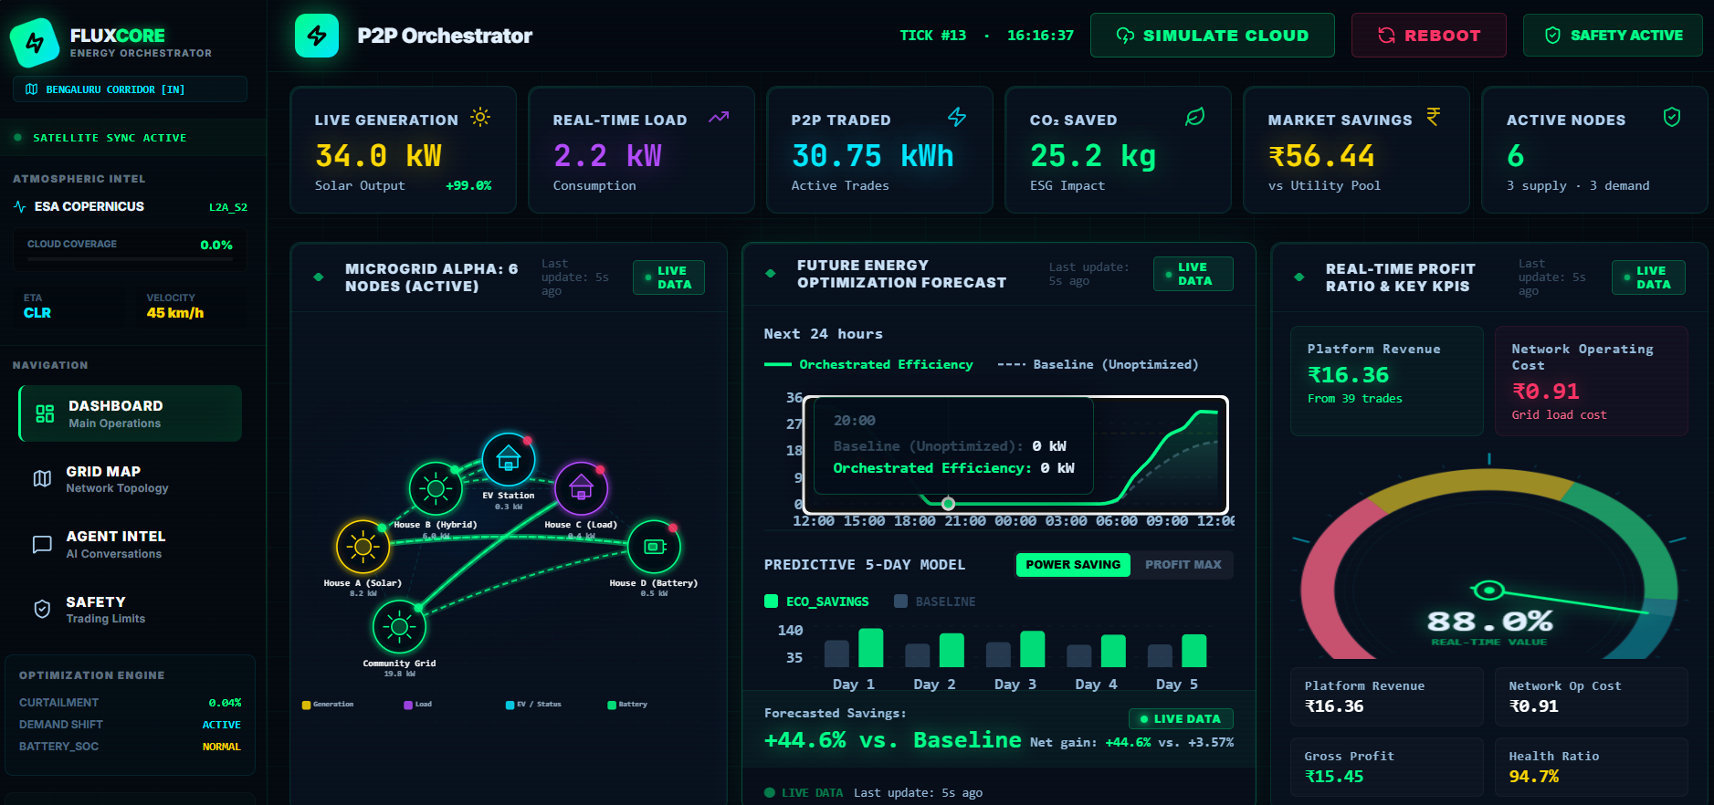

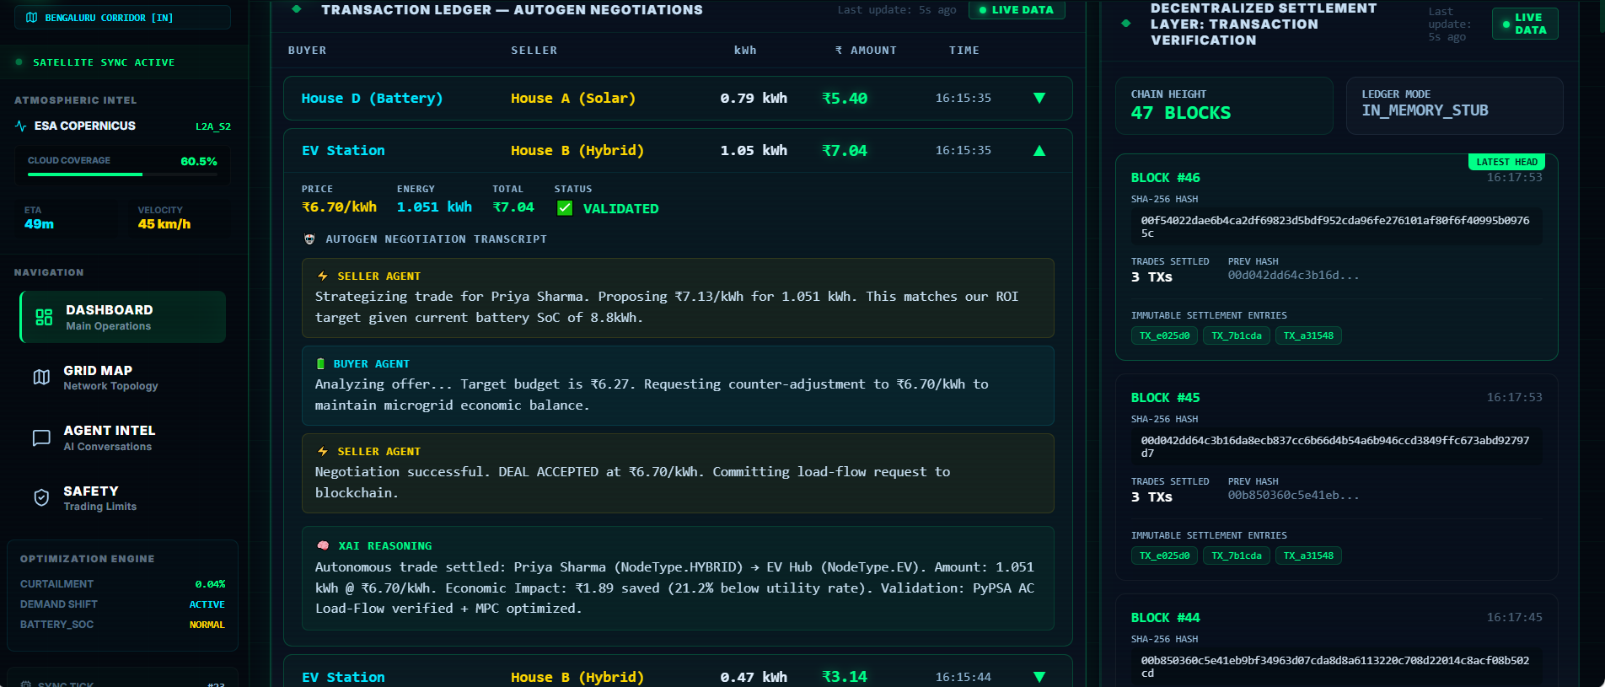
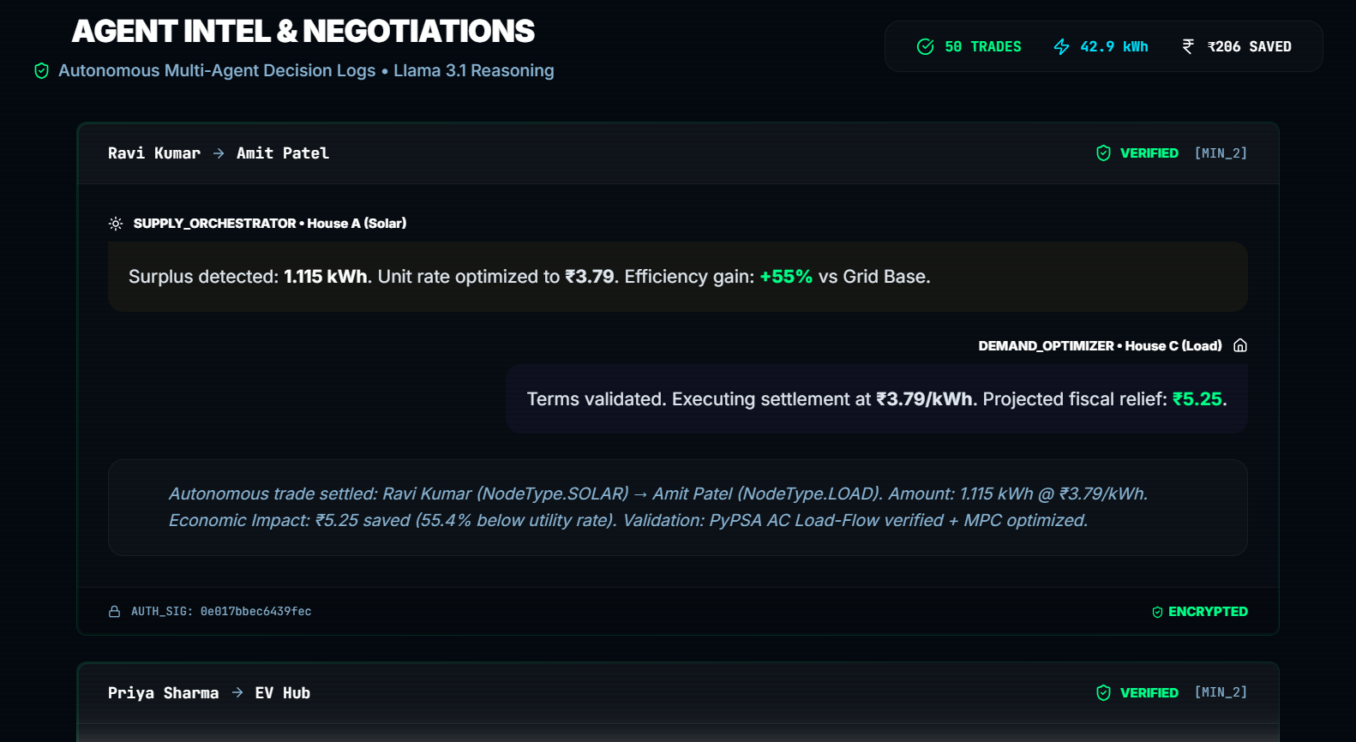

MIRAGEX • SLIDE 2 OF 3
Product - Prototype Stage
Try the live app

Slide 5

MIRAGEX • SLIDE 3 OF 3
Proof on the field
STATUS: Software Prototype Deployed & in Active Use
Miragex isn't just a software project; it's a solution to India's ₹600 Crore solar wastage problem. By combining Agentic AI with Edge Privacy, we are creating a self-healing, profitable energy network for a sustainable future.
Live demo:
Flux-Agent | Autonomous P2P Solar Energy Trading — India

