Slide 1

Multi Agentic Energy Trading
Team: Abhiraj · Chethana SB · Ashna Satrasala.

Slide 2
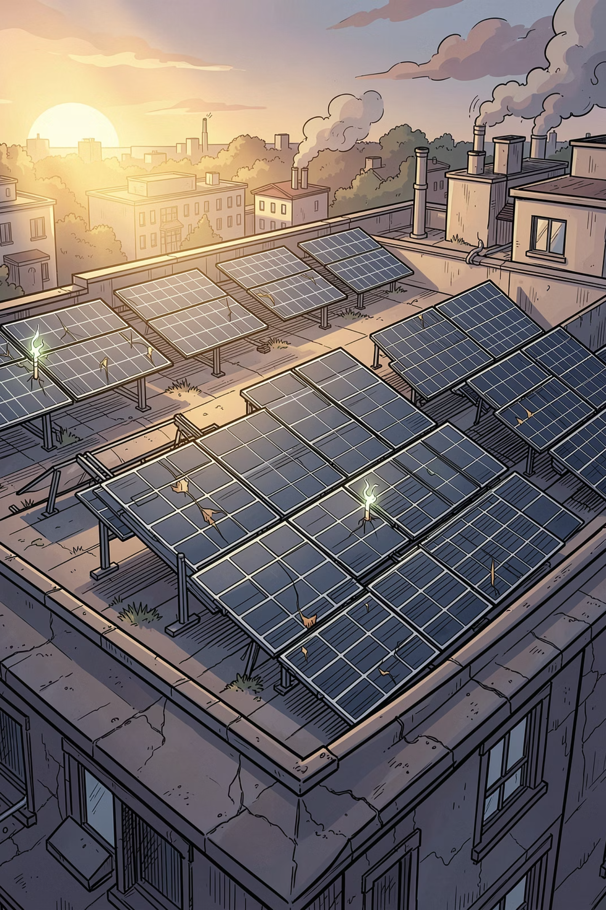
Problem Statement — Why this matters
By end-2025 India reached ~20.8 GW rooftop solar, yet grid operators discarded an estimated 2.3 TWh of solar while paying ~₹6,000 crore in must‑run compensation. The issue is not lack of demand but the absence of a direct, low‑latency mechanism for neighbours to trade surplus energy. Traditional cloud auctions and public blockchains fail to meet residential latency, privacy and scalability requirements.

Slide 3


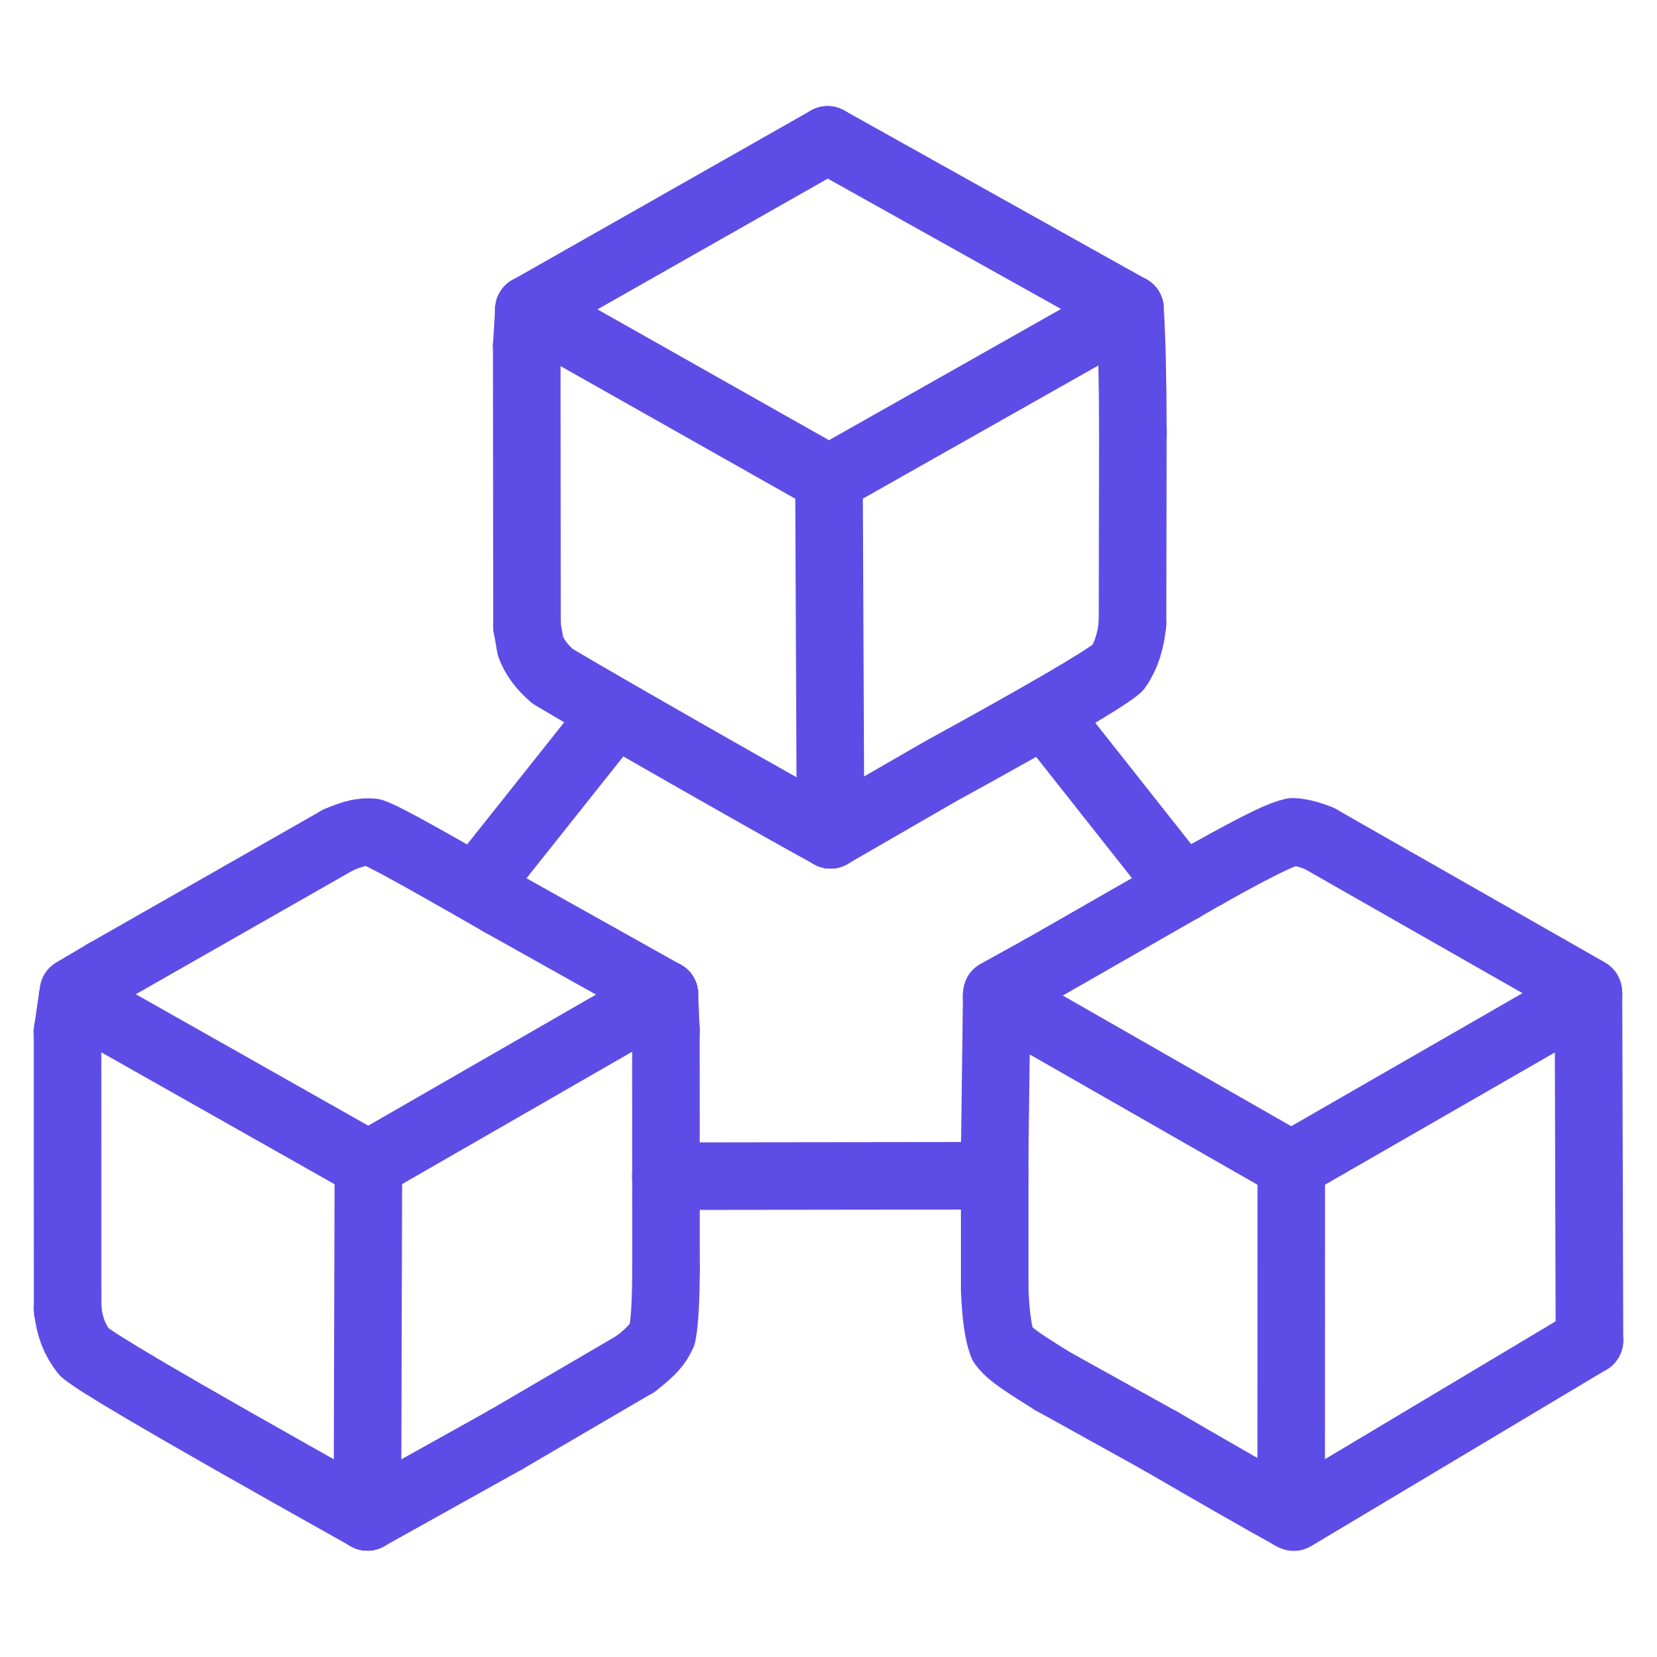
Solution Overview
We propose a complete local-edge energy trading platform where autonomous agents negotiate real‑time prices, satellite‑informed forecasts run via federated learning to preserve privacy, grid feasibility is validated locally, and settlements are recorded on a dual‑tier local blockchain. Key results: 20% reduction in wasted solar, 22.5% cluster efficiency improvement, low‑latency trading, privacy‑preserving forecasts, and secure local settlements.
Low Latency
Privacy
Secure Settlements
Local negotiation and communication minimize delays for 15‑minute interval trading.
Federated Learning trains models without sending raw household data offsite.
Local Ethereum (Hardhat) nodes provide immutable transaction records for trust.

Slide 4
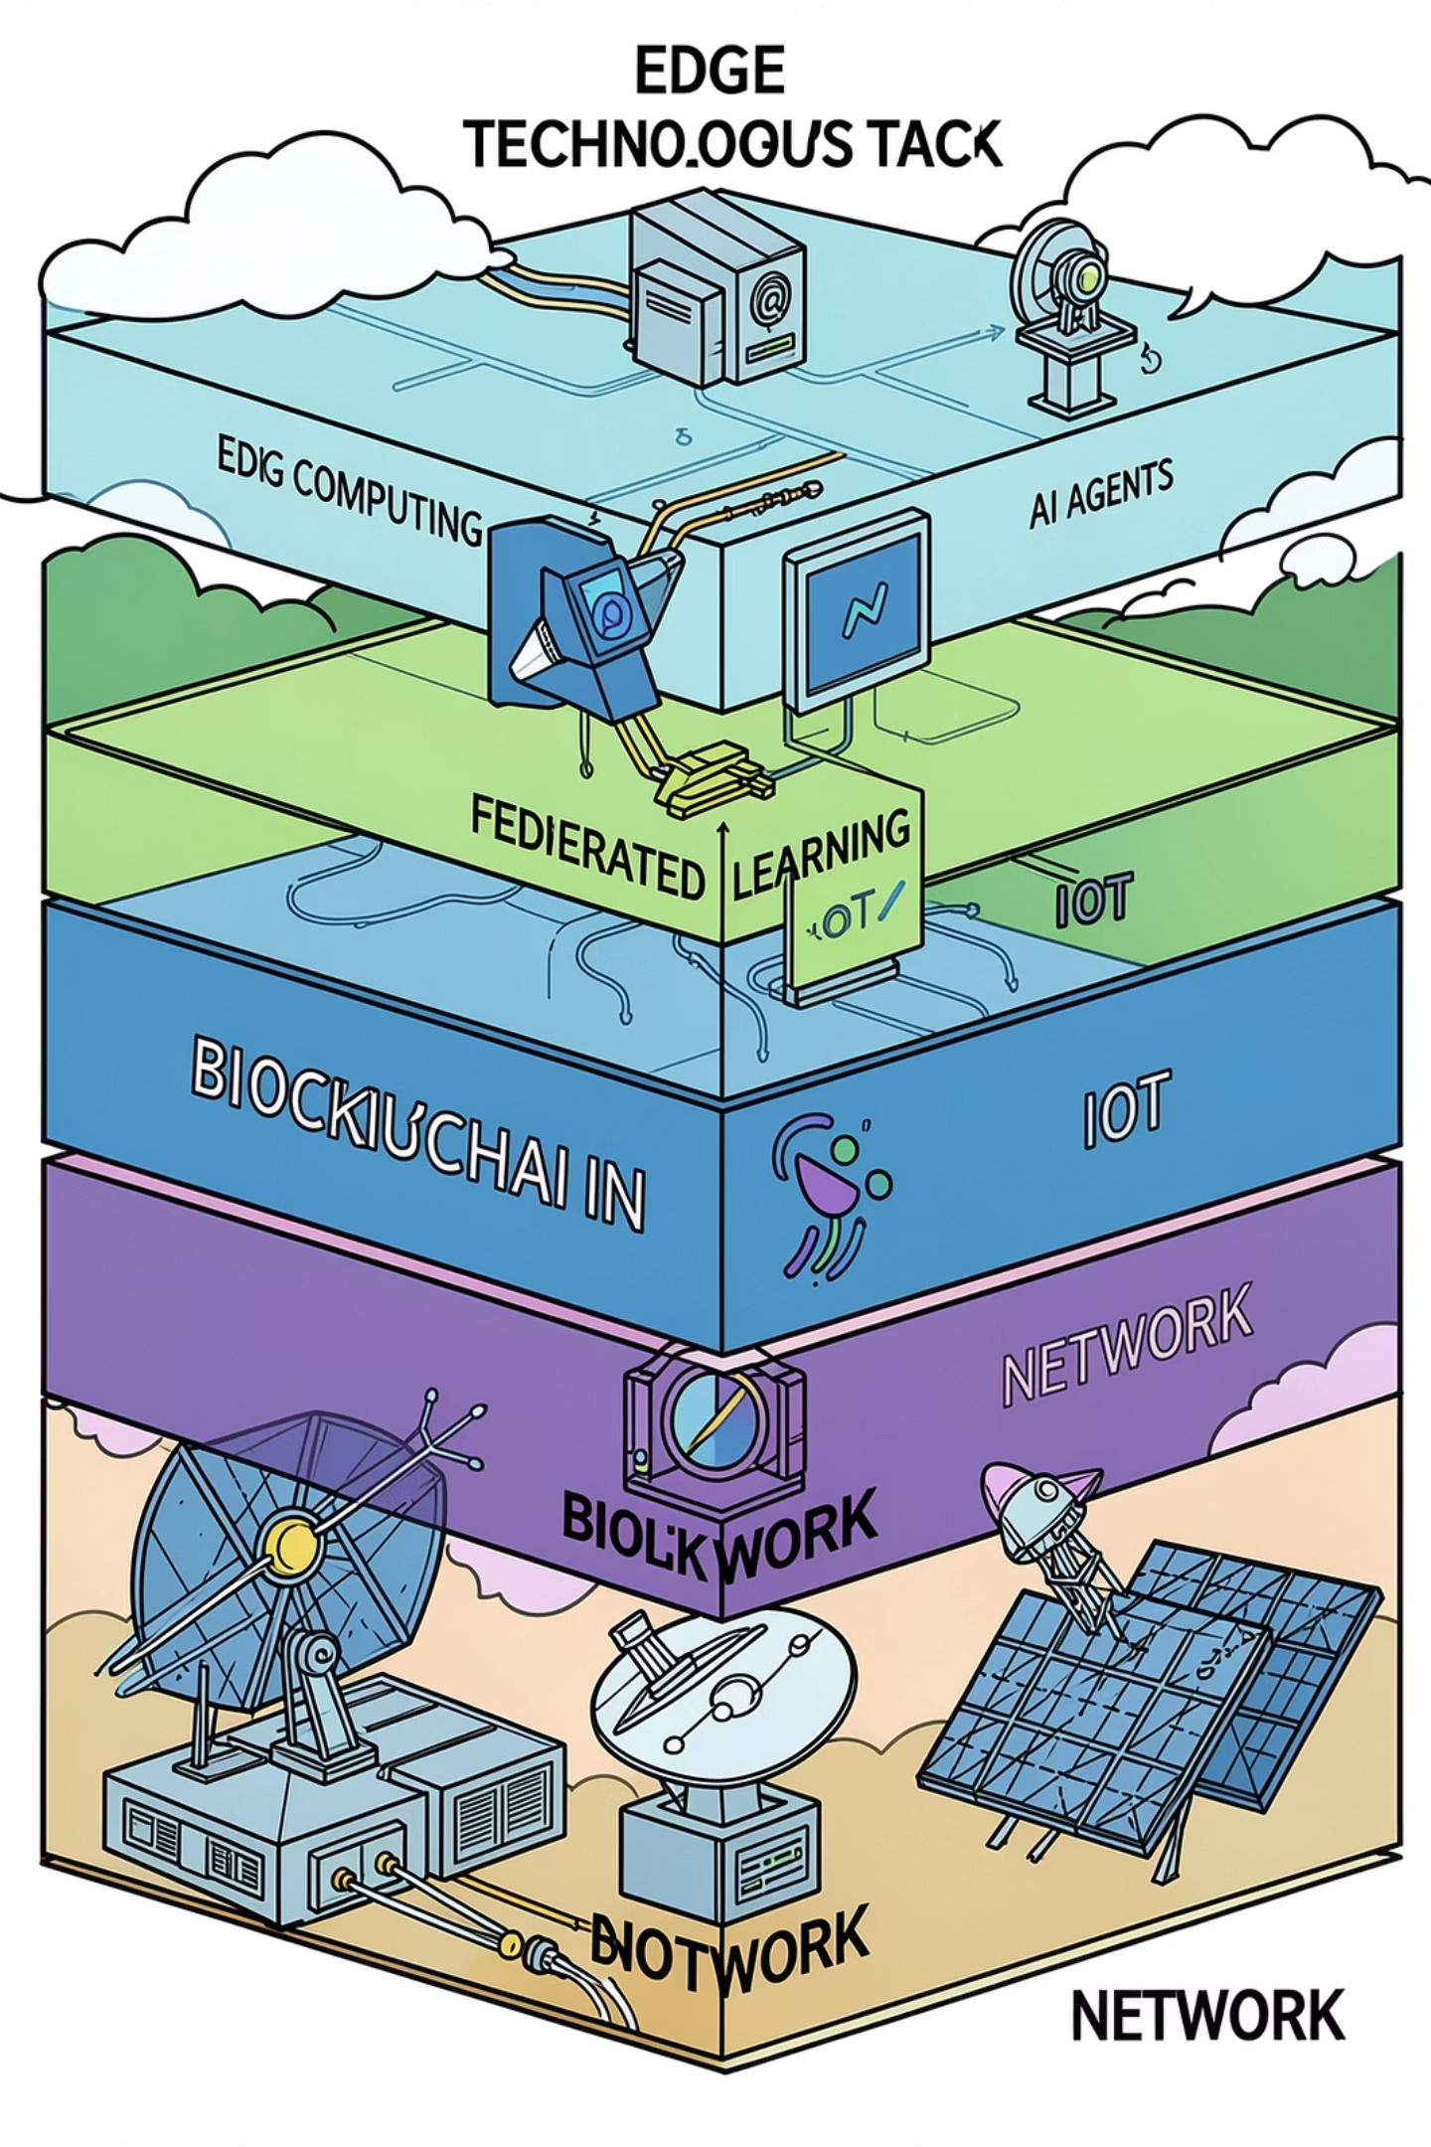
Technology Stack
The system integrates: Edge Computing, Multi‑Agent AI, Federated Learning, Blockchain, IoT energy monitoring, Power‑system optimization, Satellite data analytics (Sentinel‑2), and Real‑time communication. These layers work together to forecast, negotiate, validate and settle trades within a local cluster.

Slide 5
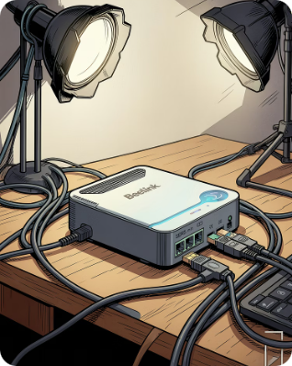
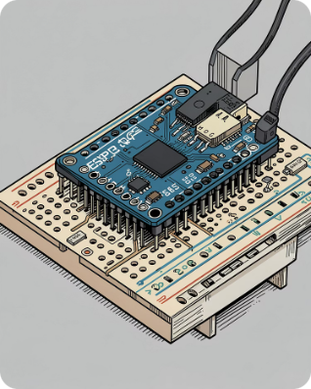
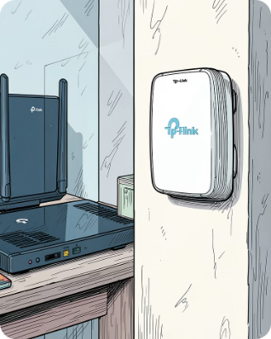
Hardware & System Architecture — Components
Architecture consists of: (1) Cluster Server (shared edge), (2) Household Nodes, (3) Local Communication Network, (4) Satellite Data Integration Layer, (5) Blockchain Settlement Layer. The Cluster Server hosts forecasting, negotiation, validation and blockchain services while household nodes provide sensing, control and local actuation.
Cluster Server
Household Node
Local Network
Shared edge system hosting multi‑agent engine, FL server, OPF engine, blockchain node and real‑time comms.
ESP32 microcontroller coordinates local sensors, relays and communicates with the cluster server.
TP‑Link EAP225 forms the LAN for low‑latency, internet‑independent communication across the cluster.

Slide 6
Cluster Server — Internal Modules
Multi‑Agent AI Engine
Language Model Module
Federated Learning Server
Power System Analysis Engine
Creates an autonomous agent per household to negotiate trades, set prices and optimise allocations across the cluster in real time.
Supports agent reasoning, improves coordination, enables contextual and adaptive negotiation strategies.
Trains distributed forecasting models on local data, preserving privacy and improving prediction accuracy without sharing raw data.
Runs Optimal Power Flow (OPF) to validate physical grid feasibility and prevent overloads before trades are approved.
Blockchain Node
Real‑Time Communication Server
Private Ethereum (Hardhat) node records validated transactions for transparency and immutable settlement records.
Provides low‑latency messaging, dashboard updates and synchronisation across household nodes.

Slide 7
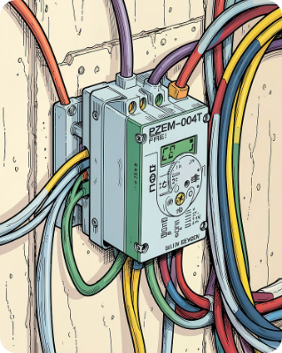
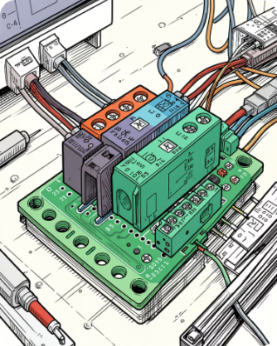
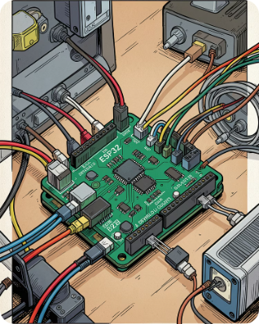
Household Node — Devices & Functions
PZEM‑004T Sensor
4‑Channel Relay
ESP32 Controller
Measures voltage, current and calculates instantaneous power for generation and consumption monitoring.
Controls household loads for demand response and executes switching based on trading outcomes.
Acts as the household controller: collects sensor data, executes control commands, and communicates with the cluster server.

Slide 8
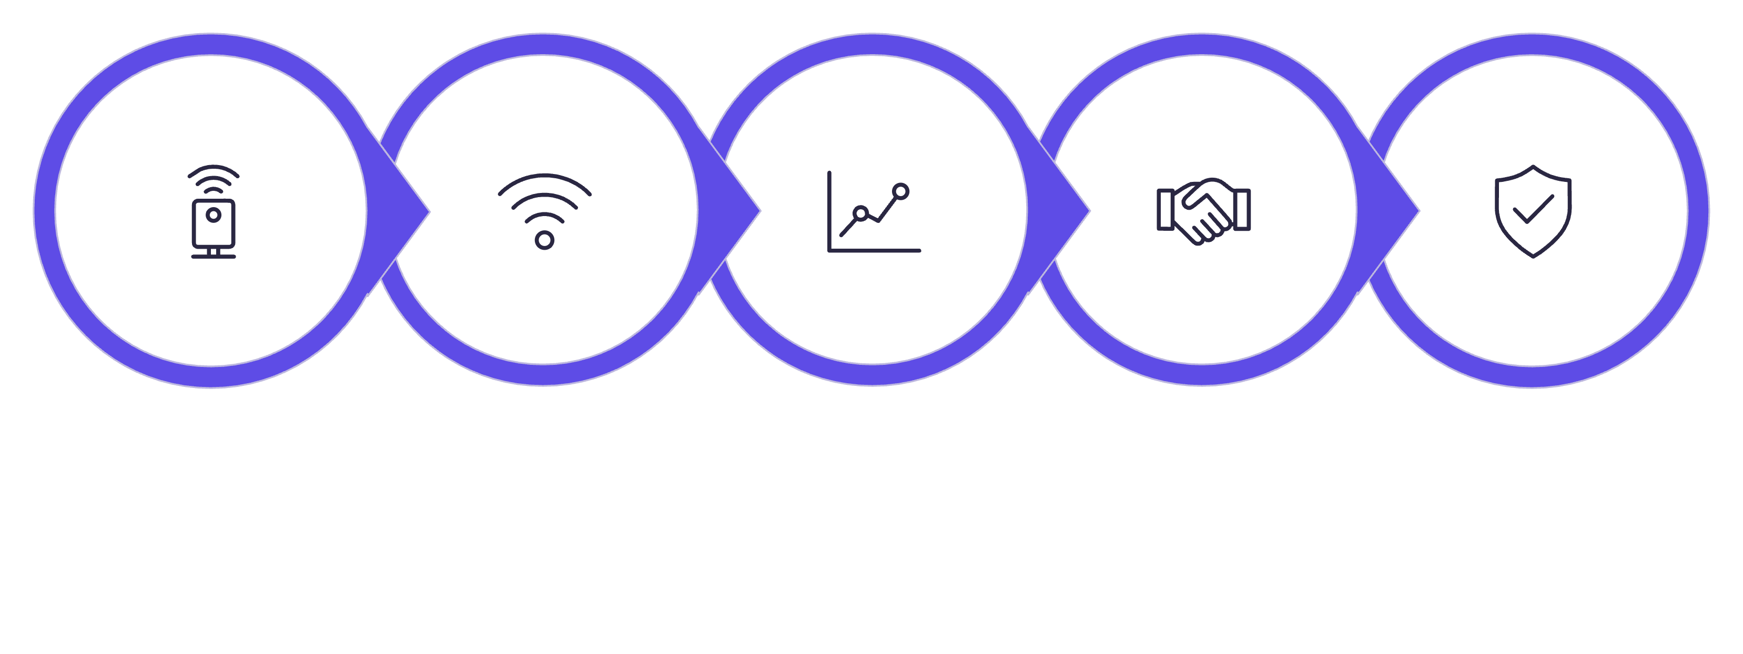
Energy Trading Workflow (15‑minute rounds)
Measure
Transmit
Forecast
Negotiate
Validate
Process summary: (1) PZEM sensors measure; (2) ESP32 sends data to Cluster; (3) forecasting estimates demand & generation; (4) agents negotiate trades; (5) OPF validates grid constraints; (6) approved trades finalised; (7) transactions written to local Ethereum; (8) dashboards update in real time.

Slide 9
Cost Analysis — Per Household & Shared Infrastructure
Per Household Component
Cost (INR)
PZEM‑004T Energy Sensor
₹534
ESP32 Microcontroller
₹249
4‑Channel Relay Module
₹249
Share of Mini‑PC Cost
₹2,800
Share of Wi‑Fi Access Point
₹506
Total per Household
₹4,338
Shared Infrastructure
Cost (INR)
Beelink SER5 Mini‑PC
₹28,000
TP‑Link EAP225 Access Point
₹5,059

Slide 10
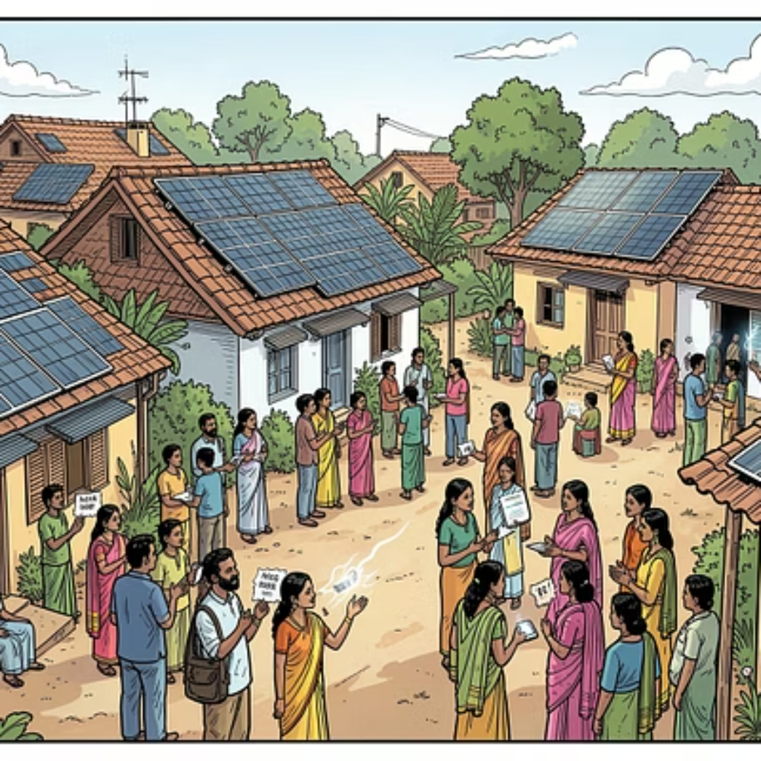
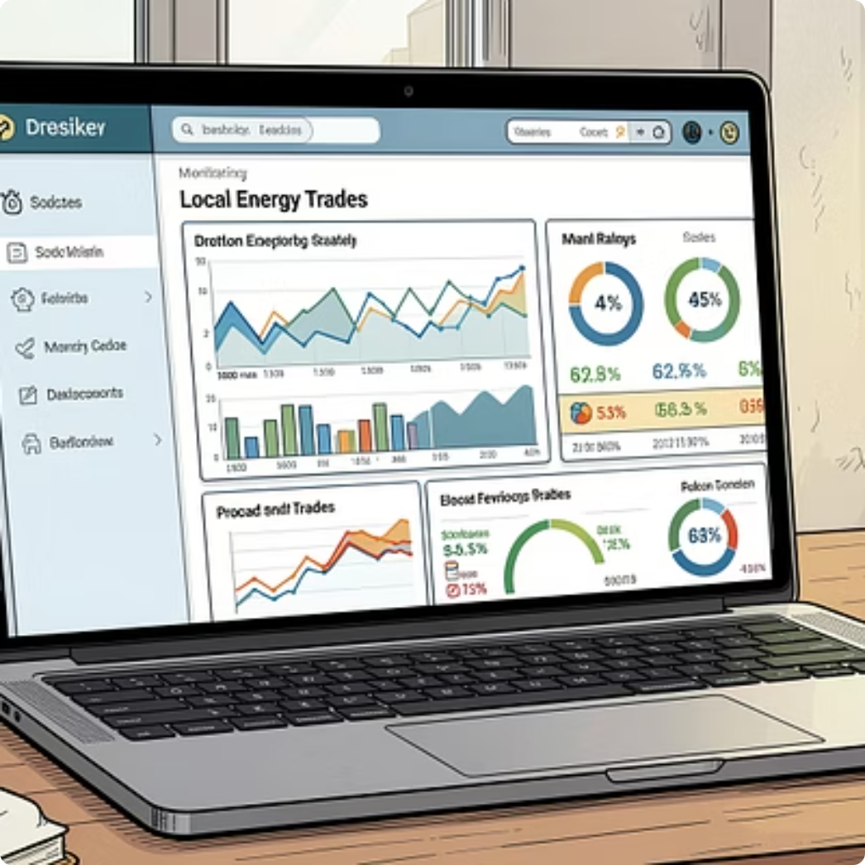
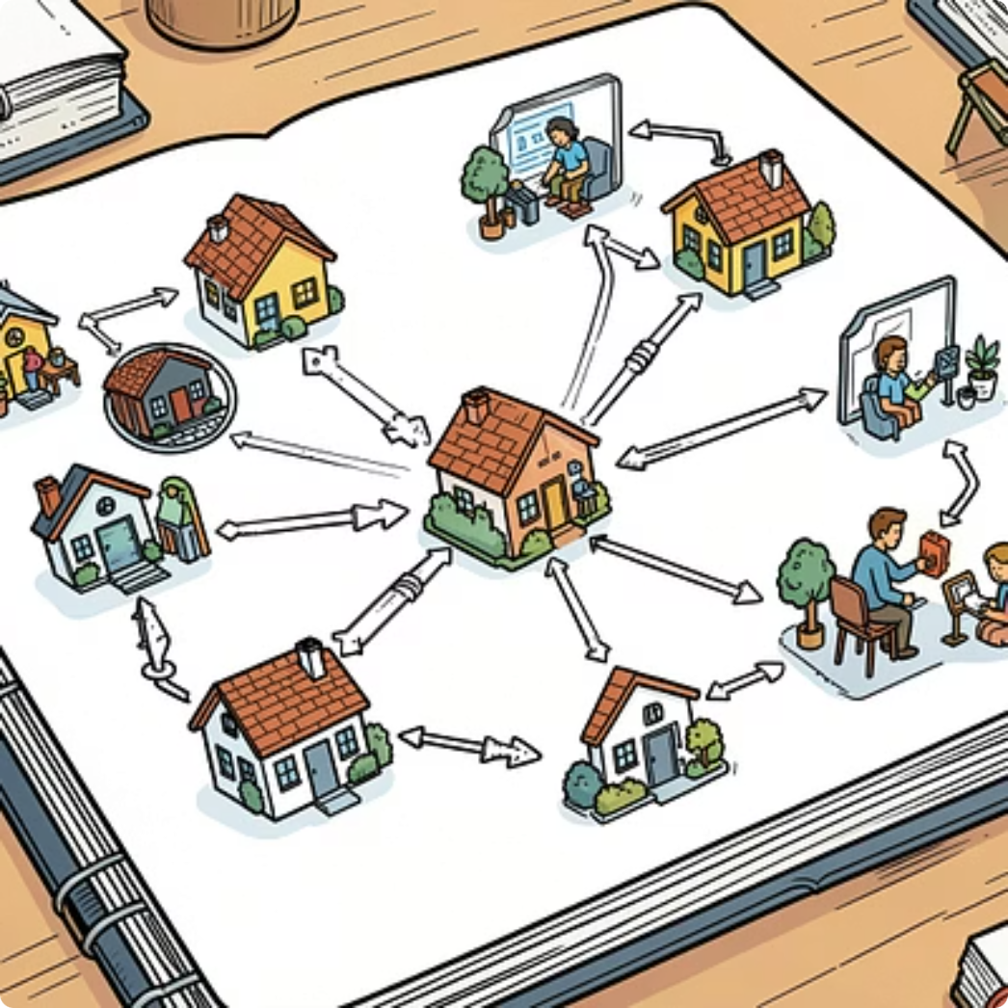
Proof of Concept, Social Impact & Conclusion
Proof of Concept
Social Impact
Conclusion
Web demo: https://p2p-trading-nrj4iz7e0-abhirajs-projects-1d7aabae.vercel.app/ · Video demo: https://drive.google.com/file/d/17HzW5DpCWRaoFsLILpnOXY-AOs39rTaz/view
Reduces renewable energy wastage, lowers household electricity costs, promotes community energy independence, preserves privacy via federated learning and builds trust through transparent blockchain settlements — supporting India’s clean energy goals.
By combining Edge Computing, Multi‑Agent AI, Federated Learning, IoT sensing, Satellite Analytics, Power‑system Optimization and Blockchain, the platform enables real‑time local energy exchange, reduces waste, improves efficiency and accelerates residential adoption of sustainable energy.

