Slide 1
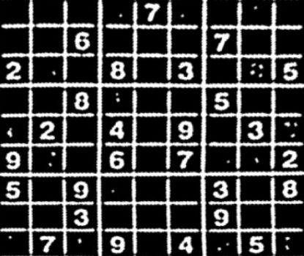
Sudoku Solver using Python and OpenCV
PESU I/O: Digital Image Processing with OpenCV
Project By: Devang Saraogi & Abhiraj
SMEs: Pooja Mahesh & Nikita Sharma

Slide 2
Flow of Our Project
Importing the Image
Pre-Processing the Image
Gaussian Blur: We need to gaussian blur the image to reduce noise in thresholding algorithm
Thresholding: Segmenting the regions of the image
Dilating the image: In cases like noise removal, erosion is followed by dilation.
Sudoku Extraction
Find Contours
Find Corners: Using Ramer Doughlas Peucker algorithm / approxPolyDP for finding corners
Crop and Warp Image: We remove all the elements in the image except the sudoku
Extract Cells
Interpreting the Digits
Import the libraries and load the dataset
Preprocess the data
Creating the Model
Predicting the digits
Solving the Sudoku

Slide 3
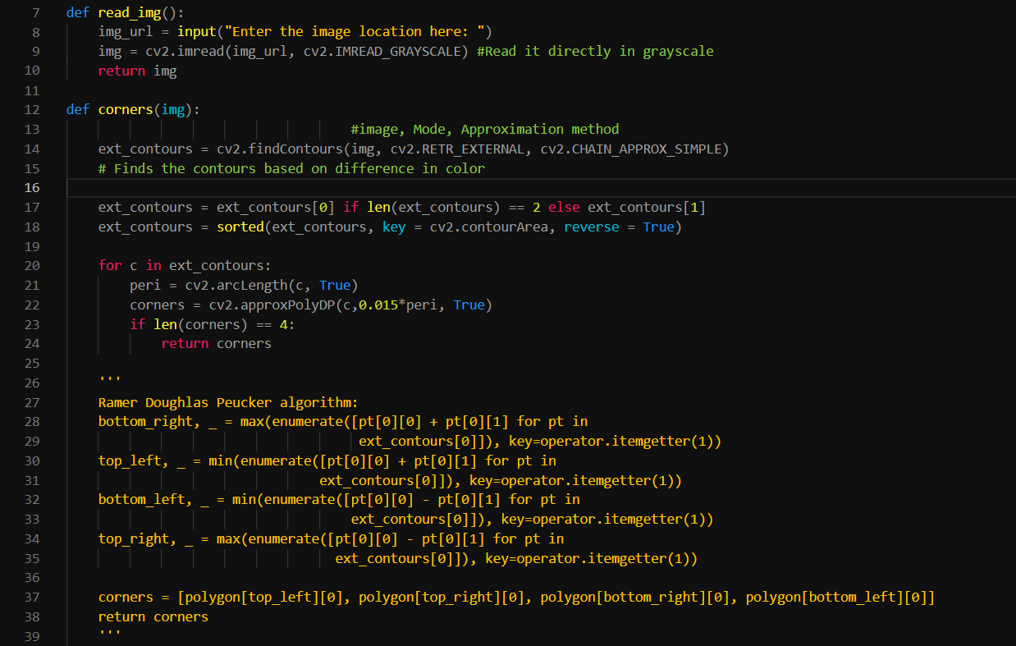
read_img function
takes the input image and reads it as grayscale and returns an image object
corners(img) function
uses the cv2.findContours function to get the external borders for the sudoku input image and returns the corners of the box using the approxPolyDP method

Slide 4
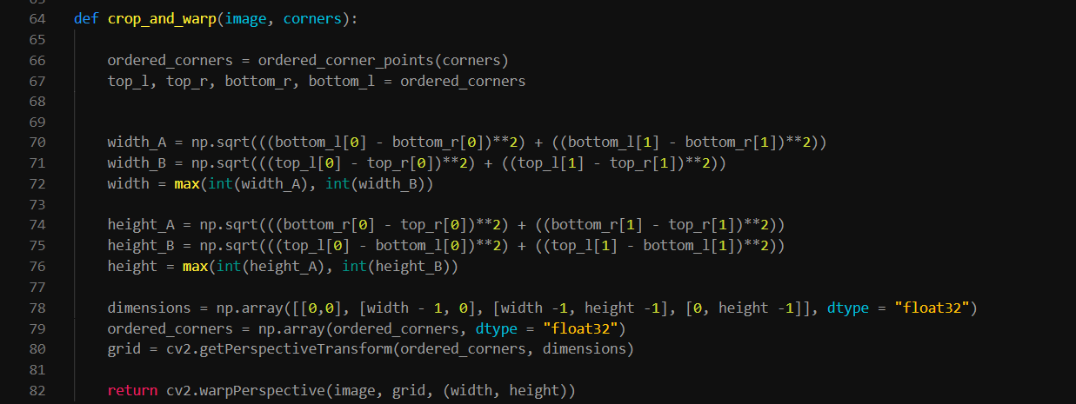
crop_and_warp function
calculates the max dimensions required for proper representation of the image and accordingly modifies the original image to appear as close as possible to a flat surface sudoku table

Slide 5
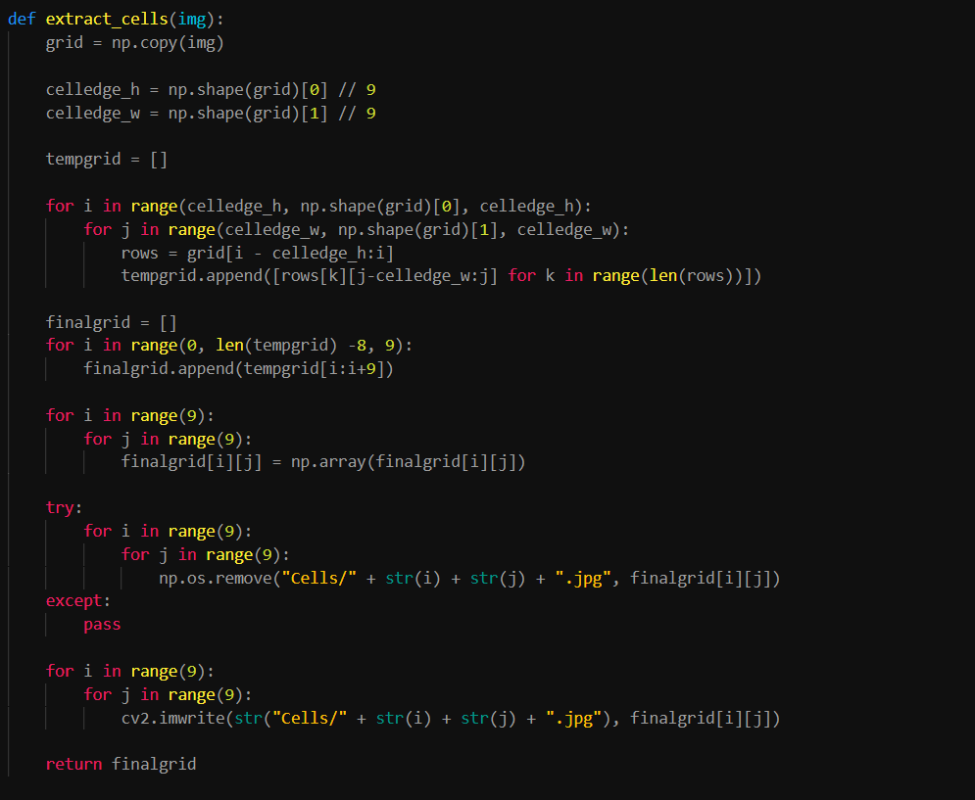
extract_cells function
creates a numpy array of each individual sudoku cell, it also stores all the cells as an image file in the cells folder.

Slide 6
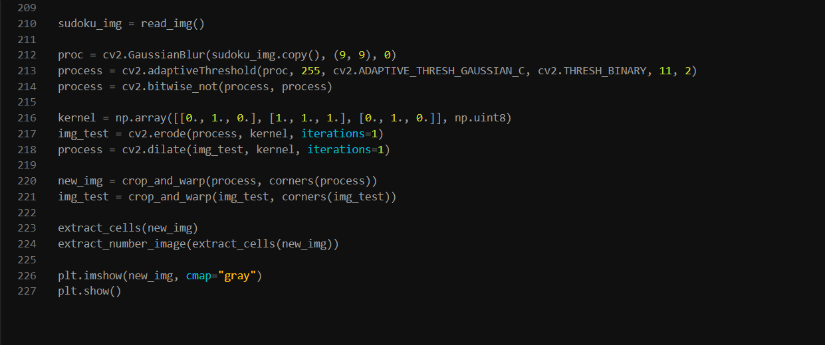
main function
we first read the image in grayscale and then we apply GaussianBlur function in order to reduce image noise and then we invert the image using the cv2.bitwise_not method
erosion and dilation
cv2.erode removes(erodes) the boundaries of the foreground object and diminishes the features of an image. Basically removes white noise
cv2.dilate increases the object area and accentuates features of the image.
Erode is usually followed by dilate as erode removes noise thus shrinking the picture. Once the white noise is gone it won’t be back, so we use dilate to increase the size
Now we apply the cop and warp method and then extract_cells and extract_number_images methods are applied to the image and the image is plotted using matplotlib

