Slide 1

Travels
Presented BY:-
Abhiraj Kumar
201269
2028511

Slide 2

About Organization
Proveb Technosoft Pvt. Ltd., located in Bangalore's Electronic City Phase 1, is a leading technology solutions provider specializing in the development of travel booking websites and related software applications. Established with a vision to revolutionize the travel industry through innovative technological solutions, Proveb Technosoft has carved a niche for itself by delivering high-quality, reliable, and user-centric products.

Slide 3




SOFTWARE TRAINING WORK UNDERTAKEN
1. Express Framework
MVC Architecture
Database Interaction
Form Handling and Validation
Session Management
Routing and Middleware
2. API Integration
Amadeus API
RESTful Services
Error Handling
3. Payment Gateway Integration
PhonePe Integration:
Payment Flow Management
Security Measures
4. React Library
User Interface

Slide 4
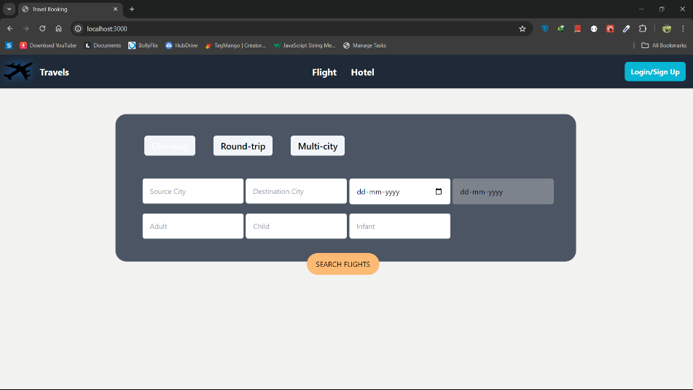
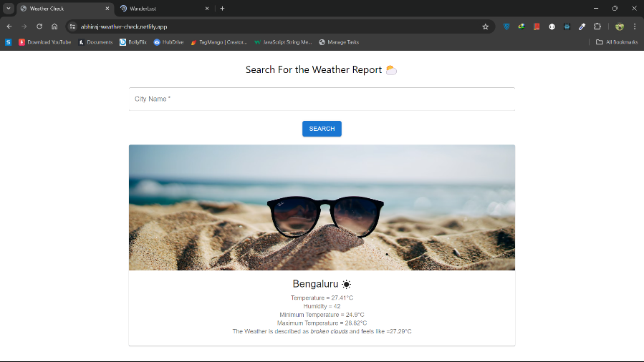
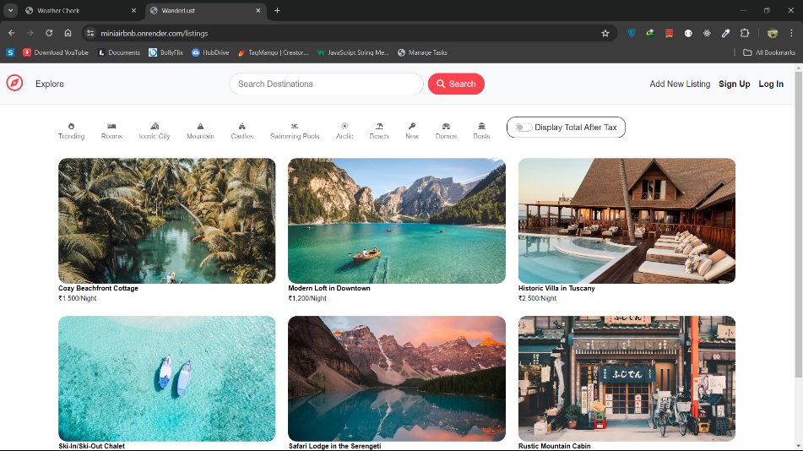
Projects Undertaken
MiniAirBnb
Flight Booking System
Weather Check

Slide 5
Travels
Comprehensive flight booking website developed as part of my final year project using Express.Js, a robust JavaScript framework.
The primary objective of Travels is to provide users with a seamless, efficient, and secure platform for searching, booking, and managing flight reservations.
The website integrates the Amadeus API for real-time flight information and the PhonePe payment gateway for secure transactions, ensuring a complete and user-friendly booking experience.
Notes:
In Slide Show mode, click the arrow to enter the PowerPoint Getting Started Center.

Slide 6
Technology Used:
Goals:
Express.Js and Node.Js
React.Js
Amadeus API
PhonePe Payment Gateway
MongoDB
HTML/CSS
JavaScript
User-Friendly Interface
Real-Time Data
Secure Transactions
Efficient Booking Management

Slide 7

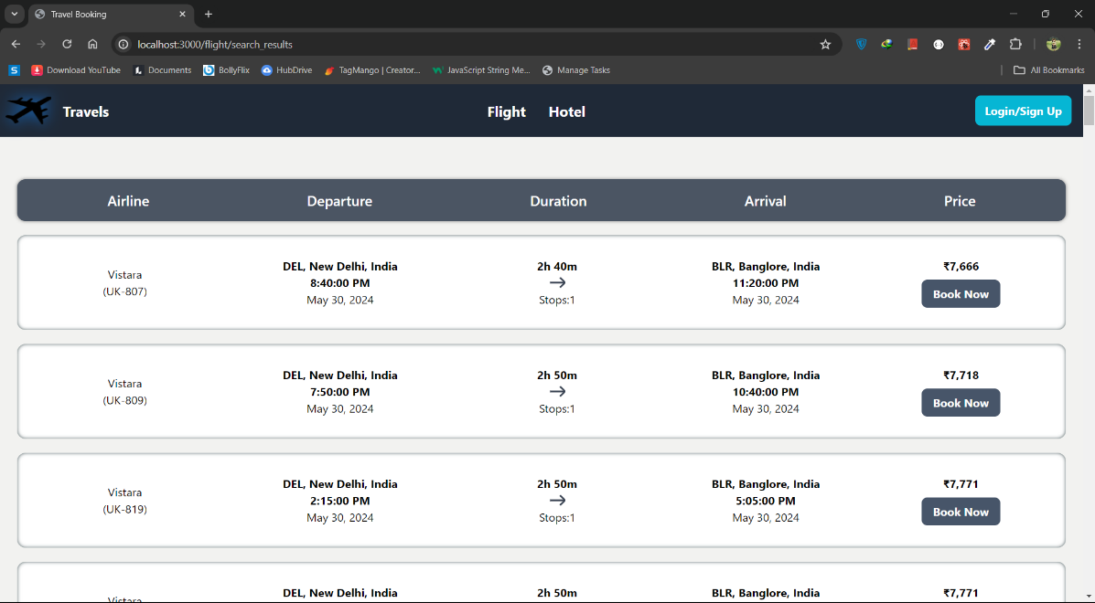
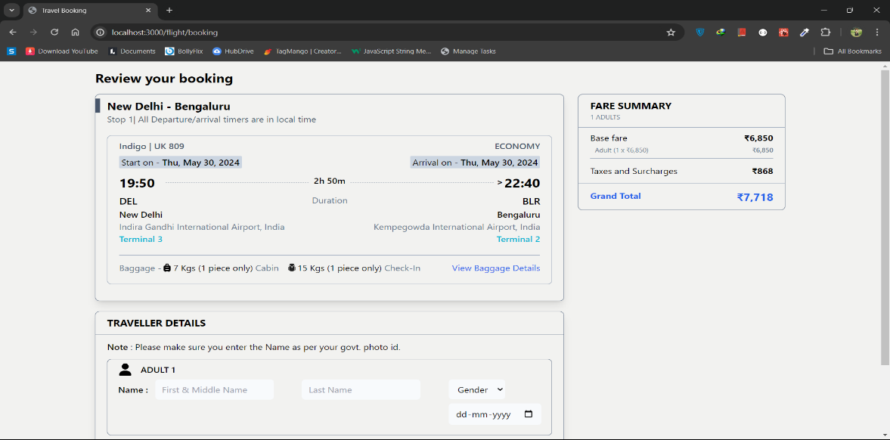
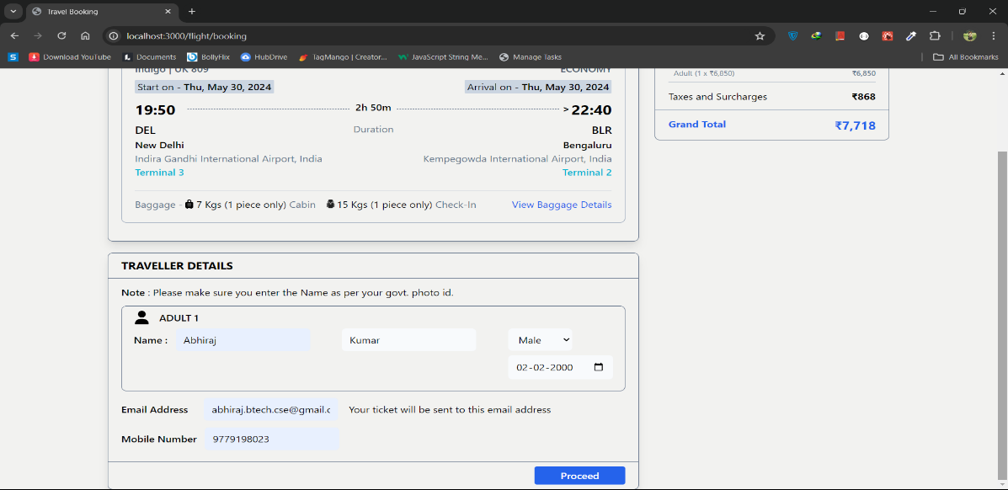
OUTPUT

Slide 8
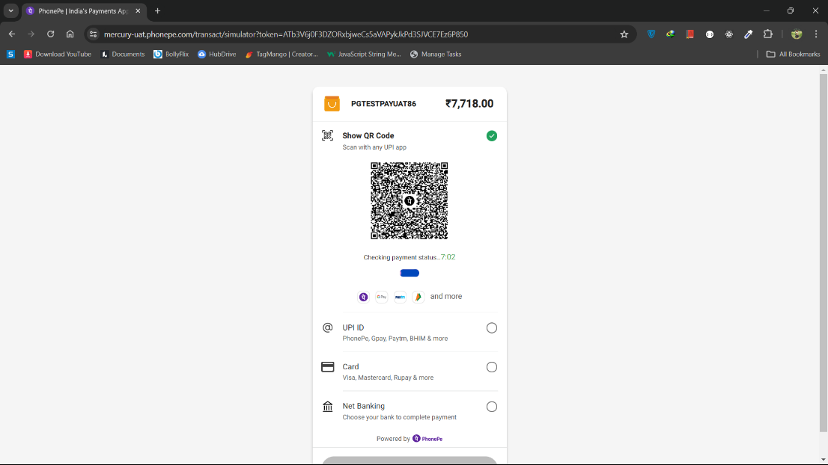
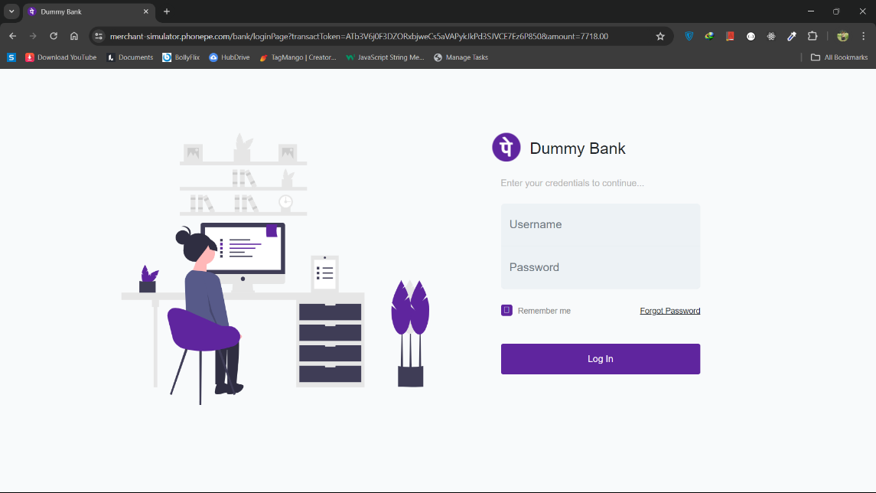
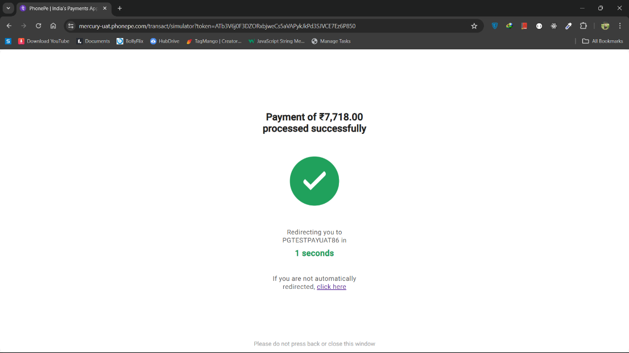
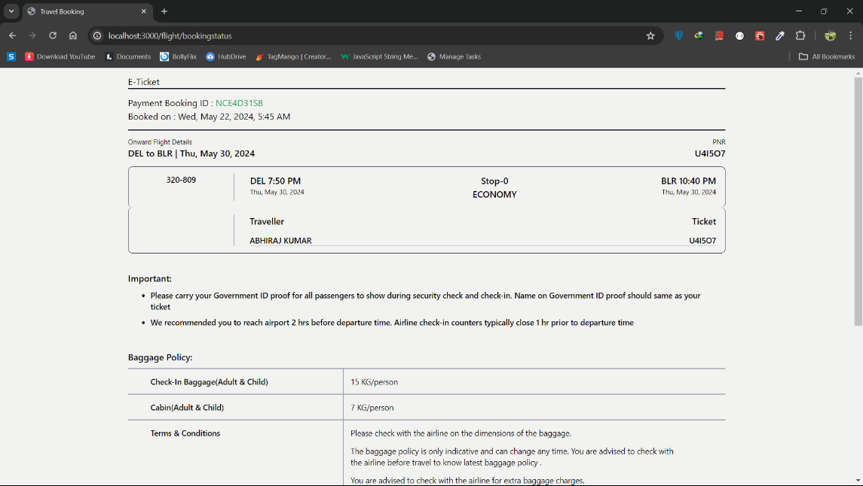

Slide 9
FUTURE SCOPE
REFERENCE
Mobile Application
Multi-Currency Support
Additional Payment Gateways
Advanced Search Filters
Loyalty Programs
Express Documentation
Amadeus API Documentation
PhonePe Payment Gateway Documentation
MongoDB Documentation
HTML/CSS/JavaScript Tutorials

Slide 10
THANK YOU

