Slide 1


Slide 2
What is jQuery?
jQuery is a fast, small and feature-rich JavaScript library included in a single .js file.

Slide 3
jQuery features
DOM Selection: jQuery provides Selectors to retrieve DOM element based on different criteria like tag name, id, css class name, attribute name, value, nth child in hierarchy etc.
DOM Manipulation: You can manipulate DOM elements using various built-in jQuery functions. For example, adding or removing elements, modifying html content, css class etc.
Special Effects: You can apply special effects to DOM elements like show or hide elements, fade-in or fade-out of visibility, sliding effect, animation etc.

Slide 4
Features Cont..
Events: jQuery library includes functions which are equivalent to DOM events like click, dblclick, mouseenter, mouseleave, blur, keyup, keydown etc. These functions automatically handle cross-browser issues.
Ajax: jQuery also includes easy to use AJAX functions to load data from servers without reloading whole page.
Cross-browser support: jQuery library automatically handles cross-browser issues, so the user does not have to worry about it. jQuery supports IE 6.0+, FF 2.0+, Safari 3.0+, Chrome and Opera 9.0+.

Slide 5
Advantages of jQuery
Easy to learn: jQuery is easy to learn because it supports same JavaScript style coding.
Write less do more: jQuery provides a rich set of features that increase developers' productivity by writing less and readable code.
Excellent API Documentation: jQuery provides excellent online API documentation.
Cross-browser support: jQuery provides excellent cross-browser support without writing extra code.

Slide 6
Setup Development Environment for jQuery
Use any JavaScript editor to write jQuery code
Download jQuery library / Using CDN
Reference jQuery in web page
Fallback to loading jQuery from a local path if the CDN is unavailable
(window.jQuery || document.write('<script src="~/scripts/jquery-2.1.3.min.js"></script>'));

Slide 7
Workshop 1
Create a registration form which includes “Email, Name, Password, Confirm Password”
Save the registration details in Local Storage(Make sure email id is unique).
Create a login page with field email address and password.
After successful login go to profile view page which shows Email and Name of current user.
Provide an edit button in profile page, on button click show edit field for name and email.
On Save Update the local storage with new value.

Slide 8
Start using jQuery
After setting up the environment and including reference of jQuery library in your web page, it's time to use jQuery.

Slide 9
jQuery() function
When you open your web page in a browser and load jQuery library successfully, it adds a global function named jQuery().
$ is an alias of jQuery function, so you can also use $() as a short form of jQuery().
window.jQuery = window.$ = jQuery = $

Slide 10
Example - Selector parameter
jQuery('div')
//Or
window.jQuery('div')
//Or
$('div')
//Or
window.$('div')

Slide 11
Where to write jQuery code
Typically, jQuery interacts with the DOM elements and performs some operation on them. Therefore, we need to detect when the DOM (Document Object Model) is loaded fully, so that the jQuery code starts interacting with DOM without any error.
For example, we want to write "Hello World!" to div tag in our web page. The first step is to check when the DOM is loaded fully so that we can find the div element and write "Hello World" to it. If we try to write it before DOM loads, jQuery may not find the div element because it might not be constructed at that time (if you write jQuery script in the <head> tag).

Slide 12
ready() function
jQuery API includes built-in function ready(), which detects whether a particular element is ready (loaded) or not. Here, we need to check whether a document object is loaded or not using ready() function because document loads entire DOM hierarchy. When the document loads successfully we can be sure that all DOM elements have also loaded successfully.
Ex : $(document).ready();

Slide 13
jQuery document ready function
$(document).ready(function() {
// DOM is loaded by now...
// Write jQuery code here...
});

Slide 14
Difference between window.onload and $(document).ready
The $(document).ready() function determines when the full DOM hierarchy is loaded whereas window.onload event is raised when entire window is loaded including DOM, images, css and other required resources. The DOM loads before entire window loads.

Slide 15
window.onload and $(document).ready
window.onload = function () {
alert('window loaded');
};
$(document).ready(function () {
alert('document loaded');
});

Slide 16
Workshop 2
Implement the workshop 1 using jQuery

Slide 17
jQuery Selectors
Syntax:
$(selector expression, context)
jQuery(selector expression, context)
Select elements by name : $('div').yourFunction()
Example: Select element by #Id : $('#idName').yourFunction()
Example: Select elements by attribute : $('[class]').append('This element has class attribute');

Slide 18
Example: Select element by attribute value :
$('[title="sample"]').append('This element includes title="sample" attribute');

Slide 19
jQuery Selector Patterns
Category | Selector | Description
Find by Element | $('p') | Find all <p> elements
 | $('p, div, code') | Find <p>,<div> and <code> elements
Find Descendant Elements | $('div p') | Find all <p> elements which are descendants of <div>
 | $('div > p') | Find <p> which is child of <div>
 | $(*) | Find all elements
Find by Id | $('#myDiv') | Find element whose id is myDiv
 | $('p#myPrg') | Find <p> element whose Id is myPrg
 | $('#myDiv1, #myDiv2') | Find multiple elements by id separated by comma.

Slide 20
Category | Selector | Description
Find by CSS Class | $('.myCSSClass') | Find all the elements with class=myCSSClass.
 | $('.myCSSClass1, .myCSSClass2 ') | Finds all elements whose class attribute is set to myCSSClass1 or myCSSClass2
 | $('div.myCSSClass') | Finds all <div> elements with class=myCSSClass
 | $('p:first-child') | Find all <p> elements, which is the first child of its parent element. (parent element can be anything)
Find by Attributes | $('[class]') | Find all the elements with the class attribute(whatever the value).
 | $('div[class]') | Find all the <div> elements that have a class attribute(whatever the value).
Find by containing value of attribute | $('div[class=myCls]') | Find all the <div> elements whose class attributes are equal to myCls.
 | $('div[class *="myCls"]') | Selects <div> elements whose class attributes contain myCls.

Slide 21
Category | Selector | Description
 | $('div[class~=myCls]') | Selects div elements whose class attributes contain myCls, delimited by spaces.
 | $('div[class$=myCls]') | Selects <div> elements whose class attributes value ends with myCls. The comparison is case sensitive.
 | $('div[class!=myCls]') | Selects <div> elements which does not have class attribute or value does not equal to myCls.
 | $('div[class^=myCls]') | Selects <div> elements whose class attribute value starts with myCls.
 | $('div:contains("tutorialsteacher")' | Find all <div> elements that contains the text 'tutorialsteacher'
Find by Input type | $(":button") | Find all input whose type is button.
Even-Odd rows | $('tr:odd') | Find all odd rows. (1,3,5,7..)
 | $('tr:even') | Find all even rows.(0,2,4,6..)

Slide 22
Points to Remember
jQuery selectors enables you to find DOM elements in the web page.
jQuery uses css selector expression patterns along with its own patterns.
Syntax: $('selector expression','context'). context is an optional parameter.
jQuery includes various selector patterns e.g element name, #id, attributes, descendant elements, css class, input types etc.

Slide 23
Workshop 3
Create the previous workshop application as a single page app
Provide a left navigation with link
Register
Login
Profile
Logout
Each link click should show the corresponding section
Left navigation link should be provided in a <UL> <LI> tags.
Use addClass and removeClass to show and hide different sections
Use [type="text"] selector to validate all textbox inside login, register, edit page. Make sure it's not empty.

Slide 24
Examples
$(‘#yourLiName’).click(function(){
$(this).addClass(‘active’);
//need to remove active class from all siblings(li) using css selector.
$(‘#contentSection1’).show();
$(‘#contentSection2’).hide();
$(‘#contentSection3’).hide();
});

Slide 25
jQuery Methods

Slide 26
jQuery methods of jQuery object which is returned by jQuery selector.
jQuery provides various methods for different tasks e.g. manipulate DOM, events, ajax etc.
Different categories of methods.
DOM Manipulation
after(), append(), attr(), before()
Traversing
children(), closest(), each(), first(), next(), filter(), parent(), siblings()
CSS
addClass(), css(), hasClass(), removeClass(), toggleClass()
Attributes
attr(), html(), removeAttr(), prop(), val()
Events
bind(), blur(), change(), click(), dblclick(), focus(), keyup(), keydown()
Effects
animate(), fadeIn(), fadeOut(), hide(), show(), stop()

Slide 27
Dimensions
height(), width(), innerHeight(), innerWidth()
Forms
blur(), change(), val(), submit()
Ajax
get(), getJson(), post(), load()
Core
jQuery(), holdReady(), when()
Data
data(), removeData(), queue(), dequeue(), clearQueue()
Miscellaneous
each(), index(), get(), toArray()
Utilities
inArray(), isArray(), isFunction(), isNumeric(), isWindow(), isXmlDoc()

Slide 28
DOM Manipulation Methods
append() : Inserts content to the end of element(s) which is specified by a selector.
before() : Inserts content (new or existing DOM elements) before an element(s) which is specified by a selector.
after() : Inserts content (new or existing DOM elements) after an element(s) which is specified by a selector.
prepend() : Insert content at the beginning of an element(s) specified by a selector.
remove() : Removes element(s) from DOM which is specified by selector.
replaceAll() : Replace target element(s) with specified element.
wrap() : Wrap an HTML structure around each element which is specified by selector.

Slide 29
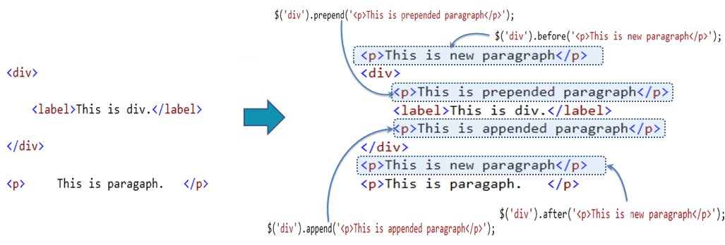

Slide 30
Manipulate HTML Attributes
attr() : Get or set the value of specified attribute of the target element(s).
prop() : Get or set the value of specified property of the target element(s).
html() : Get or set html content to the specified target element(s).
text() : Get or set text for the specified target element(s).
val() : Get or set value property of the specified target element.

Slide 31
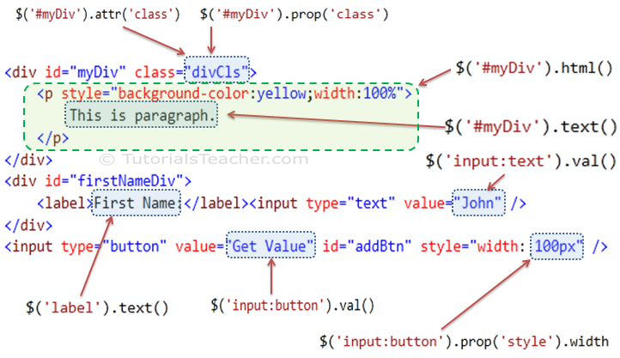

Slide 32
Workshop 4
Implement previous workshop with dom manipulation and attribute manipulation

Slide 33
Example on Login navigation link Click
$(‘#loginBtn’).click(function() {
$(‘#wrapper’).html(“”);
Var username = $(‘<input/>’);
$(‘#wrapper’).append(username);
});

Slide 34
Manipulate DOM Element's Dimensions
height() : Get or set height of the specified element(s).
innerHeight(): Get or set inner height (padding + element's height) of the specified element(s).
outerHeight() : Get or set outer height (border + padding + element's height) of the specified element(s).
offset() : Get or set left and top coordinates of the specified element(s).
position() : Get the current coordinates of the specified element(s).
width() : Get or set the width of the specified element(s).
innerWidth() : Get or set the inner width (padding + element's width) of the specified element(s).
outerWidth() : Get or set outer width (border + padding + element's width) of the specified element(s).

Slide 35
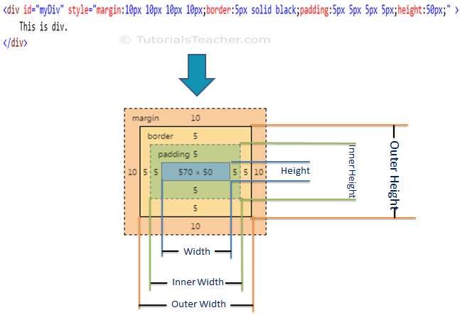

Slide 36
Traversing DOM Elements
children() : Get all the child elements of the specified element(s)
each() : Iterate over specified elements and execute specified call back function for each element.
find() : Get all the specified child elements of each specified element(s).
first() : Get the first occurrence of the specified element.
next() : Get the immediately following sibling of the specified element.
parent() : Get the parent of the specified element(s).
prev() : Get the immediately preceding sibling of the specified element.
siblings() : Get the siblings of each specified element(s)

Slide 37
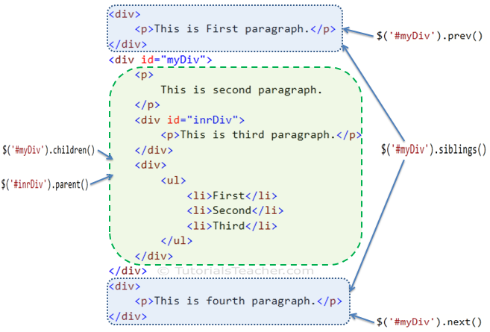

Slide 38
Workshop 5
Create an app as shown in the demo with manipulate DOM Element's Dimensions and jQuery traversing
Eg: Dimensions and Traversing Demo

Slide 39
CSS Manipulation using jQuery:
css(); Get or set style properties to the specified element(s).
addClass(); Add one or more class to the specified element(s).
hasClass(); Determine whether any of the specified elements are assigned the given CSS class.
removeClass(); Remove a single class, multiple classes, or all classes from the specified element(s).
toggleClass(); Toggles between adding/removing classes to the specified elements

Slide 40
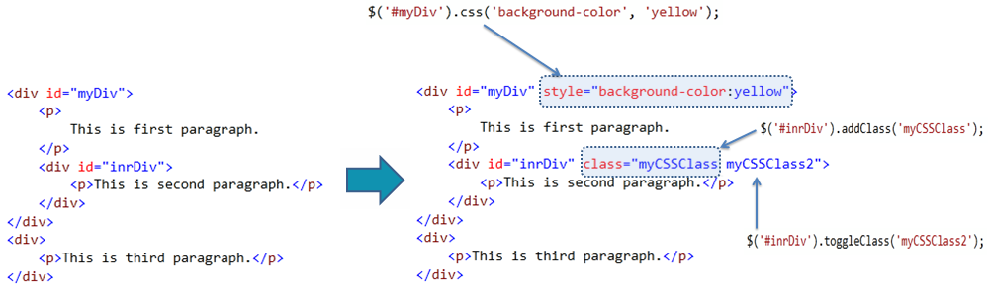

Slide 41
jQuery Animation:
animate(); Perform custom animation using element's style properties.
queue(); Show or manipulate the queue of functions to be executed on the specified element.
stop(); Stop currently running animations on the specified element(s).
fadeIn(); Display specified element(s) by fading them to opaque.
fadeOut(); Hides specified element(s) by fading them to transparent.

Slide 42
jQuery Animation:
fadeTo(); Adjust the opacity of the specified element(s)
fadeToggle(); Display or hide the specified element(s) by animating their opacity.
hide(); Hide specified element(s).
show(); Display specified element(s).
toggle(); Display hidden element(s) or hide visible element(s).
slideUp(); Hide specified element(s) with sliding up motion.

Slide 43
jQuery Animation:
slideDown(); Display specified element(s) with sliding down motion.
slideToggle(); Display or hide specified element(s) with sliding motion.

Slide 44
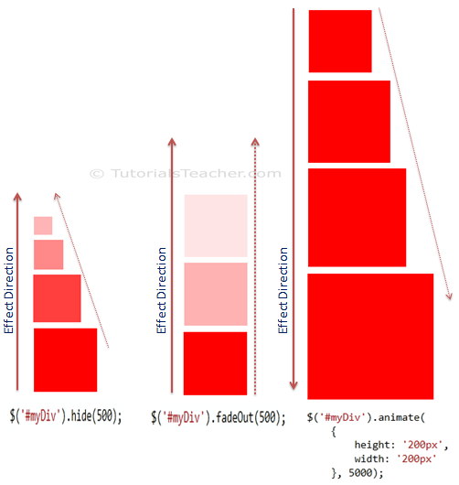

Slide 45
Workshop 6
Create a dropdown using animation method

Slide 46
jQuery Events:
Form events
blur
Change
Focus
Focusin
Select
submit

Slide 47
jQuery Events:
Keyboard events
keydown
keypress
Keyup

Slide 48
jQuery Events:
Mouse events
Click
dblclick
focusout
Hover
Mousedown
Mouseenter
Mouseleave
Mousemove

Slide 49
jQuery Events:
Mouseout
Mouseover
Mouseup
Browser events
Error
Resize
Scroll

Slide 50
jQuery Events:
Document loading
Load
Ready
Unload

Slide 51
Event handling
Demo
Event Object
Demo
this keyword in event handler
Demo
Hover events
Demo 1
Demo 2

Slide 52
Workshop 7
Create an app as shown in the demo with CSS Manipulation and jQuery Animation
Eg: jQuery Event Game

Slide 53
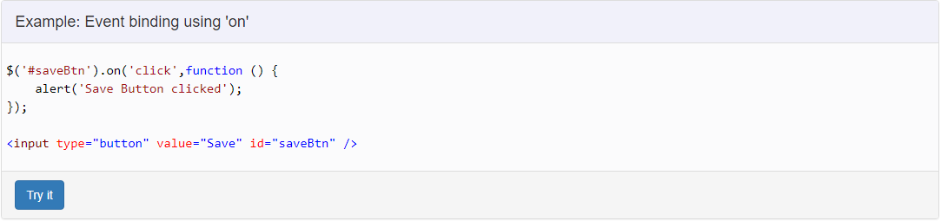
Event Binding using on():

Slide 54
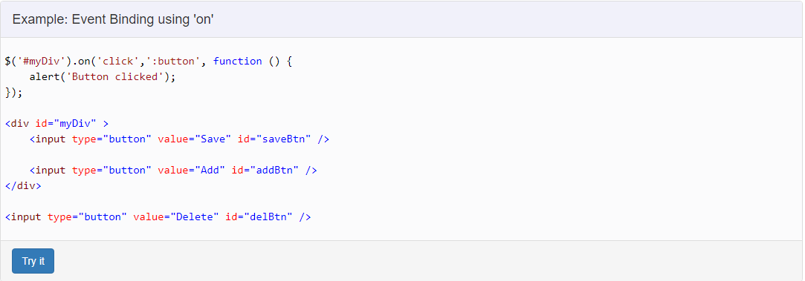

Slide 55
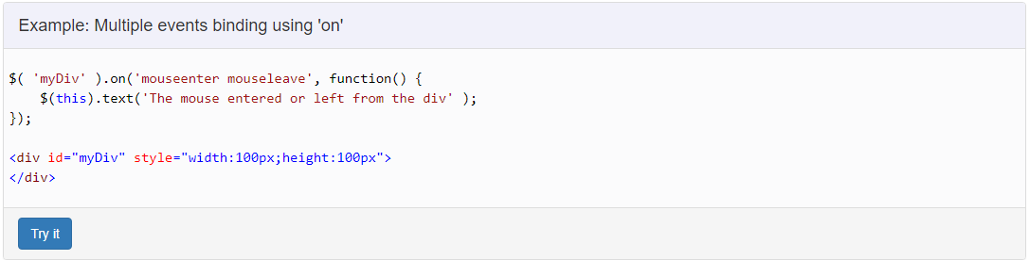
Binding multiple events:

Slide 56
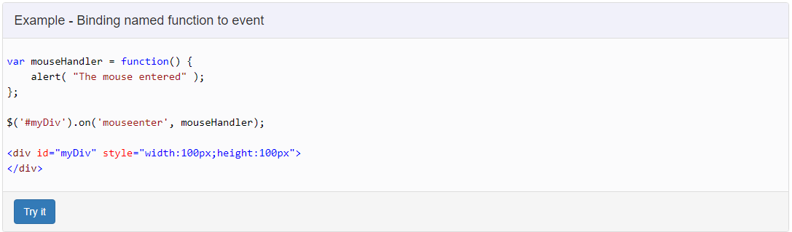
Specify named function as event handler:

Slide 57
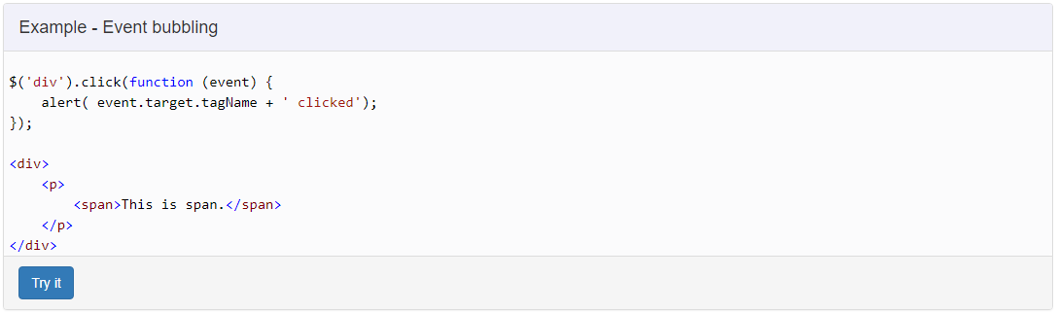
Event bubbling:
Demo

Slide 58
Workshop 7

Slide 59
END

