Slide 1


Bayesian Learning: Unlocking Insights from Probabilities
This presentation explores the powerful world of Bayesian learning, focusing on Naive Bayes and Bayesian Belief Networks. We will delve into the fundamentals of this probabilistic approach, its practical applications, and its strengths and limitations.
by richa sharma

Slide 2
Fundamentals of Bayesian Inference
Probabilistic Reasoning
Prior and Posterior Distributions
Bayesian inference uses probability to update beliefs based on new evidence. It's a powerful tool for decision-making and reasoning under uncertainty.
Bayesian methods work with prior beliefs and update them with observed data to form posterior distributions reflecting the updated knowledge.

Slide 3




Bayes' Theorem: The Core of Bayesian Inference
Prior Probability
1
The probability of an event before observing any evidence.
Likelihood
2
The probability of observing evidence given a specific event.
Posterior Probability
3
The updated probability of an event after observing evidence.
Evidence Probability
4
The probability of observing the evidence itself.

Slide 4
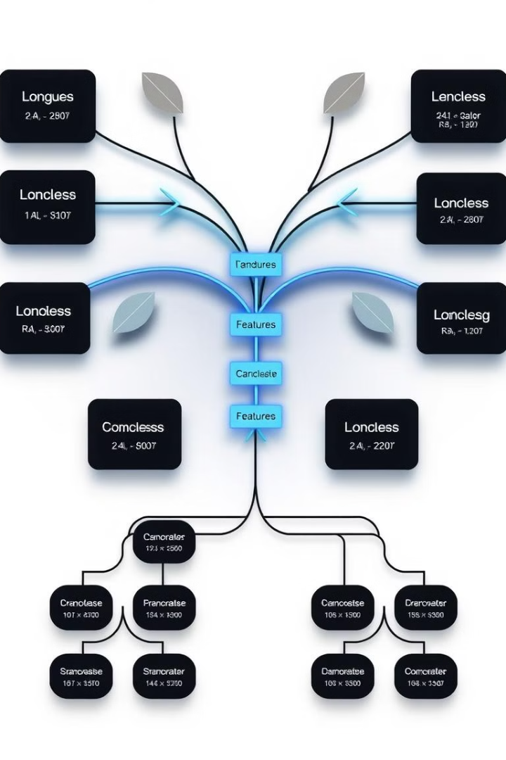
Naive Bayes Classifier: A Simple Yet Powerful Tool
1
Conditional Independence Assumption
2
Probability Calculation
It calculates the probability of a class given observed features based on Bayes' theorem.
Naive Bayes assumes features are independent of each other given a specific class.
3
Classification Task
Naive Bayes classifies instances into categories by selecting the class with the highest probability.

Slide 5
Naive Bayes in Action: Text Classification
1
Data Preparation
Prepare text data by tokenizing words and creating a vocabulary.
2
Feature Extraction
Extract features like word frequencies or presence of keywords.
3
Probability Calculation
Calculate probabilities of classes based on feature frequencies.
4
Classification
Classify new text by selecting the class with the highest probability.

Slide 6




Bayesian Belief Networks: Representing Complex Dependencies
Directed Acyclic Graph (DAG)
Conditional Probability Tables (CPTs)
Inference Algorithms
A network structure representing relationships between variables.
Algorithms for computing probabilities of unobserved variables given evidence.
Tables defining probabilities of variables given their parents in the network.

Slide 7
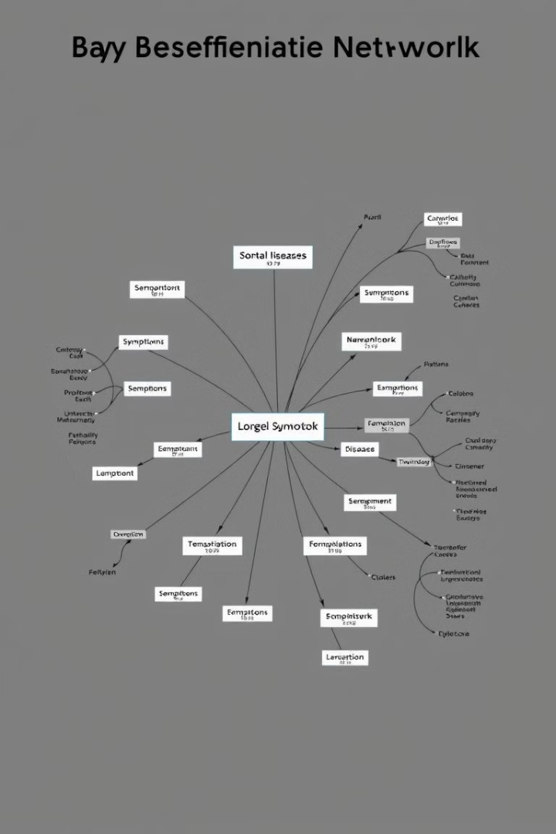



Modeling Dependencies with Bayesian Belief Networks
Structure Learning
Identifying the relationships between variables based on domain knowledge or data analysis.
Parameter Estimation
Estimating the conditional probabilities in the CPTs using training data.
Inference
Computing probabilities of interest given observed evidence in the network.

Slide 8
Advantages and Limitations of Bayesian Learning
2
1
Limitations
Strengths
Assumptions of independence can be restrictive, computational complexity for large networks.
Robust to noisy data, interpretable models, handles missing data well.

