Slide 1


Comparing Logistic Regression and K-Nearest Neighbors
This presentation will explore two common classification algorithms, Logistic Regression and K-Nearest Neighbors. We'll delve into their working mechanisms, compare their strengths and weaknesses, and discuss their real-world applications.
by richa sharma

Slide 2
Introduction to Classification Algorithms
What is Classification?
Types of Algorithms
Predicting a categorical outcome based on input features. For instance, predicting whether a customer will purchase a product based on their demographics and browsing history.
There are many classification algorithms, each with its own strengths and weaknesses. We'll focus on two: Logistic Regression and K-Nearest Neighbors.

Slide 3



Logistic Regression: How it Works
Linear Model
1
Creates a line or plane that separates data points into different categories.
Sigmoid Function
2
Transforms the linear output to probabilities between 0 and 1, representing the likelihood of belonging to a class.
Threshold
3
A cut-off point on the probability scale, where values above the threshold are classified into one category, and below into the other.

Slide 4
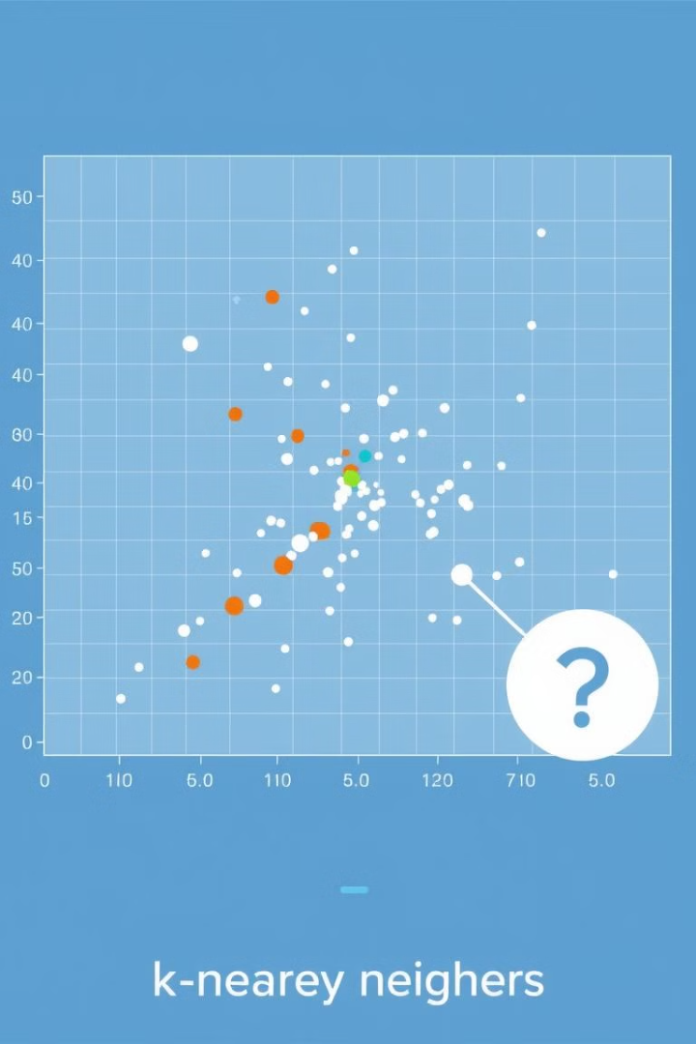



K-Nearest Neighbors: Intuition and Implementation
Distance Metric
K Neighbors
Calculates the distance between a new point and all existing points in the dataset.
Identifies the 'k' nearest points to the new point, based on the distance metric.
Majority Voting
The new point is classified based on the majority class among its 'k' nearest neighbors.

Slide 5
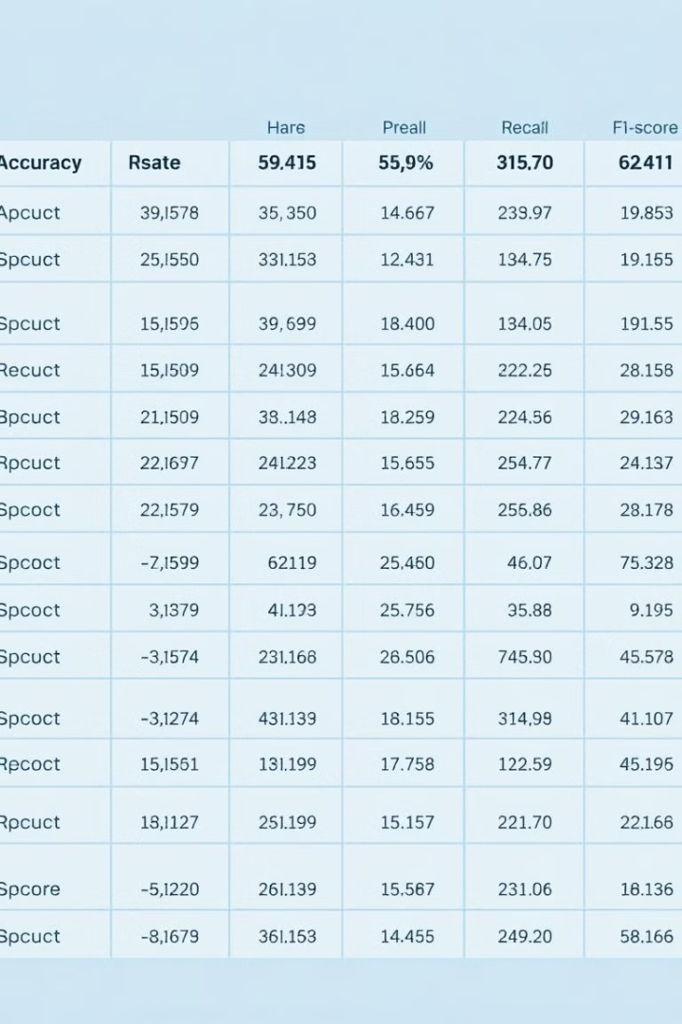
Comparing Performance Metrics
0.85
0.92
Accuracy
Precision
The proportion of correctly classified instances.
The proportion of true positive predictions out of all positive predictions.
0.78
0.84
Recall
F1-Score
The proportion of true positive predictions out of all actual positive instances.
A harmonic mean of precision and recall, balancing both metrics.

Slide 6
Advantages and Disadvantages of Each Algorithm
Logistic Regression
K-Nearest Neighbors
Interpretable model, good for high-dimensional data, can be used for probability prediction.
Simple to understand and implement, can handle non-linear data, flexible choice of distance metric.
Requires linear separation of data, sensitive to outliers, can overfit on small datasets.
Sensitive to noisy data, computationally expensive for large datasets, requires careful choice of 'k' value.

Slide 7

Real-World Use Cases and Applications
Healthcare
Finance
Disease prediction, patient risk assessment, medical image analysis.
Fraud detection, credit risk assessment, customer segmentation.
Marketing
Social Media
Customer churn prediction, targeted advertising, campaign optimization.
Sentiment analysis, spam detection, content recommendation.

Slide 8

Conclusion and Key Takeaways
1
Model Selection
2
Performance Evaluation
The choice of algorithm depends on the specific problem and data characteristics.
Carefully evaluate model performance using appropriate metrics and validation techniques.
3
Real-World Applications
Classification algorithms play a crucial role in solving diverse challenges across various industries.

