Slide 1
Understanding the effect of Weather on Bike Sharing Systems
Abhiraj Vinnakota

Slide 2
Introduction
Bike sharing systems are new generation of traditional bike rentals where the user can easily rent a bike from a position and return at another position.
Currently, there are about over 500 bike-sharing programs around the world which is composed of over 500 thousands bicycles.
Apart from playing an important role in traffic, environmental and health issues, the characteristics of data generated make them attractive. Usually, the duration of travel, departure and arrival position is explicitly recorded, making it useful for sensing mobility in the city.
We are going to study two-year historical log from Capital Bikeshare system, Washington D.C., USA which is publicly available in (http://capitalbikeshare.com/system-data)
We hope to understand how weather effects the usage of this bikeshare system.

Slide 3
Data
The response variables of interest are the total casual users and the total registered users who used the service in a single day.
The weather variables include, temperature, feeling temperature, humidity, windspeed. All of them are normalized.
It also includes weather situation (weather_sit) :
1: Clear, Few clouds, Partly cloudy, Partly cloudy
2: Mist + Cloudy, Mist + Broken clouds, Mist + Few clouds, Mist
-3: Light Snow, Light Rain + Thunderstorm + Scattered clouds, Light Rain + Scattered clouds
4: Heavy Rain + Ice Pallets + Thunderstorm + Mist, Snow + Fog
The time variables include date, year (0: 2011, 1:2012) , month, weekday, working day, holiday, season (1:springer, 2:summer, 3:fall, 4:winter)

Slide 4
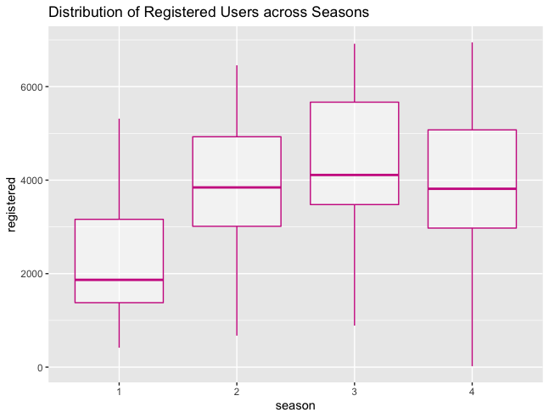
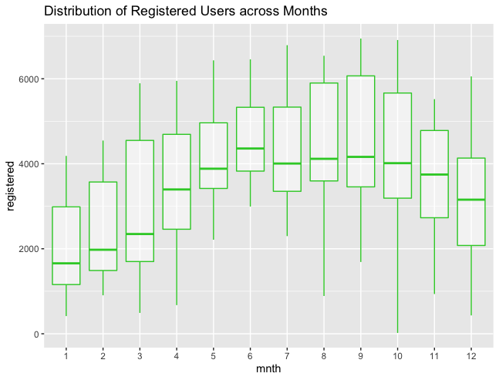
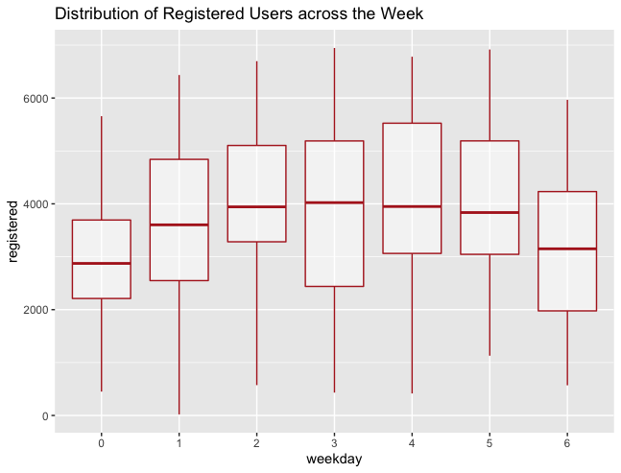
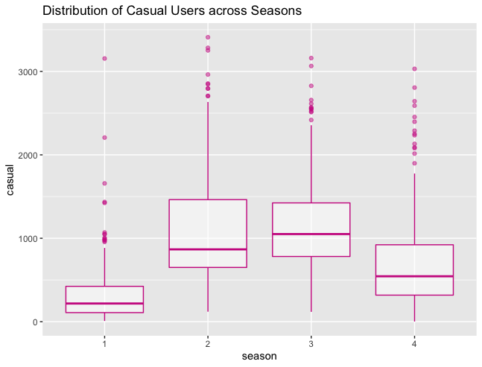
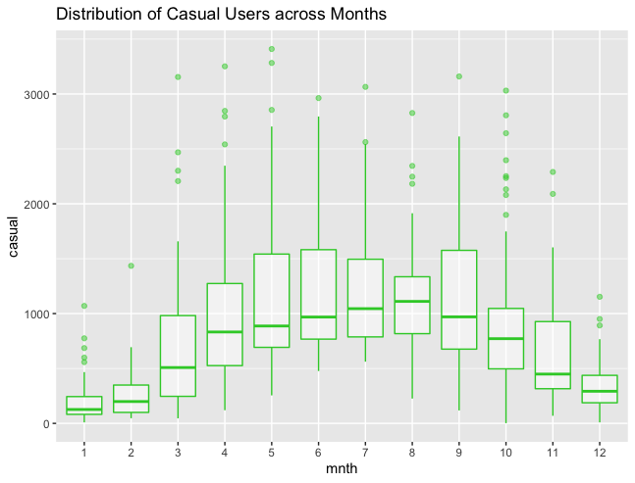
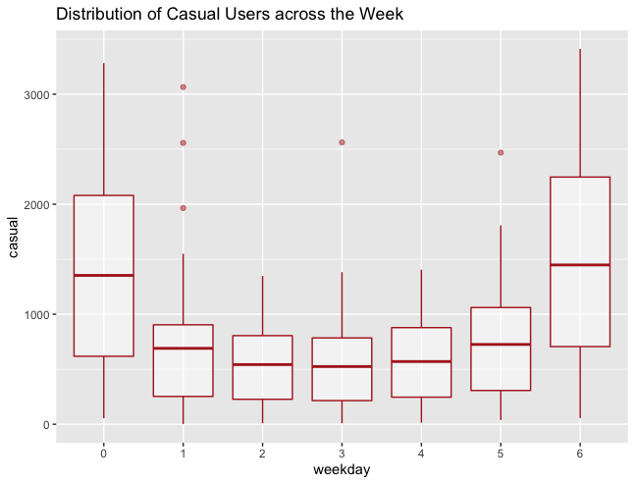
Exploratory Data Analysis – Time Variables

Slide 5
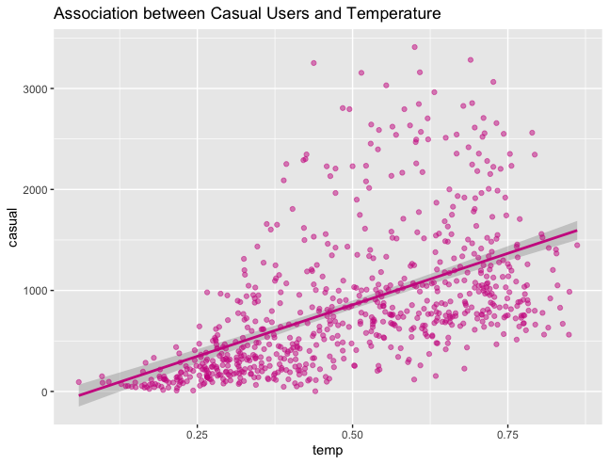
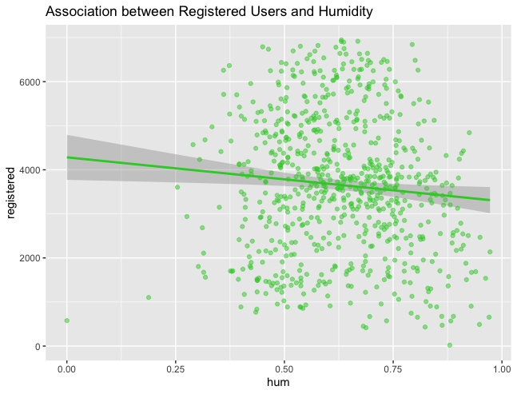
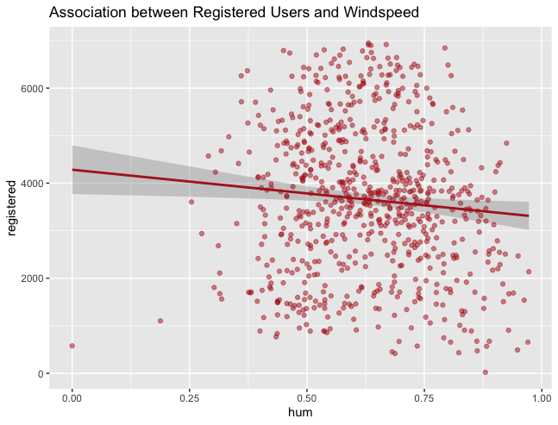
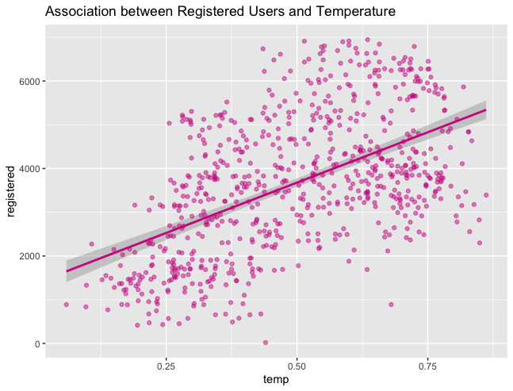
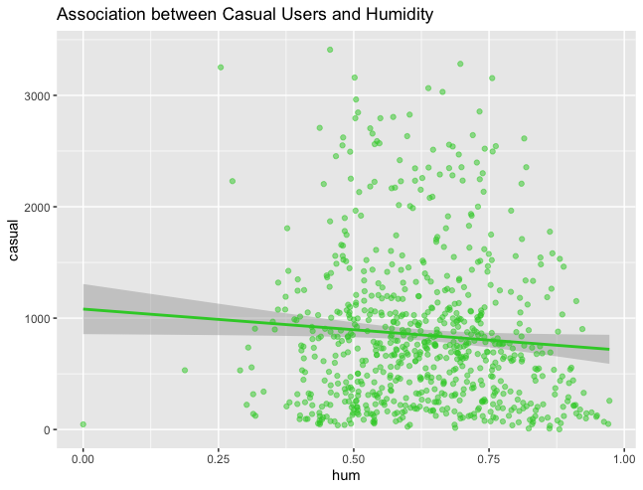
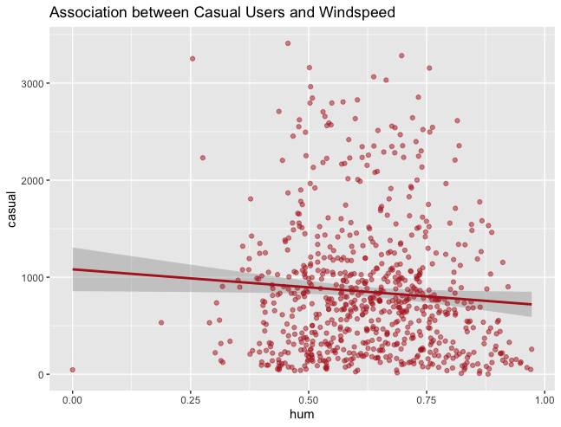
Exploratory Data Analysis – Weather Variables

Slide 6
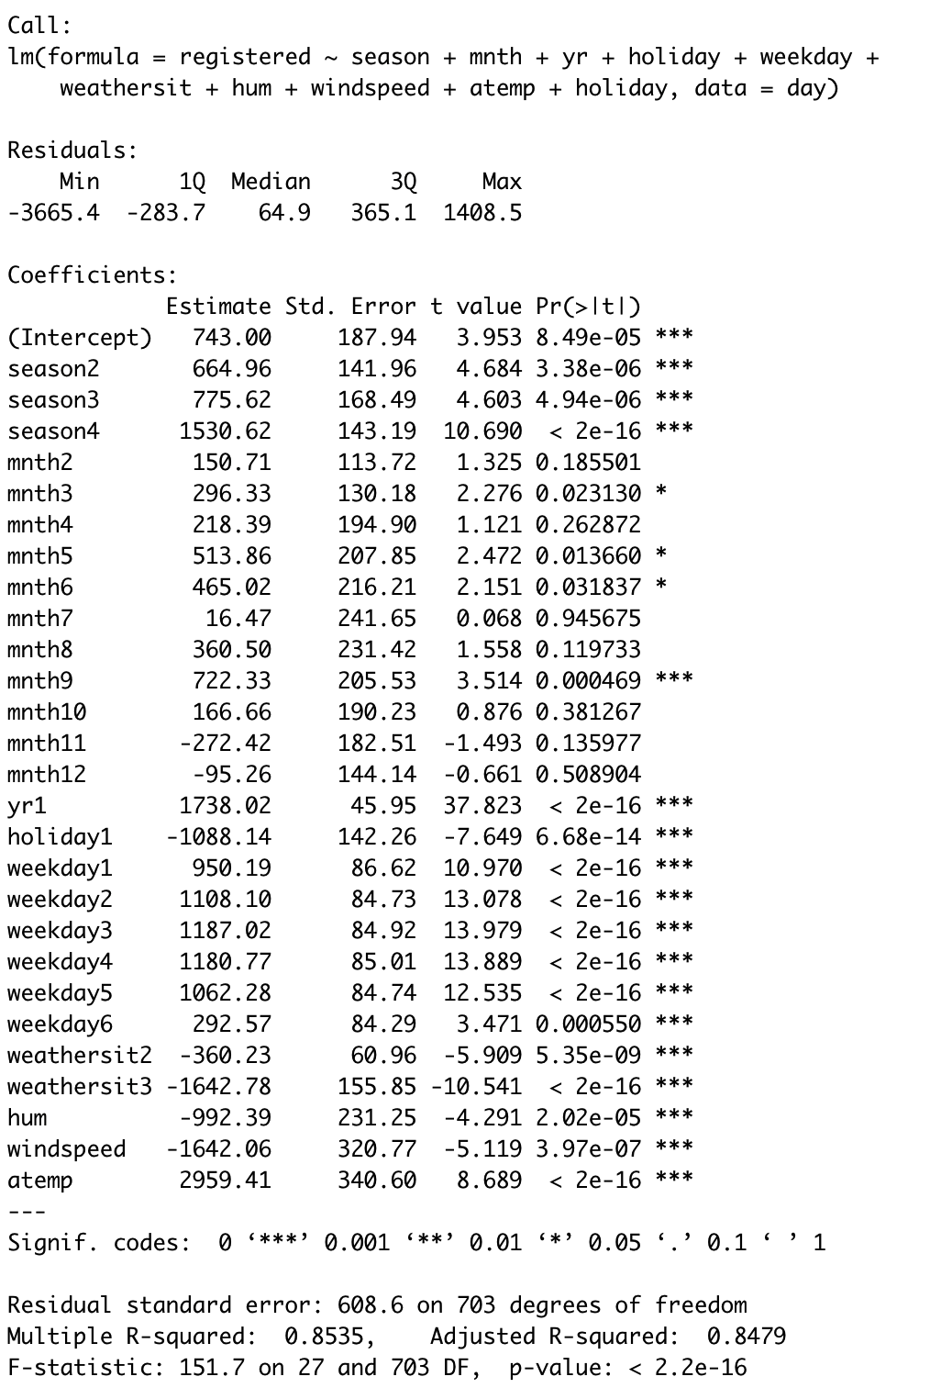
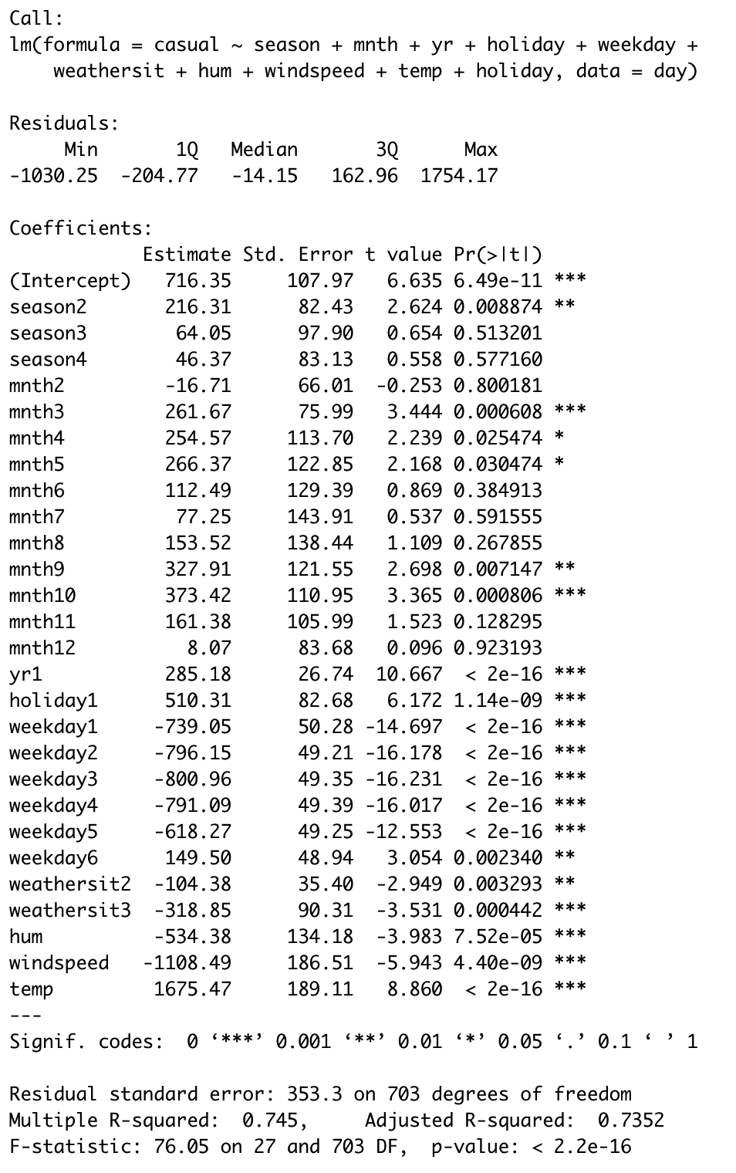
Linear Models
For every season, the behavior of registered users is statistically different
Behavior based on holiday and day of week is opposite for registered vs casual users
Registered Users are far more explainable as compared with Casual Users

Slide 7
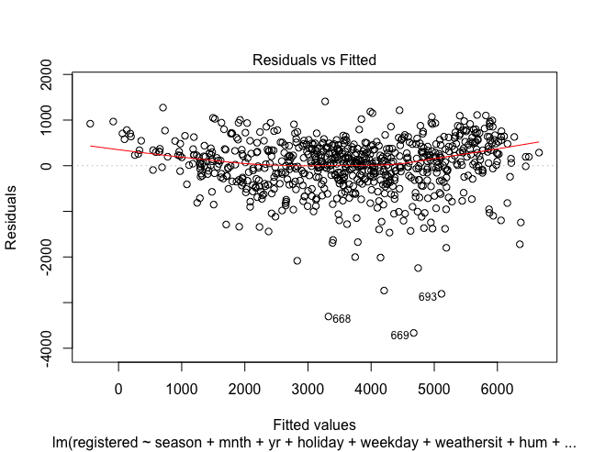
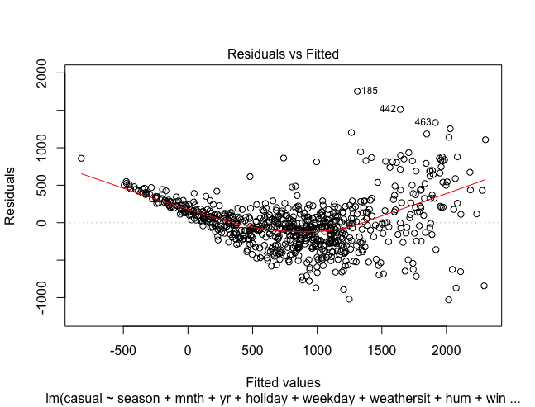
Model Validation
Residuals for both the models show a trend. A similar one.
Considering that the data is at a day level, looking at time series maybe a good idea.

Slide 8
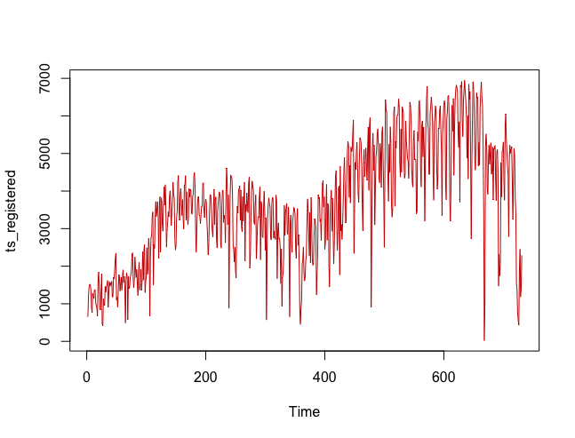
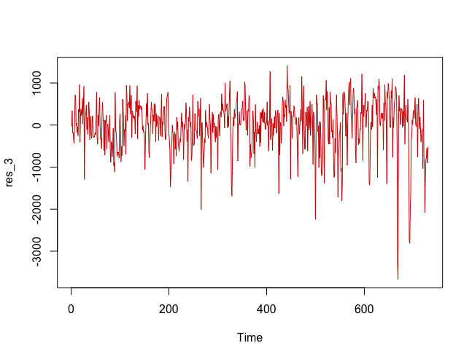
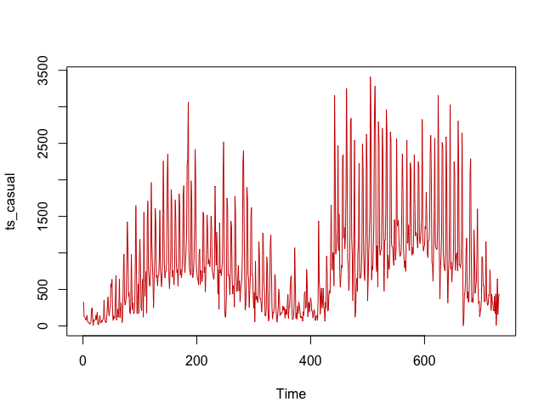
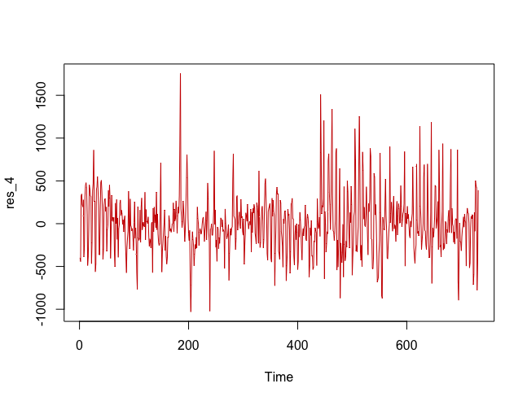
Time Trends & Stationarity
The linear models’ residuals were looked at for stationarity
Stationarity was established for both the trends by the ADF and the KPSS test

Slide 9
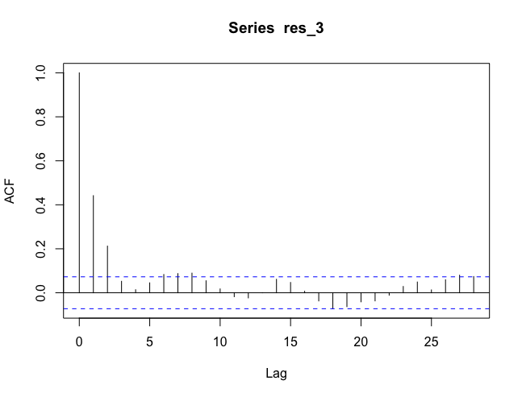
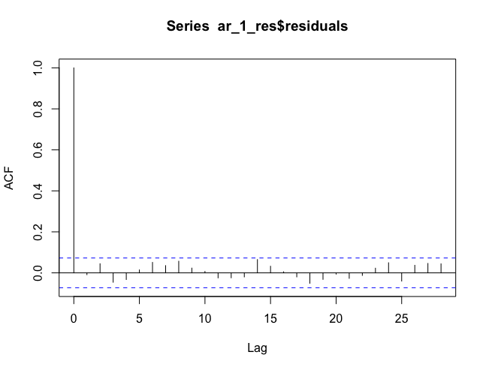
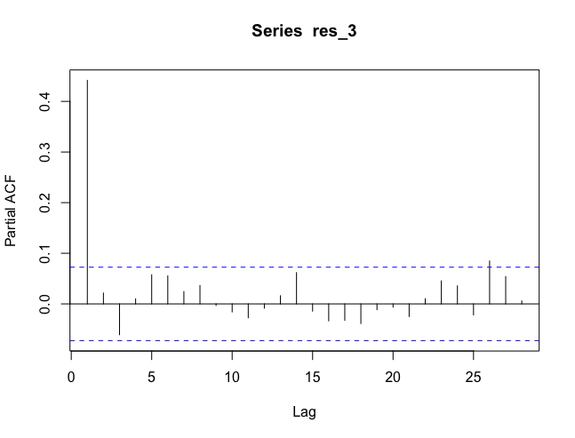
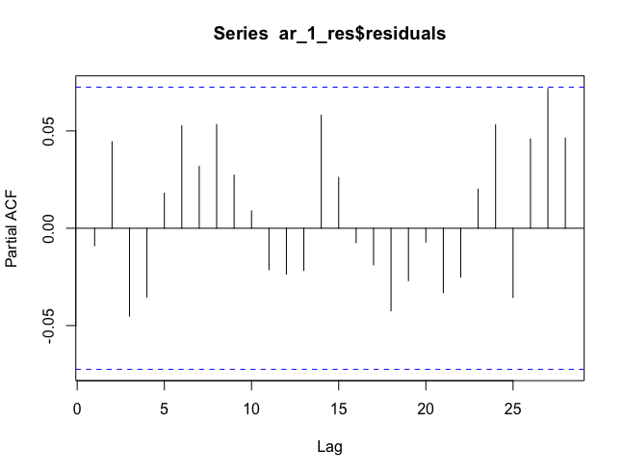
Fitting for Registered Users
An AR1 model was applied taking into consideration the insight from the PACF plot

Slide 10
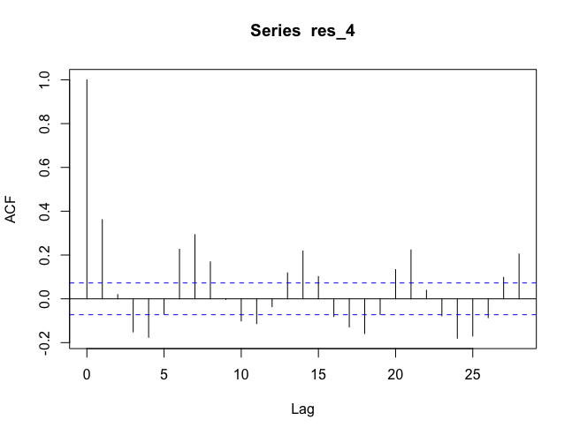
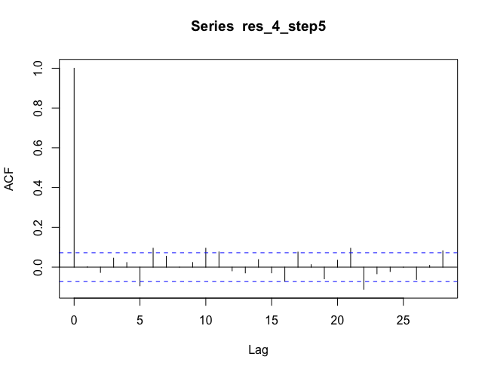
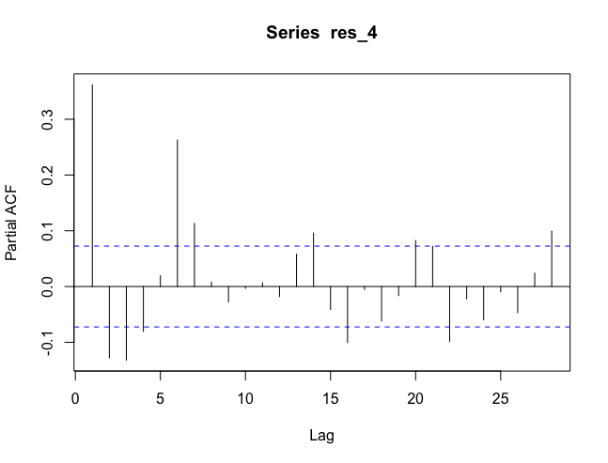
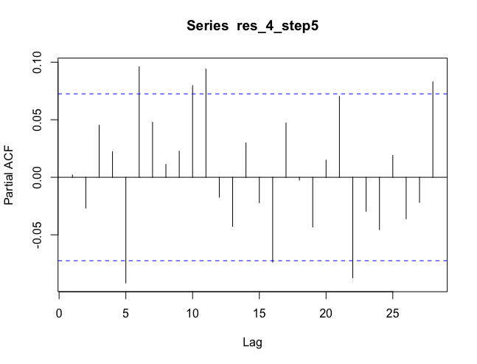
Fittings for Casual Users
An AR2MA3 model was applied taking into consideration the output of the AUTO ARIMA function in R

Slide 11
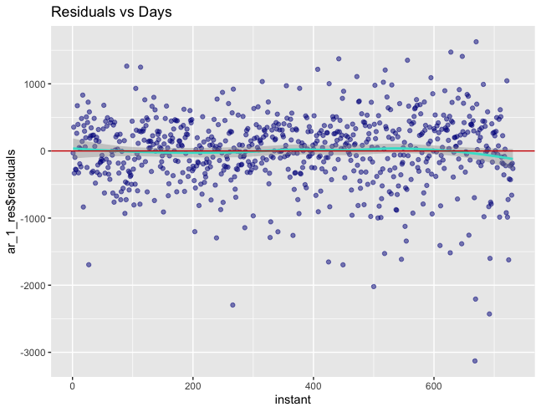
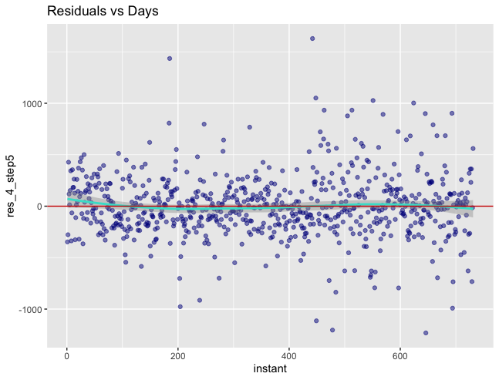
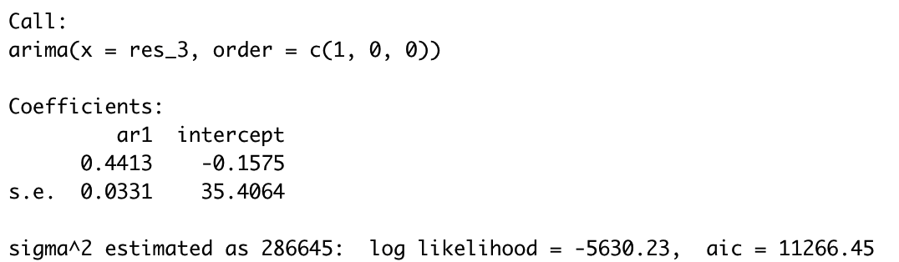
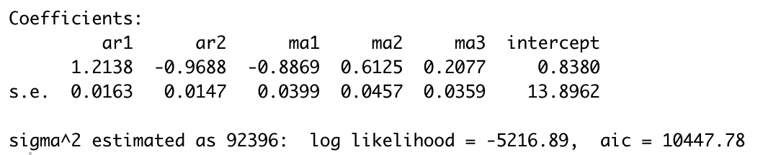
The issue of residuals

Slide 12
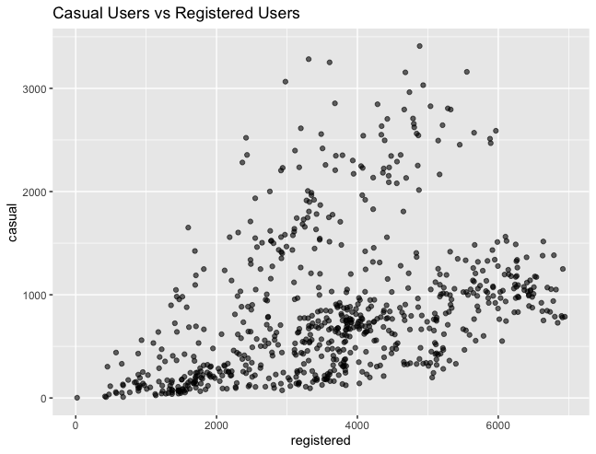
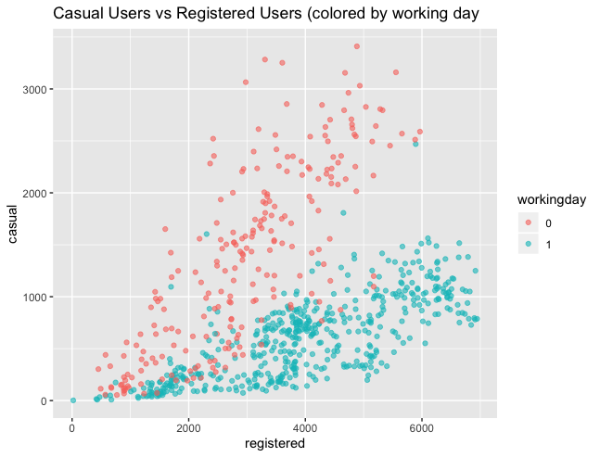
Limitations
Both the models do not capture the covariance between both the response variables. Especially when they can reasonably effect each other.
The “workingday” variable, which could explain the covariance did not find its place in the linear models.
The models that can handle this issue belong to the class of VAR (Vector Auto Regressive) models.

