Slide 1
Evaluating Channel Estimation Performance in mmWave OFDM Communication Systems: A Comprehensive Analysis
Members
Abhiram Chowdary 222CN011
Under the guidance of
Dr. Ashvini Chaturvedi Professor,Nitk

Slide 2
Problem Statement and Motivation: 1.In mmWave OFDM communication systems, accurate channel estimation is crucial for achieving reliable and high-throughput wireless communication. 2. The unique characteristics of mmWave frequencies, such as severe path loss and susceptibility to environmental factors, present significant challenges to effective channel estimation techniques. 3. This necessitates a comprehensive investigation into the performance of various channel estimation methods specifically tailored for mmWave OFDM systems. 4. The primary objective of this study is to assess: Accuracy, Robustness, Computational complexity

Slide 3
Overview
In the previous presentation ,we saw the effects of power, throughput and a mmwave signal in urban ,rural, and indoor scenarios
Next , we will see how signal processing is done on raw channel impulse data
After collecting the channel impulse response(CIR),we implemented an OFDM communication system to get BER VS SNR for QPSK,QAM16,QAM32 and QAM63 modulation schemes.

Slide 4
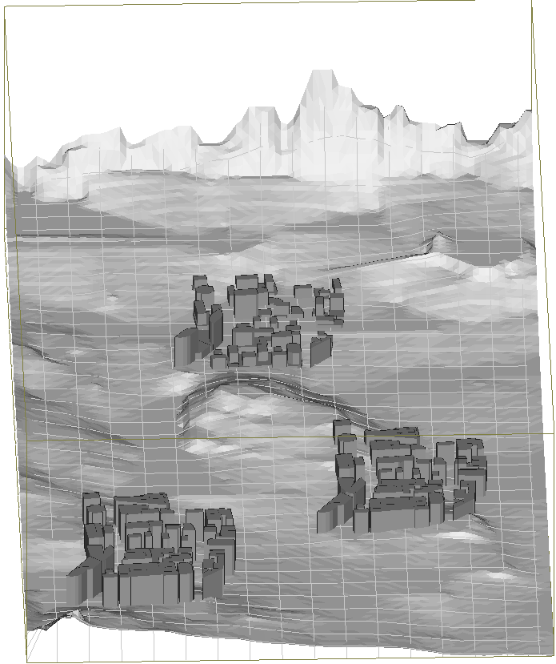
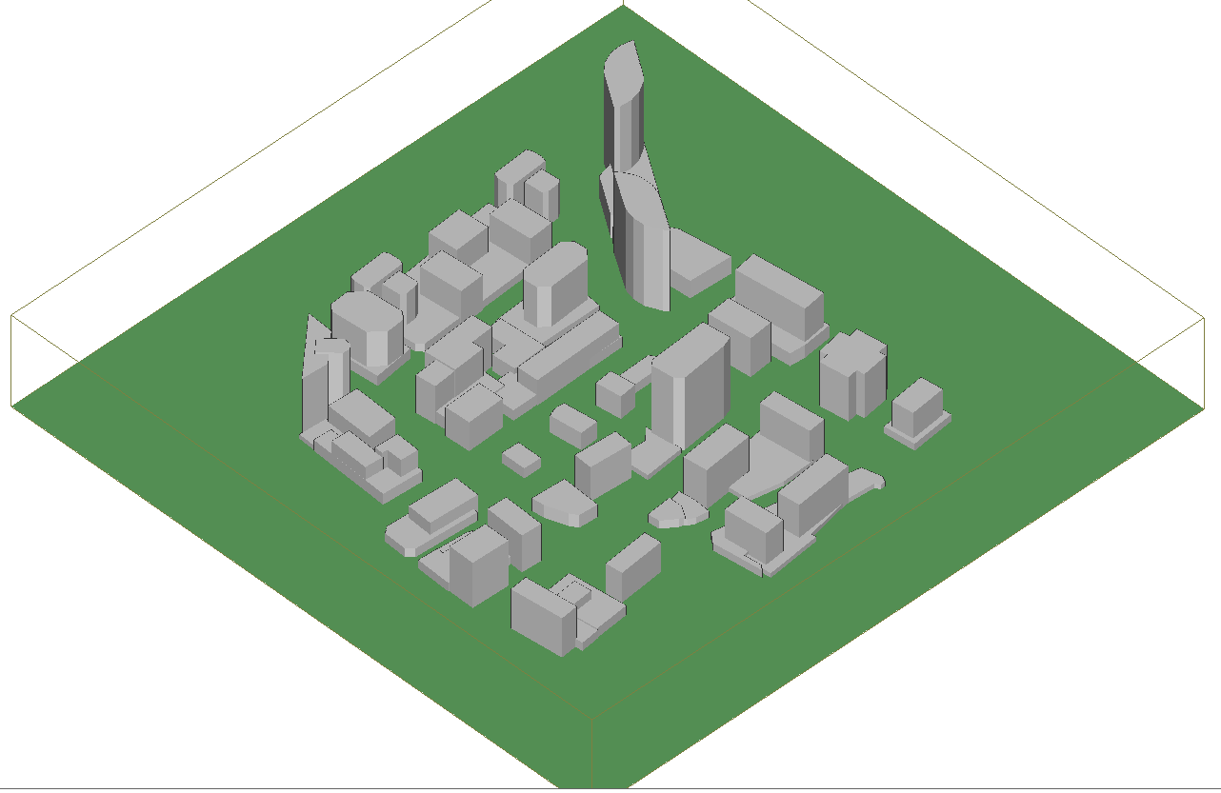
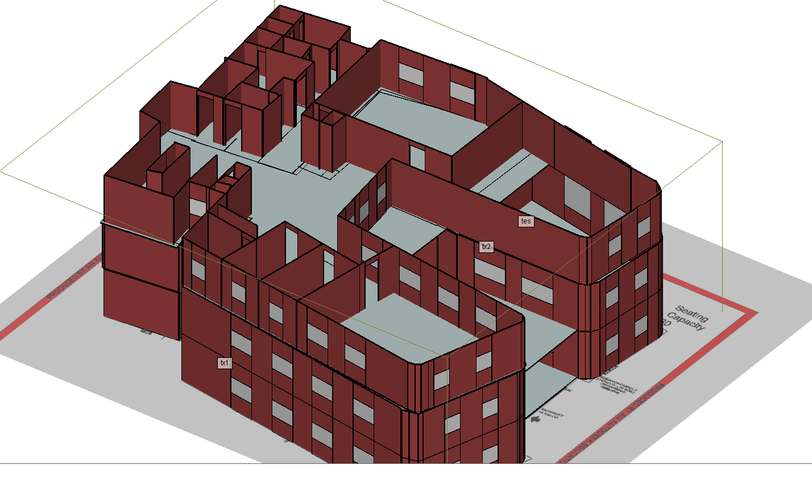
Different Senarios

Slide 5
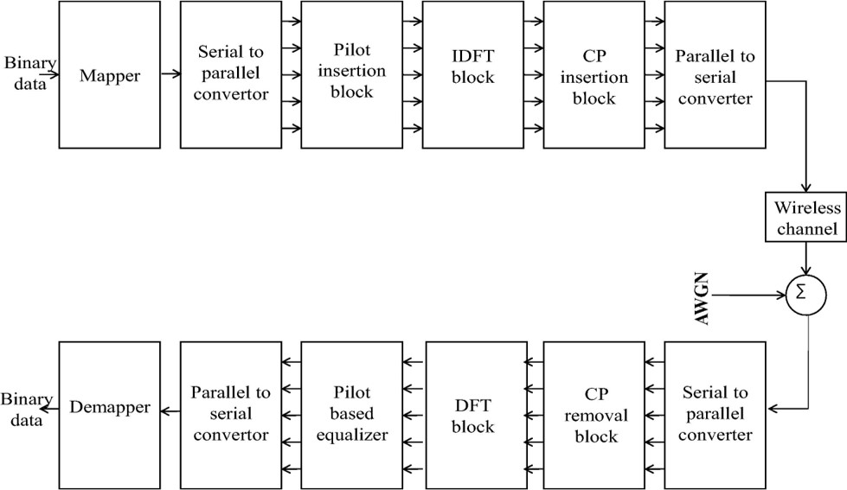
Block diagram of OFDM system model.

Slide 6
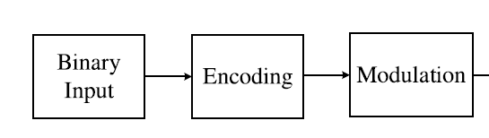
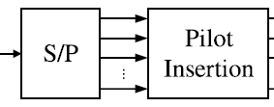
the binary data sequence is firstly encoded and mapped with QAM modulation schemes
The modulated signal is converted from serial to parallel ones
the pilot tones are inserted to estimate the CIR of the channel model.

Slide 7
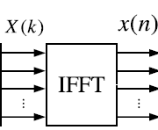
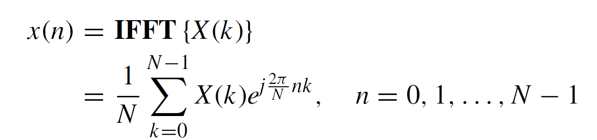
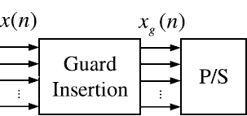
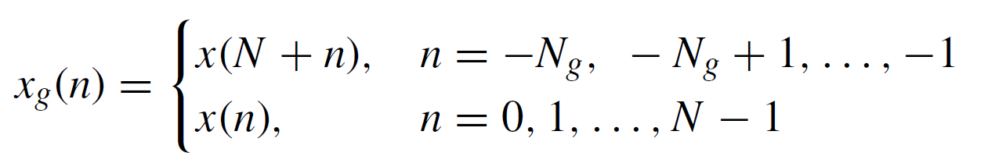
In the OFDM system, the parallel data are transformed by inverse fast Fourier transform (IFFT) with N orthogonal narrowband subcarriers
The time domain signal x(n) is obtained from the frequency domain signals X(k) as follows:
Parallel subcarriers are converted to a serial bitstream and the cyclic prefix samples are inserted as guard intervals to alleviate the ISI
So the time-domain transmitted signal including cyclic prefix can be represented as follows:

Slide 8
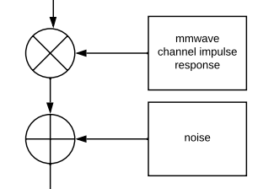
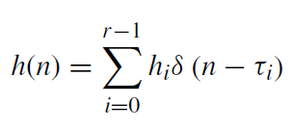
After passing through the mmwave channel, the received signal yg(n) is given by
the operator ⊗ corresponds to the circular convolution and w(n) is the additive white Gaussian noise (AWGN)
h(n) is the channel impulse response that can be represented as follows:

Slide 9
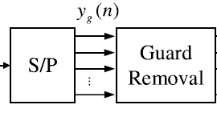
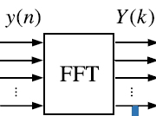
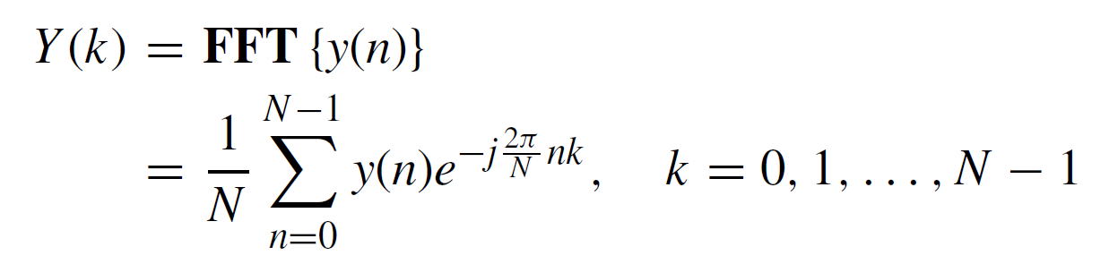
The received signal is split into parallel subcarriers.
Then cyclic prefix is removed out.
The time-domain signal y(n) is transformed to frequency-domain signal Y (k) by FFT
Under the assumption that the ISI is completely eliminated, the received signal can be formulated as:

Slide 10
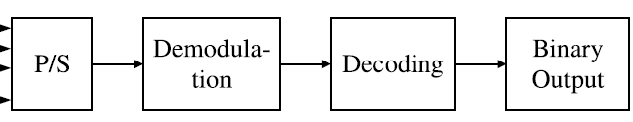
The compensated signal after channel estimation is congregated into a serial sequence
Which is then demodulated and decoded by the corresponding methods in the transmitter.
At this point, the output of OFDM system model is obtained as the final binary data sequence.

Slide 11
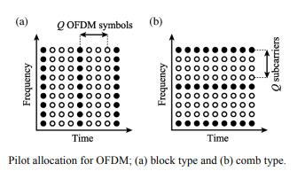
Pilot Insertion
A pilot symbol is a complete OFDM symbol where the value of each subcarrier is predefined and known in transmitter and receiver.
It is repeated with a certain rate that depends on how fast the channel changes.
The received signal is correlated with the pilot symbol to detect the OFDM symbol start.
Results have been obtained by using both block type and comb type pilot signals for different channel estimation techniques.

Slide 12
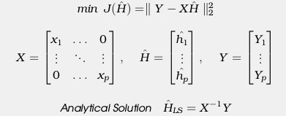
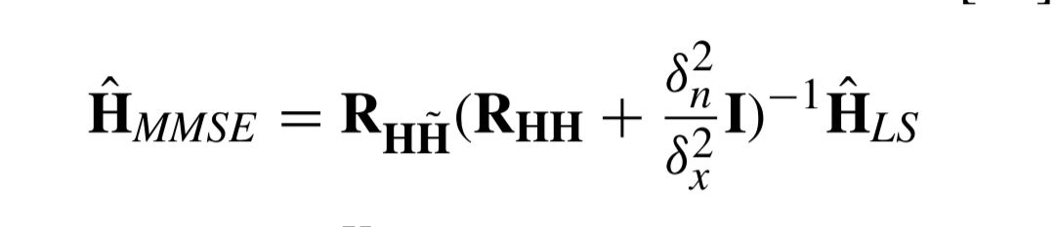
Channel Estimation Methods
Least Square Method
Least Square estimation is the Euclidean distance between the received signal and the original signal.
Minimum Mean Square Error Method
Estimates the channel response by applying them to various M-QAM modulations
MMSE channel Estimation is given by

Slide 13
Sample CIR data
# <Transmitter Set: Tx: 1 tx1 - Point 11>
# <Receiver Set: Rx: 2 rx1 >
# <number of receiver points>
# <receiver point number> <number of paths for this point>
# <path number> <phase value(deg)> <mean time of arrival(sec)> <received power(dBm)>
2862
1 25
1 124.519 1.83972e-06 -132.894
2 17.6893 1.69644e-06 -136.159
3 -122.339 1.65286e-06 -136.225
4 146.765 2.29071e-06 -137.699
5 -109.922 1.66492e-06 -144.042
6 8.29758 1.66687e-06 -144.821
7 107.554 1.675e-06 -146.376
8 13.3671 1.66367e-06 -148.496
9 89.4907 1.65904e-06 -152.113

Slide 14

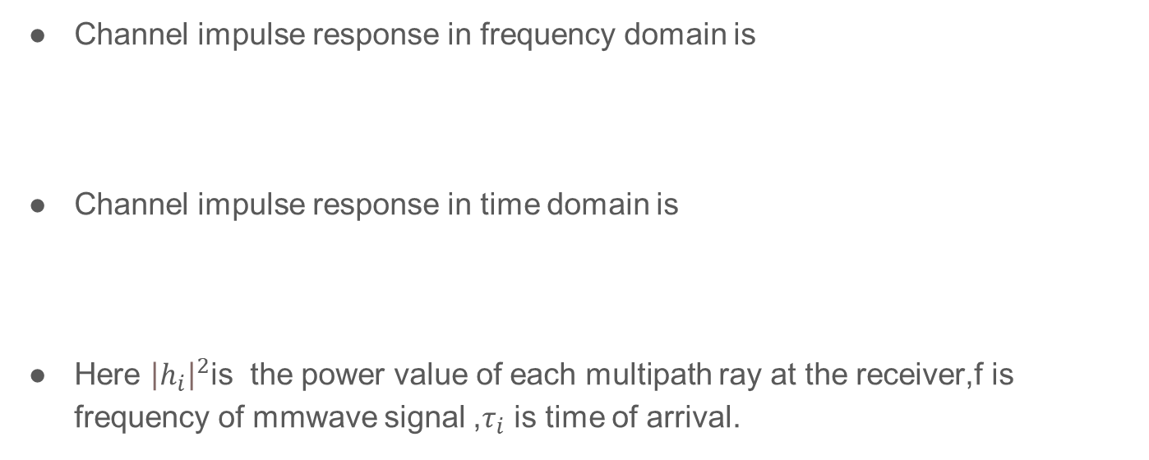
Channel impulse response modelling
Channel impulse response in frequency domain is
Channel impulse response in time domain is
Here ${\left|h_{i}\right|}^{2}$is the power value of each multipath ray at the receiver,f is frequency of mmwave signal ,$τ_{i}$ is time of arrival.

Slide 15
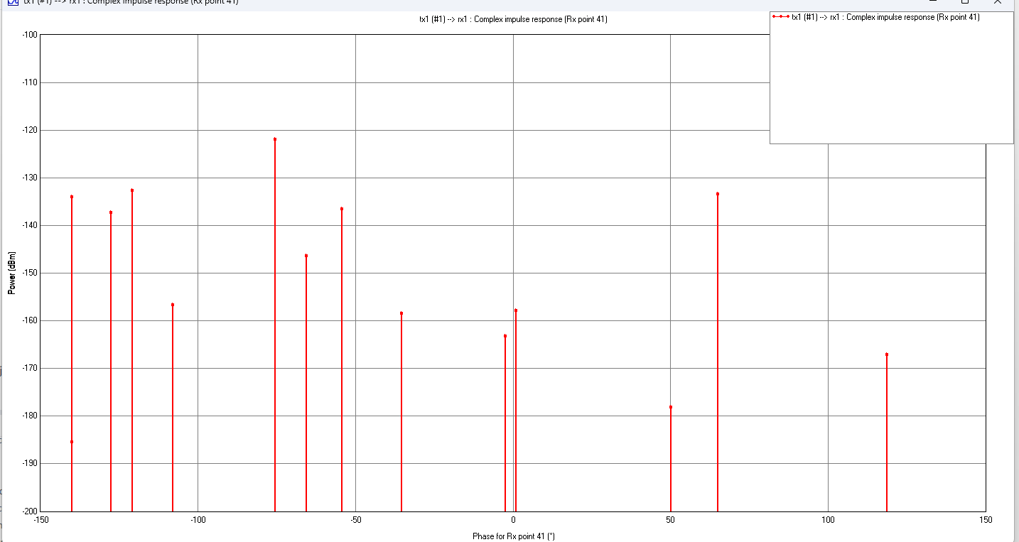
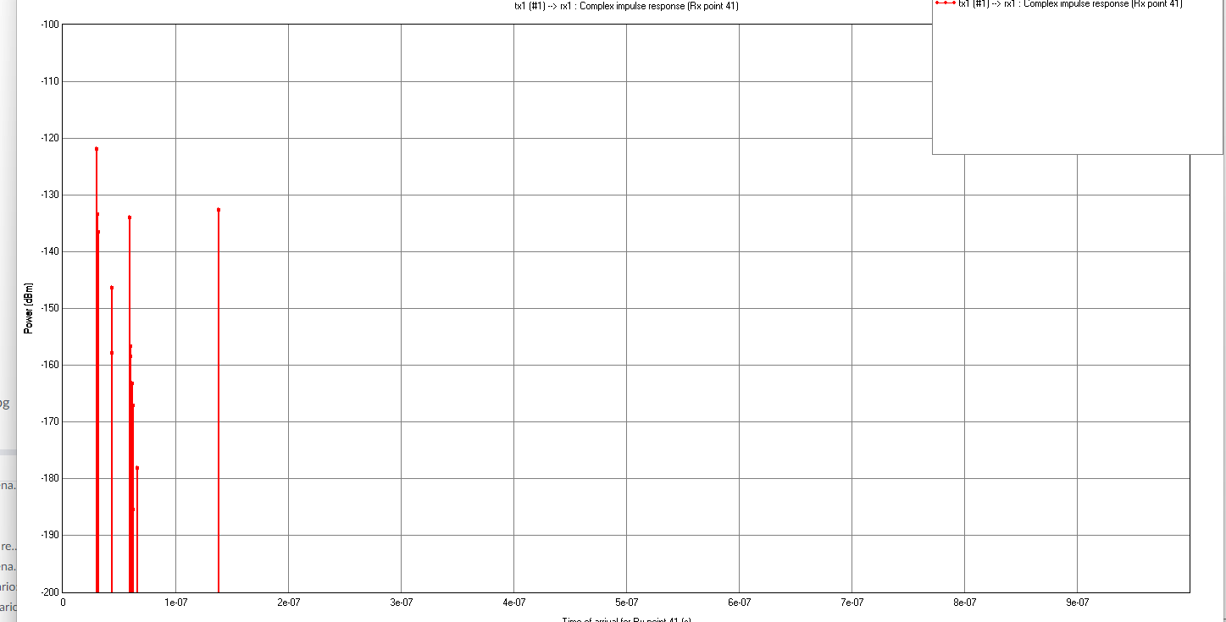
Example channel impulse response output:power vs phase,time of arrival

Slide 16
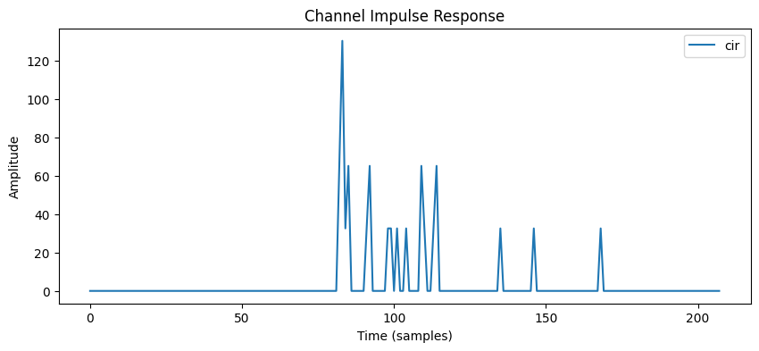
Sample channel impulse response
Below is cir of an receiver from urban scenario using 5e7 as sampling rate

Slide 17
5G NR Parameters
Here are parameter used in
parameters | values
Carrier frequency | 28Ghz
Carrier bandwidth | 100Mhz
Carrier spacing | 120Khz
Channel estimation methods | LS and MMSE
Number of subcarriers | 833

Slide 18
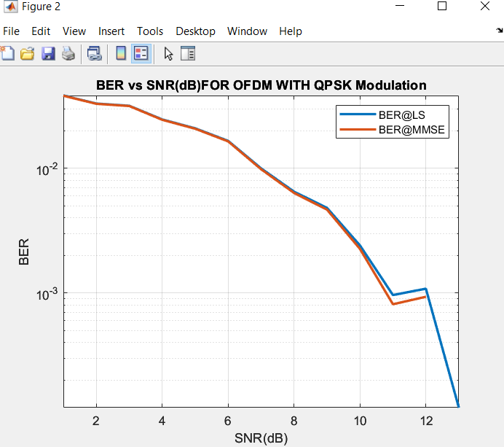
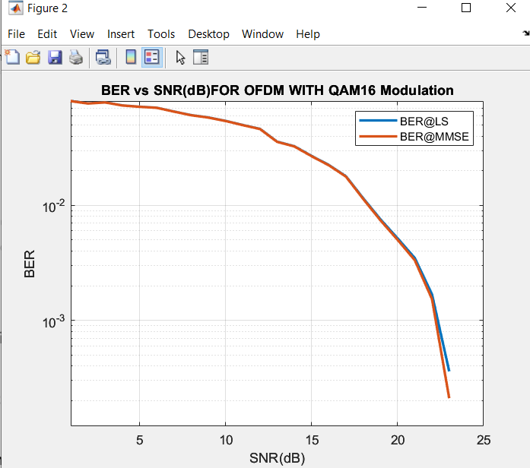
Conclusion and Results:
Here we can see that MMSE is performing better than LS,QPSK is better than QAM16,sample size is 200 from NITK campus 3d model.

Slide 19
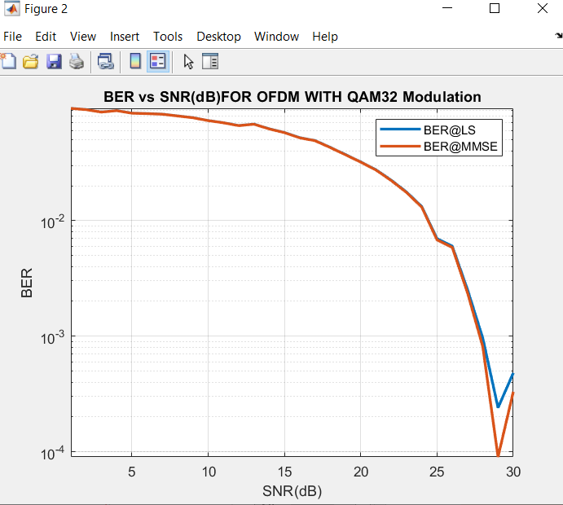
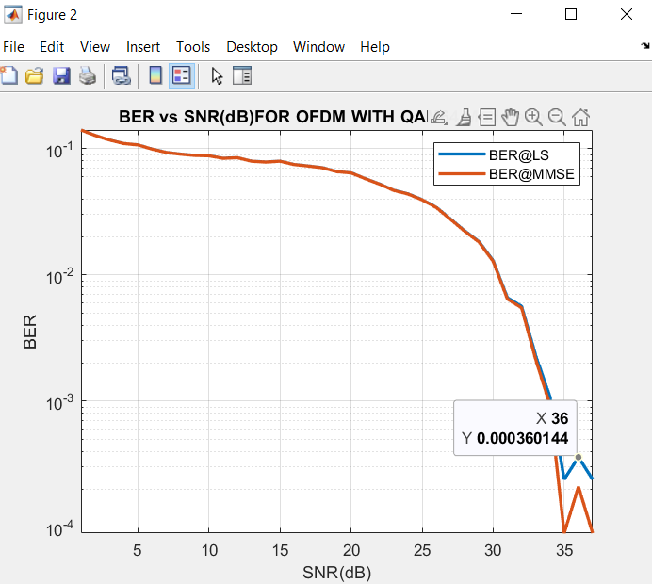

Slide 20
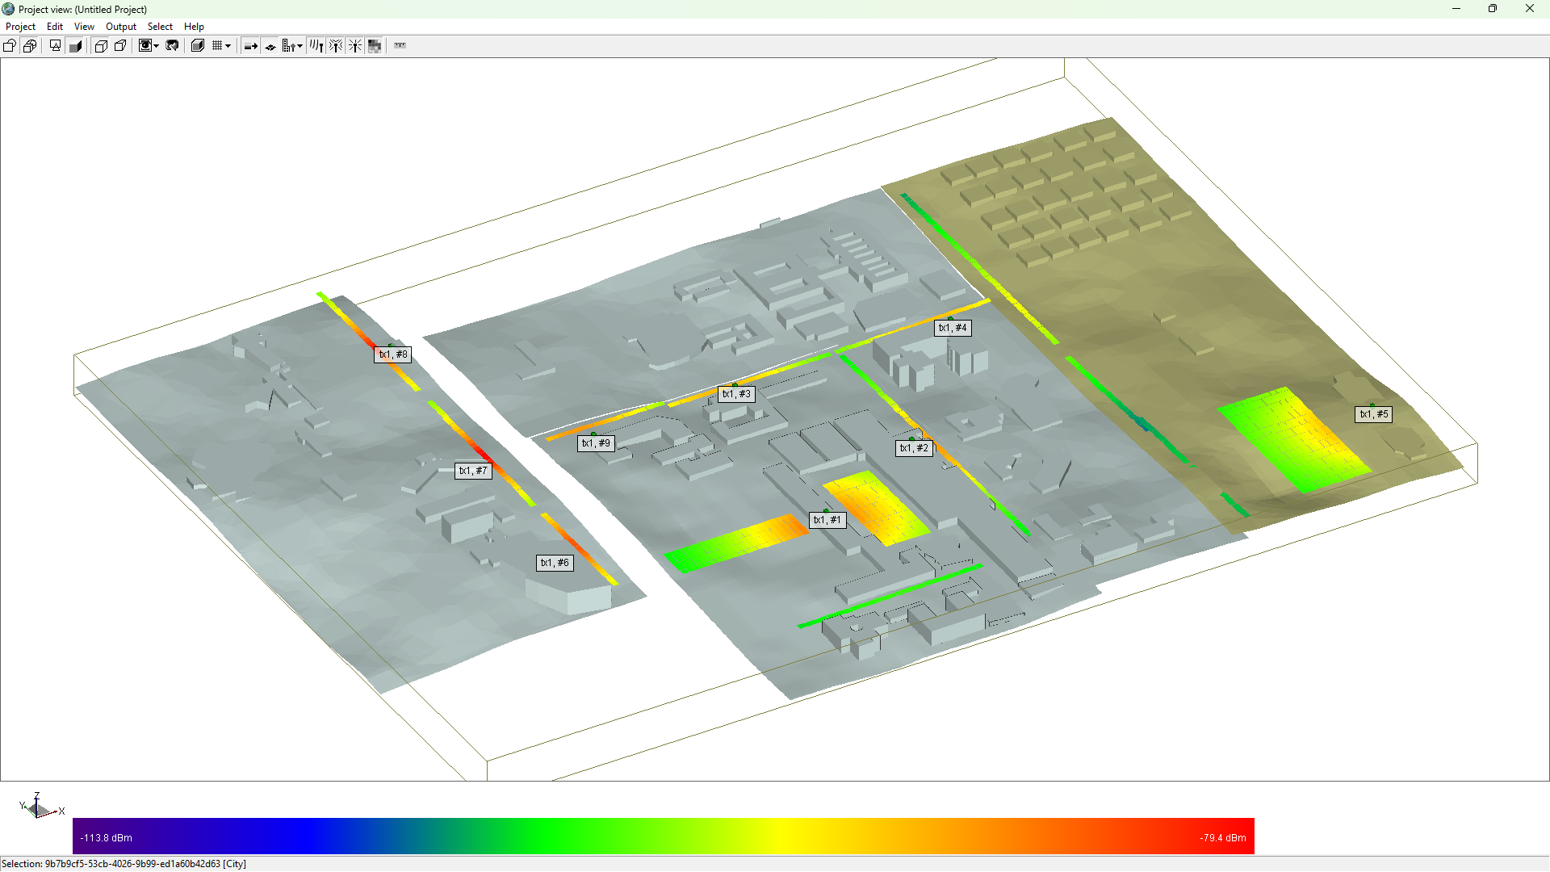

Slide 21
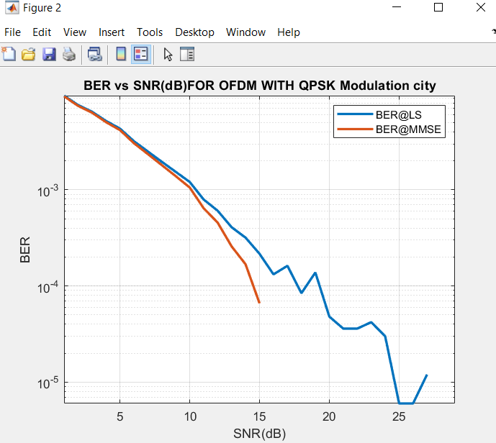
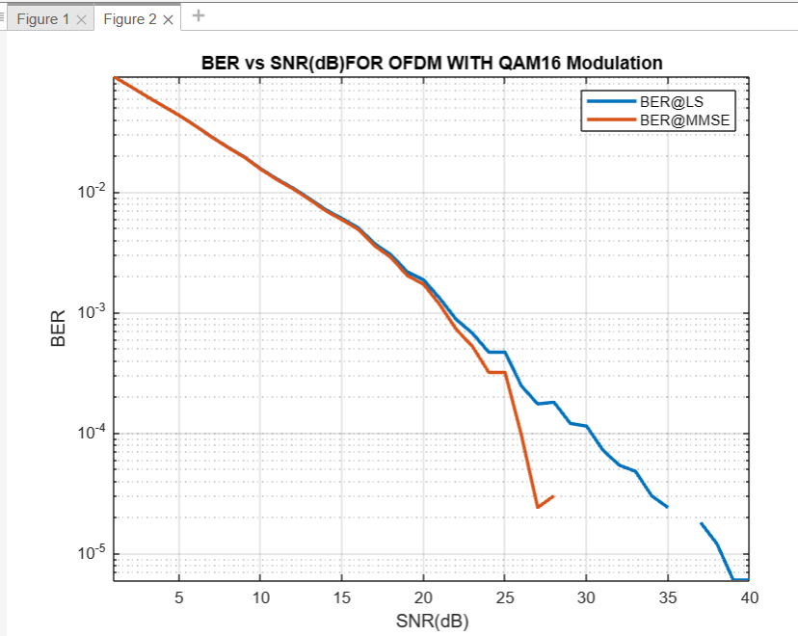
CITY BER VS SNR
Sample size is 1000

Slide 22
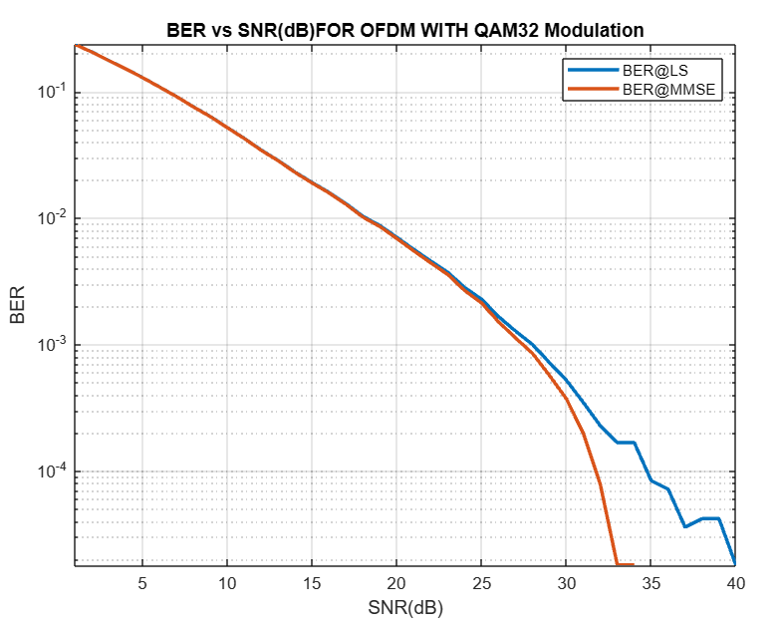
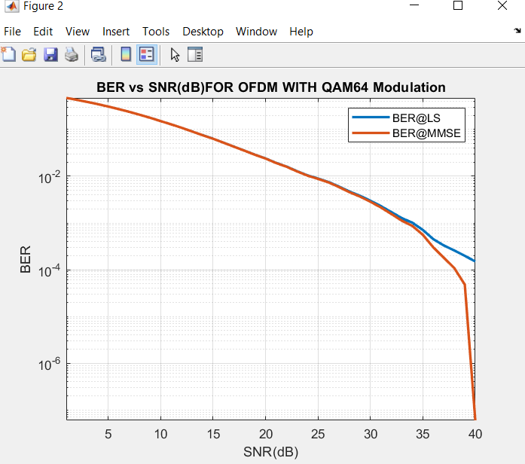

Slide 23
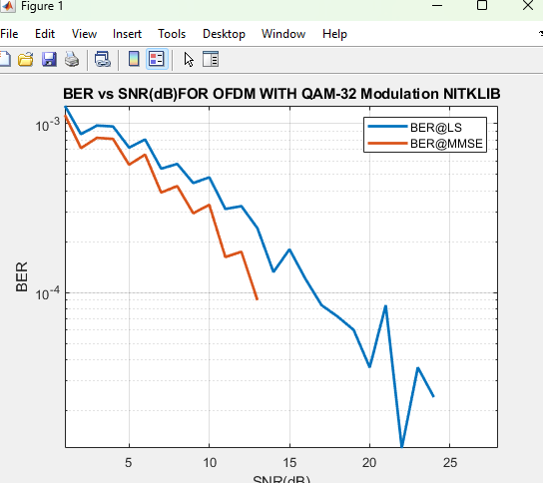
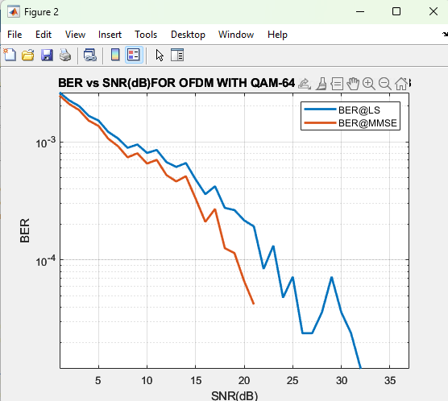
NITK LIBRARY BER vs SNR
Sample size 150

Slide 24
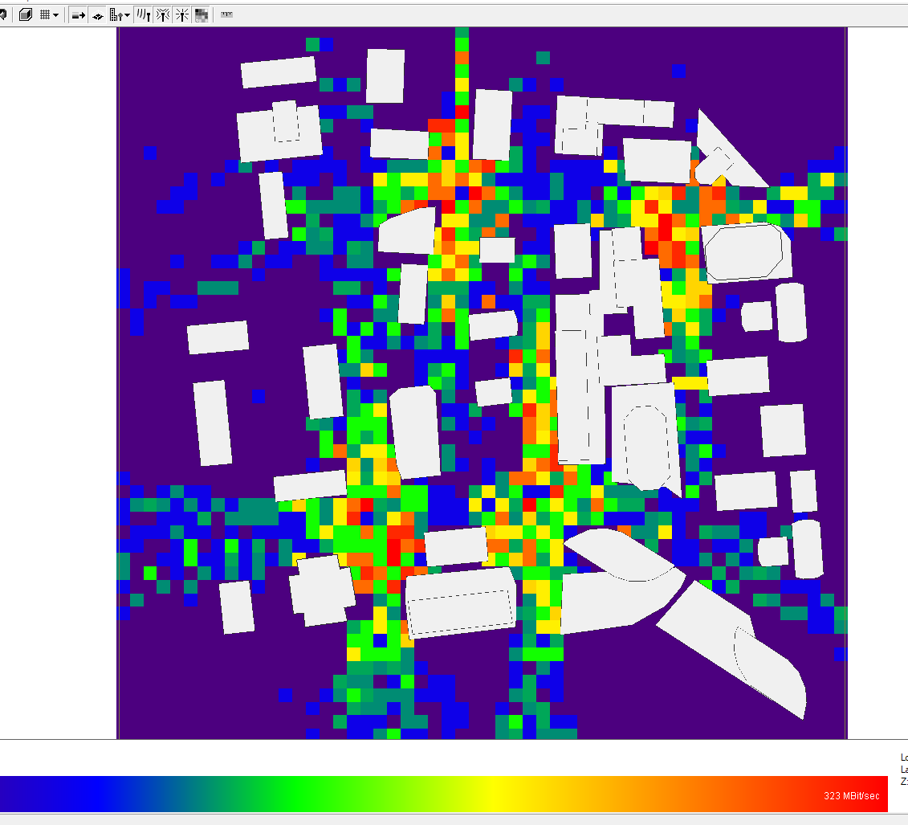
Throughput for urban area:
Range 1mb/sec - 323mb/sec

Slide 25
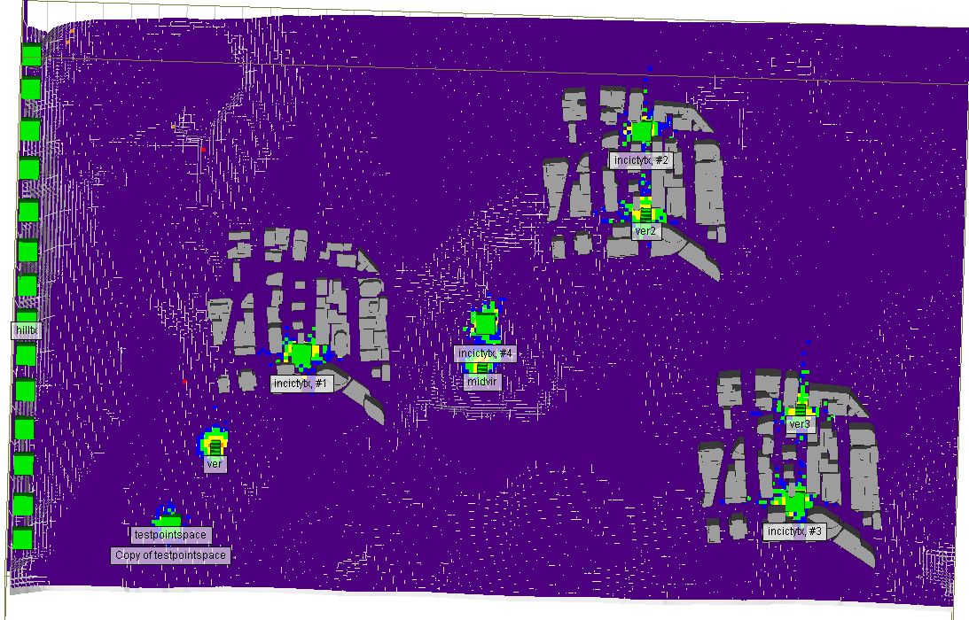
Throughput for outdoor area:
here we can see the inorder to achieve high throughput we need large amount Tx

Slide 26
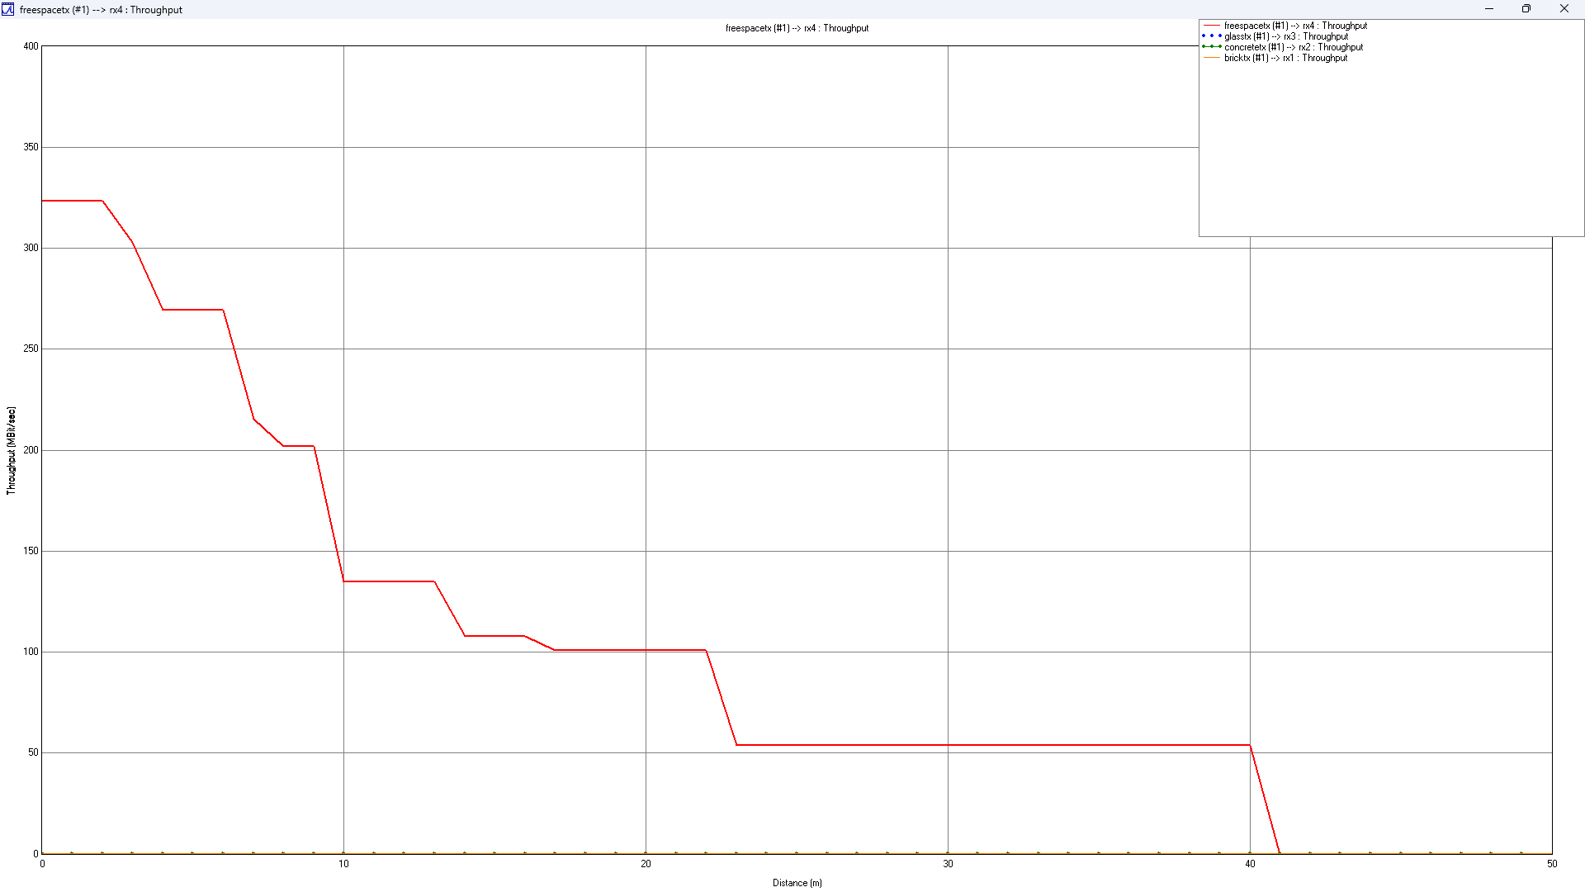
Throughput VS distance:

Slide 27
Conclusion
Here we can see QPSK gives better results with lowest SNR below 15db
We have also obverse the behaviors of BER vs SNR in indoor, urban and free space scenarios.
We have obverse that rural scenario has very poor coverage and low throughput if we want to increase coverage we have we increase transmitter which add upto the cost of equipment so we propose that mmwave communication in rural not economically viable option.

Slide 28
Completed Work
We have developed OFDM Model
Channel Estimation using Least Square method and Minimum Mean Square Error Method is implemented
Build more complex mmwave channel to accurate measure of mmwave in outdoor and indoor by is using Wireless insite software.
Future Plan
study the effect of ANN as channel estimator.
Do more comparative study on indoor and urban scenarios and effect ANN as channel estimator on them

Slide 29
Reference
D. F. Carrera, C. Vargas-Rosales, N. M. Yungaicela-Naula and L. Azpilicueta, "Comparative Study of Artificial Neural Network Based Channel Equalization Methods for mmWave Communications," in IEEE Access, vol. 9, pp. 41678-41687, 2021, doi: 10.1109/ACCESS.2021.3065337.
Carrera, D.F., Vargas-Rosales, C., Azpilicueta, L. and Galaviz-Aguilar, J.A. (2020), Comparative study of channel estimators for massive MIMO 5G NR systems. IET Communications, 14: 1175-1184. https://doi.org/10.1049/iet-com.2019.0973
Savaux, V., Louët, Y., Djoko-Kouam, M. and Skrzypczak, A. (2013), Minimum mean-square-error expression of LMMSE channel estimation in SISO OFDM systems. Electron. Lett., 49: 1152-1154. https://doi.org/10.1049/el.2013.1993

