Slide 1

Problem statement
EEG classification of Alzheimer’s disease and frontotemporal dementia
Can a resting EEG
help identify the diagnosis
of a new person?
Comparing Alzheimer’s disease,
frontotemporal dementia and controls.
Project progress presentation
27 September 2026
01
Notes:
The project studies three-class classification from eyes-closed resting EEG. AD and FTD are both causes of dementia. Our research objective is to recognize patterns that transfer to people outside training. This is an internal research benchmark and does not establish clinical diagnostic performance.
Sources:
C:/Projects/AIBSI/PROJECT_MASTER_REPORT.md
https://www.mdpi.com/2306-5729/8/6/95
Illustration: AI-generated conceptual cartoon using the built-in image generation tool. Asset: assets/eeg_participant.png. Prompt: illustration_prompts.md. The artwork is not measured data or an exact mathematical diagram.

Slide 2

The core challenge
EEG patterns vary across both diagnoses and individuals
Overlapping brain activity
Different diagnoses can produce similar changes in brain rhythms.
Few independent patients
The dataset has only 88 people, including 23 with FTD.
Signal quality and individual variation
Artifacts and recording conditions can hide useful EEG patterns.
Generalization to a new person
A model must recognize disease patterns across people.
02
Notes:
EEG measures electrical activity at the scalp. It provides an indirect view of brain function. Clinical diagnosis uses a broader assessment. The dataset is small at the participant level. The model needs to generalize across individual oscillatory baselines and recording differences. Do not claim that all errors are noise or that this dataset has a known accuracy ceiling.
Sources:
C:/Projects/AIBSI/PROJECT_MASTER_REPORT.md
https://www.nia.nih.gov/health/alzheimers-symptoms-and-diagnosis/how-biomarkers-help-diagnose-dementia
https://pmc.ncbi.nlm.nih.gov/articles/PMC4561903/
Illustration: AI-generated conceptual cartoon using the built-in image generation tool. Asset: assets/brain_inspection.png. Prompt: illustration_prompts.md. The artwork is not measured data or an exact mathematical diagram.

Slide 3
Dataset: OpenNeuro ds004504
Eyes-closed resting EEG from a clinical recording setting
88 people
19 scalp electrodes
500 Hz source sampling
Local dataset version 1.0.9
FTD has the fewest independent participants
Source: Miltiadous et al., Data (2023), OpenNeuro ds004504
03
Notes:
The full dataset contains 36 AD, 23 FTD and 29 cognitively normal participants. Recordings vary in duration. We use EEG as predictors. Age, sex and MMSE are not model inputs in the current experiments.
Sources:
C:/Projects/AIBSI/PROJECT_MASTER_REPORT.md
C:/Projects/AIBSI/dataset/ds004504/dataset_description.json
https://www.mdpi.com/2306-5729/8/6/95

Slide 4
Preprocessing already completed
We started with the authors’ cleaned EEG derivatives
Dataset authors
Our project
0.5–45 Hz filtering
Mastoid reference
Artifact Subspace Reconstruction
ICA and artifact-component removal
250 Hz, four-second windows
Common-average reference
Amplitude, step and flat-channel checks
Boundary guards in V2 and later
The current inputs have substantial preprocessing
Additional noise curation remains a proposed experiment
04
Notes:
Authors supplied approximately 0.5–45 Hz filtering, A1–A2 referencing, ASR with threshold 17, RunICA and ICLabel artifact rejection. Our original primary QC excluded 65 windows and moved 61 additional windows for class balance. V2 excluded windows near EEGLAB boundary events with a 0.5-second guard. The current primary array itself retains its original window set, while later analysis indices enforce boundary exclusions. Broad filtering, ASR and ICA were not repeated. The source README calls the filter Butterworth, while sampled embedded history records pop_eegfiltnew, so this slide states the supported passband without asserting exact filter design.
Sources:
C:/Projects/AIBSI/PROJECT_MASTER_REPORT.md
C:/Projects/AIBSI/preprocessing/reports/03_signal_quality_audit_and_cleaning.md
C:/Projects/AIBSI/dataset/ds004504/README
C:/Projects/AIBSI/tensor_pipeline/v2/AUDIT_AND_PROTOCOL.md

Slide 5
Primary cohort and full cohort
Later experiments added people and usable windows from the leftovers
69 people in the primary cohort. 88 in the full cohort.
Primary: 12,270 stored windows. Full-cohort analysis: 16,824 eligible windows.
05
Notes:
The original primary cohort selected 23 people per diagnosis, with 12,270 four-second windows after QC and balancing. Boundary guarding in V2 retained 11,942 windows from the same 69 people. V3 used 16,824 eligible windows from all 88 people, with class and subject weighting. The additional AD/CN people expanded diversity, but the number of FTD people remained 23. More windows from a person do not create more independent patients.
Sources:
C:/Projects/AIBSI/PROJECT_MASTER_REPORT.md
C:/Projects/AIBSI/tensor_pipeline/outputs/v3_waveform_full_cohort/preparation_report.json

Slide 6
What the analysis pipeline does
Each stage turns EEG into one diagnosis prediction per person
1 Prepare EEG
Check signal quality and divide each recording into short windows.
2 Describe the signal
Measure frequency power, waveform patterns or connections between electrodes.
3 Learn compact features
Use decomposition or feature selection to reduce the representation.
4 Classify and evaluate
Train on one group of people and test on people held out from training.
06
Notes:
Some spectral controls do not use decomposition. Features from multiple windows are pooled for each participant, or V5 uses groups of windows called bags while keeping every bag of a participant together during validation. All learned transformations fit only on the training partition.
Sources:
C:/Projects/AIBSI/PROJECT_MASTER_REPORT.md
C:/Projects/AIBSI/tensor_pipeline/v5_connectivity/PROTOCOL.md

Slide 7
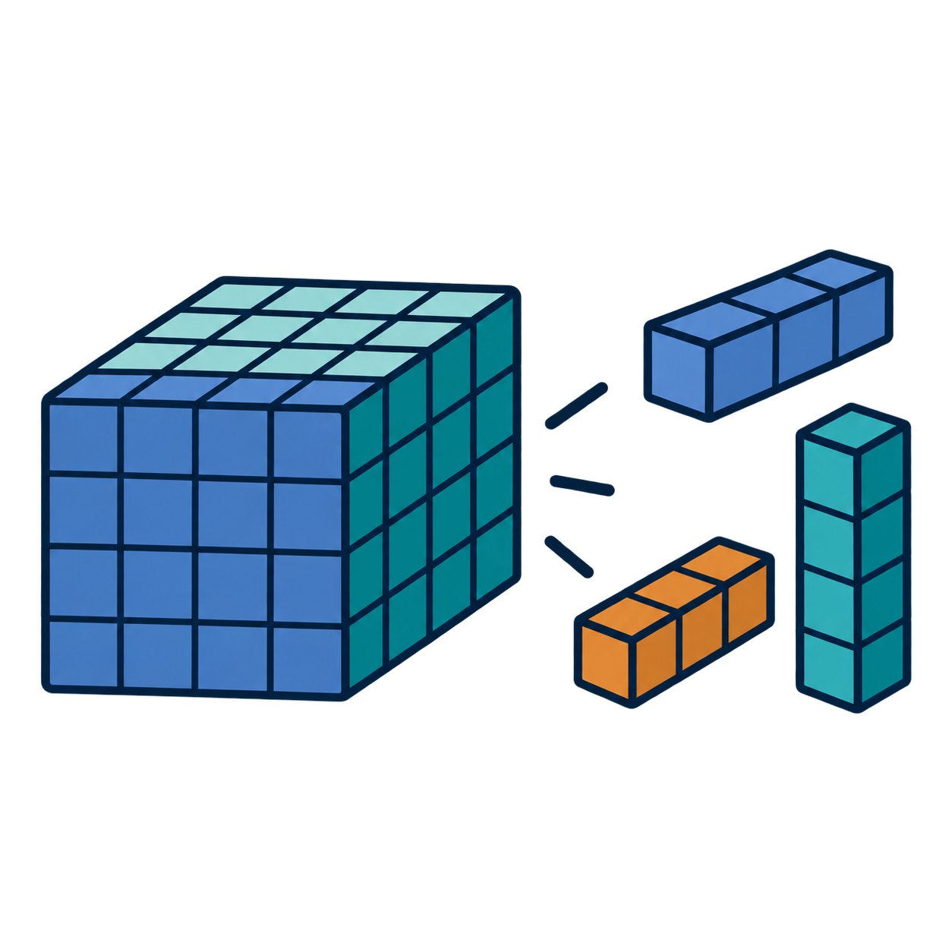
What decomposition contributes
A smaller set of patterns summarizes a large EEG representation
Original description
Compact description
19 electrodes
59 frequency values
10 recording-time bins
Recurring electrode patterns
Frequency profiles
Strength of each pattern
for each person
11,210 values
per person
A good reconstruction does not guarantee good class separation
07
Notes:
The first tensor had shape 69 × 19 × 59 × 10. The product of 19, 59 and 10 is 11,210 values per person. Rank 3, 5 and 8 were explored in early factor models. Rank has different meanings in PCA, CP, Tucker and Tensor Train, so it does not imply an identical feature count across all methods. Unsupervised decomposition prioritizes reconstruction or retained variation. A large source of EEG variation may be unrelated to diagnosis. Low rank can suppress noise but can also discard subtle discriminative information.
Sources:
C:/Projects/AIBSI/PROJECT_MASTER_REPORT.md
C:/Projects/AIBSI/tensor_pipeline/outputs/summary/EXPERIMENT_REPORT.md
Illustration: AI-generated conceptual cartoon using the built-in image generation tool. Asset: assets/tensor_decomposition.png. Prompt: illustration_prompts.md. The artwork is not measured data or an exact mathematical diagram.

Slide 8
Decomposition methods explored
Different ways to summarize the same multidimensional signal
Method | Simple explanation
PCA and NMF | Compact patterns after flattening the EEG representation
CP decomposition | A sum of simple channel, frequency and time patterns
Tucker / HOSVD | Separate compressed axes linked by a smaller core
Tensor Train (TT) | A chain of smaller factors describing interactions
Graph-based methods | Encourage related electrodes to have similar patterns
Supervised TT | Learn tensor factors using diagnosis labels
Early graph-CP results have implementation caveats. V2 used graph smoothing followed by TT.
08
Notes:
PCA is a linear flattened baseline. NMF imposes nonnegative factors. CP decomposes a tensor into a sum of rank-one outer products. Tucker learns factor matrices and a core. TT factorizes dimensions into a chain of cores. The old anatomical graph used incorrect channel labels and its penalty scaling had a caveat. V2 verified row order and used fixed anatomical graph pre-smoothing before TT, which is a different method. Supervised TT jointly learned waveform factors and a classification head.
Sources:
C:/Projects/AIBSI/PROJECT_MASTER_REPORT.md
C:/Projects/AIBSI/tensor_pipeline/v2/AUDIT_AND_PROTOCOL.md

Slide 9
Evaluation and the meaning of each metric
Every test prediction belongs to a person excluded from model fitting
Accuracy
The fraction of all participants classified correctly.
Recall for a diagnosis
The fraction of people with that diagnosis correctly identified.
Balanced accuracy
The average of AD, FTD and CN recall. Each diagnosis counts equally.
Nested validation
Inner folds choose settings. Outer folds estimate performance on held-out people.
Chance balanced accuracy for three classes: 33.3%. Reported means average three CV repetitions.
09
Notes:
Most current experiments use three repeats of five-fold outer subject cross-validation and three-fold inner validation. Keep all windows of one person together. Scaling, decomposition bases, feature selection and classifier tuning use only current training participants. Ordinary accuracy and balanced accuracy coincide in the balanced V2 cohort. They differ in the 88-person cohort. A best family observed after examining outer scores is secondary. The complete inner-selected pipeline is the primary endpoint. CV repeat standard deviation is not a confidence interval. Researcher reuse of these people remains a limitation.
Sources:
C:/Projects/AIBSI/PROJECT_MASTER_REPORT.md
C:/Projects/AIBSI/tensor_pipeline/v4_tuning/PROTOCOL.md

Slide 10
Experiments completed
The project tested several representations and learning strategies
Run | Main question | Reported balanced accuracy
V1 · 69 people | Do compact spectral factors help? | 54.1% best exploratory result
V2 · 69 people | Do corrected TT / Tucker features help? | 47.3% selected pipeline
V3 · 88 people | Do more people and waveform factors help? | 52.0% selected pipeline
V4 · 88 people | Does broader classifier tuning help? | 54.5% selected pipeline
V5 · 88 people | Do connectivity and window groups help? | 55.0% selected pipeline
Later experiments repeatedly reached the mid-50% range
V1 is exploratory. Cohorts and procedures differ, so these rows do not isolate one algorithm’s effect.
10
Notes:
V1 best PCA and NMF plus logistic regression reached 54.1% in a non-nested comparison. V2 best observed Tucker family reached 56.0%, but the complete inner-selected pipeline reached 47.3%. V3 spectral control reached 55.8%. V4 best observed SVM family reached 59.7%. V5 local JSON records all 15 completed folds, 55.0% primary BA. V5 is absent from the older master summary and is presented here as a local experimental result. No external cohort validation exists.
Sources:
C:/Projects/AIBSI/PROJECT_MASTER_REPORT.md
C:/Projects/AIBSI/tensor_pipeline/outputs/v2_tensor_train/nested_benchmark/nested_report.json
C:/Projects/AIBSI/tensor_pipeline/outputs/v3_waveform_full_cohort/nested_report.json
C:/Projects/AIBSI/tensor_pipeline/outputs/v4_tuning/nested_report.json
C:/Projects/AIBSI/tensor_pipeline/outputs/v5_connectivity/nested_report.json

Slide 11
Classifier comparison: accuracy
V4, the same 88 participants and outer splits
RBF SVM had the strongest observed family result: 59.7%
Primary complete selection: 54.5% balanced accuracy. Family comparisons are secondary.
11
Notes:
Each classifier family tunes features and its own settings within inner CV. Consequently, these rows can use different representations across outer folds. The primary endpoint, automatic selection of the full pipeline, is 54.516%. SVM is the strongest observed family with 59.682% BA and 60.606% ordinary accuracy. Values come directly from the nested report. The bars show means without confidence intervals.
Sources:
C:/Projects/AIBSI/tensor_pipeline/outputs/v4_tuning/nested_report.json
C:/Projects/AIBSI/tensor_pipeline/outputs/v4_tuning/EXPERIMENT_REPORT.md

Slide 12
Classifier comparison: recall
V4, percentage correctly identified within each diagnosis
FTD recall remained lower than AD and control recall
For SVM: AD 57.4%, FTD 43.5%, CN 78.2%.
12
Notes:
All recalls average three repetitions. The FTD class has only 23 independent participants. Low FTD recall persists across classifier families even with class weighting. Class weights rebalance training loss but do not add new FTD examples or ensure clean separation.
Sources:
C:/Projects/AIBSI/tensor_pipeline/outputs/v4_tuning/nested_report.json

Slide 13
Decomposition comparison: performance
V2, the same balanced cohort of 69 participants
Tucker / HOSVD was the strongest observed V2 family: 56.0%
Accuracy equals balanced accuracy here because every diagnosis has 23 people. Primary selection: 47.3%.
13
Notes:
Macro F1 averages class-wise F1 scores. F1 balances precision with recall. Values on the chart express F1 on a 0–100 scale for visual comparison, not as ordinary accuracy. The spectral control has no tensor decomposition. Graph + TT means fixed graph pre-smoothing followed by TT. These family results independently select rank or model settings within training folds. The primary full-family selection scored 47.343%.
Sources:
C:/Projects/AIBSI/tensor_pipeline/outputs/v2_tensor_train/nested_benchmark/nested_report.json
C:/Projects/AIBSI/tensor_pipeline/outputs/v2_tensor_train/EXPERIMENT_REPORT.md

Slide 14
Decomposition comparison: recall
V2, the same methods and participant splits as the previous slide
Tucker gave the most even recall across the three groups
Tucker: AD 59.4%, FTD 50.7%, CN 58.0%. This was a secondary family result.
14
Notes:
Recall values calculate the mean sensitivity for AD, FTD and CN from the three saved repetitions. Tucker achieved the highest FTD recall among these V2 families. This finding does not prove a reproducible gain on an independent cohort.
Sources:
C:/Projects/AIBSI/tensor_pipeline/outputs/v2_tensor_train/nested_benchmark/nested_report.json

Slide 15
Waveform tensors versus spectral features
V3, all 88 participants and 16,824 eligible windows
Spectral features outperformed these waveform tensor methods
Primary complete selection: 52.0% balanced accuracy. Spectral control: 55.8%.
15
Notes:
Waveform features used channel × lag × local-position tensors with a 120-ms lag span. They pooled squared filter responses across windows and time. This preserves second-order waveform information but discards ordering and higher-order detail. It is not a test of every possible waveform model. Waveform arms kept approximately 0.5–45 Hz content and the spectral control used 1–30 Hz, so this is not a perfectly bandwidth-matched ablation. The 100-iteration supervised TT optimizer did not report convergence in the initial run.
Sources:
C:/Projects/AIBSI/tensor_pipeline/outputs/v3_waveform_full_cohort/nested_report.json
C:/Projects/AIBSI/tensor_pipeline/outputs/v3_waveform_full_cohort/EXPERIMENT_REPORT.md

Slide 16
Latest experiment: connectivity features
V5, the same 88 people with whole-recording and grouped-window summaries
Connectivity features did not resolve the FTD difficulty
Local V5 results: all 15 folds completed. Primary balanced accuracy: 55.0%, FTD recall: 33.3%.
16
Notes:
V5 compared power, Riemannian covariance features, connectivity and hybrid features. Riemannian methods compare covariance matrices using their geometry. Connectivity measures include correlation, amplitude-envelope correlation, imaginary phase-locking components and weighted phase-lag index. Whole-recording, four-bag and eight-bag representations kept each participant together. Hierarchical CN-versus-dementia then AD-versus-FTD classification achieved 53.3% BA, multiclass selection 56.0%. Bag-family results were 54.8%, 53.2% and 51.1% for one, four and eight bags. These are internal local experimental results, with no independent external validation.
Sources:
C:/Projects/AIBSI/tensor_pipeline/outputs/v5_connectivity/nested_report.json
C:/Projects/AIBSI/tensor_pipeline/v5_connectivity/PROTOCOL.md

Slide 17
Why higher accuracy remains difficult
Working hypothesis: limited patient diversity plus loss of useful signal
Only 23 FTD people
Individual differences can dominate the learned patterns.
Compression and averaging may remove weak diagnostic clues.
V2 balanced accuracy. These training and validation gaps support the hypothesis but do not prove its cause.
17
Notes:
The figure uses the rounded percentages in the V2 report. High training accuracy with much lower held-out performance is consistent with overfitting and unstable selection on a small sample. EEG overlap and FTD heterogeneity are plausible contributors. Unsupervised decomposition optimizes signal reconstruction rather than diagnosis separation. Pooling removes temporal detail. Residual noise may also contribute, but we have not measured how much. More iterations alone did not improve the V3 fixed-model comparison.
Sources:
C:/Projects/AIBSI/PROJECT_MASTER_REPORT.md
C:/Projects/AIBSI/tensor_pipeline/outputs/v2_tensor_train/EXPERIMENT_REPORT.md
C:/Projects/AIBSI/tensor_pipeline/outputs/v3_waveform_full_cohort/convergence_sensitivity/REPORT.md

Slide 18

Progress achieved and next experiment
The next question is whether targeted signal curation improves generalization
Completed
Reproducible EEG preparation
Participant-level evaluation
Tensor and classifier comparisons
A clear record of FTD errors
Proposed next steps
Audit residual noise in the primary cohort
Fix quality rules before evaluation
Compare current and curated inputs
Seek new FTD and external participants
Further cleaning needs a controlled comparison
Current results do not establish clinical validity or an accuracy ceiling.
18
Notes:
Proposed curation includes band-specific outliers, slow drift, muscle bursts, repeated transients and subject/channel quality profiles. We already use processed EEG and boundary-aware later analysis indices. Thresholds must not be chosen to improve diagnosis-specific test scores. Compare the same model and participant splits across input variants with rules defined before outcomes. A separate external cohort is needed to confirm performance after repeated work on this dataset. No new curation run was performed for this presentation.
Sources:
C:/Projects/AIBSI/PROJECT_MASTER_REPORT.md
C:/Projects/AIBSI/preprocessing/reports/03_signal_quality_audit_and_cleaning.md
Illustration: AI-generated conceptual cartoon using the built-in image generation tool. Asset: assets/researcher.png. Prompt: illustration_prompts.md. The artwork is not measured data or an exact mathematical diagram.

Slide 19
Backup: earlier results and technical corrections
The results include negative findings and known limitations
Evidence | What it showed
First spectral benchmark | PCA / NMF 54.1%, Tucker 53.6%, CP 52.2%, graph CP 51.7% BA
V1 graph caveat | Incorrect electrode labels and a penalty-scaling issue limited interpretation
V2 correction | Verified channel order and applied guards around signal discontinuities
Longer TT optimization | Fixed-model V3 comparison: 55.0% at 100 iterations, 53.7% at 2,000
V4 representation comparison | Fusion 59.1%, spectral 56.8%, Tucker 52.0%, TT 46.8% BA
V1 and the iteration sensitivity are exploratory. Fusion can select mainly spectral features.
19
Notes:
V1 results are maxima from a non-nested rank/classifier comparison, not a primary nested estimate. V1 anatomy-specific claims are unreliable due to wrong label order; ordinary flattened PCA is unaffected by that permutation. The longer-iteration supervised TT test was post-hoc and only 3 of 25 long fits reported convergence. V4 stronger regularization improved convergence status to 200 of 285 fits but did not make supervised TT the best model. The fusion starts with TT and spectral features, then selects training-side features, so it does not prove that tensor features caused a gain.
Sources:
C:/Projects/AIBSI/PROJECT_MASTER_REPORT.md
C:/Projects/AIBSI/tensor_pipeline/outputs/v3_waveform_full_cohort/convergence_sensitivity/REPORT.md
C:/Projects/AIBSI/tensor_pipeline/outputs/v4_tuning/EXPERIMENT_REPORT.md

Slide 20
Sources and result definitions
Detailed citations and explanations accompany the relevant slides in speaker notes
Dataset
Miltiadous et al. (2023), Data 8(6), 95. DOI: 10.3390/data8060095
Local project evidence
Project master report, preprocessing audit, V2–V4 experiment reports and saved predictions
Latest local experiment
V5 connectivity protocol and nested_report.json, 15 completed folds
Reading the charts
Means across three repetitions. Family comparisons are secondary. No external cohort test.
20
Notes:
Primary sources and local artifacts:
C:/Projects/AIBSI/PROJECT_MASTER_REPORT.md
C:/Projects/AIBSI/tensor_pipeline/outputs/v2_tensor_train/nested_benchmark/nested_report.json
C:/Projects/AIBSI/tensor_pipeline/outputs/v3_waveform_full_cohort/nested_report.json
C:/Projects/AIBSI/tensor_pipeline/outputs/v4_tuning/nested_report.json
C:/Projects/AIBSI/tensor_pipeline/outputs/v5_connectivity/nested_report.json
Additional sources: https://www.mdpi.com/2306-5729/8/6/95
https://www.nia.nih.gov/health/alzheimers-symptoms-and-diagnosis/how-biomarkers-help-diagnose-dementia
https://pmc.ncbi.nlm.nih.gov/articles/PMC4561903/
https://pmc.ncbi.nlm.nih.gov/articles/PMC13184051/
No figure in this deck implies that these results establish an attainable accuracy ceiling. Bars compare methods within an experiment. Rounded percentages follow the underlying saved metric values.
Sources:

