Slide 1

Problem statement
Literature review and project status
Can resting EEG help distinguish
Alzheimer’s disease, frontotemporal
dementia and healthy controls?
A participant level study of EEG features,
tensor decomposition and classification
First status presentation
01
Notes:
This deck has two sections: a short literature review, followed by our project status and next steps. The illustration is conceptual AI-generated artwork.
Sources:
C:/Projects/AIBSI/PROJECT_MASTER_REPORT.md

Slide 2

Background: EEG and dementia
What prior work gives us
EEG measures brain rhythms
Frequency power, timing and electrode relationships can differ across dementia groups.
Open research dataset
Miltiadous et al. released eyes-closed EEG from 88 people: 36 AD, 23 FTD and 29 controls.
Signals are already cleaned
The authors provide raw recordings and artifact-cleaned derivatives. Our analysis begins with the derivatives.
Miltiadous et al., Data (2023), DOI: 10.3390/data8060095
02
Notes:
AD means Alzheimer’s disease; FTD means frontotemporal dementia. The dataset has 19 scalp electrodes and 500 Hz source sampling. Its derivatives include filtering, re-referencing, ASR, ICA and ICLabel artifact-component rejection. The illustration is conceptual AI-generated artwork.
Sources:
https://doi.org/10.3390/data8060095
https://openneuro.org/datasets/ds004504

Slide 3
What earlier studies found
Three ideas shaped our experiments
Validation changes the answer
Miltiadous et al. found much lower accuracy when testing on unseen people than when splitting EEG epochs.
Feature choice matters
Rostamikia et al. examined power, complexity and connectivity. Gupta et al. used tensor factors to retain EEG structure.
Our question
Do compact tensor features improve three-class, person-level prediction beyond simpler EEG features?
Miltiadous et al. (2021); Rostamikia et al. (2024); Gupta et al. (2023)
03
Notes:
The 2021 study directly compares epoch-level tenfold validation with leave-one-person-out validation and reports major drops. Rostamikia et al. report 87.8% AD versus FTD and 93.5% dementia versus control accuracy using tenfold CV. Their tasks and validation are not identical to our three-class nested subject evaluation, so their percentages should not be compared as like-for-like scores. Gupta et al. use CP factors for healthy, MCI and AD cohorts, not our AD/FTD/control task.
Sources:
https://doi.org/10.3390/diagnostics11081437
https://doi.org/10.1007/s11571-024-10152-7
https://arxiv.org/abs/2211.13793

Slide 4
Data and preparation
We worked from preprocessed EEG, then applied project-specific quality checks
Primary study
Later full-cohort work
69 people: 23 per diagnosis
12,270 clean four-second windows
Balanced for the first comparisons
88 people from the source dataset
16,824 eligible windows after re-QC
Kept each person together in evaluation
Boundary guards and artifact checks reduce avoidable signal problems
Authors’ filtering/ASR/ICA were not repeated. More targeted curation is proposed.
04
Notes:
Project-specific steps included downsampling to 250 Hz, non-overlapping four-second windows, common-average rereferencing, fixed amplitude/step/flat-channel exclusions and, from V2 onward, a 0.5-second guard around EEGLAB boundary annotations. The controlled 69-person dataset has 4,090 windows per group. Later full-cohort analyses re-QC’d the remaining people. The original raw EEG remains untouched.
Sources:
C:/Projects/AIBSI/PROJECT_MASTER_REPORT.md
C:/Projects/AIBSI/preprocessing/reports/03_signal_quality_audit_and_cleaning.md

Slide 5
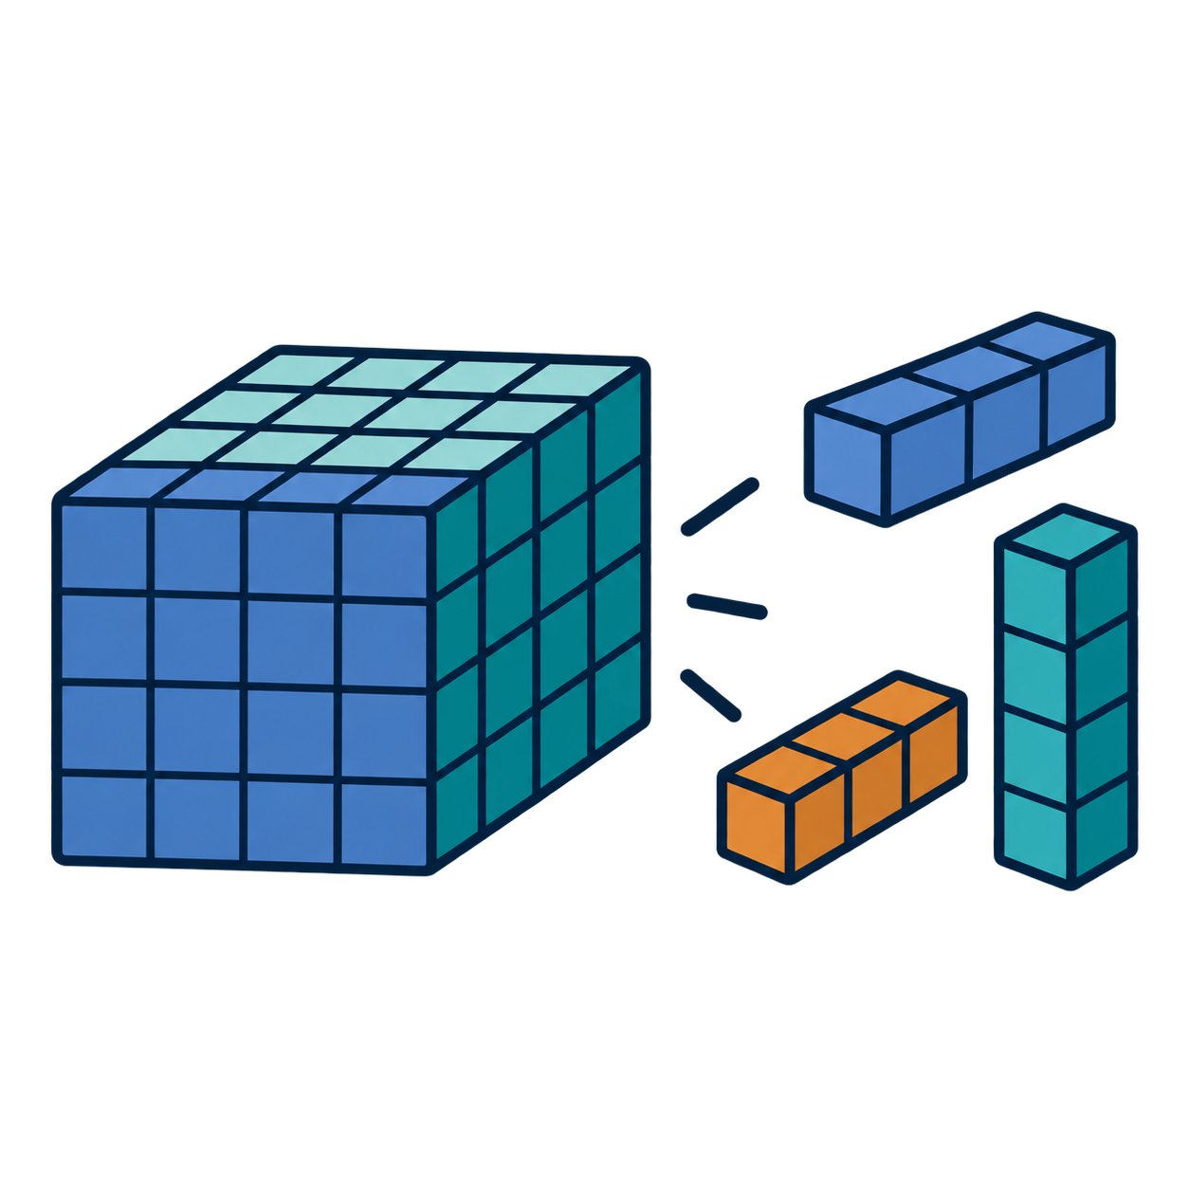
How the method works
Compress a structured EEG description, then predict one label per person
EEG recording
Signal description
Classification
Short clean windows
19 electrode signals
Power across frequencies
and recording time
Compact features
one prediction per person
Tensor decomposition keeps electrode, frequency and time structure while reducing size.
Compared PCA/NMF, CP, Tucker, Tensor Train and simpler spectral controls.
05
Notes:
The first spectral tensor represented participant by electrode by frequency by recording-time bin. Decomposition finds a small collection of factors. It may capture common patterns, but optimizing reconstruction does not ensure the factors separate diagnoses. The illustration is conceptual rather than an exact mathematical diagram.
Sources:
C:/Projects/AIBSI/PROJECT_MASTER_REPORT.md
https://arxiv.org/abs/2211.13793

Slide 6
How we evaluate
The unit of evidence is the person, not the EEG window
Participant-level splits
All windows from one participant stay in the same training or test fold.
Nested selection
Inner folds choose features and model settings. Outer folds estimate performance on held-out people.
Metrics
Accuracy is total correct. Recall is correct within a class. Balanced accuracy averages recall across AD, FTD and controls.
Chance balanced accuracy for three classes: 33.3%. No independent external cohort yet.
06
Notes:
Most later experiments use three repeats of five-fold outer participant CV with three-fold inner validation. Preprocessing fits, decomposition bases, feature selection and classifier tuning remain inside training folds. Reported numbers are internal cross-validation results, not estimates from an untouched external cohort.
Sources:
C:/Projects/AIBSI/PROJECT_MASTER_REPORT.md
C:/Projects/AIBSI/tensor_pipeline/v4_tuning/PROTOCOL.md

Slide 7
Classifier results
V4: same 88 people and the same outer evaluation splits
RBF SVM led these families, but FTD remained difficult
Observed family results are secondary. Primary automatic selection: 54.5% balanced accuracy.
07
Notes:
SVM mean balanced accuracy 59.7%, mean accuracy 60.6%, FTD recall 43.5%. Classifier families tune their own settings and can select different representations. The complete inner-selected pipeline is the primary outcome, 54.5% BA. Results average three CV repeats. No external validation.
Sources:
C:/Projects/AIBSI/tensor_pipeline/outputs/v4_tuning/nested_report.json
C:/Projects/AIBSI/tensor_pipeline/outputs/v4_tuning/EXPERIMENT_REPORT.md

Slide 8
Decomposition results
V2: the balanced 69-person cohort, evaluated with the same splits
Tucker reached 56.0% balanced accuracy as a method-family result
Accuracy equals balanced accuracy here. Complete automatic selection: 47.3% BA.
08
Notes:
Balanced cohort: 23 AD, 23 FTD, 23 CN. Tucker mean BA 56.0%, FTD recall 50.7%; spectral control mean BA 51.7%. These are secondary family results, not a confirmatory comparison. V2 primary automatic family selection was 47.3% BA. Results use participant-level nested CV.
Sources:
C:/Projects/AIBSI/tensor_pipeline/outputs/v2_tensor_train/nested_benchmark/nested_report.json
C:/Projects/AIBSI/tensor_pipeline/outputs/v2_tensor_train/EXPERIMENT_REPORT.md

Slide 9
What the results mean
Promising signals, but limited generalization so far
What we learned
Tensor methods did not consistently beat simple spectral features. More model complexity has not solved the FTD errors.
Latest check
V5 compared power, covariance and connectivity features in all 88 people. Selected pipeline: 55.0% balanced accuracy, 33.3% FTD recall.
Working hypothesis
Only 23 FTD people, overlap in EEG patterns and remaining noise may limit learning. Compression may discard weak clues.
Hypotheses are unproven. Internal results do not establish clinical validity or an accuracy ceiling.
09
Notes:
The V2 report shows high training scores relative to held-out people, consistent with overfitting; it does not prove the specific cause. Unsupervised decomposition prioritizes reconstruction rather than diagnosis. V5 selected pipeline 55.0% balanced accuracy and 33.3% FTD recall; this is an internal 15-fold result. Comparing V2, V4 and V5 percentages directly is limited by changing cohorts and procedures.
Sources:
C:/Projects/AIBSI/PROJECT_MASTER_REPORT.md
C:/Projects/AIBSI/tensor_pipeline/outputs/v5_connectivity/nested_report.json

Slide 10

Project status and next steps
Test whether targeted signal curation improves participant-level results
Completed
EEG inventory and reproducible preparation
Corrected channel labels and boundary handling
Tensor and classifier comparisons
Recorded FTD errors
Next experiment
Audit residual artifacts in the primary cohort
Fix quality rules before evaluating outcomes
Compare current and curated inputs on the same splits
Seek new FTD and external participants
No additional curation experiment has been completed yet.
10
Notes:
Keep curation rules label-blind and fixed before model evaluation. Examine slow drift, muscle bursts, spikes and channel/subject quality profiles. Compare same pipelines and person-level splits across input variants. Independent data are needed for a credible external estimate. The illustration is conceptual AI-generated artwork.
Sources:
C:/Projects/AIBSI/PROJECT_MASTER_REPORT.md
C:/Projects/AIBSI/preprocessing/reports/03_signal_quality_audit_and_cleaning.md

