Slide 1

Problem statement
Literature review and project status
Can resting EEG help distinguish
Alzheimer’s disease, frontotemporal
dementia and healthy controls?
A participant level study of EEG features,
tensor decomposition and classification
First status presentation
01
Notes:
This deck has two sections: a short literature review, followed by our project status and next steps. The illustration is conceptual AI-generated artwork.
Sources:
C:/Projects/AIBSI/PROJECT_MASTER_REPORT.md

Slide 2

Background: EEG and dementia
What prior work gives us
EEG measures brain rhythms
Frequency power, timing and electrode relationships can differ across dementia groups.
Open research dataset
Miltiadous et al. released eyes-closed EEG from 88 people: 36 AD, 23 FTD and 29 controls.
Signals are already cleaned
The authors provide raw recordings and artifact-cleaned derivatives. Our analysis begins with the derivatives.
Miltiadous et al., Data (2023), DOI: 10.3390/data8060095
02
Notes:
AD means Alzheimer’s disease; FTD means frontotemporal dementia. The dataset has 19 scalp electrodes and 500 Hz source sampling. Its derivatives include filtering, re-referencing, ASR, ICA and ICLabel artifact-component rejection. The illustration is conceptual AI-generated artwork.
Sources:
https://doi.org/10.3390/data8060095
https://openneuro.org/datasets/ds004504

Slide 3
What earlier studies found
Three ideas shaped our experiments
Validation changes the answer
Miltiadous et al. found much lower accuracy when testing on unseen people than when splitting EEG epochs.
Feature choice matters
Rostamikia et al. examined power, complexity and connectivity. Gupta et al. used tensor factors to retain EEG structure.
Our question
Do compact tensor features improve three-class, person-level prediction beyond simpler EEG features?
Miltiadous et al. (2021); Rostamikia et al. (2024); Gupta et al. (2023)
03
Notes:
The 2021 study directly compares epoch-level tenfold validation with leave-one-person-out validation and reports major drops. Rostamikia et al. report 87.8% AD versus FTD and 93.5% dementia versus control accuracy using tenfold CV. Their tasks and validation are not identical to our three-class nested subject evaluation, so their percentages should not be compared as like-for-like scores. Gupta et al. use CP factors for healthy, MCI and AD cohorts, not our AD/FTD/control task.
Sources:
https://doi.org/10.3390/diagnostics11081437
https://doi.org/10.1007/s11571-024-10152-7
https://arxiv.org/abs/2211.13793

Slide 4
Data and preparation
We worked from preprocessed EEG, then applied project-specific quality checks
Primary study
Later full-cohort work
69 people: 23 per diagnosis
12,270 clean four-second windows
Balanced for the first comparisons
88 people from the source dataset
16,824 eligible windows after re-QC
Kept each person together in evaluation
Boundary guards and artifact checks reduce avoidable signal problems
Authors’ filtering/ASR/ICA were not repeated. More targeted curation is proposed.
04
Notes:
Project-specific steps included downsampling to 250 Hz, non-overlapping four-second windows, common-average rereferencing, fixed amplitude/step/flat-channel exclusions, and a later 0.5-second guard around EEGLAB boundary annotations. The controlled 69-person dataset has 4,090 windows per group. Full-cohort analyses rechecked the remaining people. The original raw EEG remains untouched.
Sources:
C:/Projects/AIBSI/PROJECT_MASTER_REPORT.md
C:/Projects/AIBSI/preprocessing/reports/03_signal_quality_audit_and_cleaning.md

Slide 5
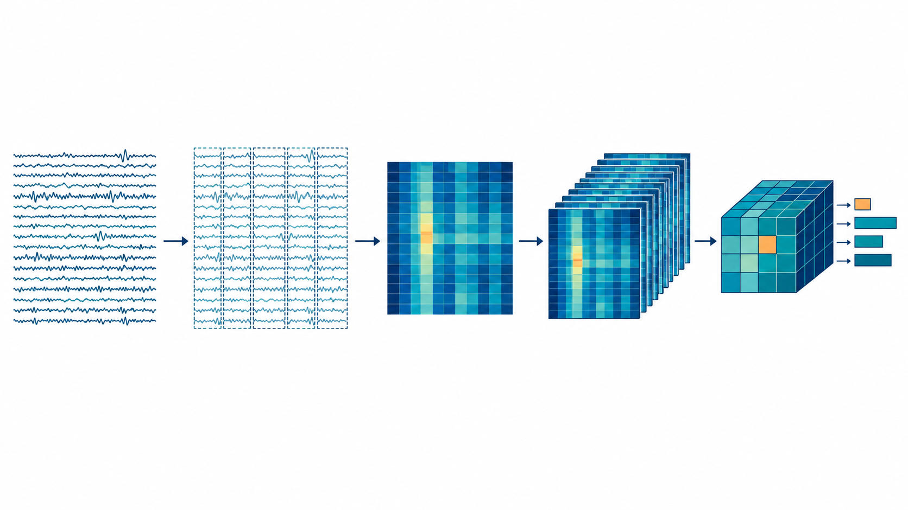
EEG waveform to tensor features
The spectral representation used for the first CPD and Tucker comparison
Cleaned EEG
4 s windows
Welch PSD
10 recording bins
Tensor features
19 electrodes
artifact-cleaned derivative
250 Hz
19 × 1,000 samples
√(relative PSD)
1–30 Hz, 59 bins
Chronological deciles
median map in each
69 × 19 × 59 × 10
CPD / Tucker scores
The dataset authors cleaned the EEG before our analysis. Each held-out person was projected onto a basis fitted only on training people.
05
Notes:
Walk left to right: The released dataset contains an artifact-cleaned EEG derivative, not untouched raw acquisition. We resampled each recording to 250 Hz and divided it into non-overlapping four-second windows. Each window is 19 channels by 1,000 samples. Welch power spectral density used two-second Hann segments with 50 percent overlap; from 1 to 30 Hz there are 59 frequency bins. We normalized each channel spectrum to relative power and took its square root. The windows were assigned to ten chronological bins and reduced by median, giving each person a 19 by 59 by 10 channel-frequency-time tensor. Across 69 people, that is a 69 by 19 by 59 by 10 four-way tensor. CPD and Tucker/MLSVD decomposed that tensor into lower-dimensional subject features, which were fed to a classifier. This first comparison had 69 people, not the later 88-person classifier comparison. Fit decomposition only on training subjects, then project held-out subjects to avoid leakage.
Sources:
tensor_pipeline/tensorize_subjects.py
PROJECT_MASTER_REPORT.md

Slide 6
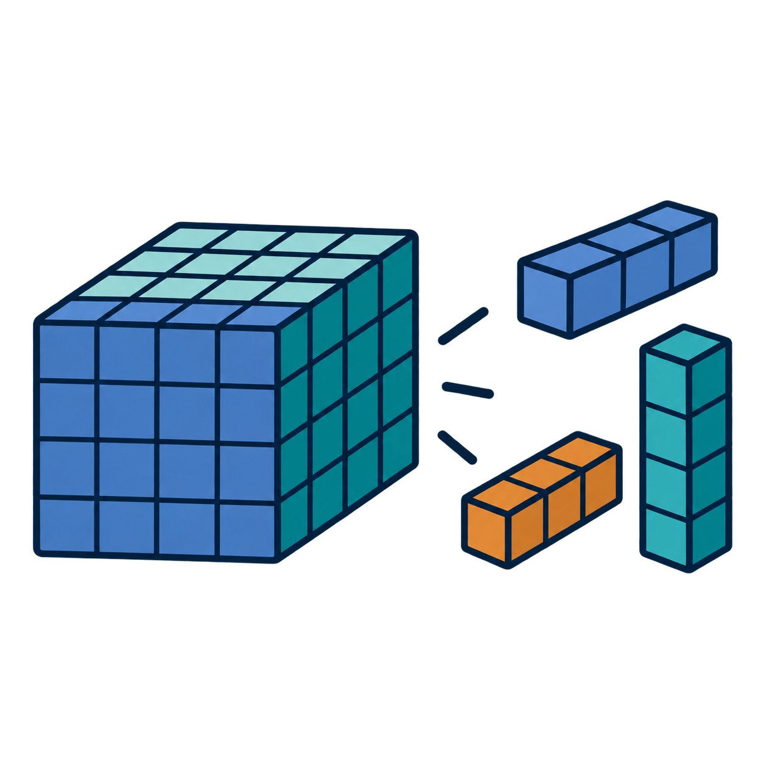
Tensor methods: CPD and Tucker/MLSVD
Both compress the person × electrode × frequency × time tensor
CPD
Tucker / MLSVD family
A sum of rank-one components. Each component links one pattern from every tensor axis.
A small core connects factor matrices for each axis. MLSVD/HOSVD uses orthogonal factors.
How we used them
CPD and nonnegative Tucker compressed the spectral tensor.
Their participant-level component scores
became features for classification.
Nonnegative Tucker and HOSVD/MLSVD are related Tucker methods, not the same fit.
06
Notes:
The first tensor was subject × electrode × frequency × relative recording-time bin, shape 69 × 19 × 59 × 10. CPD represents it as a sum of rank-one components. Tucker uses a compact core and factor matrices. Nonnegative CPD and Tucker were fitted using training participants, and participant-level component scores became classifier features. HOSVD/MLSVD is an orthogonal Tucker-family construction, distinct from the nonnegative Tucker fit. The illustration is conceptual.
Sources:
C:/Projects/AIBSI/tensor_pipeline/run_decomposition_benchmark.py
C:/Projects/AIBSI/tensor_pipeline/outputs/summary/EXPERIMENT_REPORT.md

Slide 7
How we evaluate
The unit of evidence is the person, not the EEG window
Participant-level splits
All windows from one participant stay in the same training or test fold.
Nested selection
Inner folds choose features and model settings. Outer folds estimate performance on held-out people.
Metrics
Accuracy is total correct. Recall is correct within a class. Balanced accuracy averages recall across AD, FTD and controls.
Chance balanced accuracy for three classes: 33.3%. No independent external cohort yet.
07
Notes:
Most later experiments use three repeats of five-fold outer participant CV with three-fold inner validation. Preprocessing fits, decomposition bases, feature selection and classifier tuning remain inside training folds. Reported numbers are internal cross-validation results, not estimates from an untouched external cohort.
Sources:
C:/Projects/AIBSI/PROJECT_MASTER_REPORT.md
C:/Projects/AIBSI/tensor_pipeline/v4_tuning/PROTOCOL.md

Slide 8
Classifier results
Classifier comparison on the same 88 participants
RBF SVM led these families, but FTD remained difficult
Observed family results are secondary. Primary automatic selection: 54.5% balanced accuracy.
08
Notes:
SVM mean balanced accuracy 59.7%, mean accuracy 60.6%, FTD recall 43.5%. Classifier families tune their own settings and can select different representations. The complete inner-selected pipeline is the primary outcome, 54.5% BA. Results average three CV repeats. No external validation.
Sources:
C:/Projects/AIBSI/tensor_pipeline/outputs/v4_tuning/nested_report.json
C:/Projects/AIBSI/tensor_pipeline/outputs/v4_tuning/EXPERIMENT_REPORT.md

Slide 9
CPD and Tucker results
Initial comparison on the same 69-person tensor
CPD: 52.2% Tucker: 53.6% PCA/NMF: 54.1%
Best observed rank and classifier per method; exploratory, non-nested results.
09
Notes:
These are exploratory means across three repeats for each method’s best observed rank and classifier. CPD rank 5 with logistic regression scored 52.2%; nonnegative Tucker rank 3 with histogram gradient boosting scored 53.6%; PCA and NMF rank 8 with logistic regression scored 54.1%. The first tensorizer had an electrode-row metadata mismatch, so anatomical interpretations from that stage need caution. These 69-person results cannot be directly ranked against the later 88-person classifier comparison.
Sources:
C:/Projects/AIBSI/tensor_pipeline/outputs/summary/all_rank_results.csv
C:/Projects/AIBSI/tensor_pipeline/outputs/summary/EXPERIMENT_REPORT.md
C:/Projects/AIBSI/tensor_pipeline/outputs/summary/V2_AUDIT_NOTE.md

Slide 10

Project status and next steps
Test whether targeted signal curation improves participant-level results
Completed
EEG inventory and reproducible preparation
Corrected channel labels and boundary handling
Tensor and classifier comparisons
Recorded FTD errors
Next experiment
Audit residual artifacts in the primary cohort
Fix quality rules before evaluating outcomes
Compare current and curated inputs on the same splits
Seek new FTD and external participants
No additional curation experiment has been completed yet.
10
Notes:
Keep curation rules label-blind and fixed before model evaluation. Examine slow drift, muscle bursts, spikes and channel/subject quality profiles. Compare same pipelines and person-level splits across input variants. Independent data are needed for a credible external estimate. The illustration is conceptual AI-generated artwork.
Sources:
C:/Projects/AIBSI/PROJECT_MASTER_REPORT.md
C:/Projects/AIBSI/preprocessing/reports/03_signal_quality_audit_and_cleaning.md

