Slide 1

Project progress
Tensor representation, spectrograms and hybrid EEG classification
Resting EEG classification of
Alzheimer’s disease, frontotemporal
dementia and healthy controls
Progress from handcrafted EEG features to
Tensor Train compression and EEGPT fusion
Updated status presentation · October 2026
01
Notes:
This presentation summarizes the experiments completed after the first status review.
The main additions are the combined cohort, log-mel inputs, Tensor Train decomposition, pretrained EEGPT and participant-level stability testing.

Slide 2

Research origin
The initial hypothesis came from Miltiadous et al. and the AHEPA EEG programme
Starting paper
Miltiadous et al. (2021) tested whether quantitative EEG features could distinguish AD, FTD and healthy controls.
Public dataset
The 2023 descriptor released eyes-closed recordings from 88 people: 36 AD, 23 FTD and 29 controls, using 19 electrodes.
Core methodological lesson
Accuracy drops when the test set contains unseen people. Participant-level validation matters more than epoch-level scores.
Miltiadous et al., Diagnostics 2021, 11, 1437 · Data 2023, 8, 95
02
Notes:
Sources:
https://doi.org/10.3390/diagnostics11081437
https://doi.org/10.3390/data8060095
https://openneuro.org/datasets/ds004504

Slide 3
Initial approach and our extension
We kept the clinical question but changed the data scale, representation and evaluation
Their approach
A small 28-person cohort, handcrafted statistical and spectral features, six conventional classifiers and three binary comparisons.
Their validation finding
Epoch-level 10-fold accuracy reached 96–99%, while leave-one-patient-out results fell to 60–86% depending on the task and classifier.
Our research question
Can a single three-class, participant-level model improve when spectral summaries, tensor compression and pretrained raw-EEG features are compared fairly?
Main change: AD, FTD and healthy controls are predicted together for each participant
03
Notes:
The original work reported AD versus control, FTD versus control and AD versus FTD separately.
Their leave-one-patient-out table reported 78.5% for AD versus control with decision trees and 86.3% for FTD versus control with random forests.
Source: https://doi.org/10.3390/diagnostics11081437

Slide 4
Dataset expansion and preparation
The combined experiment now includes 174 participants from three acquisition sites
AHEPA / ds004504
BrainLat cohort
88 participants
36 AD · 23 FTD · 29 healthy
19 electrodes · eyes closed · 500 Hz
86 participants from AR and CL
35 AD · 19 FTD · 32 healthy
Mapped to the same 19-electrode montage
Combined cohort: 71 AD · 42 FTD · 61 healthy controls
All windows from one participant remain in the same training, validation or test fold.
04
Notes:
Combined manifest: 174 participants across AHEPA, AR and CL.
The preparation pipeline harmonizes channel names, references, sampling rates and labels before feature extraction.

Slide 5
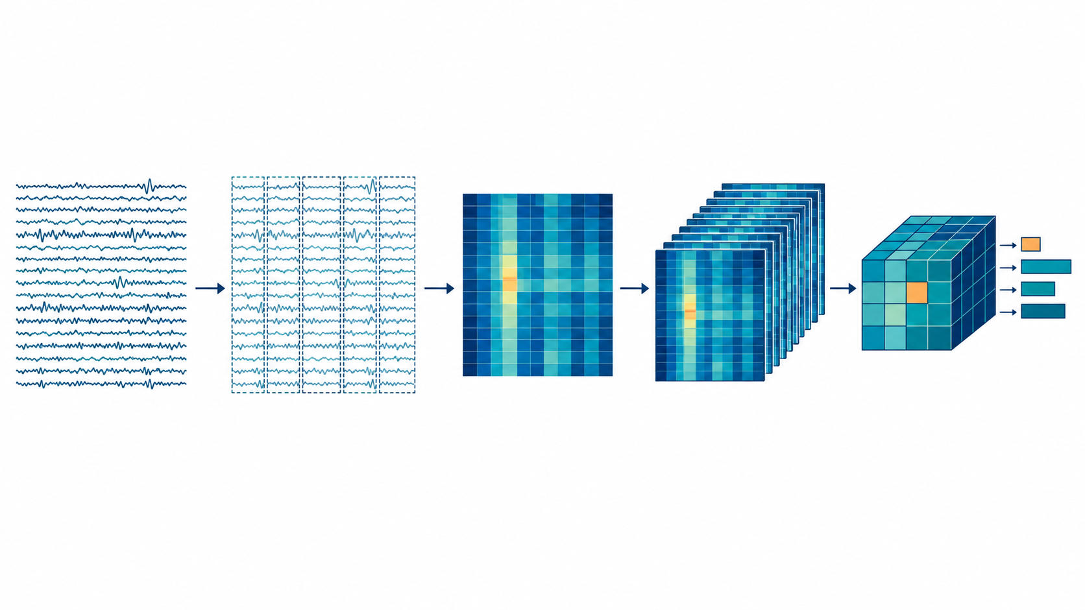
Updated EEG to tensor and hybrid features
The current pipeline keeps both spectral structure and the raw temporal signal
Moderately cleaned EEG
Four-second windows
Log-mel spectrum
Participant tensor
Two model branches
19 common electrodes
1–40 Hz filtering
Participant-safe segmentation
artifact rejection
19 × 24 × 13
electrode × mel × time
19 × 24 × 4
mean · SD · median · IQR
Tensor / SVM features
raw EEG for EEGPT
Tensor bases, site normalization and model settings are fitted using training participants only.
05
Notes:
The illustration is retained from the earlier deck, while the labels now describe the current pipeline.
The SVM branch summarizes log-mel windows. EEGPT receives raw 19-channel four-second windows resampled to 256 Hz.

Slide 6
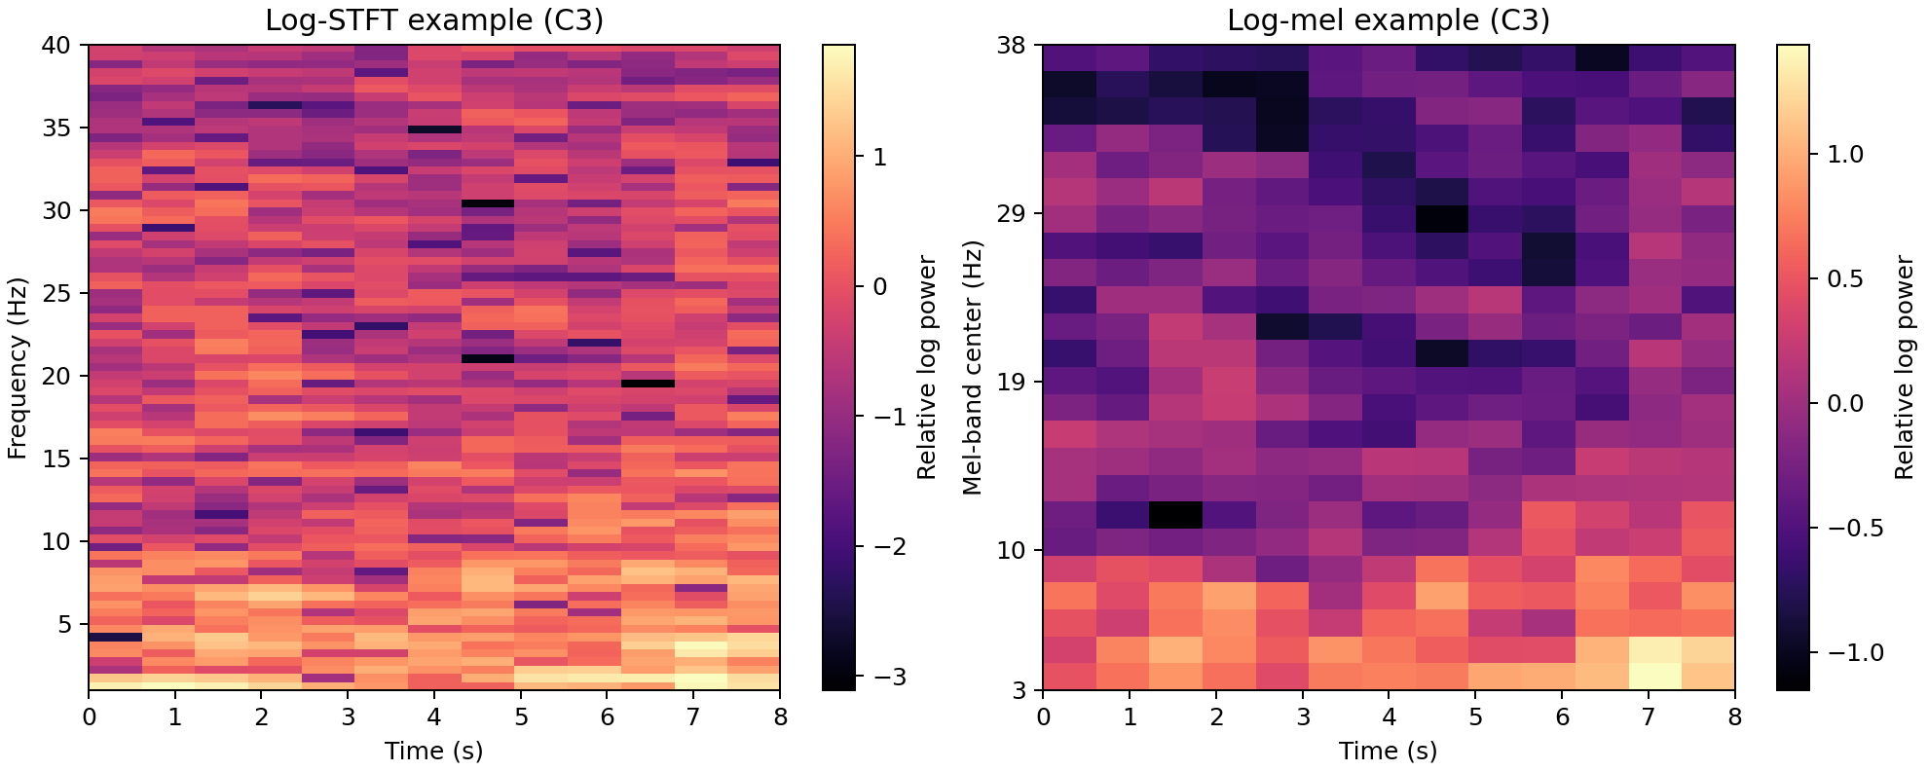
Spectrograms and tensor construction
STFT preserves linear frequency detail; log-mel gives a compact frequency representation
Window tensor
19 × 24 × 13
electrodes × mel bands × time frames
Participant tensor
19 × 24 × 4
mean
standard deviation
median
interquartile range
The displayed C3 example spans 8 seconds; model inputs use four-second windows with 13 log-mel frames.
06
Notes:
The SVM statistical summary uses mean and standard deviation, producing 19 × 48 = 912 participant features before PCA.
The Tensor Train experiment also retains median and interquartile range, producing 19 × 24 × 4 = 1,824 values per participant.
Figure source: C:\Projects\AIBSI\neural_comparison\advanced_clean_spectral\outputs\results\spectral_examples.png

Slide 7
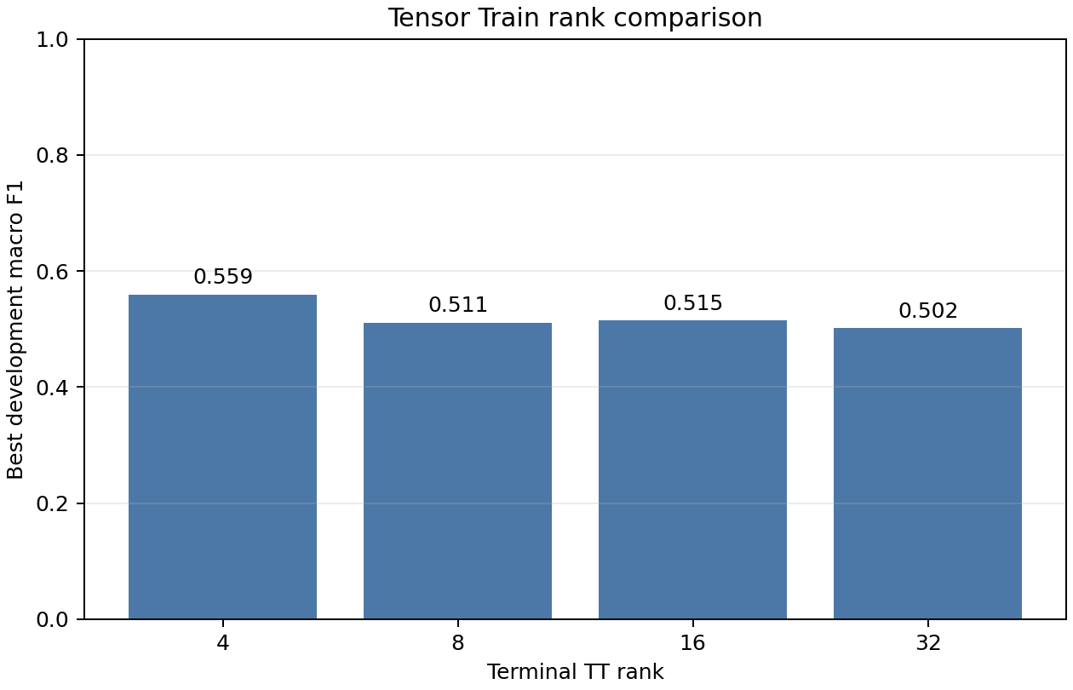
Tensor Train decomposition
A training-fitted basis compresses the participant × electrode × mel × statistic tensor
Input
174 × 19 × 24 × 4
The observation mode follows the feature modes during TT-SVD, so validation participants can be contracted against the same basis.
Selected compression
Terminal rank 4 produced four participant features. It retained a compact representation but had 63.7% centered reconstruction error.
Rank and SVM settings were selected inside development folds; the held-out test labels were not used.
07
Notes:
Training-only TT basis fitting prevents independently decomposed participants from having incompatible signs or rotations.
Selected ranks: channel rank 4, spectral rank 24 and terminal rank 4.
Figure source: C:\Projects\AIBSI\neural_comparison\advanced_clean_spectral\outputs\tensor_train_svm\tt_rank_selection.png

Slide 8
What changed to improve performance
The largest gains came from data harmonization and complementary representations
1 Data and cleaning
2 Representation
3 Evaluation
Combined two cohorts
Standardized the 19-channel montage
Used moderate artifact rejection
Avoided excessive interpolation
Log-mel summaries for SVM
Raw EEG for pretrained EEGPT
Tensor Train as a course ablation
Probability fusion of both branches
Participant-level splits
Training-only site normalization
Macro F1 and class recall
Repeated nested cross-validation
SVM + EEGPT fusion improved the fixed split from 66.7% to 70.4% accuracy
The repeated experiments show that FTD sample size and site shift still limit generalization.
08
Notes:
Advanced automatic cleaning interpolated channels in 114 of 174 participants and reduced macro F1, so the moderate pipeline was retained.
The blend combines calibrated probability outputs from the spectral SVM and fine-tuned EEGPT.

Slide 9
Model results and tensor ablation
Exploratory comparison on the same fixed 27-participant test split
Tensor Train preserved structure but removed useful class information
Best fixed result: 70.4% accuracy, 67.8% macro F1 and 67.6% macro recall.
09
Notes:
Fixed test set: 11 AD, 6 FTD and 10 healthy controls.
Tensor Train + SVM: 51.9% accuracy and 46.4% macro F1.
SVM + EEGPT: 70.4% accuracy and 67.8% macro F1.
These are fixed-split exploratory results. Repeated participant-level estimates remain lower and more variable.

Slide 10

Current conclusion and final benchmark
The project now includes a complete tensor ablation and a stronger hybrid EEG model
Completed
174-participant harmonized dataset
STFT and log-mel representations
Tensor Train decomposition with SVM
CNN, EEGPT, SVM and Random Forest comparisons
Final project benchmark
SVM + EEGPT probability fusion
70.4% fixed-split accuracy
67.8% fixed-split macro F1
Tensor Train retained as the tensor-course ablation
Main limitation: only 42 FTD participants and substantial performance variation across sites and participant splits.
10
Notes:
Present the SVM + EEGPT result as the strongest fixed-split benchmark, not as external clinical accuracy.
The tensor contribution is the training-fitted TT representation and the finding that compression did not improve diagnostic separation.

