Slide 1

Predicting the IPL Player Performance
-By
Sai Abhiram Eeda

Slide 2


Slide 3
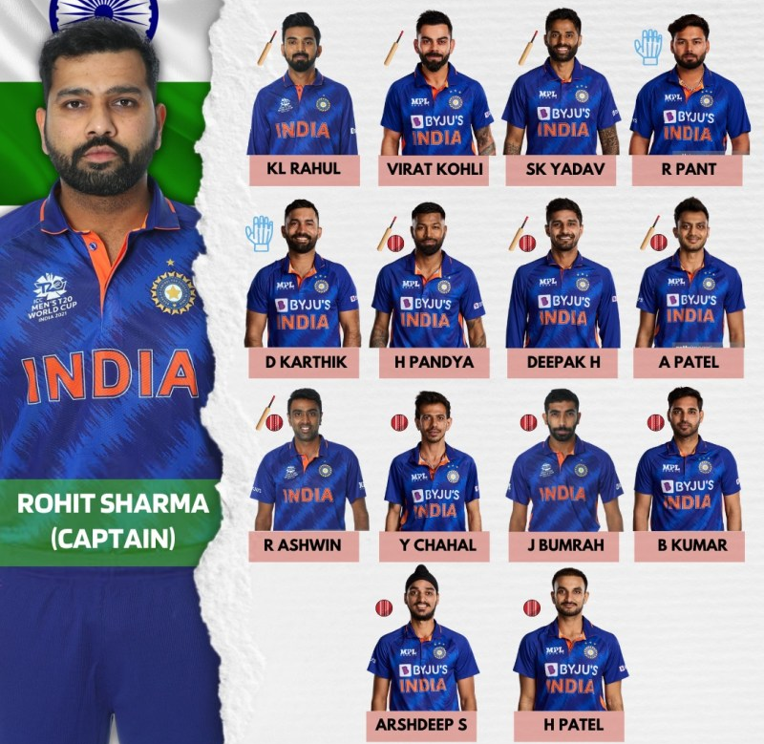
Short Intro of Cricket
11 Players in each team while playing
4-5 Batsmen
2 All-rounders
4-5 Bowlers
Ipl has 20 overs
1 over has 6balls
Batsmen will play till he/ she is out by opponent

Slide 4

Indian Premier league- IPL

Slide 5
Agenda of the Project
Planning to make a new team for that:
Find the players who are best performers (Batsmen and bowlers)
Predict those players performance

Slide 6
Best Batsmen or Bowler
Features to consider best batsmen :
No - Number of times the player remained not out after the match
Runs - Total number of runs the player has scored
Avg - Calculates the player's batting average, which is the total runs scored divided by the number
s/r - The average number of runs scored per 100 balls faced
Economy- runs conceded per over bowled

Slide 7
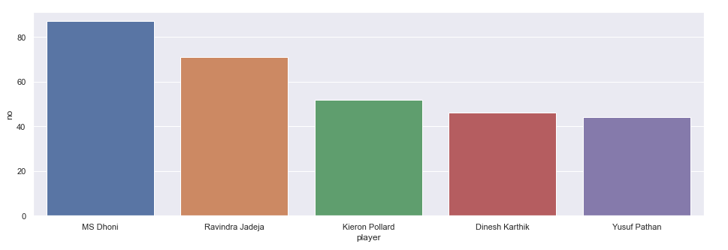
Top 5 Batsmen in feature - no

Slide 8
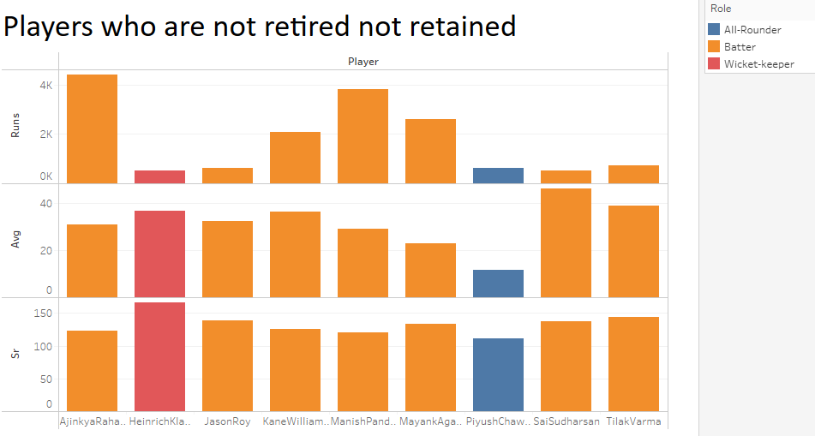

Slide 9
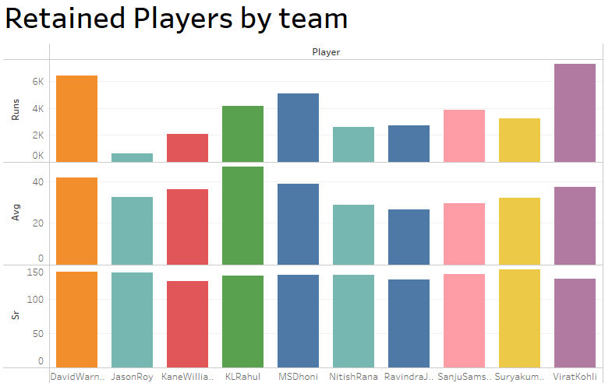

Slide 10
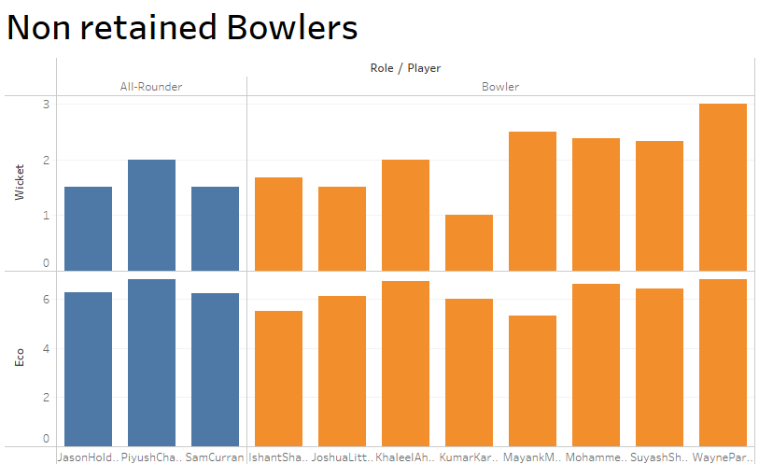

Slide 11
Predictions of batsmen
Model of the batsmen predicts the r2 score of 0.99
The model of the bowlers predicts the r2 score of 0.83
Show the difference (self)

Slide 12
Predictions of Bowlers

Slide 13
Conclusion
The selected players have potential and those players can be chosen for bidding

Slide 14


