Slide 1
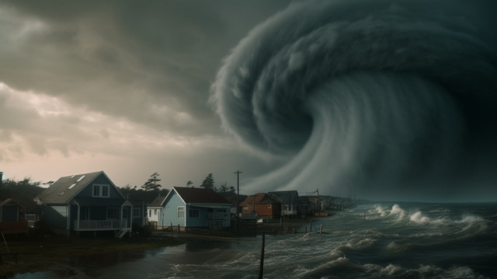
A new ML model can provide more accurate assessments of hurricane damage for responders
- Sai Abhiram Eeda

Slide 2
Agenda
The goal is to be able to provide near real-time information about building damage caused by hurricanes that can help emergency crews respond to disasters.

Slide 3
What is a hurricane?
When the maximum sustained winds of a tropical storm reach 74 miles per hour, it’s called a hurricane.

Slide 4
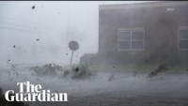

Slide 5
Affects of hurricane
Loss of life (Human and animal)
Economic loss ($25 billion by Micheal)
Emotional and psychological damages
Damage to crops
Communication

Slide 6
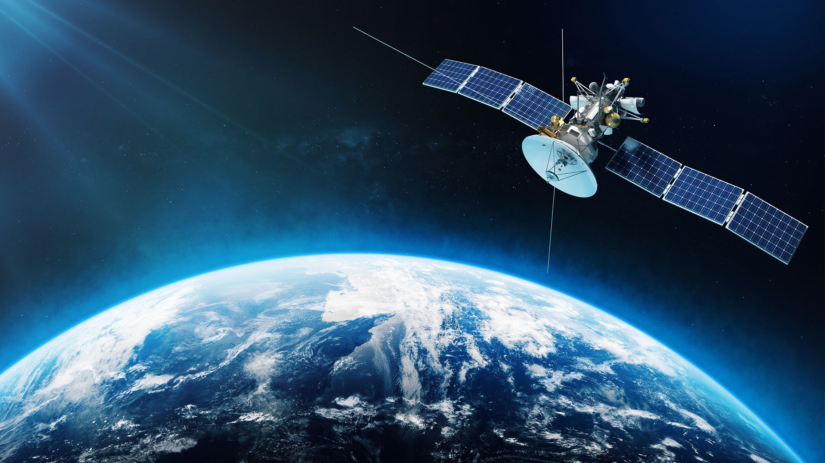
How ML model can help?
The model uses remote sensing from satellites that can generate building footprints from pre-hurricane images and then compare them with images taken after the storm.

Slide 7
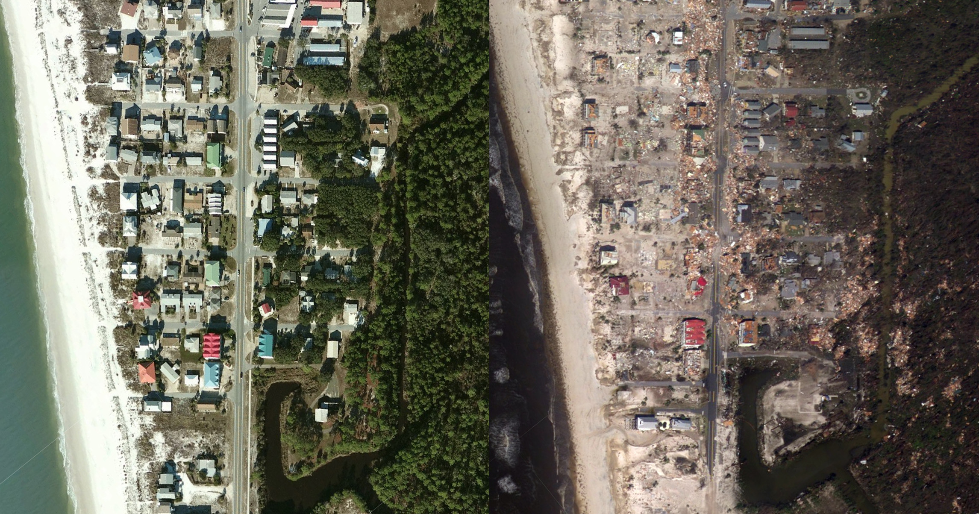
Before and After

Slide 8
About the Model
Pre-hurricane images - October or November 2017.
Post-event imagery - October. 13, 2018 of 22,686 buildings.
The CNN model is used to first generate building footprints from the pre-hurricane satellite imagery and then classify the amount of damage after the storm.

Slide 9
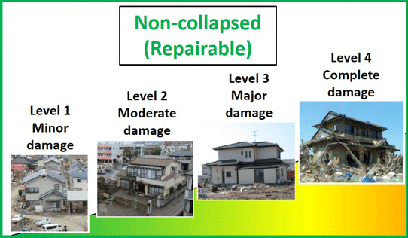
Their model classified buildings as
Undamaged
Minor damage
Major damage
or
Destroyed.

Slide 10
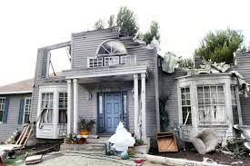
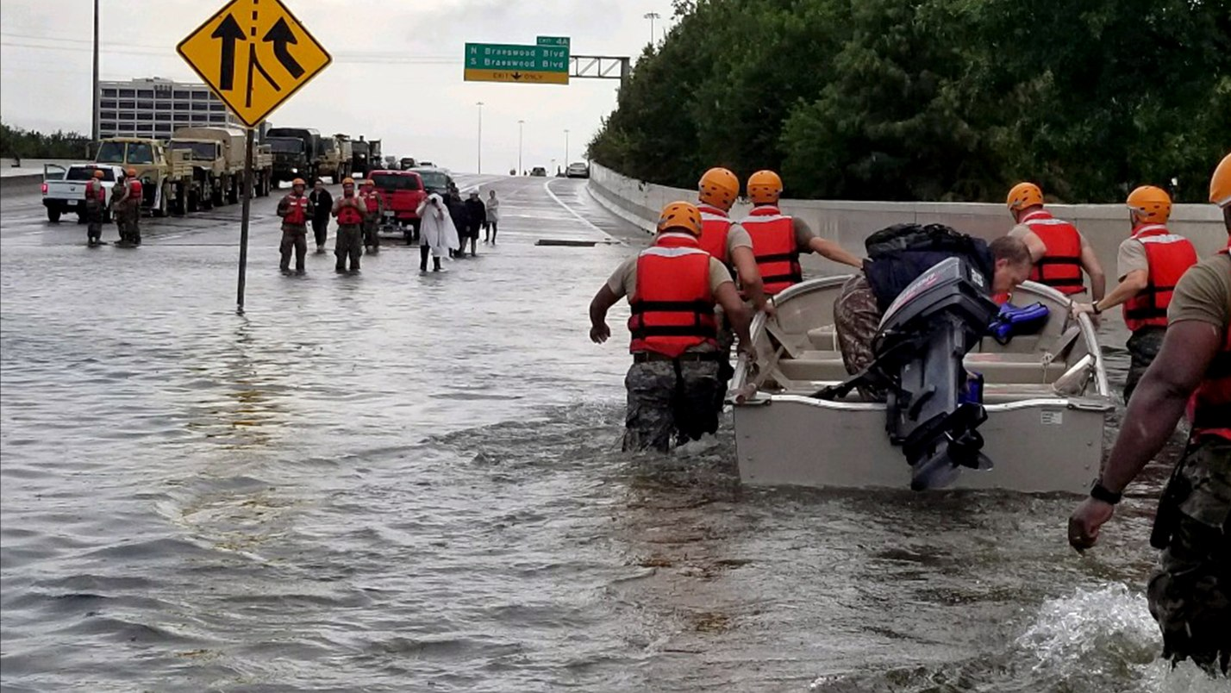
Model usage
Damage sustained by buildings
Key information for emergency responders

Slide 11
Conclusion
Accuracy of CNN model > SVM model
(86.3%) (75.3% )
The SVM struggled to distinguish between minor and major damage, which can be a major issue for teams responding after a hurricane.

Slide 12
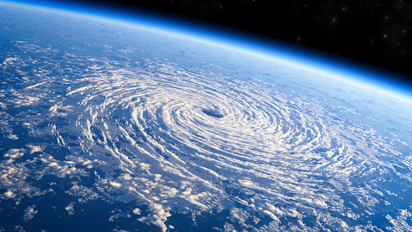
Thank you

