Slide 1

How wi-fi improve lives?
Presented by
Sonu J

Slide 2
content
INTRODUCTION.
CONNECTING PEOPLE.
INTERNET TETHERING AND ONLINE PAYMENT .
CONNECTING WITH HOME DEVICES.
DATA TRANSFER.
CONCLUSION

Slide 3

INTRODUCTION.
Wi-Fi is a wireless technology used to connect computers, tablets, smartphones and other devices to the internet.
Wi-Fi is the radio signal sent from a wireless router to a nearby device, which translates the signal into data you can see and use.

Slide 4
CONNECTING PEOPLE.
Making it easier to communicate with friends and family. From video call platforms to social media outlets, friends and family can connect more easily than ever before.
For people who are not physically located near their community or have family members in other countries, the internet provides a bridge of connection.

Slide 5
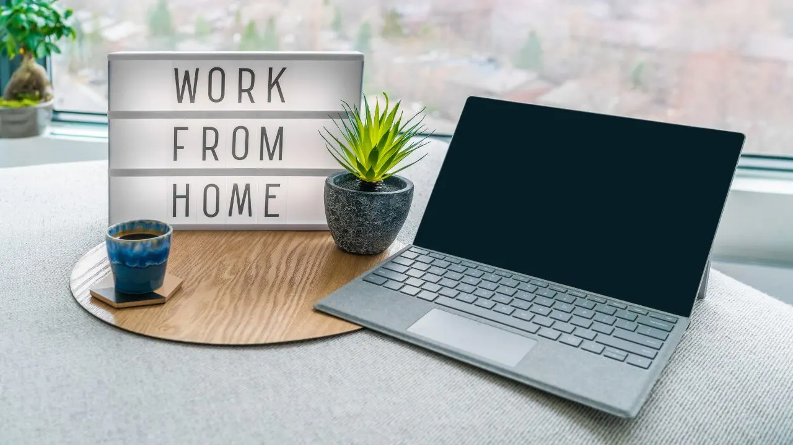
Encouraging Work from home.
m

Slide 6
CONNECTING WITH HOME DEVICES.
m

Slide 7
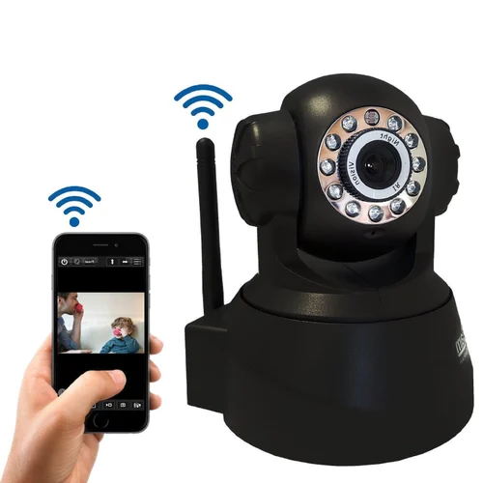
Security.
Instead of investing in security personnel or wired heavy-duty security systems, wireless technology offers you wireless cameras that can be monitored from any part of the world.
Aside from this, you also have Wi-Fi or Bluetooth-enabled devices such as gates, front doors, garage doors, cars, TV, etc., that can be controlled by your smartphone.

Slide 8
CONCLUSION
m

Slide 9
THANK YOU.

