Slide 1
AYURHEALTH

Slide 2

LOGO – remove ayurvedic medical centre
Original logo
white
1 color typo
black

Slide 3

Only English
Remove tagline
Place ayurvedic medical center as part of board as text
Also place arabi name of the brand as text
AYURVEDIC MEDICAL CENTRE
ARABIC TEXT OF THE BRAND NAME

Slide 4
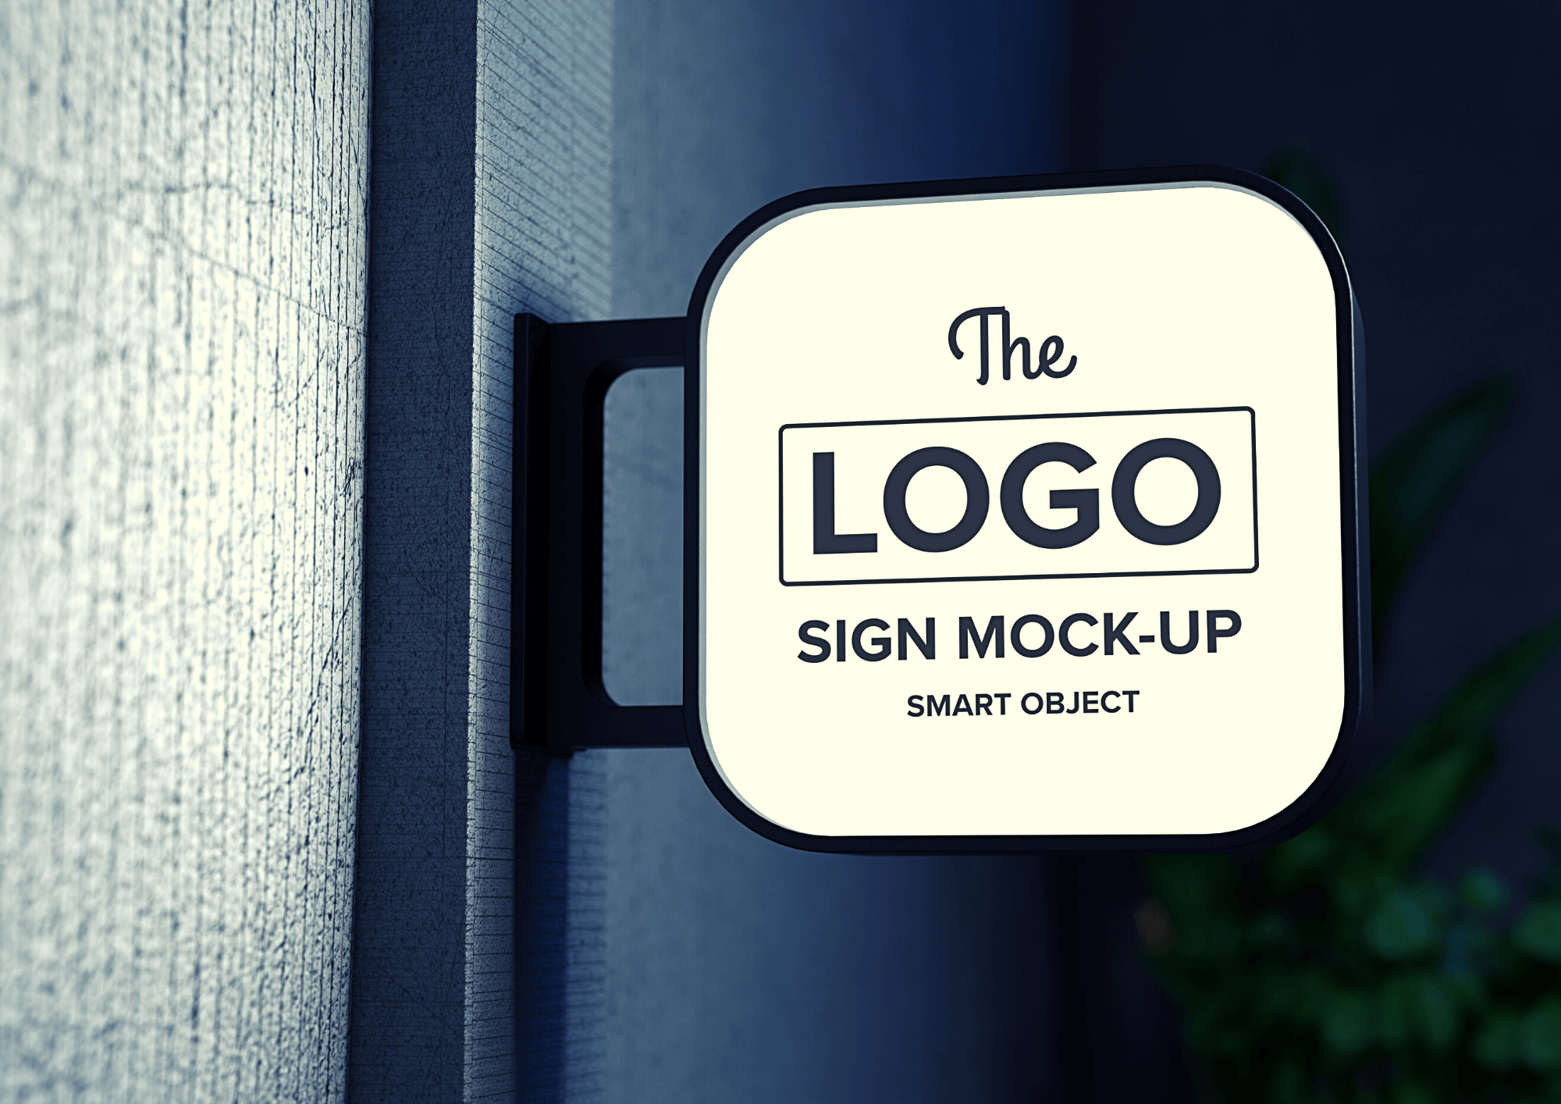
Flange

Slide 5

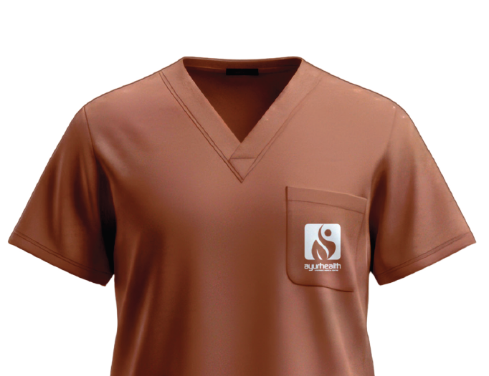
1 color typo

Slide 6
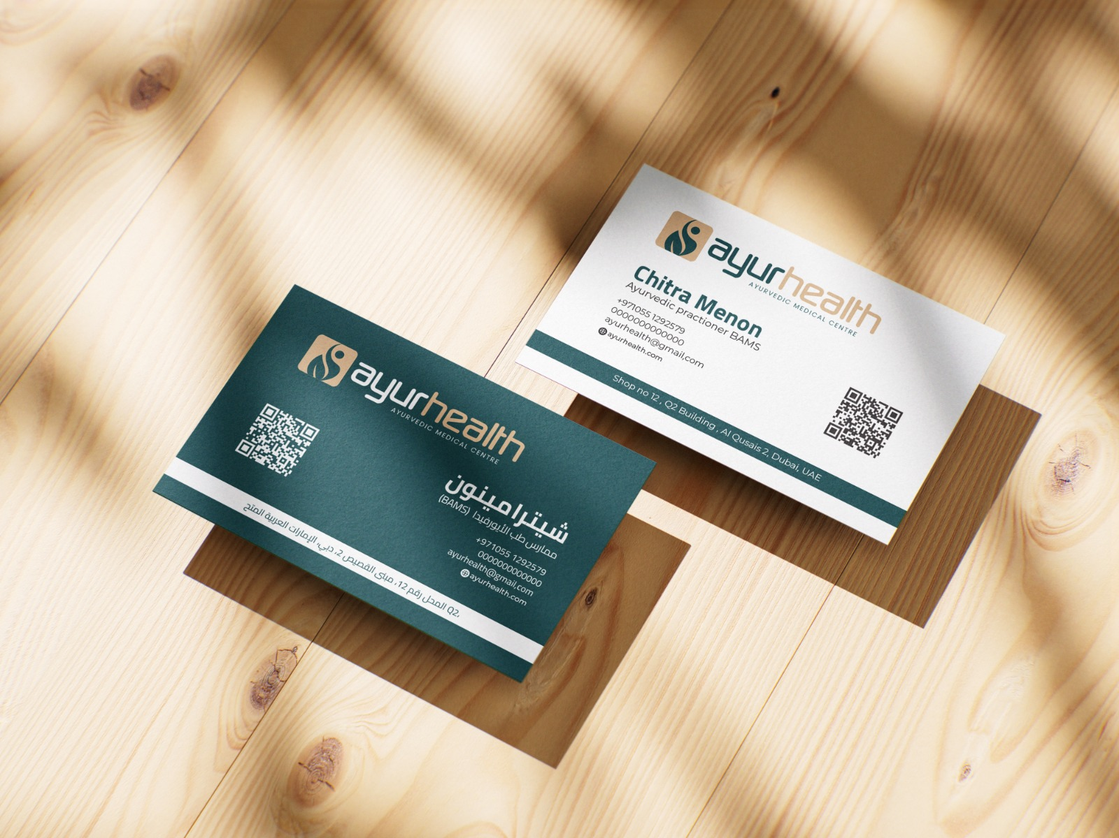
Do change in existing option
Remove the tagline
Also provide new design options

Slide 7

Logo to be white & beige combination against green or single color (2 options)
Remove the tagline

Slide 8

Logo to be white & beige combination against green or single color (2 options)
Form template look for in google to use content we will validate it
Remove the tagline

Slide 9

Logo to be white & beige combination against green or single color (2 options)
Remove the tagline

Slide 10
Brochure draft

Slide 11
1 page flier draft

Slide 12
Poster – 3 routes
1. Representing the procedure
2. Problem/solution – show a pain and tell service name
3. Happy faces/positive visual story

Slide 13
Tote bag

Slide 14
Standee

Slide 15
Round seal

Slide 16
Round seal

Slide 17
Doctor room name plate

Slide 18
Treatment Rate card

Slide 19
ONE WAY VISION NRANDING

