Slide 1
Kissan sevak
An application developed by : Abhishek K, Abhishek R, Santosh, Lokesh S

Slide 2
Problem statement
The rising cost of food that has hurt both Indian pockets is often blamed on a multi-layered system of middlemen involved in the distribution of produce from farm to fork.
The middle men over the years have created several layers of intermediaries, lengthening the supply chain, which in turn drive prices down for farmers and up for consumers.
Hyper inflation are caused by these middleman trying to buy produce from farmers for cheap and selling it at high price
A self employed farmer/labourer dies every 30 min in India as they are unable to pay the loan

Slide 3
How we solve the problem?
Make the supply chain more transparent, so that it easy for government to monitor and collect data about the crop rotation and pricing
Removing fruit and vegetables from the control of these middle man would allow the produce to find its true market value and damp down inflation
According to the wholesalers model the farmer gets around 70% of the market value of the produce compared to 25% which he gets from selling it to the middle men

Slide 4
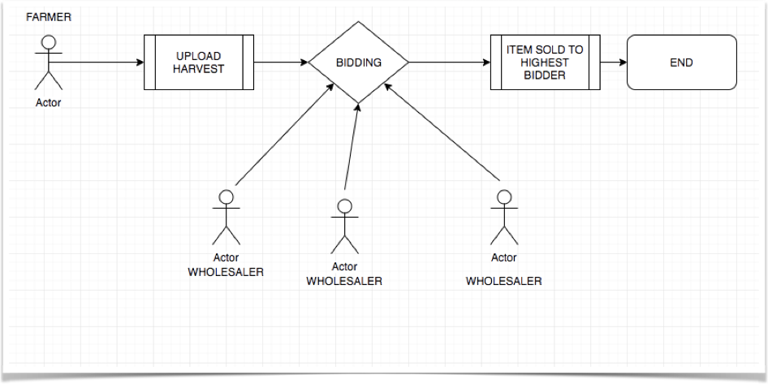
ACTIVITY DIAGRAM

Slide 5
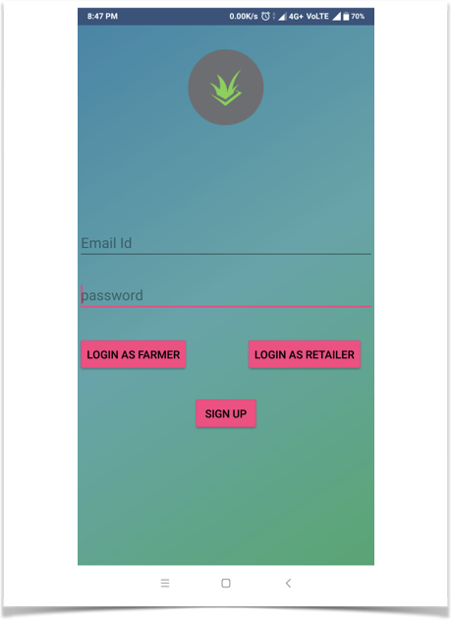
THE LOGIN PAGE

Slide 6
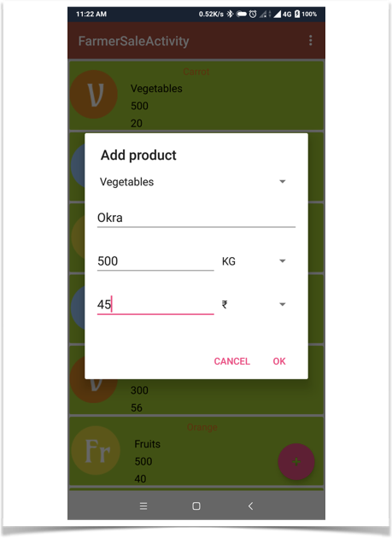
FARMER SIDE
Farmer uploading the details of the harvest

Slide 7
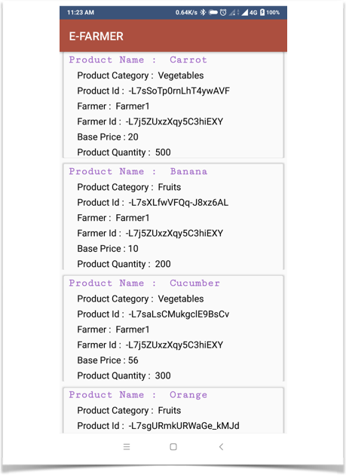
WHOLESALER SIDE
The list of harvest available for bidding

Slide 8
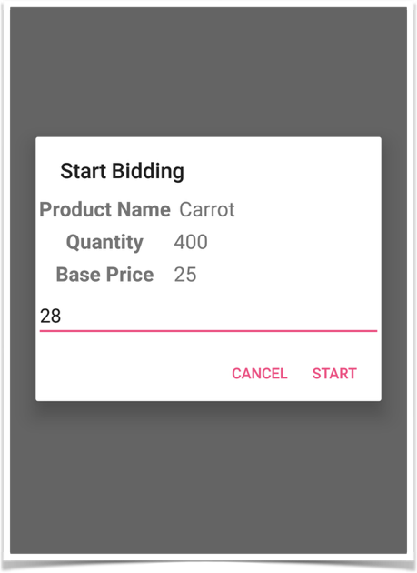
Wholesaler side
The dialogue box where the wholesaler bids

Slide 9
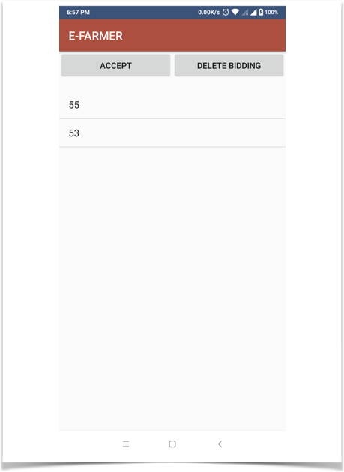
Farmer side
Bids displayed in descending order

Slide 10
Other apps in the market
Mandi app (leaning toward wholesalers)
Digital Mandi India (can only check the prices)
Mandi Trades (only buying and selling )

Slide 11
How are we different?
We provide one of the revolutionary - a bidding feature that will make the wholesalers fight in competition towards farmers advantage
Everything is real time and hence there is no necessity go the godowns for the farmer to store his produce as his harvest will be sold in real time
The exact location of the farmer is recored by our map interface and this can be used for the future survey and to track farmers activity by the government

Slide 12
Future for improvements
A real time market with commodity prices shown in a separate tab
Using the map interface to automatically send a goods vehicle with best prices
A master account for the government to have access to the entire data recorded

