Slide 1
finally finished
Repository: vva-cli | Branch: main
Generated by VVA Continuous Intelligence Engine

Slide 2
Executive Summary & Purpose
Analyzed Git commit fff2ec3: finally finished. Verified 1 changed file(s) across project subsystems.
Strategic Rationale: Implements targeted architectural and technical enhancements in vva-cli.

Slide 3
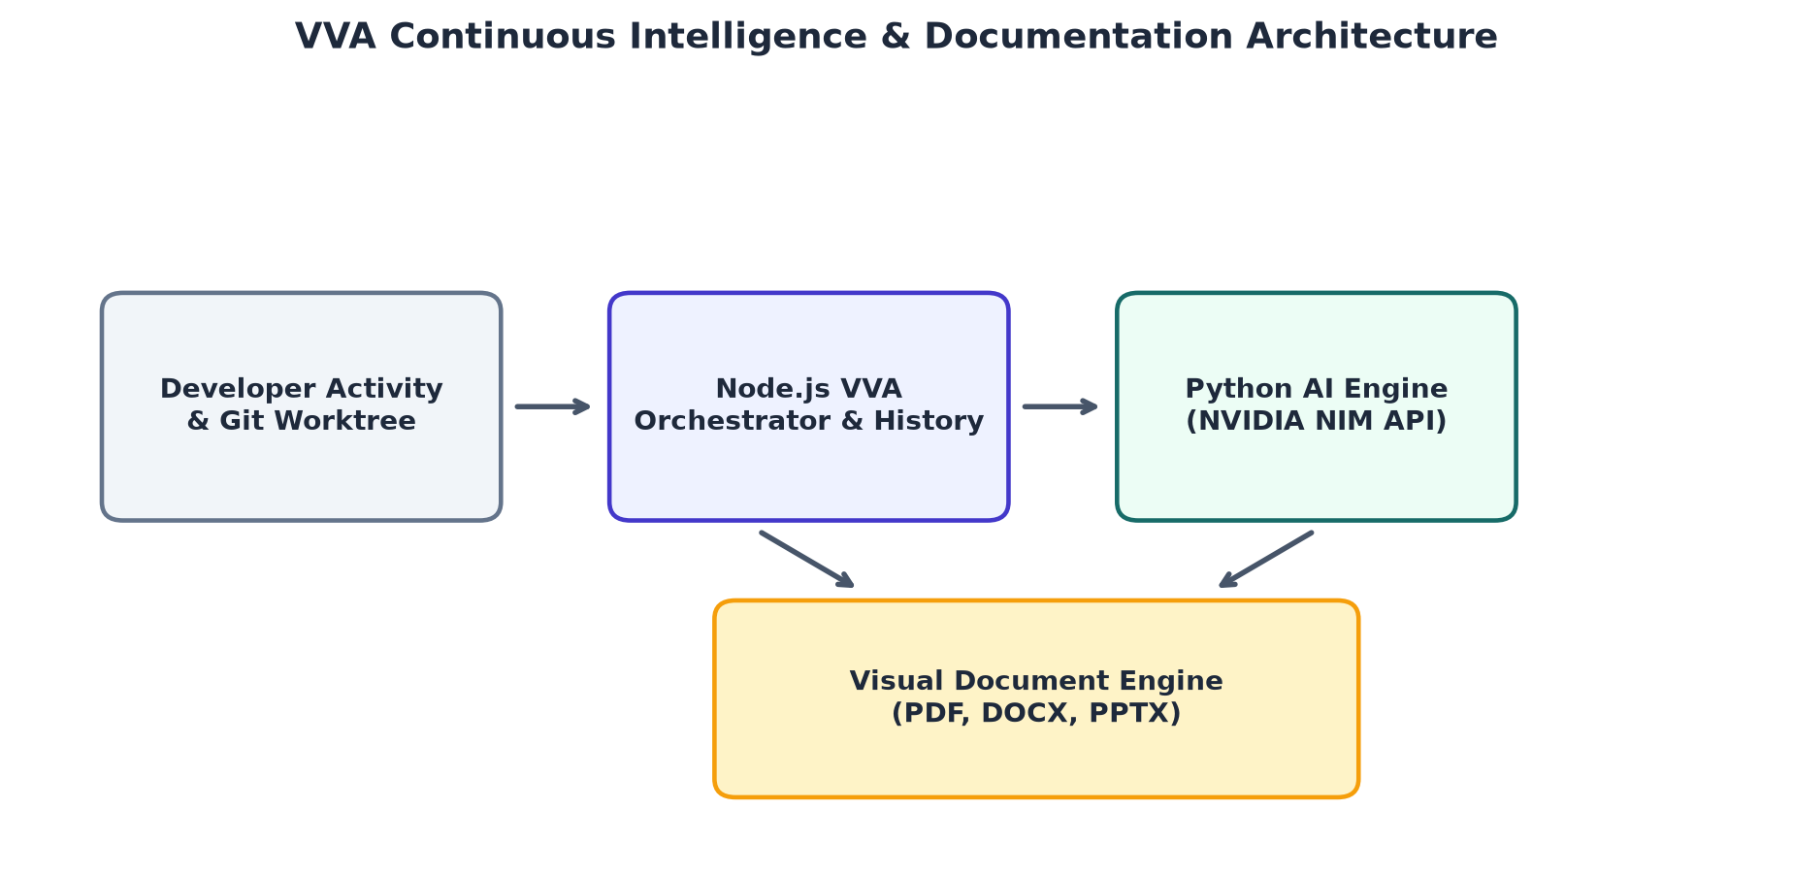
System Architecture & Continuous Workflow

Slide 4
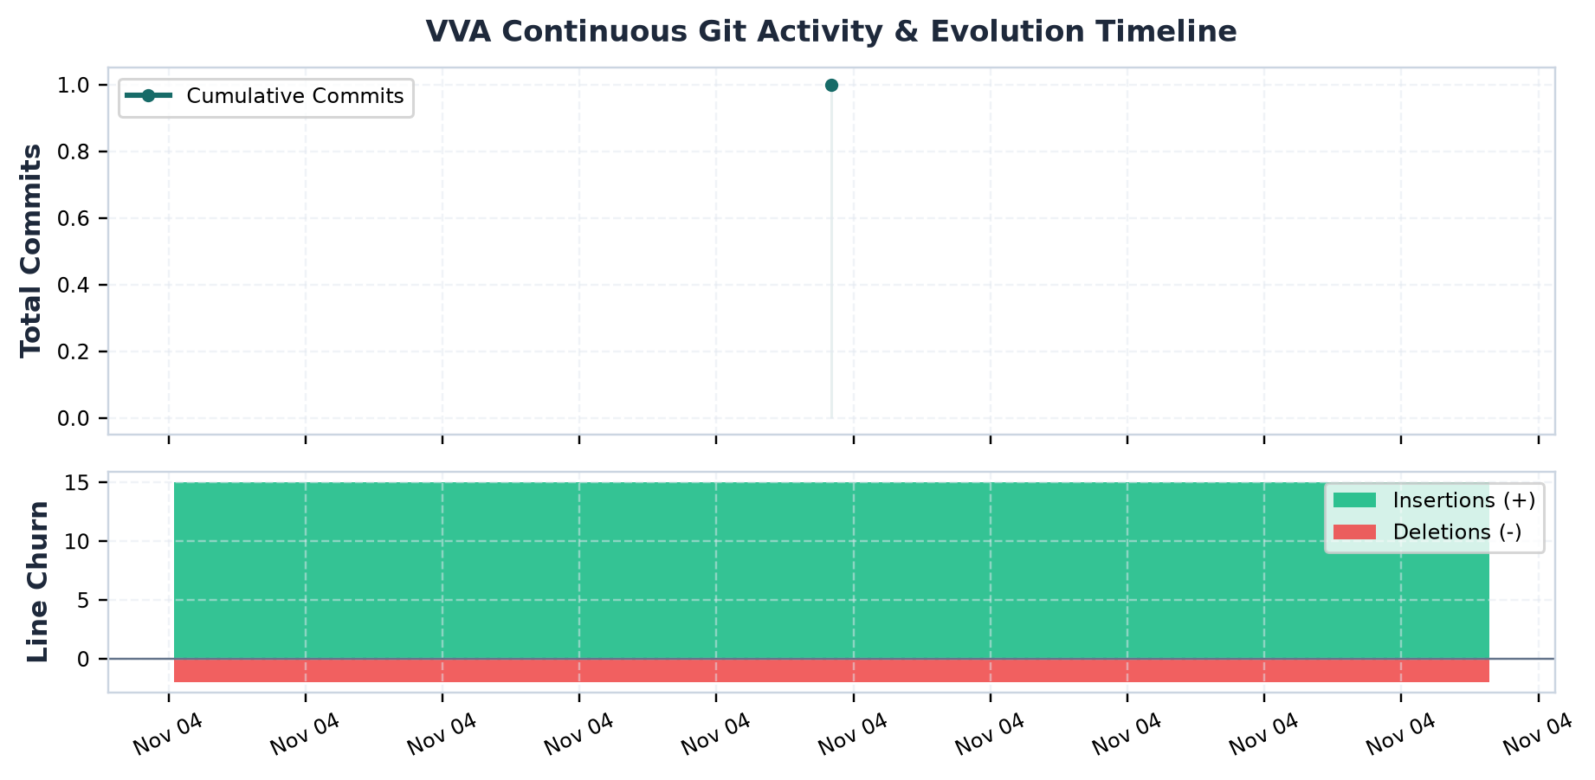
Continuous Git Evolution & Churn Metrics

Slide 5
Key Technical Implementation Changes
• Updated .vva/config.json (A) with +None / -0 lines.

Slide 6
Architectural Impact & Engineering Observations
Refines modular boundaries and ensures deterministic execution across repository workflows.
• Facts verified directly from committed diff hunk without speculative assumptions.
• Changes verified against active runtime and schema specifications.

