Slide 1
Initial VVA project setup
Repository: applet | Branch: master
Generated by VVA Continuous Intelligence Engine

Slide 2
Executive Summary & Purpose
This commit establishes the foundational structure for the VVA (Version & Workflow Automator) project. It adds a comprehensive set of source files, configuration files, and dependencies required to run the application locally and to orchestrate the Git‑to‑AI‑to‑Document pipeline.
Strategic Rationale: The purpose of this commit is to bootstrap the VVA codebase, providing the core CLI, React UI, Git data collection logic, AI analysis engine, and document generation utilities. It also includes environment configuration, package manifests, and lock files to ensure reproducible builds.

Slide 3
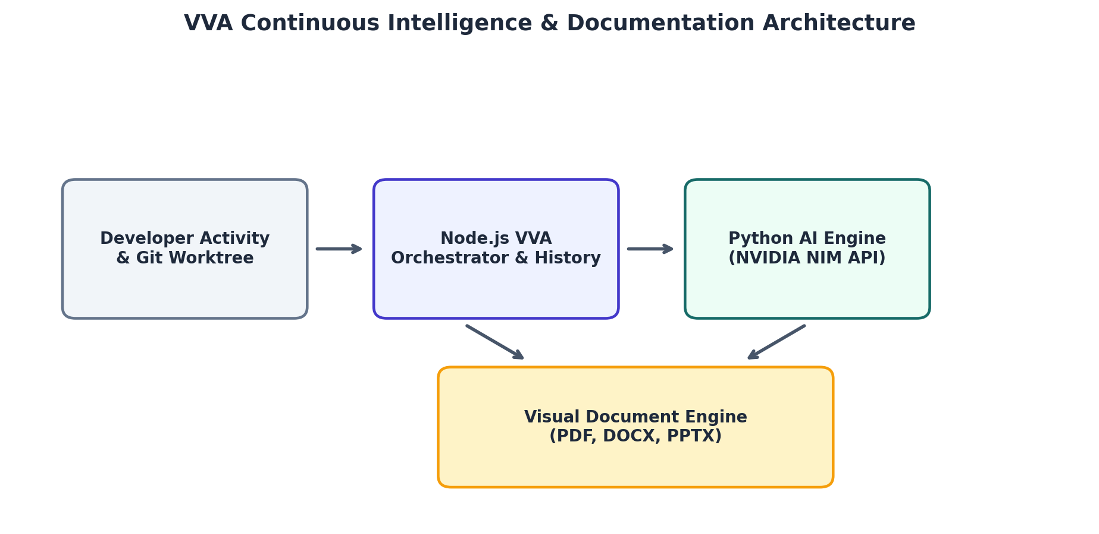
System Architecture & Continuous Workflow

Slide 4
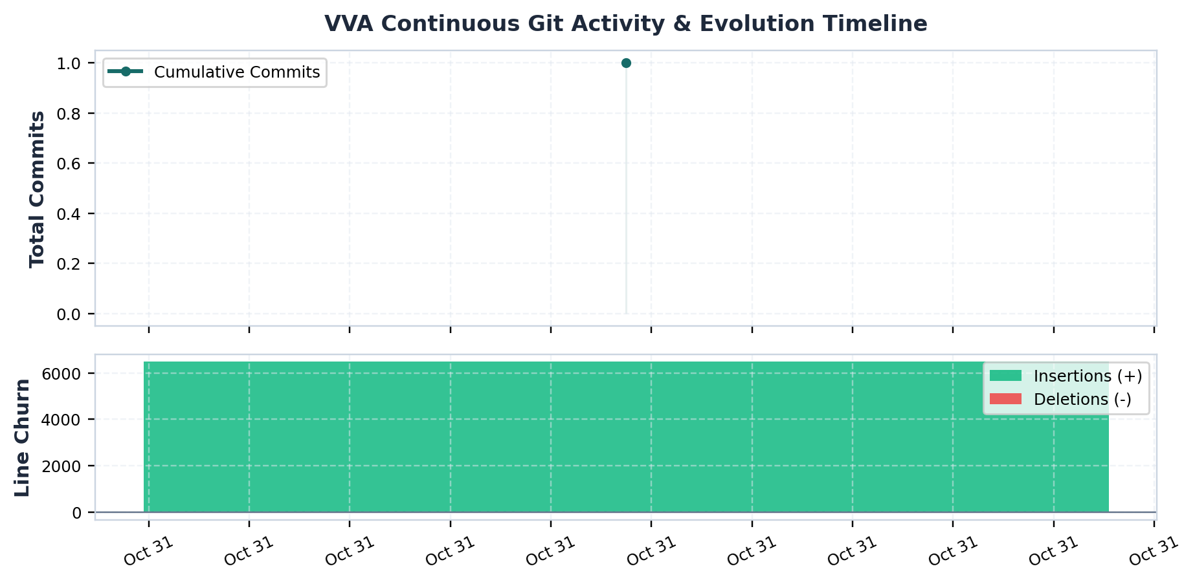
Continuous Git Evolution & Churn Metrics

Slide 5
Key Technical Implementation Changes
• Added environment example with NVIDIA API key and model configuration
• Created .gitignore to exclude build artifacts and logs
• Provided README with local run instructions
• Implemented ai/ai_engine.py to invoke NVIDIA API for commit analysis
• Added ai/test_nvidia.py for API connectivity test
• Created bin/vva.js as CLI entry point

Slide 6
Architectural Impact & Engineering Observations
The commit establishes a layered architecture: a Node.js orchestrator (CLI & React UI) coordinates Git data collection, AI analysis, and document generation. The AI engine runs in Python, communicating via JSON files. The project is modularized into commands, core utilities, components, and schemas, enabling clear separation of concerns and facilitating future extensions.
• The commit only adds files; no functional tests or CI configuration are present.
• The AI engine script relies on an NVIDIA API key hard‑coded in .env.example, which may not be secure for production.
• The bun.lock file is extremely large, potentially impacting install times.
• The project includes both Node.js and Python components but does not provide a unified build or deployment pipeline.

