Slide 1

Enhancing Search Engine Relevance for Video Subtitles
Submitted By - Abhiram Bussa (IN1240515 )
Harshit Punera (IN1240881)
Team ID - T211095

Slide 2
Objective
Developing an advanced search engine algorithm
Leveraging Natural language processing and machine learning
Enhancing relevance and accuracy of search results for video subtitles

Slide 3
Summary
In the fast-evolving landscape of digital content, effective search engines play a pivotal role in connecting users with relevant information. For Google, providing a seamless and accurate search experience is paramount. This project focuses on improving the search relevance for video subtitles, enhancing the accessibility of video content.

Slide 4
Core logic of this project
Preprocessing of Data
Cosine similarity calculation for relevance assessment
Importance of document chunking for large documents

Slide 5
Step by Step Process
Ingesting Documents
Reading and decoding the database file
Understand the encoding language
Cleaning and preprocessing steps
Experimenting with BOW/TFIDF and SentenceTransformers
Implementing document chunking
Storing embeddings in ChromaDB

Slide 6
Retrieving Documents
Take User query
Preprocessing user queries
Creating query embeddings
Calculating cosine similarity scores
Retrieving relevant candidate documents

Slide 7
Reading and Decoding the Database File:
The subtitle data is provided in a Database file format. Ingesting begins by reading this file and understanding its structure
Subtitles Data encoded with “Latin-1” and in a compressed format , so decoding is necessary to access the actual subtitle text
Cleaning and Preprocessing Steps:
We took a random sample 30% of the data for cleaning
Before analysis The subtitles text require cleaning to remove irrerelevant elements include removing Timestamps,Special characters,stopwords ,apply lemmetaization

Slide 8
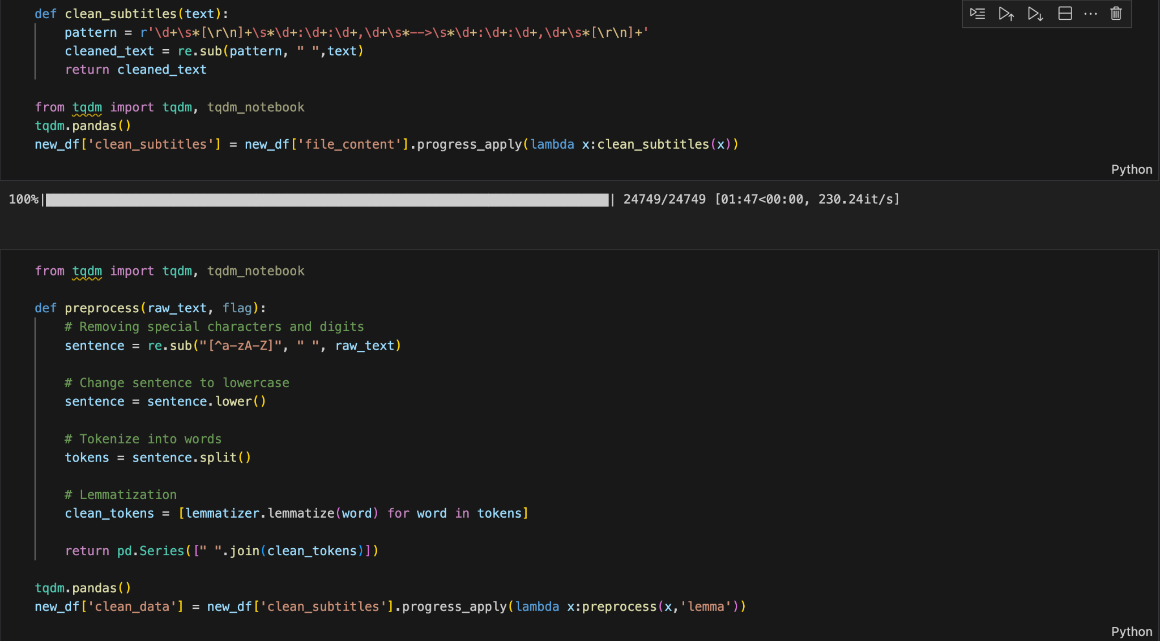

Slide 9
Document Chunking
Document chunking involves dividing large subtitle documents into smaller,more manageable chunks
This is important because embedding entire documents as single vectors may lead to information loss,especially with long documents
Overlapping windows with a specified number of tokens can be used to ensure continuity and context preservation across chunks

Slide 10
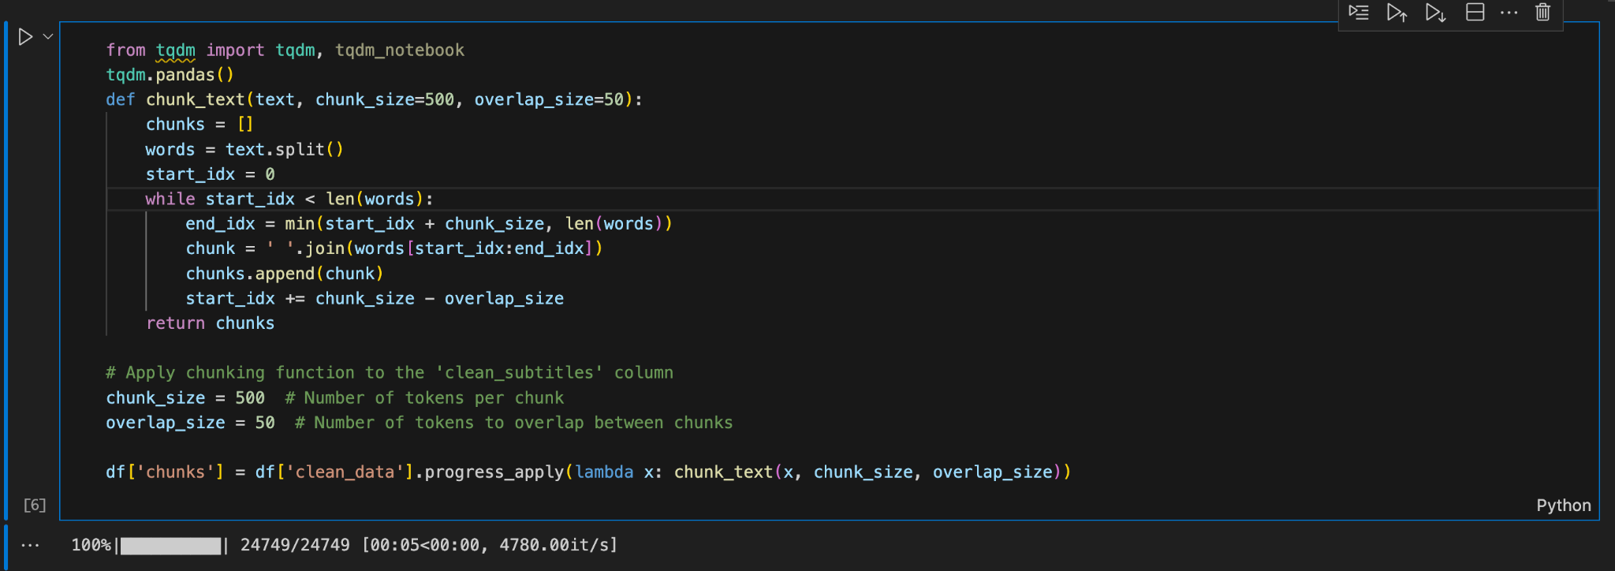

Slide 11
Experimenting with BOW/TFIDF and SentenceTransformers
After cleaning,the subtitle documents are prepared for analysis by converting them into numerical representations
We used BERT-based “Sentence Transformers” vectorization technique.
This Technique generate embeddings that encode semantic information,capturing the meaning and context of the text. They are suitable for building semantic search engines.

Slide 12
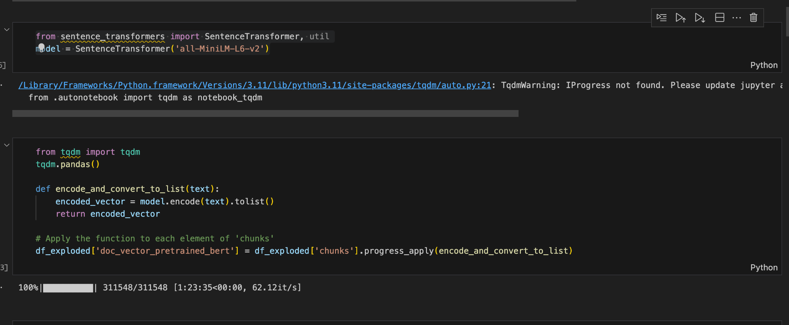

Slide 13
Storing Embeddings in a chromadb vectors database
Once the subtitles documents are processed and converted into embeddings,they need to be stored for efficient retrieval during the search process.
Chromadb is efficient in handling large-scale vector data and enabling fast retrieval
Chroma gives you the tools to:
store embeddings and their metadata
embed documents and queries
search embeddings on the basis of cosine similarity scores

Slide 14
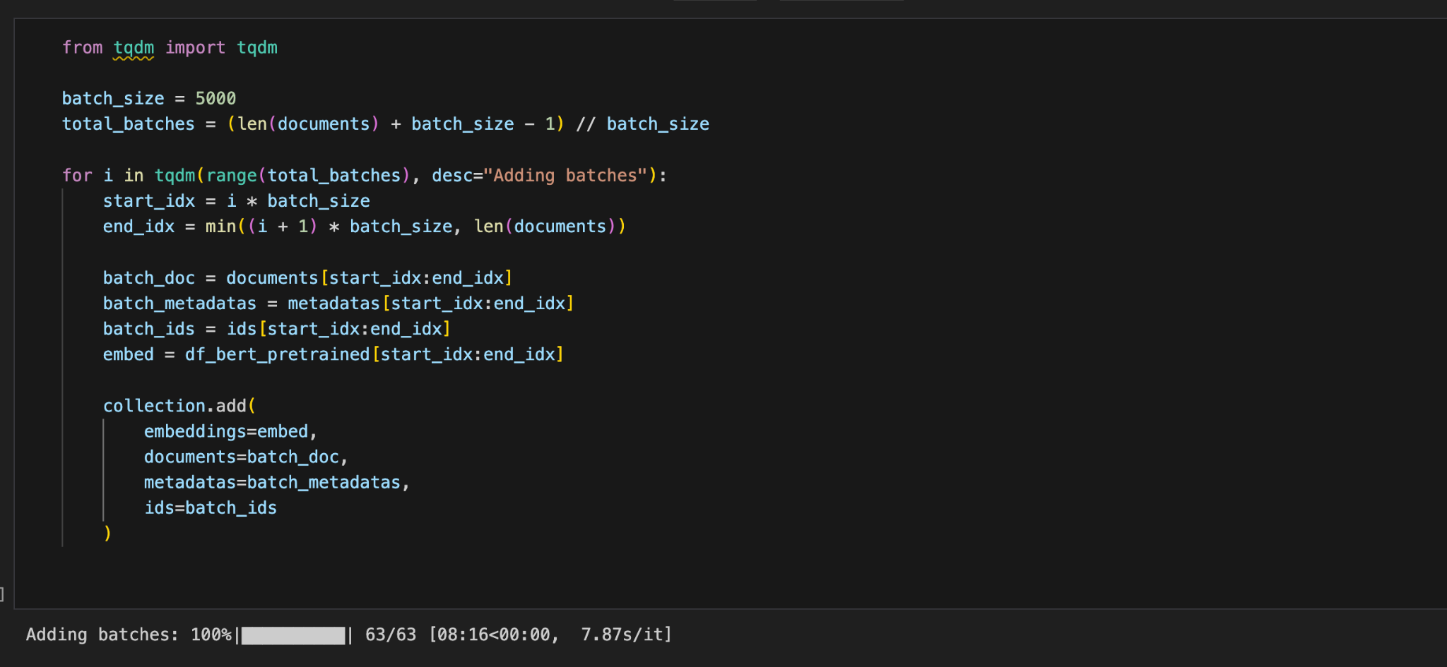

Slide 15
Retrieving Documents
Taking User query
The process begins with the user inputting a query into the search engine . This query represents the information the user is seeking from the subtitle database.
Preprocessing User queries:
Before the query can be used for retrieval, it undergoes preprocessing steps to standardize and clean the text
Creating Query Embeddings:
After preprocessing, the user query is converted into a numerical representation,known as an embedding

Slide 16
Bert-based Sentence Transformers is used to generate embeddings that encode the semantic information of the query.
This embedding captures the semantic meaning and context of the query,allowing it to be compared to the embeddings of subtitle documents
Calculating cosine similarity scores:
Now Connection is created to the path of that chromadb database
Once the query has been embedded, the next step is to compare it to the embeddings of the subtitle documents in the database.
Cosine similarity scores is calculated by chromadb between the query embedding and the embeddings of all subtitle documents.

Slide 17
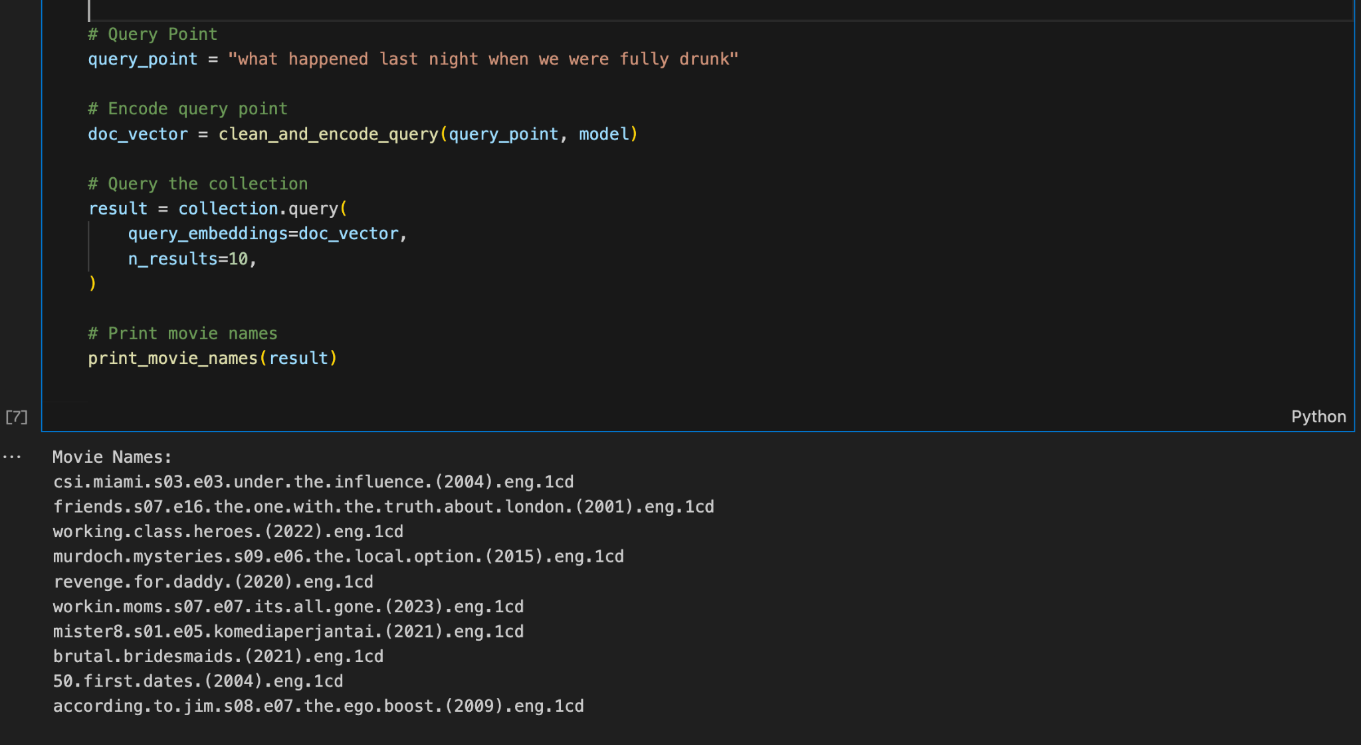

Slide 18
Retrieving Relevant candidate Documents
Finally ,based on the calculated cosine similarity scores , the search engine retrieves the most relevant Top N candidate documents from the stored data in Chromadb database
Web application.
We used Flask to build a web application that searches for a specific part of a subtitle and returns the top ten results. Linking each filename to the OpenSubtitles page allows for easy download of the subtitles.

Slide 19
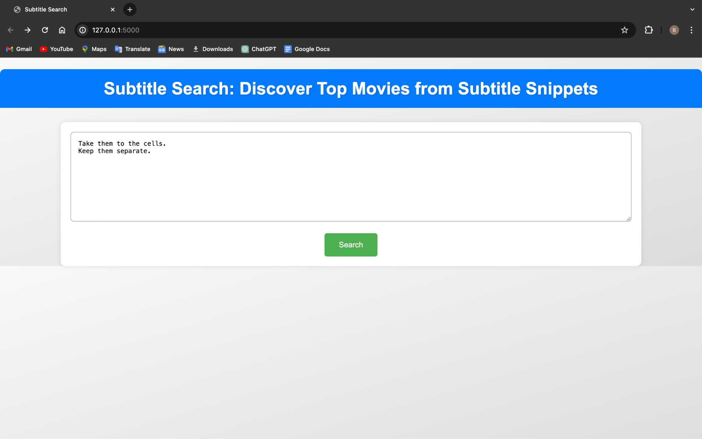

Slide 20
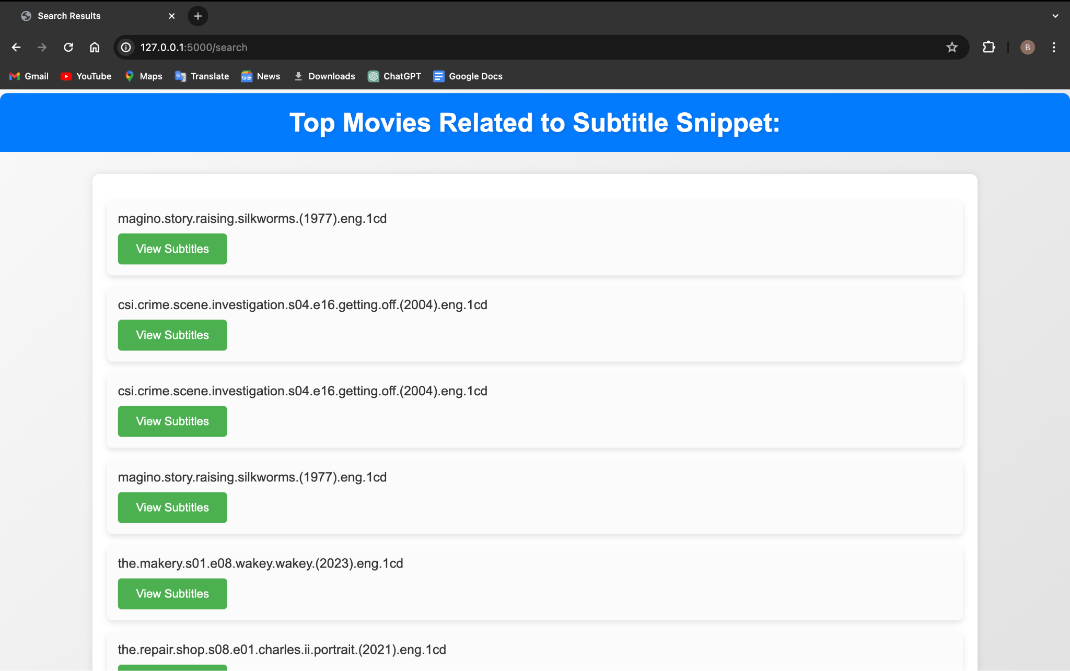

Slide 21

THANK YOU

