Slide 1

GOOGLE DATA ANALYTICS CAPSTONE PROJECT
Cyclistic Bike Share
Analysis
Prepared by Abhirami Ananthakumar
TOOLS
Google Sheets • R • Tableau • Google Docs • Google Slides • GitHub
2026

Slide 2
TABLE OF CONTENTS
Agenda
01
Business Problem
08
Dashboard
02
Business Objective
09
Key Findings
03
Business Task
10
Business Recommendations
04
Dataset
11
Expected Business Impact
05
Tools Used
12
Skills Demonstrated
06
Methodology
13
Conclusion
07
Data Cleaning
CYCLISTIC BIKE SHARE ANALYSIS
02

Slide 3


SECTION 01
Business Problem
Cyclistic is a bike-share company serving riders through two membership options: annual members and casual riders.
Casual riders use the service frequently but are less likely to purchase annual memberships.
Increasing annual memberships is important because they provide more predictable, long-term revenue.
Annual Members
Casual Riders
CYCLISTIC BIKE SHARE ANALYSIS
03

Slide 4


SECTION 02
Business Objective
Analyze 12 months of Cyclistic ride data to identify behavioral differences between annual members and casual riders.
Provide data-driven recommendations to increase annual memberships.
CYCLISTIC BIKE SHARE ANALYSIS
04

Slide 5
SECTION 03
Business Task
Provide actionable insights that help Cyclistic's marketing team convert more casual riders into annual members.
CYCLISTIC BIKE SHARE ANALYSIS
05

Slide 6




SECTION 04
Dataset
SOURCE
PERIOD
TOTAL RECORDS
FORMAT
Divvy Trip Data
(Cyclistic)
Jul 2025 – Jun 2026
(12 months)
5.93 Million
Rides
Monthly CSV
Files
Data cleaned and combined using R
CYCLISTIC BIKE SHARE ANALYSIS
06

Slide 7
SECTION 05
Tools Used
TOOLS | PURPOSE
Google Sheets | Initial data exploration
R | Data cleaning & preprocessing
Tableau | Dashboard creation
Google Docs | Project Documentation
Google Slides | Presentation
GitHub | Portfolio & version control
CYCLISTIC BIKE SHARE ANALYSIS
07

Slide 8





SECTION 06
Methodology
The Google Data Analytics six-phase framework
1
2
3
4
5
6
Ask
Prepare
Process
Analyze
Share
Act
CYCLISTIC BIKE SHARE ANALYSIS
08

Slide 9




SECTION 07
Data Cleaning
Imported 12 monthly datasets
NEW VARIABLES CREATED
Combined datasets into one file
Ride Length
Removed duplicates
Day of Week
Removed missing values
Converted date and time columns
Month
Hour
CYCLISTIC BIKE SHARE ANALYSIS
09

Slide 10
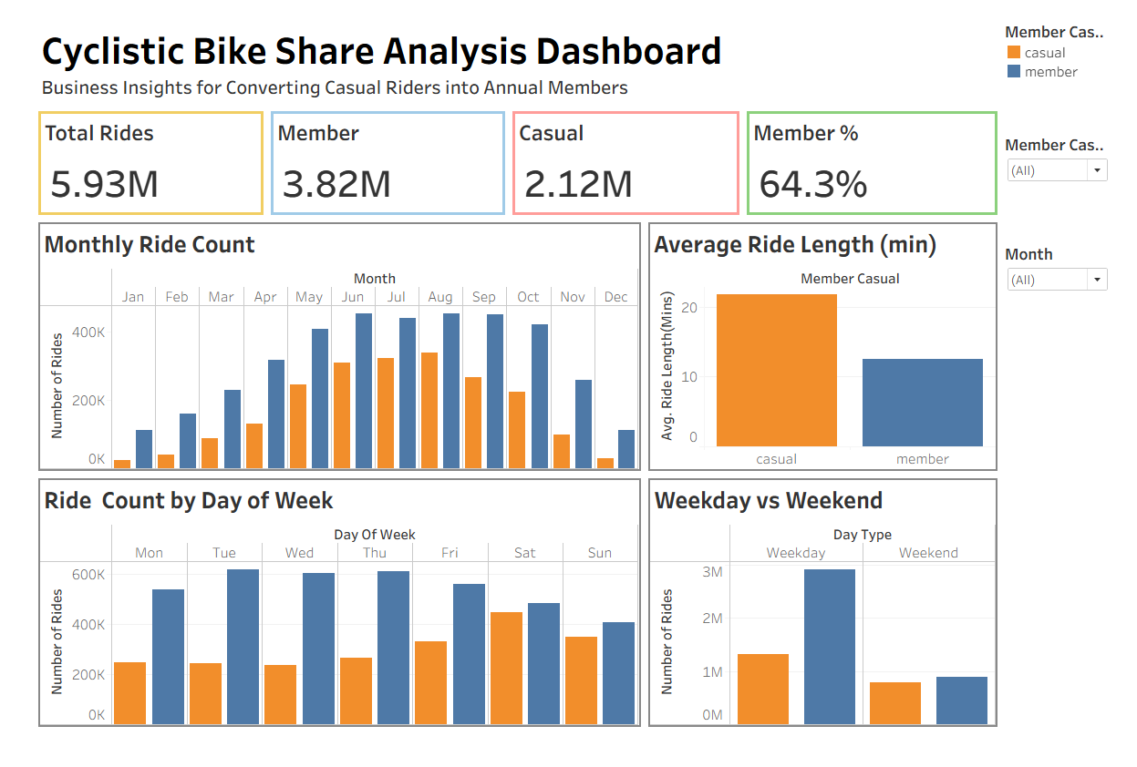
SECTION 08
Dashboard Overview
Executive Summary Dashboard
CYCLISTIC BIKE SHARE ANALYSIS
10

Slide 11
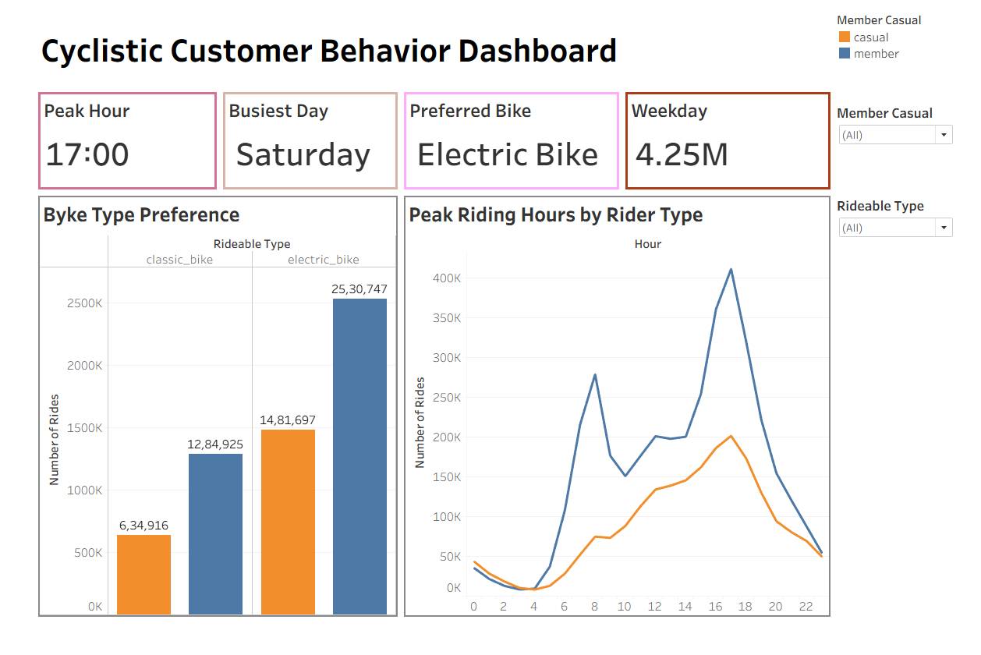
SECTION 08
Dashboard Overview
Customer Behavior Dashboard
CYCLISTIC BIKE SHARE ANALYSIS
11

Slide 12


SECTION 09
Key Findings
Casual riders take longer rides.
Summer records the highest number of rides.
Members ride more frequently.
Peak riding hour is 5:00 PM.
Casual rides increase during weekends.
Electric bikes were popular among both annual members and casual riders.
Members ride consistently throughout the week.
CYCLISTIC BIKE SHARE ANALYSIS
12

Slide 13
SECTION 10
Business Recommendations
01
02
03
04
05
Weekend membership
promotions
Electric bike
membership benefits
Summer marketing
campaigns
Evening benefits
promotions
Commuter
membership plans
CYCLISTIC BIKE SHARE ANALYSIS
13

Slide 14
SECTION 11
Expected Business Impact
Increase annual
memberships
Improve customer
retention
Enable data-driven
marketing decisions
CYCLISTIC BIKE SHARE ANALYSIS
14

Slide 15
SECTION 12
Skills Demonstrated
Data Cleaning
Data Transformation
Data Analysis
Data Visualization
Business Intelligence
Data Storytelling
Tableau Dashboard Development
R Programming
CYCLISTIC BIKE SHARE ANALYSIS
15

Slide 16
SECTION 13
Conclusion
This project analyzed 5.93 million Cyclistic rides to understand behavioral differences between annual members and casual riders. The insights provide practical recommendations that can help increase annual memberships and support business growth.
CYCLISTIC BIKE SHARE ANALYSIS
16

Slide 17
THANK YOU
Cyclistic Bike Share Analysis • Abhirami Ananthakumar

