Slide 1

Introduction to K-Nearest Neighbors (KNN) Algorithm
• Estimates likelihood of data point belonging to a group based on similarity to existing data points
• Supervised machine learning technique
Slide 1 | KNN Explainer Prototype

Slide 2

Definition and Importance of KNN in Data Science
• Non-parametric, lazy learning algorithm
• Simplistic, easy to interpret, and low computational cost
Slide 2 | KNN Explainer Prototype

Slide 3

Foundational Concepts: Supervised vs. Unsupervised Learning and Lazy vs. Eager Learning
• KNN belongs to the family of supervised learning algorithms
• KNN is a 'lazy learner' that delays computation until prediction time
Slide 3 | KNN Explainer Prototype

Slide 4

Distance Metrics and Similarity in KNN
• Choose distance metric based on data type and problem domain
• Feature scaling often necessary to prevent feature dominance
Slide 4 | KNN Explainer Prototype

Slide 5
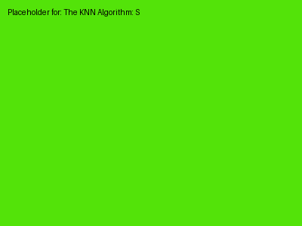
The KNN Algorithm: Step by Step
• Data preprocessing
• Choosing the optimal value of k
Slide 5 | KNN Explainer Prototype

Slide 6

Optimizing KNN Performance with Cross-Validation, Elbow Method, and Grid Search
• Cross-validation to determine optimal k
• Elbow method and grid search to address class imbalance and dimensionality
Slide 6 | KNN Explainer Prototype

Slide 7

Practical Implementation and Example
• Implement KNN in Python using scikit-learn
• Tune the model for high accuracy in classification tasks
Slide 7 | KNN Explainer Prototype

Slide 8

Real-World Applications and Performance Metrics Evaluation
• Recommendation systems, image classification, and text classification
• Accuracy, precision, recall, F1-score, and confusion matrix
Slide 8 | KNN Explainer Prototype

