Slide 1
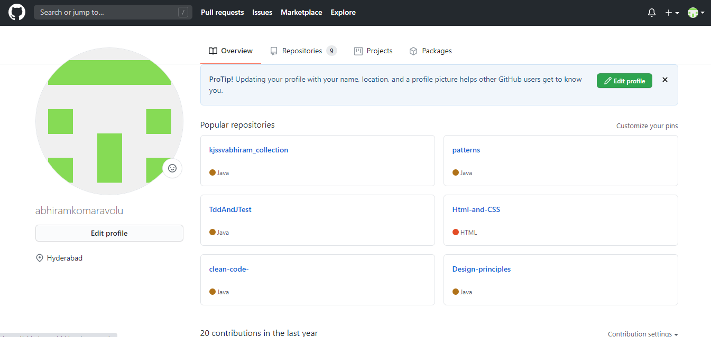
Step1: created the github account and profile of my github account

Slide 2
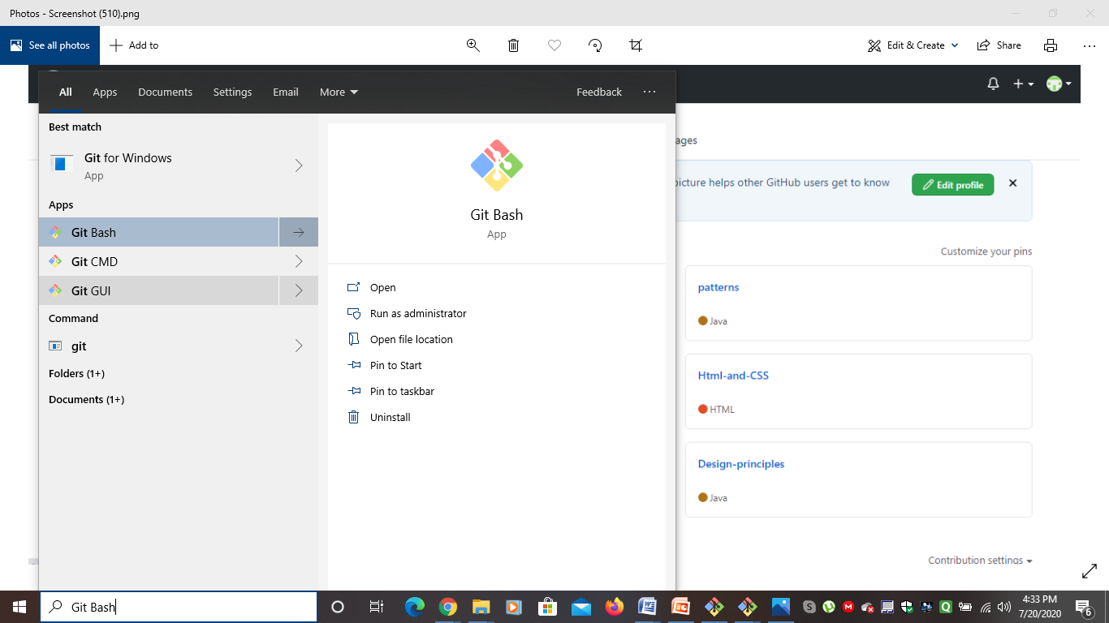
Step 2:Installed git in my personal computer

Slide 3
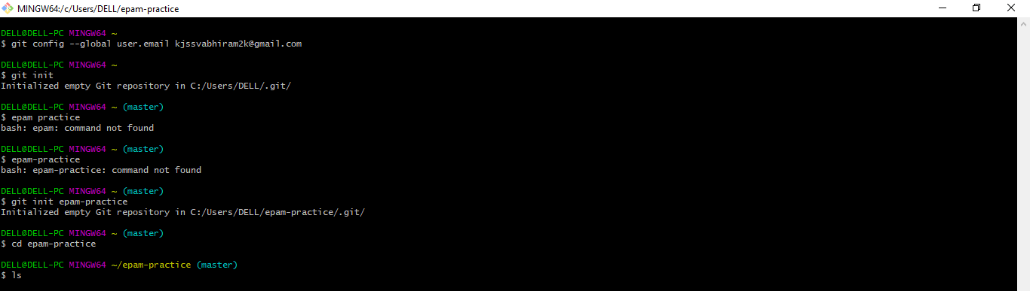
created repository using git commands

Slide 4
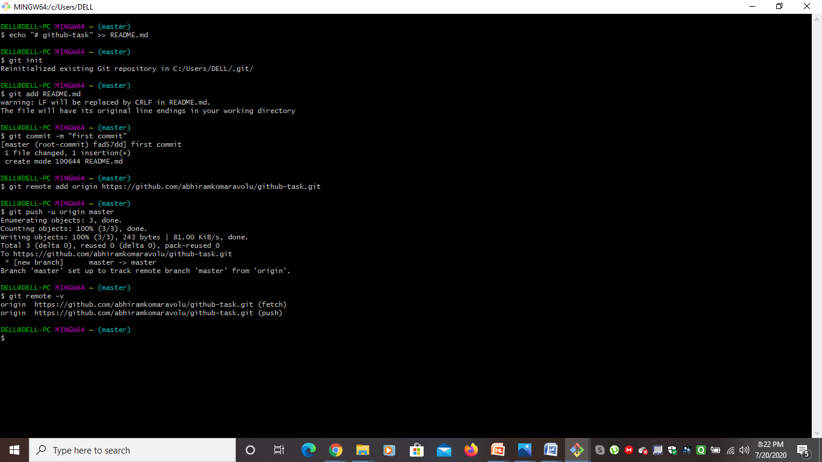
Added files to existing repository and pushed the changes

