Slide 1
What is Cryptography?
CS@Illinois Sail 2016
Tyler Kim and Abhiram Kothapalli

Slide 2
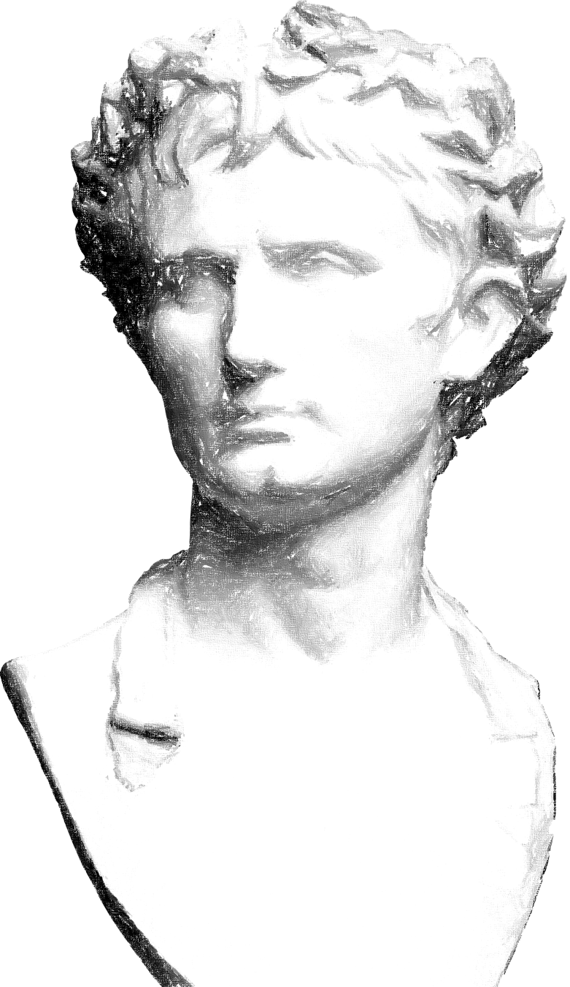
We'll start with the Caesar Cipher

Slide 3
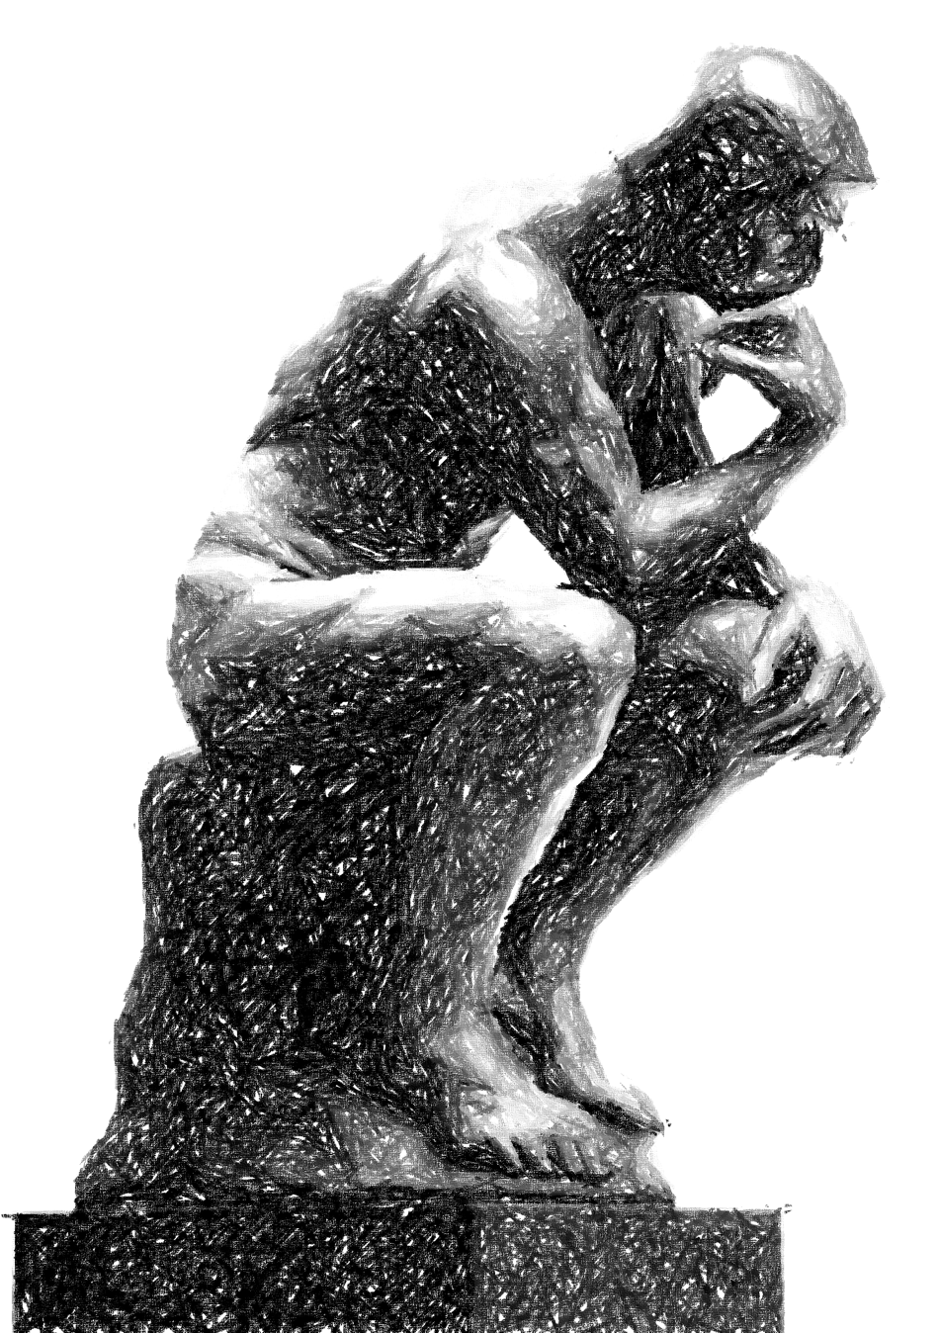
But what if Tyler and Abhiram didn’t want to meet in person?

Slide 4
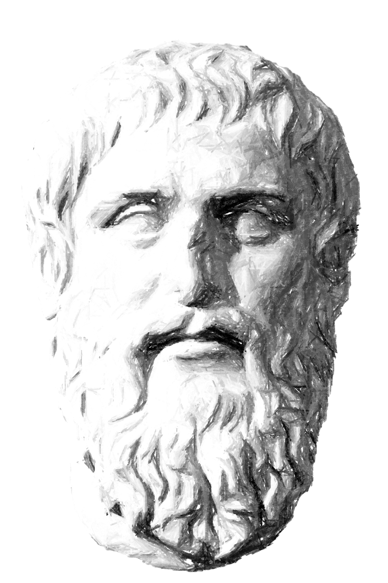
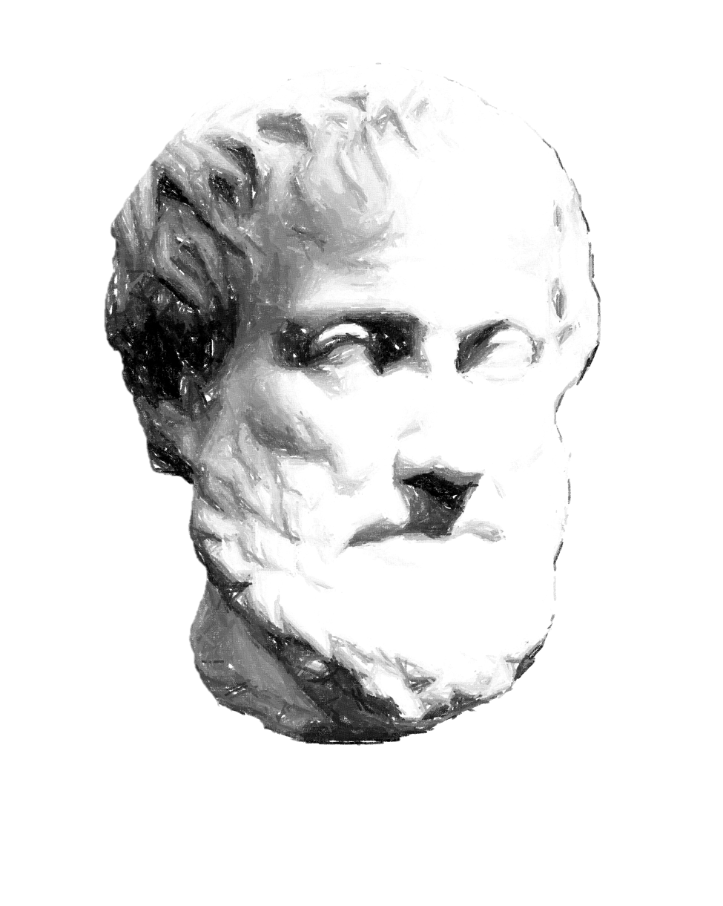
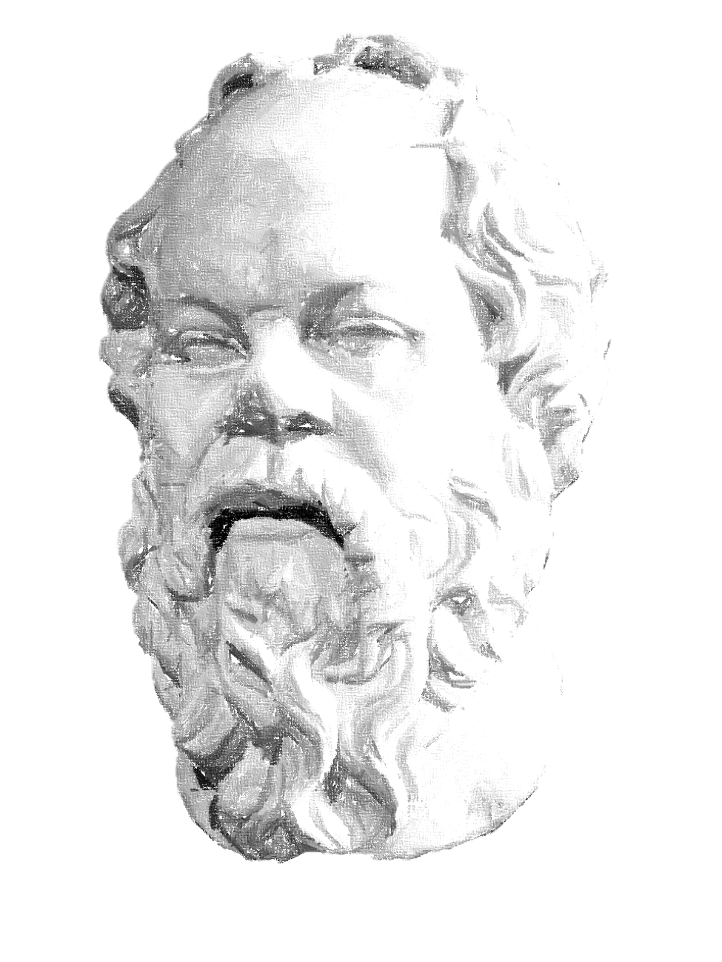
NSA
Tyler
Abhiram

Slide 5





Tyler
$$P_{1}=53$$
$$P_{2}=59$$
$$n=P_{1}×{ P}_{2}=3127$$
$$Φ\left(n\right)=Φ\left(P_{1}) × Φ({ P}_{2}\right)=3016$$
$$e=17$$
$$d=2129$$

Slide 6





Abhiram
$$N= 3127$$
$$e=17$$
$${209}^{17} mod 3127 ≡2817$$
$$Message:”209”$$
$$Encrypted Message:2817$$

Slide 7
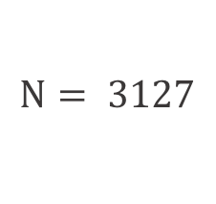


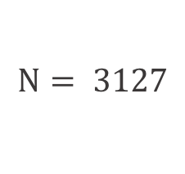


NSA
$$N= 3127$$
$$N= 3127$$
$$e=17$$
$$e=17$$
$$c=2817$$
$$c=2817$$
Tyler
Abhiram
$$N= 3127$$
$$e=17$$
$$c=2817$$

Slide 8



Tyler
$$P_{1}=53$$
$$P_{2}=59$$
$$n=P_{1}×{ P}_{2}=3127$$
$$Φ\left(n\right)=Φ\left(P_{1}) × Φ({ P}_{2}\right)=3016$$
$$e=17$$
$$d=2129$$
$$c =2817$$
$${2817}^{2129}≡209 mod 3127$$
$$Decrypted Message:209$$

Slide 9
Any burning questions about Security, CS ,UIUC?
Tyler
Abhiram
tkim139@illinois.edu
kothapa2@illinois.edu

