Slide 1
Stored Procedures and User-Defined Functions
Overview, Uses, and Key Differences
Your Name and Date

Slide 2
Introduction
Objective: Understand Stored Procedures and User-Defined Functions, their uses, syntax, and differences.
Agenda:
- Definition of Stored Procedures
- Definition of User-Defined Functions
- Advantages of using each
- Key differences and examples

Slide 3
What is a Stored Procedure?
Definition: A stored procedure is a set of SQL statements stored in the database that can be executed as a single unit.
Purpose: Automate repetitive tasks, improve performance, and enhance security.
Example Use Case: Automating monthly reporting or data processing.

Slide 4
Advantages of Stored Procedures
Efficiency: Precompiled SQL commands improve execution speed.
Code Reusability: Reduces duplication across applications.
Security: Controls access to data by encapsulating logic.
Maintainability: Centralized code is easier to update and manage.

Slide 5
Stored Procedure Syntax and Example
Syntax:
CREATE PROCEDURE procedure_name
AS
BEGIN
-- SQL statements
END
Example:
CREATE PROCEDURE GetEmployeeDetails
AS
BEGIN
SELECT * FROM Employees
END

Slide 6
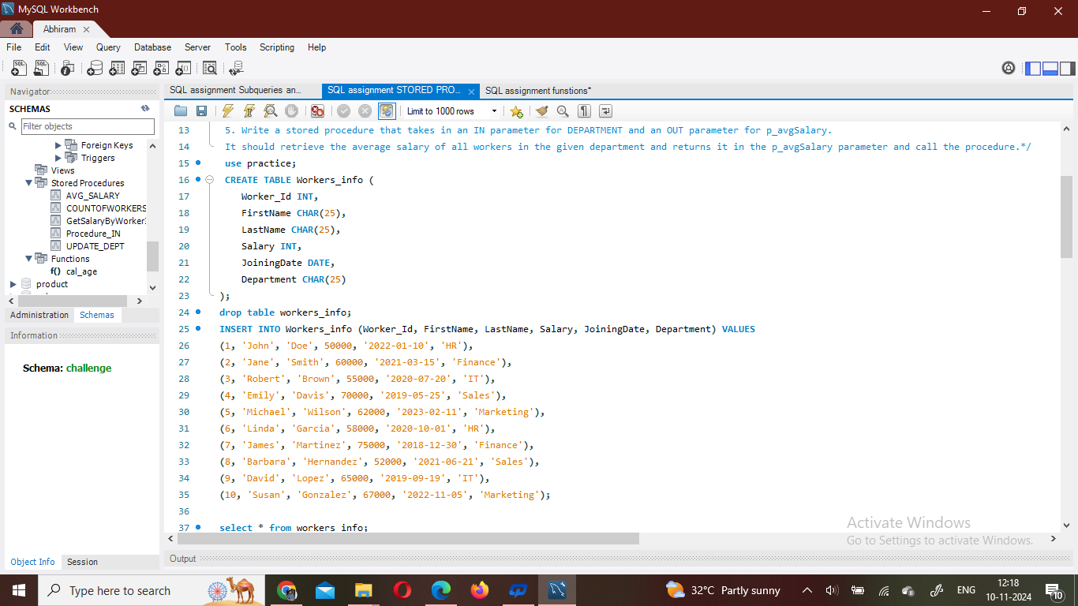
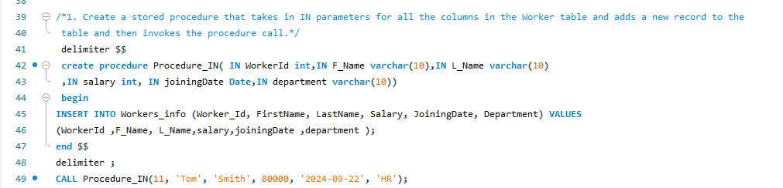

Slide 7
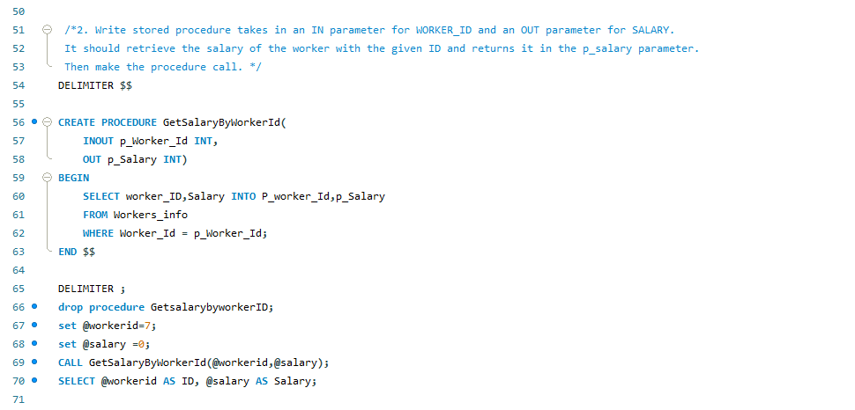
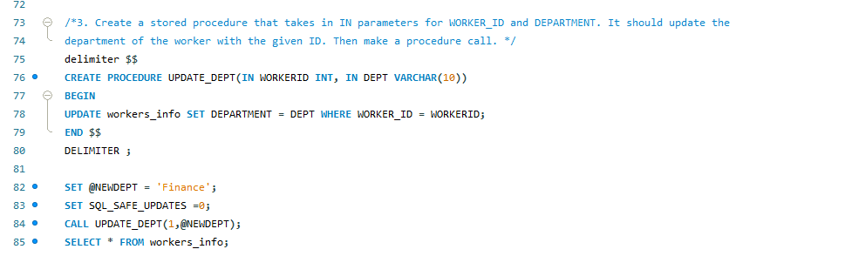

Slide 8
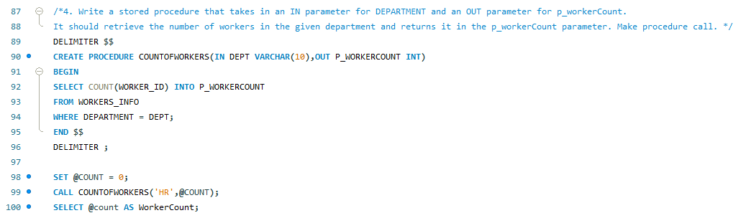
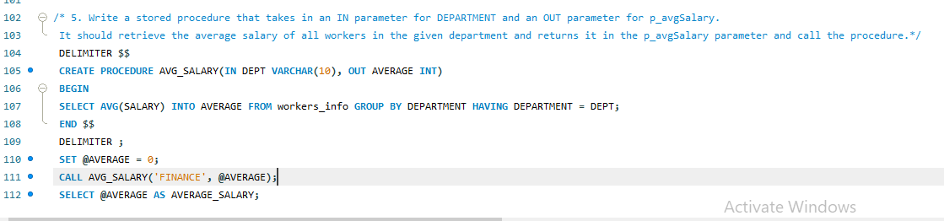

Slide 9
What is a User-Defined Function (UDF)?
Definition: A function created by the user to perform custom calculations or data manipulations that can be reused.
Purpose: Useful for computations that need to be used in multiple queries.
Example Use Case: Converting currency or calculating tax.

Slide 10
Advantages of User-Defined Functions
Modularity: Encapsulates logic within a function.
Reusability: Can be reused in multiple queries.
Readability: Simplifies complex queries.
Flexibility: UDFs can be used in SELECT, WHERE, and other SQL clauses.

Slide 11
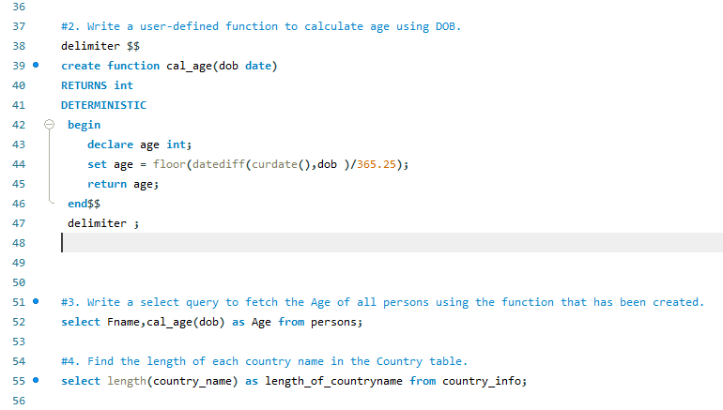

Slide 12
User-Defined Function Syntax and Example
Syntax:
CREATE FUNCTION function_name
RETURNS return_data_type
AS
BEGIN
-- SQL statements
RETURN value
END
Example:
CREATE FUNCTION CalculateTax(@amount DECIMAL)
RETURNS DECIMAL
AS
BEGIN
RETURN @amount * 0.1
END

Slide 13
Key Differences Between Stored Procedures and UDFs
| Feature | Stored Procedures | User-Defined Functions |
|--------------------------|------------------------------------|-----------------------------|
| Return Type | No strict return type | Must return a single value or table |
| Usage in SQL Queries | Cannot be used in SELECT queries | Can be used in SELECT, WHERE, etc. |
| Error Handling | Can handle errors with TRY/CATCH | Limited error handling |
| Transactions | Can contain transactions | Cannot contain transactions |
| Execution | Executed with EXEC command | Invoked like a function in SQL |

Slide 14
When to Use Stored Procedures vs UDFs
Stored Procedures:
- For complex operations or tasks (data modifications).
- When handling large data sets or repetitive tasks.
User-Defined Functions:
- For calculations or operations that return a single value or table.
- When reusability within queries is needed.

Slide 15
Examples of Usage
Stored Procedure Example: Generating monthly sales reports
User-Defined Function Example: Calculating discount or tax in financial reports

Slide 16
Best Practices
Stored Procedures:
- Use naming conventions for clarity.
- Limit the use of temporary tables.
User-Defined Functions:
- Avoid complex logic to maintain query performance.
- Prefer inline functions over multi-statement functions for efficiency.

Slide 17
Conclusion
Recap: Stored Procedures are ideal for complex operations, while UDFs are best suited for reusable calculations.
Choose based on the needs of your application, data requirements, and performance considerations.

Slide 18
Q&A
Invite any questions from the audience.

