Slide 1
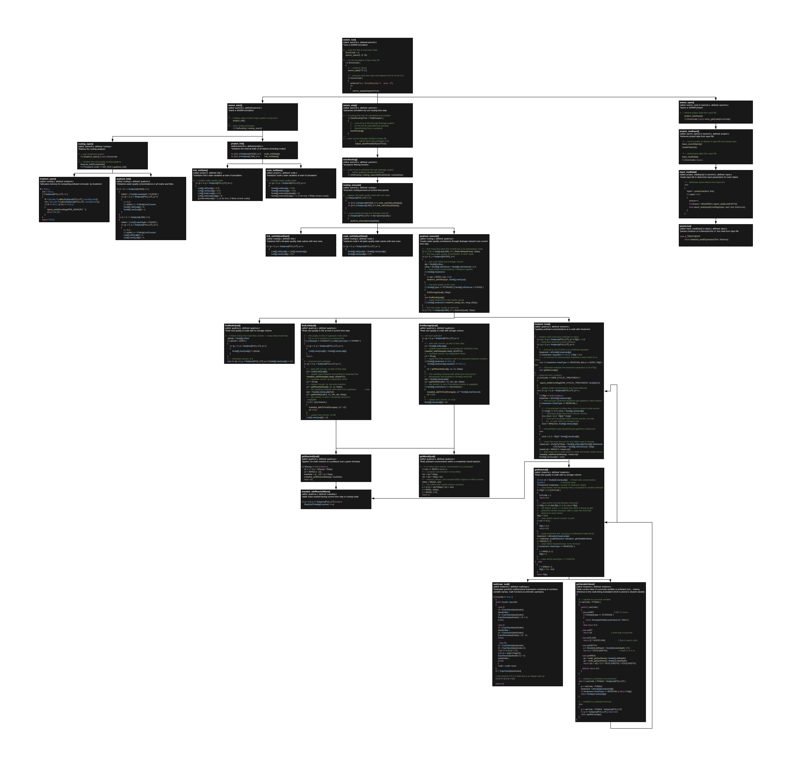
Treatmnt_readExpression() called: parseLine() in input.c defined: treatment.c *reads a treatment expression from a tokenized line of input. {
char s[MAXLINE+1];
char* expr;
int i, j, k, p;
MathExpr* equation; // ptr. to a math. expression
// --- retrieve node & pollutant
if ( ntoks < 3 ) return error_setInpError(ERR_ITEMS, "");
j = project_findObject(NODE, tok[0]);
if ( j < 0 ) return error_setInpError(ERR_NAME, tok[0]);
p = project_findObject(POLLUT, tok[1]);
if ( p < 0 ) return error_setInpError(ERR_NAME, tok[1]);
// --- concatenate remaining tokens into a single string
strcpy(s, tok[2]);
for ( i=3; i<ntoks; i++)
{
strcat(s, " ");
strcat(s, tok[i]);
}
// --- check treatment type
if ( UCHAR(s[0]) == 'R' ) k = 0;
else if ( UCHAR(s[0]) == 'C' ) k = 1;
else return error_setInpError(ERR_KEYWORD, tok[2]);
// --- start treatment expression after equals sign
expr = strchr(s, '=');
if ( expr == NULL ) return error_setInpError(ERR_KEYWORD, "");
else expr++;
// --- create treatment objects at node j if they don't already exist
if ( Node[j].treatment == NULL )
{
if ( !createTreatment(j) ) return error_setInpError(ERR_MEMORY, "");
}
// --- create a parsed expression tree from the string expr
// (getVariableIndex is the function that converts a treatment
// variable's name into an index number)
equation = mathexpr_create(expr, getVariableIndex);
if ( equation == NULL )
return error_setInpError(ERR_TREATMENT_EXPR, "");
// --- save the treatment parameters in the node's treatment object
Node[j].treatment[p].treatType = k;
Node[j].treatment[p].equation = equation;
return 0;
createTreatment() called: Treatment_readExpression() in treatment.c defined: treatment.c *creates a treatment object for each pollutant at a node. {
int p;
Node[j].treatment = (TTreatment *) calloc(Nobjects[POLLUT],
sizeof(TTreatment));
if ( Node[j].treatment == NULL )
{
return FALSE;
}
for (p = 0; p < Nobjects[POLLUT]; p++)
{
Node[j].treatment[p].equation = NULL;
}
return TRUE;
}

