Slide 1
Operations Research Using Python
Abhiram R
ML Engineer
Scribble Data

Slide 2
What is Operations Research?
It’s a subject in Undergrad in CS (and Industrial Production)
It’s the study of mathematical models for complex organizational systems
Optimization – A subset of OR

Slide 3
Origins
Around the World War I & II time
Invention of the dreadnought, airplane and the submarine
Battleships

Slide 4
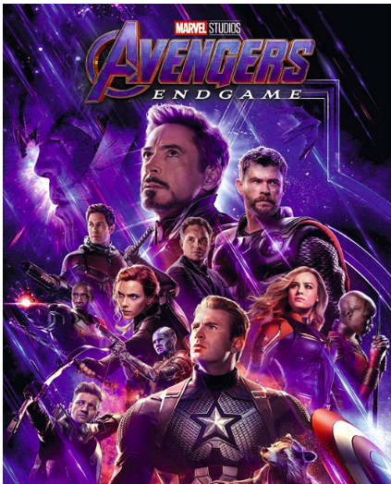
So, what is the

Slide 5
Objectives
👇💸
☝️🤑
👇🔨😓

Slide 6
Constraints
⌛
💰
👷👷👷👷👷👷

Slide 7
Applications
Supply Chain Management
Oil and Petroleum companies
Retail
Transportation & Logistics
Natural calamities relief
Day-to-day activities

Slide 8
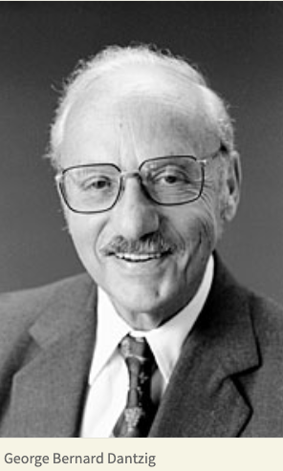
Linear Programming
Set of equations representing constraints and objectives
Obtain a solution that satisfies these conditions
Invented by 👉

Slide 9
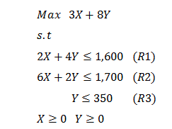
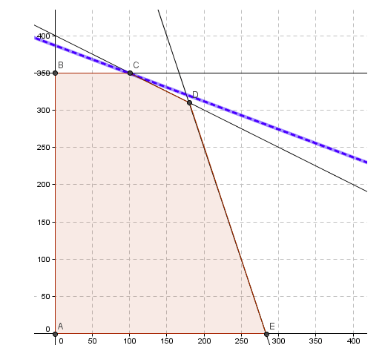
The Simplex Method

Slide 10
Implementations
scipy.optimize
cvxopt
pyomo
pulp

Slide 11
Demo time
Brb. Demoing demo.

Slide 12
Game Theory
A subset of operations research
“Game theory is the study of the ways in which interacting choices of economic agents produce outcomes with respect to the preferences (or utilities) of those agents, where the outcomes in question might have been intended by none of the agents.”
Nash Equilibrium – Stable state where no further moves by any player will return any favorable outcome

Slide 13
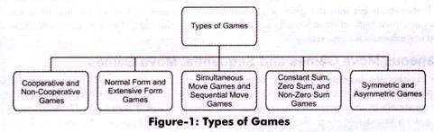
Utility function

Slide 14
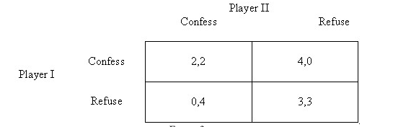
Prisoner’s Dilemma

Slide 15
Elements
Cooperators
Defectors
Tit-for-tat

Slide 16
Libraries
Nashpy
Axelrod
Demo next time. Notebooks available.

Slide 17
Sources & References
https://www.jstor.org/stable/170920?seq=1
https://www.youtube.com/watch?v=7yZ5xxdkTb8
https://plato.stanford.edu/entries/game-theory/
abhiramr (Github) / abhiramr.com
abhicantdraw (Twitter)

